Slide 1
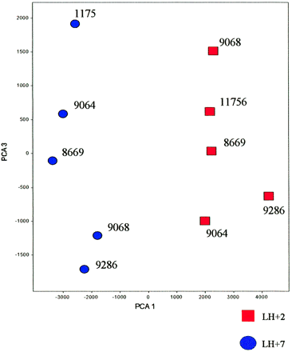
Figure 1. Principal component analyses (PCA) performed to cluster the samples based on the expression profile ...
Notes:
Figure 1. Principal component analyses (PCA) performed to cluster the samples based on the expression profile of 2000 randomly chosen genes. The PCA tool in Spotfire DecisionSite 6.3® software was used and showed a clear distinction between the LH+2 and LH+7 samples. Numbers refer to the individual women used. x‐ and y‐axis show distinction between the expression values of the individual samples in arbitrary units (see Materials and methods).
Unless provided in the caption above, the following copyright applies to the content of this slide:

Slide 2
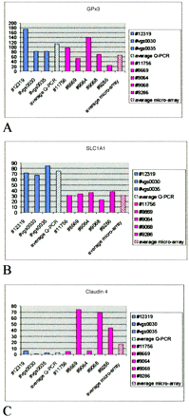
Figure 2. Validation studies. Schematic representation of the fold changes observed in endometrial samples ...
Notes:
Figure 2. Validation studies. Schematic representation of the fold changes observed in endometrial samples obtained from individual women LH+2 and LH+7 for GPx‐3, claudin‐4 and SLC1A1 (up‐regulated), by Q‐PCR and microarray analyses. Bars indicate LH+7/LH+2 ratios using Q‐PCR assays (Q1–Q3) and microarrays (A1–A5). The corresponding averaged values for each technique are also shown. Note the individual variation between the samples obtained from different women, indicating the need to compare samples from within the same patient as compared with average values.
Unless provided in the caption above, the following copyright applies to the content of this slide:

Slide 3
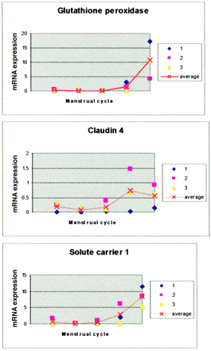
Figure 3. Pattern of mRNA expression of GPx‐3, claudin‐4 and SLC1A1 determined by Q‐PCR analysis throughout ...
Notes:
Figure 3. Pattern of mRNA expression of GPx‐3, claudin‐4 and SLC1A1 determined by Q‐PCR analysis throughout the menstrual cycle. y‐axis corresponds to normalized mRNA values for each experiment to demonstrate inter‐individual variability. The relative fold‐changes are shown in the Results section. The x‐axis corresponds to the stage of the menstrual cycle: Group I, early proliferative (days 5–8) (n = 3); Group II, mid–late proliferative (9–14) (n = 3); Group III, early secretory (15–18) (n = 3); Group IV, mid‐secretory (19–23) (n = 3); Group V, late secretory (24–28) (n = 3). 1, 2 and 3 indicate the three experiments performed with samples from five different women each. The averaged data are represented as a line.
Unless provided in the caption above, the following copyright applies to the content of this slide:

Slide 4
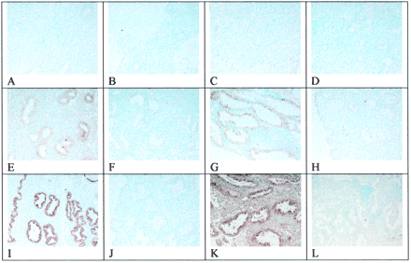
Figure 4. In‐situ hybridization experiments for GPx‐3 (complete menstrual cycle) and SLC1A (mid‐luteal). ...
Notes:
Figure 4. In‐situ hybridization experiments for GPx‐3 (complete menstrual cycle) and SLC1A (mid‐luteal). GPx‐3 antisense hybridization is shown in early proliferative (A), late proliferative (C), early luteal (E), mid‐luteal (F) and late luteal (I) phases. GPx‐3 sense hybridization was performed in the same sample as control: early proliferative (B), late proliferative (D), early luteal (G), mid‐luteal (H) and late luteal (J) respectively. SLC1A1 antisense (K) and sense (L) probe staining was shown in mid‐luteal endometrium.
Unless provided in the caption above, the following copyright applies to the content of this slide:

