Slide 1
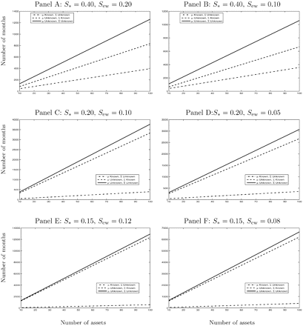
Fig. 1. Number of estimation months for mean-variance portfolio to outperform the 1/N benchmark The six panels in ...
Notes:
Fig. 1. Number of estimation months for mean-variance portfolio to outperform the 1/N benchmark The six panels in this figure show the critical number of estimation months required for the sample-based mean-variance strategy to outperform the 1/N rule on average, as a function of the number of assets, N. Each panel is drawn for different levels of the Sharpe ratios for the ex ante mean-variance portfolio, S*, and the equally weighted portfolio, Sew. Critical values are computed using the definition in Equation (22). The dashed-dotted line reports the critical value of the estimation window for the case in which the means are known, but the covariances are not. The dashed line refers to the case in which the covariances are known, but the means are not. And the solid line refers to the case in which neither the means nor the covariances are known.
Unless provided in the caption above, the following copyright applies to the content of this slide: © Oxford University Press 2007

