Slide 1
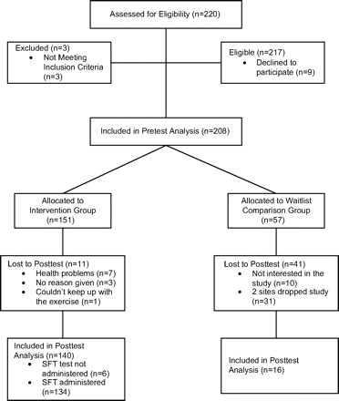
Figure 1. CONSORT diagram of Active Start.
Notes:
Figure 1. CONSORT diagram of Active Start.
Unless provided in the caption above, the following copyright applies to the content of this slide: © The Author 2009. Published by Oxford University Press on behalf of The Gerontological Society of America. All rights reserved. For permissions, please e-mail: journals.permissions@oxfordjournals.org.

