Slide 1
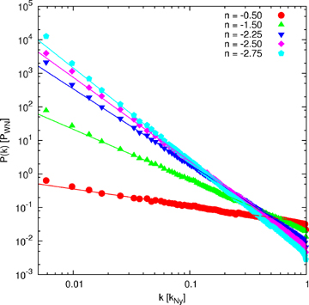
Figure 1 Shown are the theoretical power spectra and their respective realizations in the initial conditions of the ...
Notes:
Figure 1 Shown are the theoretical power spectra and their respective realizations in the initial conditions of the simulations we performed.
Unless provided in the caption above, the following copyright applies to the content of this slide: © 2008 The Authors. Journal compilation © 2008 RAS

Slide 2
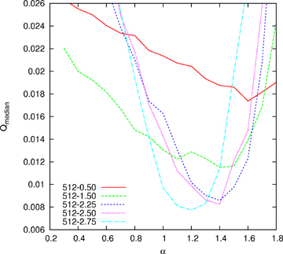
Figure 2 The median of the quality in the different simulation boxes for objects in the M* sample.
Notes:
Figure 2 The median of the quality in the different simulation boxes for objects in the M* sample.
Unless provided in the caption above, the following copyright applies to the content of this slide: © 2008 The Authors. Journal compilation © 2008 RAS

Slide 3
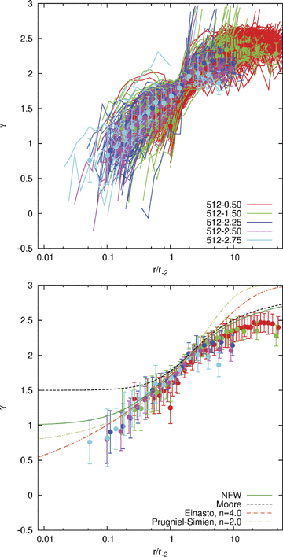
Figure 3 The maximal inner slope as given by equation (11) as a function of the radius normalized to r₋₂ ...
Notes:
Figure 3 The maximal inner slope as given by equation (11) as a function of the radius normalized to r−2 for haloes in the M* sample. Upper panel: We plot all curves from all the simulations and overplot a binned curve for each run. Lower panel: Here only the averages of each simulation are shown and compared to a set of theoretical predictions derived from the NFW, Moore et al., Einasto and Prugniel–Simien profiles. Note that in this instance n corresponds to the shape parameter for the Einasto and Prugniel–Simien profiles.
Unless provided in the caption above, the following copyright applies to the content of this slide: © 2008 The Authors. Journal compilation © 2008 RAS

Slide 4
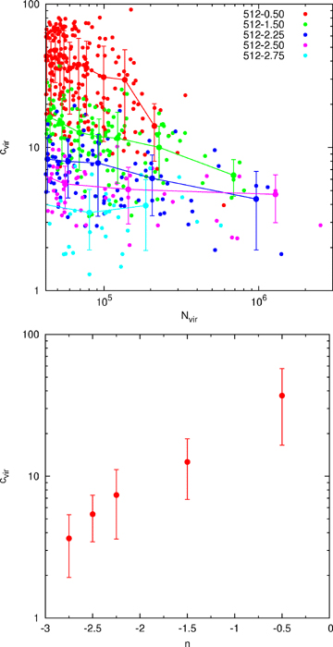
Figure 4 In the upper panel we show the concentration of all haloes with mass larger than M* as a function ...
Notes:
Figure 4 In the upper panel we show the concentration of all haloes with mass larger than M* as a function of the number of particles within the virial radius. Additionally we plot a binned distribution of the concentration. The lower panel gives the mean concentration for objects in our M* sample depending on the spectral index n.
Unless provided in the caption above, the following copyright applies to the content of this slide: © 2008 The Authors. Journal compilation © 2008 RAS

