Slide 1
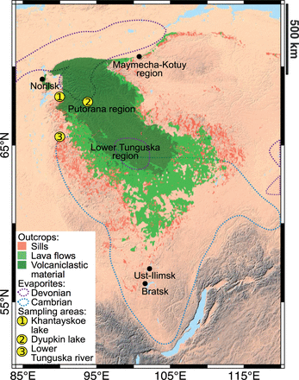
Fig. 1. Schematic geological map of the Siberian Craton and the Tunguska Basin, showing the distribution of outcrops ...
Notes:
Fig. 1. Schematic geological map of the Siberian Craton and the Tunguska Basin, showing the distribution of outcrops of sills, lava flows and volcaniclastic deposits [modified from Malich et al. (1974) ]. The distribution of Devonian and Cambrian evaporites is from Zharkov (1984) and Petrychenko et al. (2005) . Sampling areas indicate the locations of samples from which melt inclusions were analysed.
Unless provided in the caption above, the following copyright applies to the content of this slide: © The Author 2015. Published by Oxford University Press. This is an Open Access article distributed under the terms of the Creative Commons Attribution License ( http://creativecommons.org/licenses/by/4.0/ ), which permits unrestricted reuse, distribution, and reproduction in any medium, provided the original work is properly cited.

Slide 2
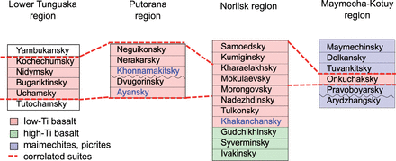
Fig. 2. Schematic stratigraphy of the Lower Tunguska, Putorana, Norilsk and Maymecha–Kotuy regions of the Siberian ...
Notes:
Fig. 2. Schematic stratigraphy of the Lower Tunguska, Putorana, Norilsk and Maymecha–Kotuy regions of the Siberian Traps (see Fig. 1 for locations). Modified from the Soviet regional stratigraphic scheme for Triassic deposits of the Tungusskaya syncline and Kuznetsk Basin. Melt inclusions were analysed in samples from formations whose names are highlighted in blue.
Unless provided in the caption above, the following copyright applies to the content of this slide: © The Author 2015. Published by Oxford University Press. This is an Open Access article distributed under the terms of the Creative Commons Attribution License ( http://creativecommons.org/licenses/by/4.0/ ), which permits unrestricted reuse, distribution, and reproduction in any medium, provided the original work is properly cited.

Slide 3
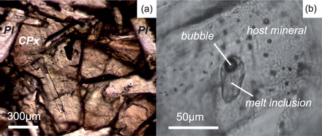
Fig. 3. (a) Lath-shaped plagioclase crystals enclosed within sub-ophitic titanaugite. (b) Clinopyroxene-hosted ...
Notes:
Fig. 3. (a) Lath-shaped plagioclase crystals enclosed within sub-ophitic titanaugite. (b) Clinopyroxene-hosted rehomogenized melt inclusion with a bubble.
Unless provided in the caption above, the following copyright applies to the content of this slide: © The Author 2015. Published by Oxford University Press. This is an Open Access article distributed under the terms of the Creative Commons Attribution License ( http://creativecommons.org/licenses/by/4.0/ ), which permits unrestricted reuse, distribution, and reproduction in any medium, provided the original work is properly cited.

Slide 4
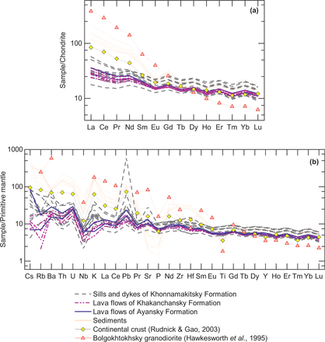
Fig. 4. (a) Rare earth and (b) multi-element patterns for analysed sills, dykes and lava flows, average continental ...
Notes:
Fig. 4. (a) Rare earth and (b) multi-element patterns for analysed sills, dykes and lava flows, average continental crust ( Rudnick & Gao, 2003 ), Bolgokhtokhsky granodiorite ( Hawkesworth et al. , 1995 ) and local sediments. Concentrations are normalized to C1-chondrite values ( Sun & McDonough, 1989 ) and Primitive Mantle values ( McDonough & Sun, 1995 ), respectively.
Unless provided in the caption above, the following copyright applies to the content of this slide: © The Author 2015. Published by Oxford University Press. This is an Open Access article distributed under the terms of the Creative Commons Attribution License ( http://creativecommons.org/licenses/by/4.0/ ), which permits unrestricted reuse, distribution, and reproduction in any medium, provided the original work is properly cited.

Slide 5
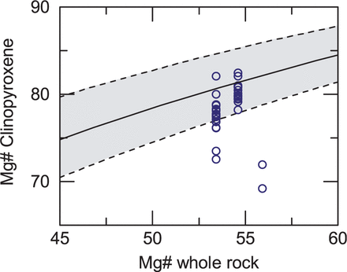
Fig. 5. Clinopyroxene compositions (Mg#) compared with the whole-rock Mg#, calculated with FeO set to 90% of the ...
Notes:
Fig. 5. Clinopyroxene compositions (Mg#) compared with the whole-rock Mg#, calculated with FeO set to 90% of the total iron in the whole-rock. The grey band shows the range of equilibrium clinopyroxene compositions for a given Mg-number (Mg#) when KD = 0·275 ± 0·067 ( Putirka et al. 2003 ). The 2σ errors are smaller than the symbol size.
Unless provided in the caption above, the following copyright applies to the content of this slide: © The Author 2015. Published by Oxford University Press. This is an Open Access article distributed under the terms of the Creative Commons Attribution License ( http://creativecommons.org/licenses/by/4.0/ ), which permits unrestricted reuse, distribution, and reproduction in any medium, provided the original work is properly cited.

Slide 6
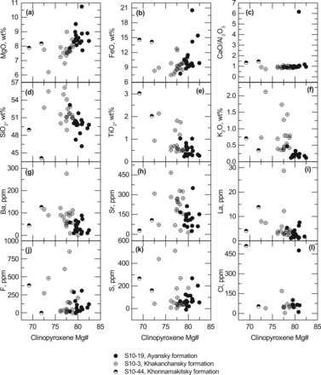
Fig. 6. Major (a–f) and trace (g–i) element and volatile (j–l) contents of melt inclusions vs Mg# of host ...
Notes:
Fig. 6. Major (a–f) and trace (g–i) element and volatile (j–l) contents of melt inclusions vs Mg# of host clinopyroxene.
Unless provided in the caption above, the following copyright applies to the content of this slide: © The Author 2015. Published by Oxford University Press. This is an Open Access article distributed under the terms of the Creative Commons Attribution License ( http://creativecommons.org/licenses/by/4.0/ ), which permits unrestricted reuse, distribution, and reproduction in any medium, provided the original work is properly cited.

Slide 7
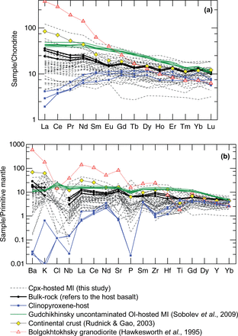
Fig. 7. (a) Rare earth and (b) multi-element patterns of analysed clinopyroxene-hosted melt inclusions from lava ...
Notes:
Fig. 7. (a) Rare earth and (b) multi-element patterns of analysed clinopyroxene-hosted melt inclusions from lava flows south of Norilsk, host clinopyroxenes, bulk-rock host basalt from which the clinopyroxene crystals were picked, average continental crust ( Rudnick & Gao, 2003 ), Bolgokhtokhsky granodiorite ( Hawkesworth et al. , 1995 ), and the most primitive uncontaminated melt inclusions from the Gudchikhinsky Formation ( Sobolev et al. , 2009 ). Concentrations are normalized to the C1-chondrite values ( Sun & McDonough, 1989 ) and Primitive Mantle values ( McDonough & Sun, 1995 ), respectively.
Unless provided in the caption above, the following copyright applies to the content of this slide: © The Author 2015. Published by Oxford University Press. This is an Open Access article distributed under the terms of the Creative Commons Attribution License ( http://creativecommons.org/licenses/by/4.0/ ), which permits unrestricted reuse, distribution, and reproduction in any medium, provided the original work is properly cited.

Slide 8
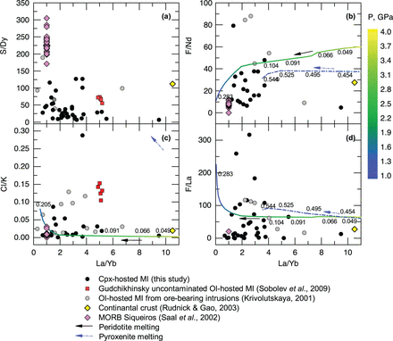
Fig. 8. Volatile/trace element ratios vs La/Yb in SLIP melt inclusions (MI) from this and other studies. Data ...
Notes:
Fig. 8. Volatile/trace element ratios vs La/Yb in SLIP melt inclusions (MI) from this and other studies. Data sources: Gudchikhinsky Formation uncontaminated primitive melt inclusions, Sobolev et al. (2009) ; olivine-hosted MI from ore-bearing intrusions, Krivolutskaya (2001) . Shown for comparison are data for Siqueiros MORB ( Saal et al. , 2002 ) and average continental crust ( Rudnick & Gao, 2003 ). Model melting curves for peridotite (continuous line) and pyroxenite (short dash–dot line) are colour-coded for pressure, varying from 4 to 1 GPa (see text for details).
Unless provided in the caption above, the following copyright applies to the content of this slide: © The Author 2015. Published by Oxford University Press. This is an Open Access article distributed under the terms of the Creative Commons Attribution License ( http://creativecommons.org/licenses/by/4.0/ ), which permits unrestricted reuse, distribution, and reproduction in any medium, provided the original work is properly cited.

Slide 9
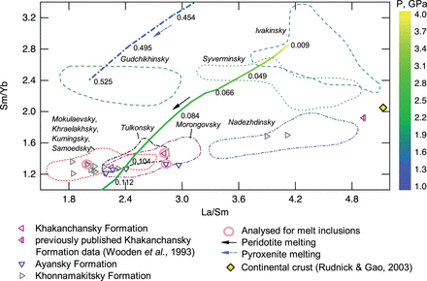
Fig. 9. La/Sm vs Sm/Yb for individual Siberian Traps formations. Data sources: Lightfoot et al. ( 1990 , 1993 ); ...
Notes:
Fig. 9. La/Sm vs Sm/Yb for individual Siberian Traps formations. Data sources: Lightfoot et al. ( 1990 , 1993 ); Wooden et al. (1993) ; Hawkesworth et al. (1995) . Model curves for partial melting of peridotite (continuous line) and pyroxenite (short dash–dot line) are colour-coded for changing pressure from 4 to 1 GPa. Melt fractions are indicated. Samples analysed for melt inclusion composition are highlighted.
Unless provided in the caption above, the following copyright applies to the content of this slide: © The Author 2015. Published by Oxford University Press. This is an Open Access article distributed under the terms of the Creative Commons Attribution License ( http://creativecommons.org/licenses/by/4.0/ ), which permits unrestricted reuse, distribution, and reproduction in any medium, provided the original work is properly cited.

Slide 10
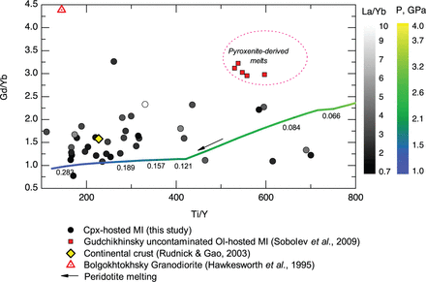
Fig. 10. Gd/Yb vs Ti/Y for analysed cpx-hosted melt inclusions (MI) colour-coded for La/Yb variations. A model curve ...
Notes:
Fig. 10. Gd/Yb vs Ti/Y for analysed cpx-hosted melt inclusions (MI) colour-coded for La/Yb variations. A model curve showing melting of peridotite is colour-coded for pressure, varying from 4 to 1 GPa. Melt fractions are indicated. Shown for comparison are the average composition of continental crust and the Bolgokhtokhsky granodiorite.
Unless provided in the caption above, the following copyright applies to the content of this slide: © The Author 2015. Published by Oxford University Press. This is an Open Access article distributed under the terms of the Creative Commons Attribution License ( http://creativecommons.org/licenses/by/4.0/ ), which permits unrestricted reuse, distribution, and reproduction in any medium, provided the original work is properly cited.

Slide 11
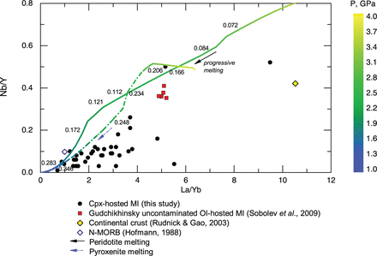
Fig. 11. The variation of Nb/Y vs La/Yb in the analysed cpx-hosted SLIP melt inclusions (MI) from this study compared ...
Notes:
Fig. 11. The variation of Nb/Y vs La/Yb in the analysed cpx-hosted SLIP melt inclusions (MI) from this study compared with MI from the Gudchikhinsky Formation ( Sobolev et al. , 2009 ), average continental crust ( Rudnick & Gao, 2003 ) and average N-MORB ( Hofmann, 1988 ). Model curves showing partial melting of peridotite (continuous line) and pyroxenite (short dash–dot line) are colour-coded for pressure, varying from 4 to 1 GPa.
Unless provided in the caption above, the following copyright applies to the content of this slide: © The Author 2015. Published by Oxford University Press. This is an Open Access article distributed under the terms of the Creative Commons Attribution License ( http://creativecommons.org/licenses/by/4.0/ ), which permits unrestricted reuse, distribution, and reproduction in any medium, provided the original work is properly cited.

Slide 12
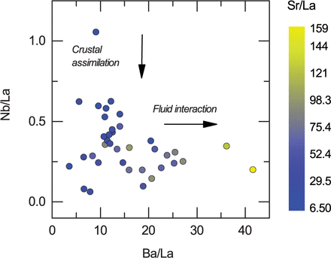
Fig. 12. Nb/La vs Ba/La, colour-coded according to Sr/La. Variability of large ion lithophile and volatile elements is ...
Notes:
Fig. 12. Nb/La vs Ba/La, colour-coded according to Sr/La. Variability of large ion lithophile and volatile elements is subtracted from fractionation by dividing Nb, Ba and Sr by La.
Unless provided in the caption above, the following copyright applies to the content of this slide: © The Author 2015. Published by Oxford University Press. This is an Open Access article distributed under the terms of the Creative Commons Attribution License ( http://creativecommons.org/licenses/by/4.0/ ), which permits unrestricted reuse, distribution, and reproduction in any medium, provided the original work is properly cited.

Slide 13
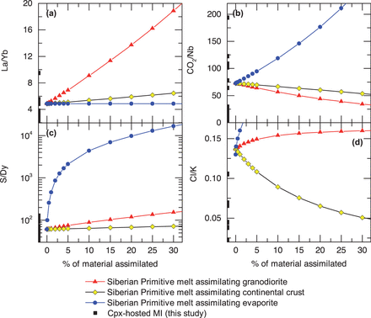
Fig. 13. Changes in elemental ratios with assimilation of different crustal components by the reconstructed primitive ...
Notes:
Fig. 13. Changes in elemental ratios with assimilation of different crustal components by the reconstructed primitive Siberian Traps melt composition of Sobolev et al. (2009) . Ranges of analysed clinopyroxene-hosted melt inclusions from this study are also shown. Data sources: Bolgokhtokhsky granodiorite, Hawkesworth et al. (1995) ; average continental crust, Rudnick & Gao (2003) ; Devonian sulphate-rich evaporite, Pang et al. (2013) .
Unless provided in the caption above, the following copyright applies to the content of this slide: © The Author 2015. Published by Oxford University Press. This is an Open Access article distributed under the terms of the Creative Commons Attribution License ( http://creativecommons.org/licenses/by/4.0/ ), which permits unrestricted reuse, distribution, and reproduction in any medium, provided the original work is properly cited.

Slide 14
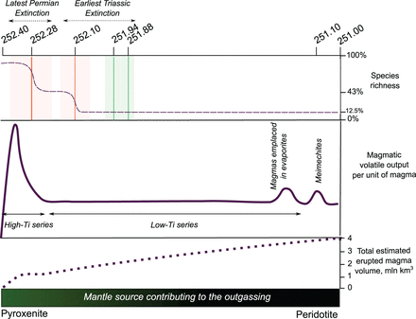
Fig. 14. Magmatic contribution to the total volatile output and mantle source evolution over time. The ages of the ...
Notes:
Fig. 14. Magmatic contribution to the total volatile output and mantle source evolution over time. The ages of the mass extinctions are from Song et al. (2012) (orange vertical lines with pale orange shaded field representing error bars) and Burgess et al. (2014) (green lines and pale green shaded fields). Ages for the onset and the end of magmatic activity are from Kamo et al. (2003) and for meimechite emplacement from Arndt et al. (1998) . High-Ti series magmas make up less than 1 million km 3 , which is less than a quarter of the total magma volume. The onsets of both the latest Permian and the earliest Triassic mass extinctions occur after the emplacement of high-Ti pyroxenite-derived chlorine- and carbon-rich magmas. Two-thirds of SLIP magma volume were emplaced before or during the extinction ( Burgess & Bowring, 2015 ).
Unless provided in the caption above, the following copyright applies to the content of this slide: © The Author 2015. Published by Oxford University Press. This is an Open Access article distributed under the terms of the Creative Commons Attribution License ( http://creativecommons.org/licenses/by/4.0/ ), which permits unrestricted reuse, distribution, and reproduction in any medium, provided the original work is properly cited.

