Slide 1
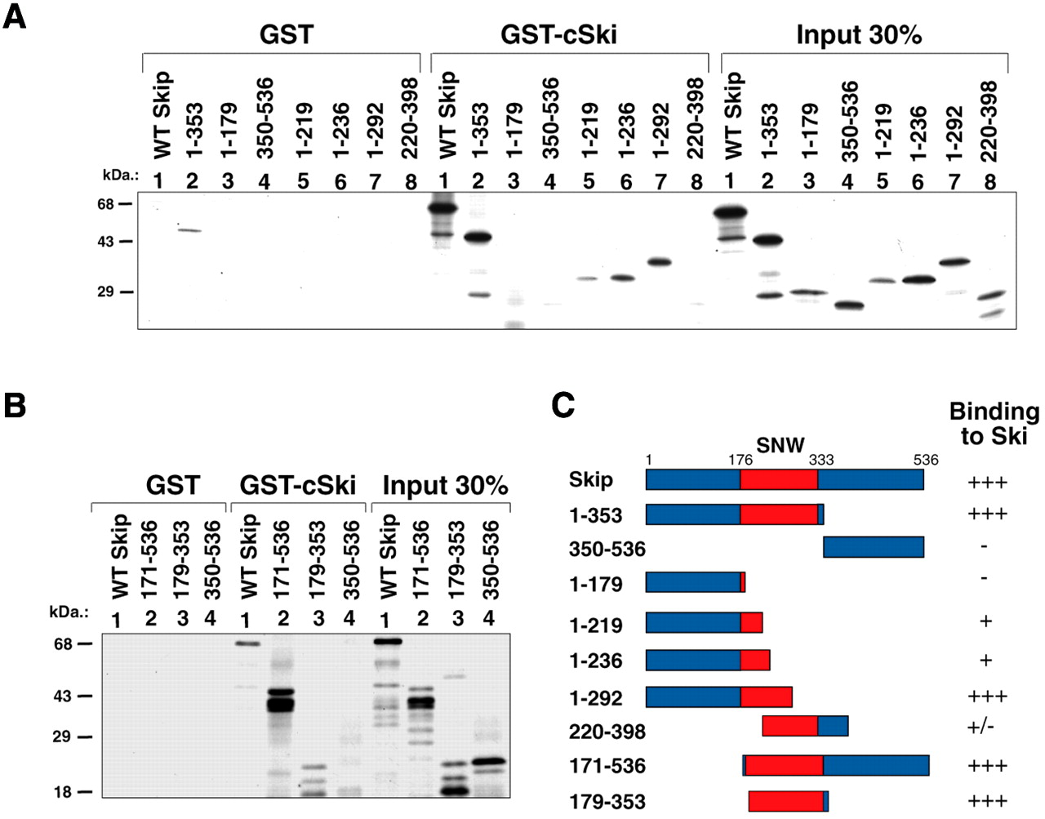
Figure 1. Mapping the c-Ski interaction domain on Skip. (A and B) Results from representative GST pull-down ...
Notes:
Figure 1. Mapping the c-Ski interaction domain on Skip. (A and B) Results from representative GST pull-down assays. Purified GST or GST–c-Ski on glutathione resin were incubated with the in vitro translated Skip deletion mutants for 1 h at room temperature. After extensive washing, bound proteins were analysed by SDS–PAGE and autoradiography. (C) A schematic diagram of the Skip deletion mutants used in the analysis. Numbers refer to the amino acid residues and the central red boxed region corresponds to the highly conserved SNW region, where homology with Skip proteins derived from other species is >90%. The relative strength of binding of each protein to c-Ski is also shown, together with the mean percentage binding from at least three separate assays, where +++ and +/– indicate 20–30% and 2–3% binding, respectively.
Unless provided in the caption above, the following copyright applies to the content of this slide:

Slide 2
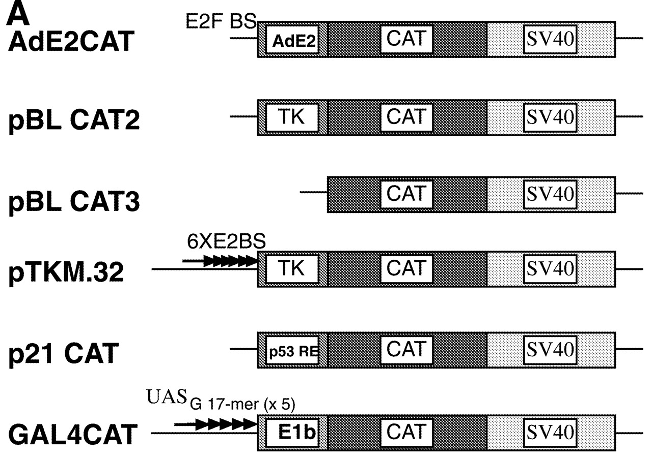
Figure 2. Skip stimulates the activation of diverse viral and cellular promoters. (A) CAT reporter constructs ...
Notes:
Figure 2. Skip stimulates the activation of diverse viral and cellular promoters. (A) CAT reporter constructs used in the study. The promoter and SV40 polyadenylation signal is shown. BS refers to DNA binding site, RE refers to responsive element, 6XE2BS means six HPV-16 E2 binding sites. GAL4 CAT contains five consensus GAL4 binding sites, which is represented as UASG17-mer (× 5). (B) U2OS cells were transfected with the indicated reporter plasmids together with increasing amounts of the Skip expression plasmid as shown (concentrations are shown in micrograms). After 48 h the cells were harvested and CAT assays performed. In each case a representative CAT assay is shown, together with the collated results from at least three independent transfections. Standard deviations are shown.
Unless provided in the caption above, the following copyright applies to the content of this slide:

Slide 3
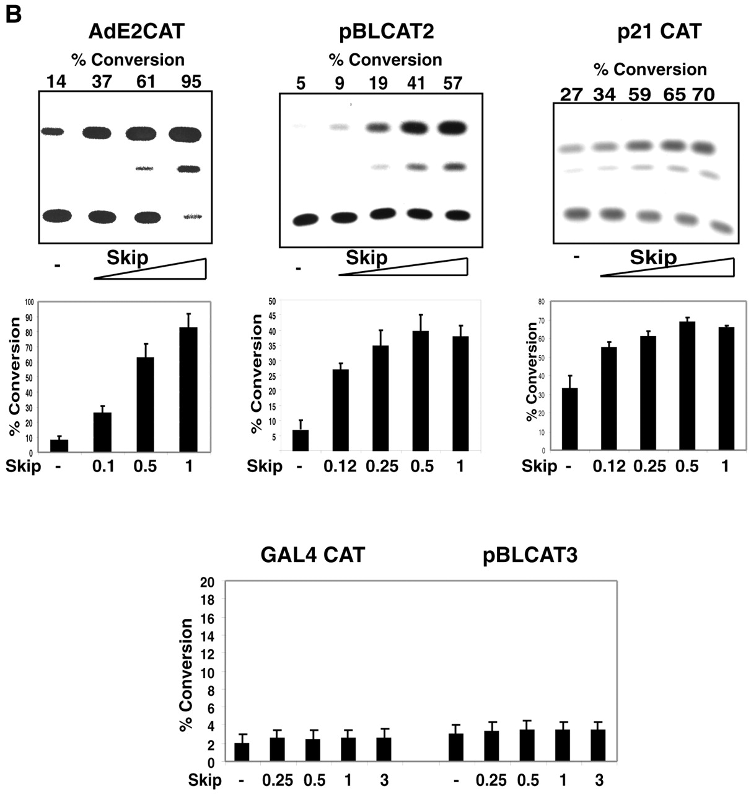
Figure 2. Skip stimulates the activation of diverse viral and cellular promoters. (A) CAT reporter constructs ...
Notes:
Figure 2. Skip stimulates the activation of diverse viral and cellular promoters. (A) CAT reporter constructs used in the study. The promoter and SV40 polyadenylation signal is shown. BS refers to DNA binding site, RE refers to responsive element, 6XE2BS means six HPV-16 E2 binding sites. GAL4 CAT contains five consensus GAL4 binding sites, which is represented as UASG17-mer (× 5). (B) U2OS cells were transfected with the indicated reporter plasmids together with increasing amounts of the Skip expression plasmid as shown (concentrations are shown in micrograms). After 48 h the cells were harvested and CAT assays performed. In each case a representative CAT assay is shown, together with the collated results from at least three independent transfections. Standard deviations are shown.
Unless provided in the caption above, the following copyright applies to the content of this slide:

Slide 4
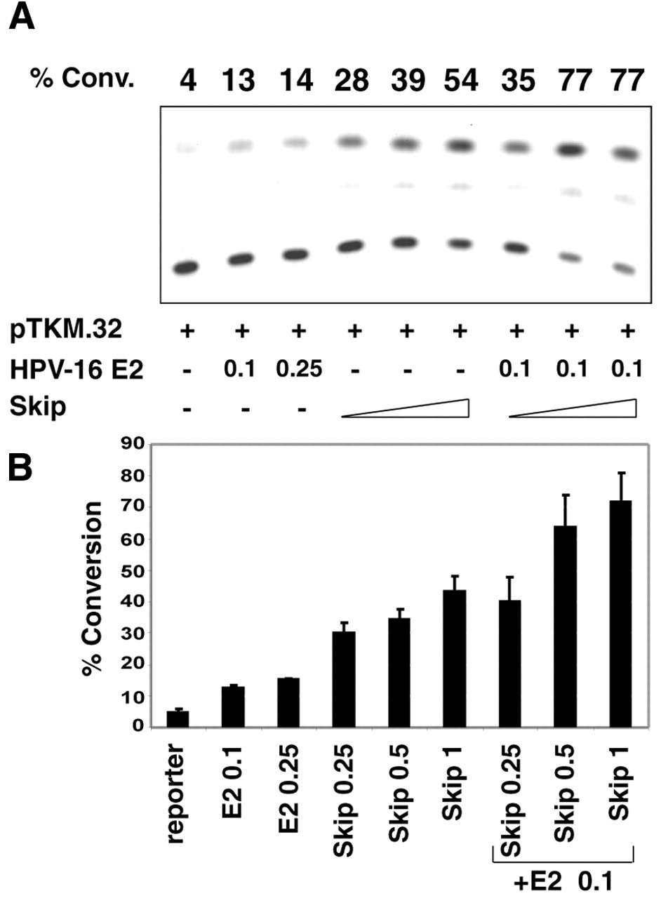
Figure 3. Skip is a transcriptional co-activator. U2OS cells were transfected with the HPV-16 E2-responsive ...
Notes:
Figure 3. Skip is a transcriptional co-activator. U2OS cells were transfected with the HPV-16 E2-responsive pTKM.32 CAT reporter plasmid together with 0.1 or 0.25 µg of pJ4womega.16 E2, as indicated. For assessing Skip co-activation, the input of pJ4womega.16 E2 was fixed at 0.1 µg and increasing amounts of Skip expression plasmid were used as indicated (concentrations are shown in micrograms). After 48 h the cells were harvested and CAT assays performed. (A) Results from a representative assay; (B) collated results from at least three independent transfections. Standard deviations are shown.
Unless provided in the caption above, the following copyright applies to the content of this slide:

Slide 5
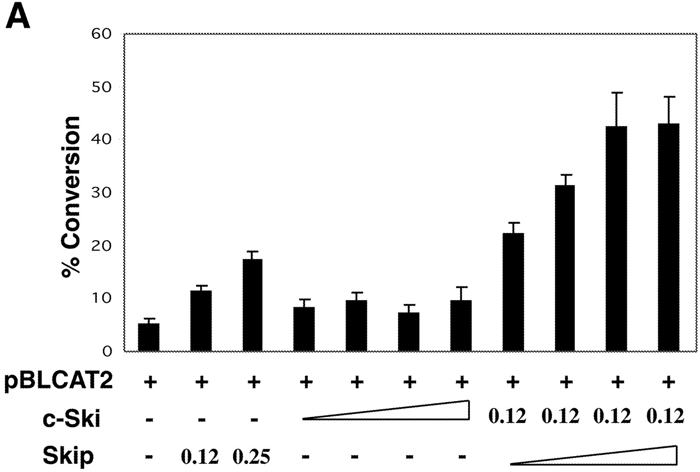
Figure 4. Skip and c-Ski can synergistically activate transcription. (A) HSV TK promoter. U2OS cells were ...
Notes:
Figure 4. Skip and c-Ski can synergistically activate transcription. (A) HSV TK promoter. U2OS cells were transfected with the pBLCAT2 reporter plasmid together with the combinations of Skip and c-Ski expression plasmids indicated (concentrations are in micrograms). The concentrations of c-Ski and Skip expression plasmids used were 0.125, 0.25, 0.5 and 1 µg. (B) AdE2 promoter. Saos-2 cells were transfected with the AdE2 reporter plasmid together with the combinations of Skip and c-Ski expression plasmids indicated (concentrations are in micrograms). After 48 h the cells were harvested and CAT assays performed. The graph shows the collated results from at least three independent transfections. Standard deviations are shown.
Unless provided in the caption above, the following copyright applies to the content of this slide:

Slide 6
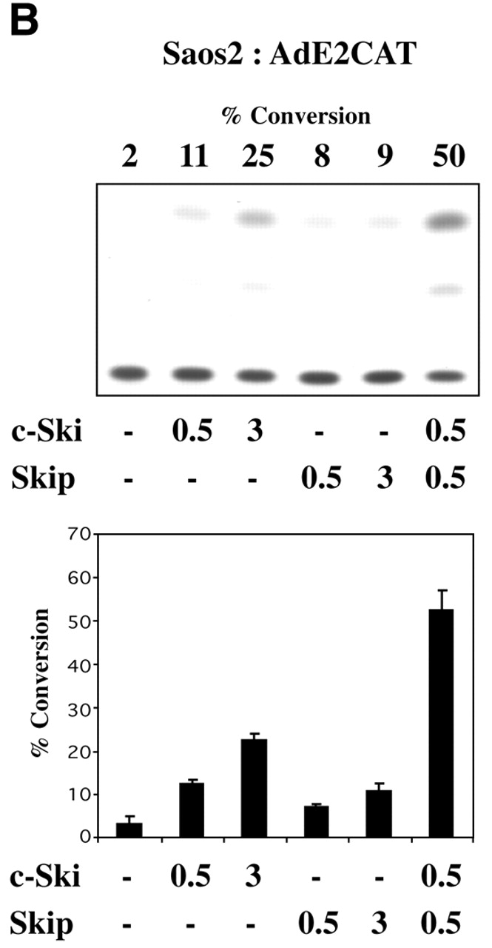
Figure 4. Skip and c-Ski can synergistically activate transcription. (A) HSV TK promoter. U2OS cells were ...
Notes:
Figure 4. Skip and c-Ski can synergistically activate transcription. (A) HSV TK promoter. U2OS cells were transfected with the pBLCAT2 reporter plasmid together with the combinations of Skip and c-Ski expression plasmids indicated (concentrations are in micrograms). The concentrations of c-Ski and Skip expression plasmids used were 0.125, 0.25, 0.5 and 1 µg. (B) AdE2 promoter. Saos-2 cells were transfected with the AdE2 reporter plasmid together with the combinations of Skip and c-Ski expression plasmids indicated (concentrations are in micrograms). After 48 h the cells were harvested and CAT assays performed. The graph shows the collated results from at least three independent transfections. Standard deviations are shown.
Unless provided in the caption above, the following copyright applies to the content of this slide:

Slide 7
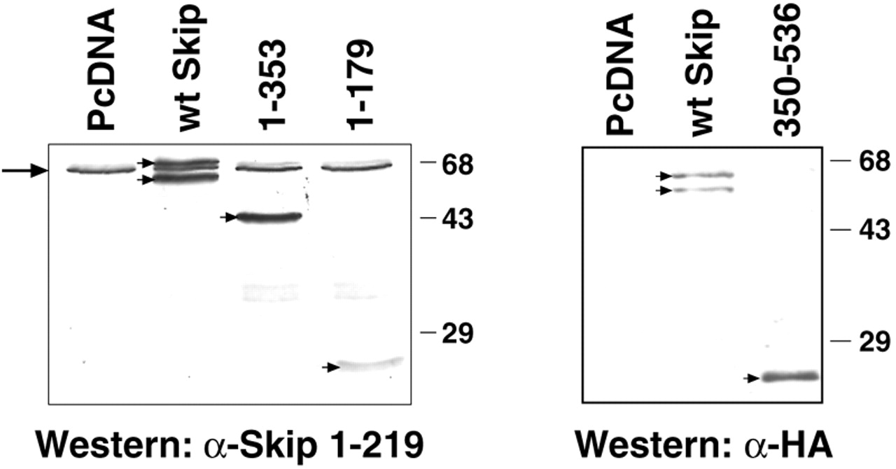
Figure 5. Expression levels of Skip proteins in U2OS. Total protein extracts were prepared, transferred to ...
Notes:
Figure 5. Expression levels of Skip proteins in U2OS. Total protein extracts were prepared, transferred to nitrocellulose membrane and incubated with either anti-Skip polyclonal antibody or with an anti-HA-tag monoclonal antibody. Staining was done with the ECL detection system. Arrow indicates the position of endogenous Skip protein, arrowheads indicate position of transfected Skip protein.
Unless provided in the caption above, the following copyright applies to the content of this slide:

Slide 8
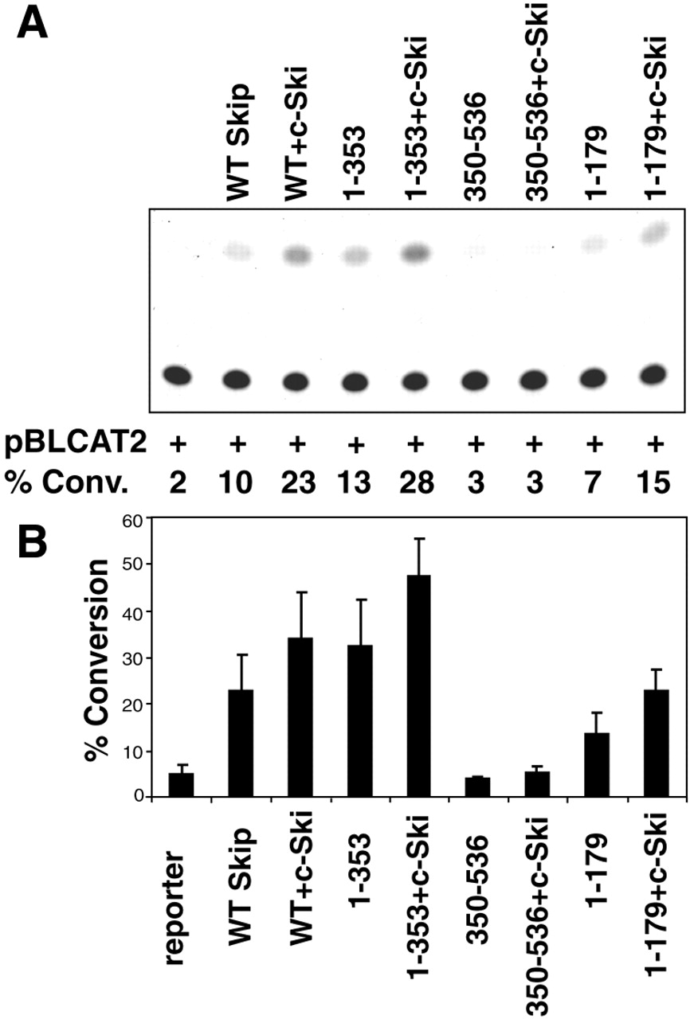
Figure 6. The c-Ski binding region of Skip is required for its ability to stimulate the HSV TK promoter. U2OS ...
Notes:
Figure 6. The c-Ski binding region of Skip is required for its ability to stimulate the HSV TK promoter. U2OS cells were transfected with the pBLCAT2 reporter construct together with 0.25 µg of the different deletion constructs of Skip. In addition, 0.5 µg of c-Ski expression plasmid was also included as indicated. (A) Results from a representative assay; (B) collated results from at least three separate transfections. Standard deviations are shown.
Unless provided in the caption above, the following copyright applies to the content of this slide:

Slide 9
Figure 7. Schematic diagram showing the domains of Skip required for binding c-Ski, activating transcription ...
Notes:
Figure 7. Schematic diagram showing the domains of Skip required for binding c-Ski, activating transcription and synergising with c-Ski. Numbers refer to the amino acid residues and the central red boxed region corresponds to the evolutionarily conserved SNW region.
Unless provided in the caption above, the following copyright applies to the content of this slide:

