Slide 1
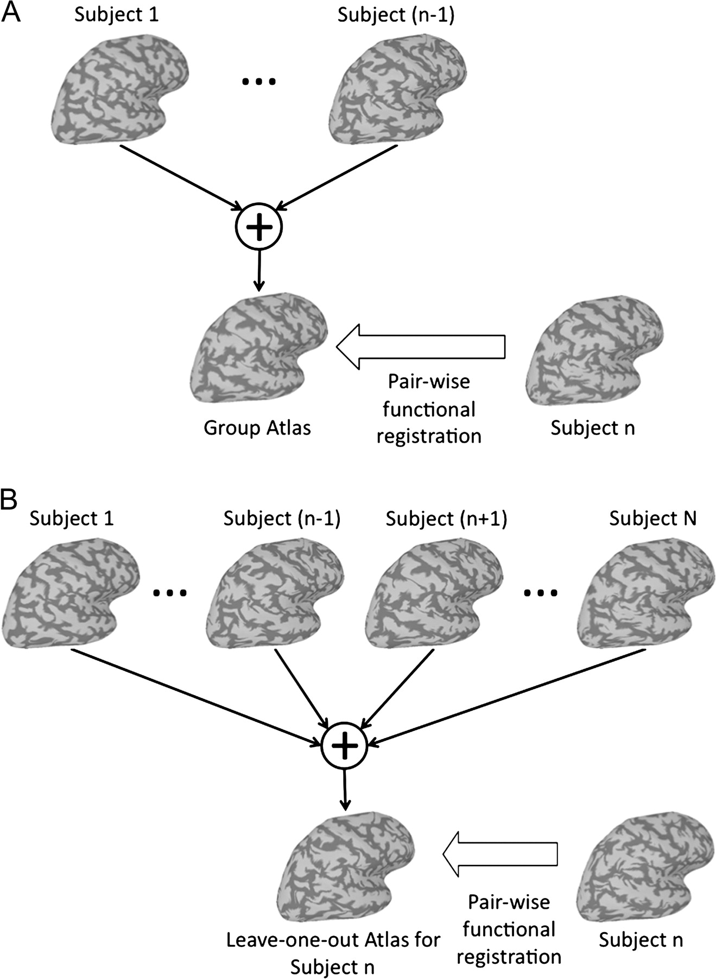
Figure 1. (A) The first step for developing a group atlas. First, one subject's functional data is aligned to that of ...
Notes:
Figure 1. (A) The first step for developing a group atlas. First, one subject's functional data is aligned to that of another. The mean time-series at each cortical node is calculated for these 2 subjects. The functional data for the third subject is aligned to the mean data for the first 2 subjects, and the mean time-series at each cortical node is calculated for these 3 subjects. The functional data for each additional subject is added to the atlas in the same way, by first aligning the functional data then calculating the group mean time-series for each cortical node. (B) The atlas is further refined by iteratively realigning each subject's functional data to its leave-one-out atlas, that is, the mean time-series for all of the other functionally normalized subjects. After each pair-wise registration, all subjects’ warps are renormalized so that the average location of all individual subject nodes warped to each atlas node is the anatomical location of that node in standardized spherical cortical space. This is done to prevent universal (across subjects) drifts in the warps (see Online Supplemental Material for details).
Unless provided in the caption above, the following copyright applies to the content of this slide: © 2009 The AuthorsThis is an Open Access article distributed under the terms of the Creative Commons Attribution Non-Commercial License (http://creativecommons.org/licenses/by-nc/2.0/uk/) which permits unrestricted non-commercial use, distribution, and reproduction in any medium, provided the original work is properly cited.

Slide 2
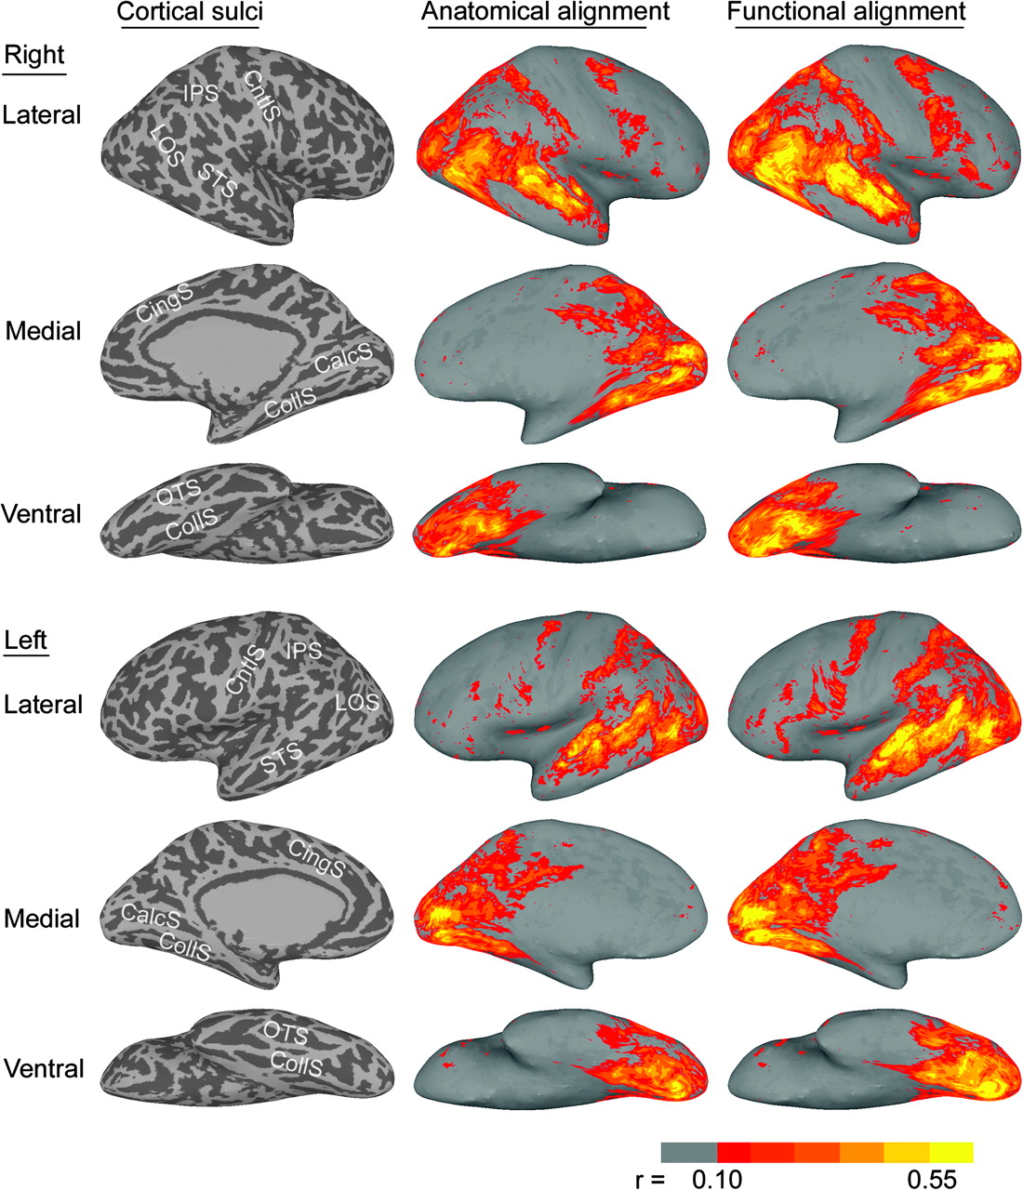
Figure 2. Generalization to the first half of the movie. The images in the left column show the sulcal anatomy for the ...
Notes:
Figure 2. Generalization to the first half of the movie. The images in the left column show the sulcal anatomy for the inflated cortical surfaces (IPS—intraparietal sulcus; LOS—lateral occipital sulcus; STS—superior temporal sulcus; CntlS—central sulcus; CingS—cingulate sulcus; CalcS—calcarine sulcus; CollS—collateral sulcus; OTS—occipitotemporal sulcus). The images in the middle column show the mean correlation of each subject with the other 9 subjects for corresponding nodes after anatomical cortical registration. The images in the right column show mean correlations after applying the warps to these nodes that maximized functional similarity in the second half of the movie (cross-validation test). The effect of applying the warps based on the first half of the movie to the data from second half of the movie was highly similar (see Supplemental Fig. S1). Correlations less than +0.10 (P < 0.01) are not shown.
Unless provided in the caption above, the following copyright applies to the content of this slide: © 2009 The AuthorsThis is an Open Access article distributed under the terms of the Creative Commons Attribution Non-Commercial License (http://creativecommons.org/licenses/by-nc/2.0/uk/) which permits unrestricted non-commercial use, distribution, and reproduction in any medium, provided the original work is properly cited.

Slide 3
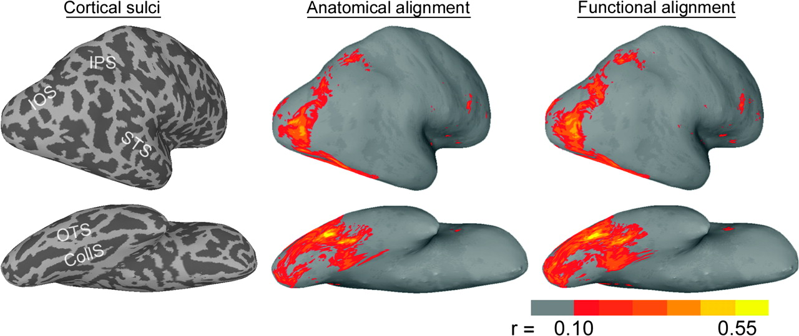
Figure 3. Generalization to a face and object perception experiment—between-subject correlations. The images on the ...
Notes:
Figure 3. Generalization to a face and object perception experiment—between-subject correlations. The images on the left show the sulcal anatomy for the inflated cortical surfaces of a representative subject (IOS—intraoccipital sulcus; IPS—intraparietal sulcus; STS—superior temporal sulcus; OTS—occipitotemporal sulcus; CollS—collateral sulcus). The images in the middle show between-subject correlations in posterolateral and ventral views of the right hemisphere (r > 0.1, P < 0.01) after anatomical registration. The images on the right show between-subject correlations after functional registration based on a cortical warp derived from the first half of the movie data. The lateral view has been turned to enhance the view of posterior occipital and parietal cortex.
Unless provided in the caption above, the following copyright applies to the content of this slide: © 2009 The AuthorsThis is an Open Access article distributed under the terms of the Creative Commons Attribution Non-Commercial License (http://creativecommons.org/licenses/by-nc/2.0/uk/) which permits unrestricted non-commercial use, distribution, and reproduction in any medium, provided the original work is properly cited.

Slide 4
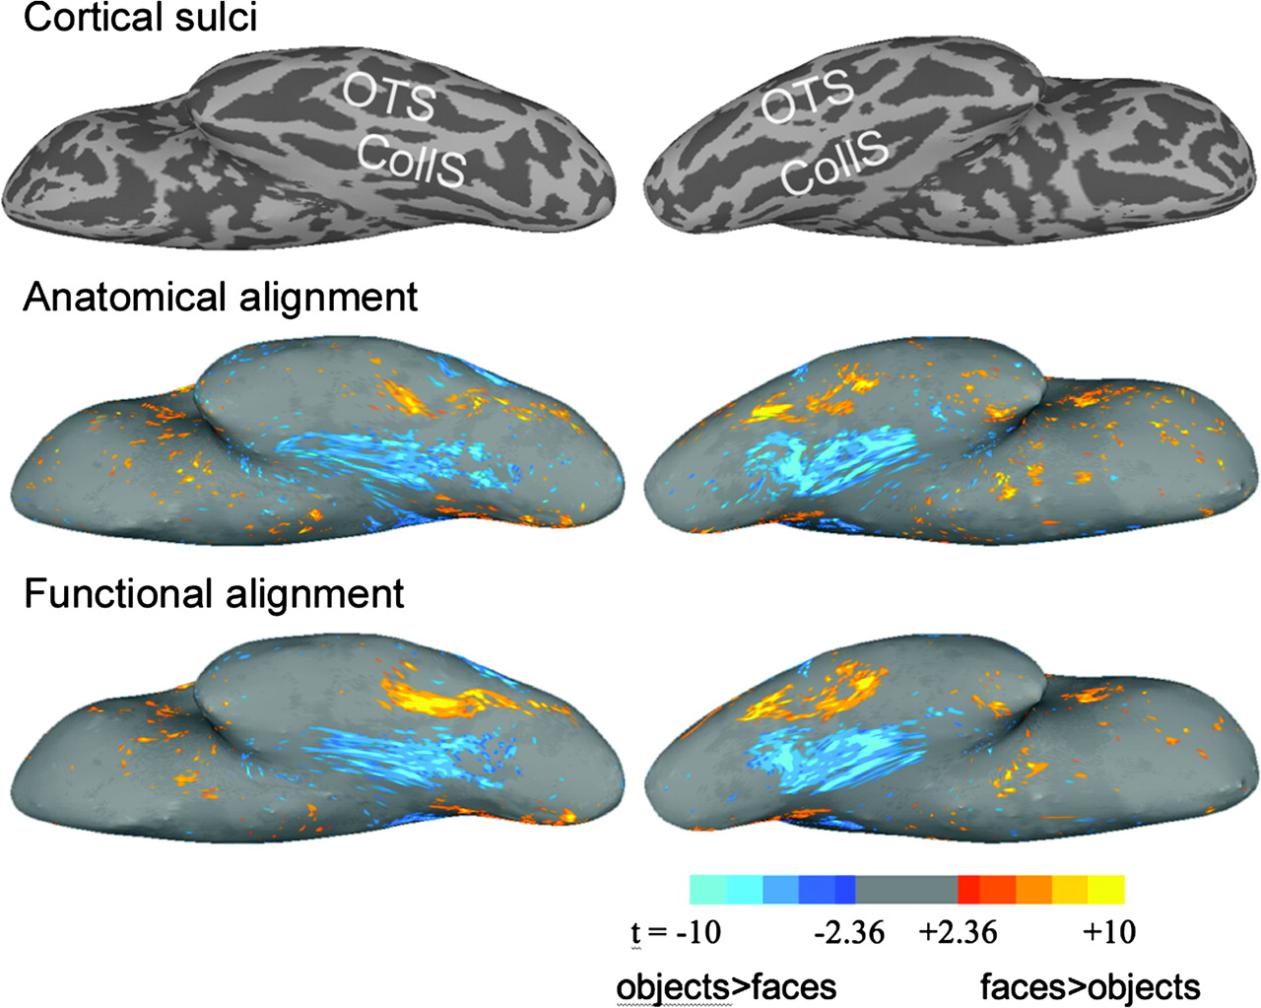
Figure 4. Generalization to a face and object perception experiment—GLM group analysis. The left images show the ...
Notes:
Figure 4. Generalization to a face and object perception experiment—GLM group analysis. The left images show the t-statistic between 10 subjects after anatomically aligning betas for faces (red to yellow) versus objects (dark to light blue) contrast (right hemisphere). The right images show the t-statistic after further aligning the betas using functional warps from the first half of the movie. Absolute t-values less than 2.36 (P > 0.05) are not shown.
Unless provided in the caption above, the following copyright applies to the content of this slide: © 2009 The AuthorsThis is an Open Access article distributed under the terms of the Creative Commons Attribution Non-Commercial License (http://creativecommons.org/licenses/by-nc/2.0/uk/) which permits unrestricted non-commercial use, distribution, and reproduction in any medium, provided the original work is properly cited.

Slide 5
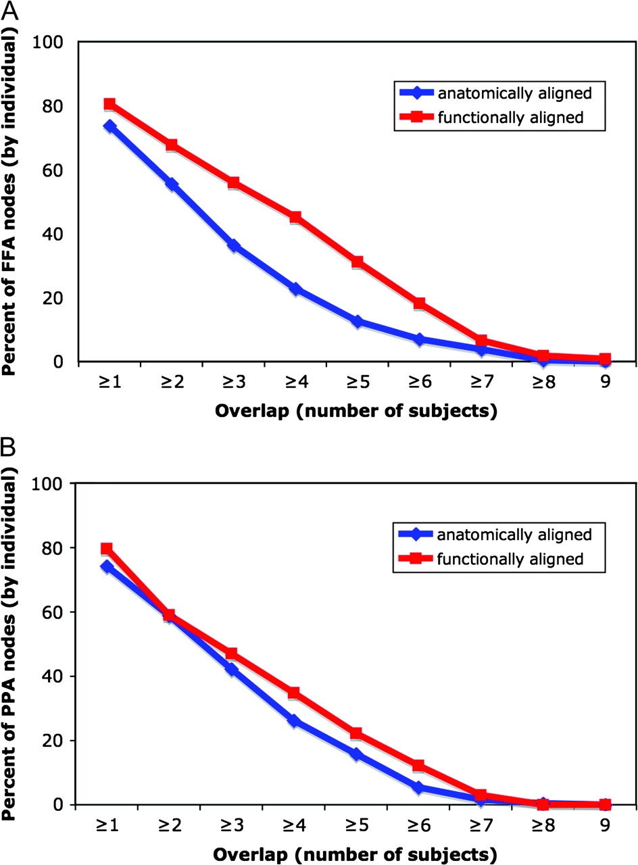
Figure 5. The effect of functional alignment on the overlap of 2 functionally defined regions—the FFA and the ...
Notes:
Figure 5. The effect of functional alignment on the overlap of 2 functionally defined regions—the FFA and the PPA—across subjects. The graphs show the average portion of an individual subject's FFA (Panel A) and PPA (Panel B) that overlaps with the same functional region in other subjects for different amounts of overlap.
Unless provided in the caption above, the following copyright applies to the content of this slide: © 2009 The AuthorsThis is an Open Access article distributed under the terms of the Creative Commons Attribution Non-Commercial License (http://creativecommons.org/licenses/by-nc/2.0/uk/) which permits unrestricted non-commercial use, distribution, and reproduction in any medium, provided the original work is properly cited.

Slide 6
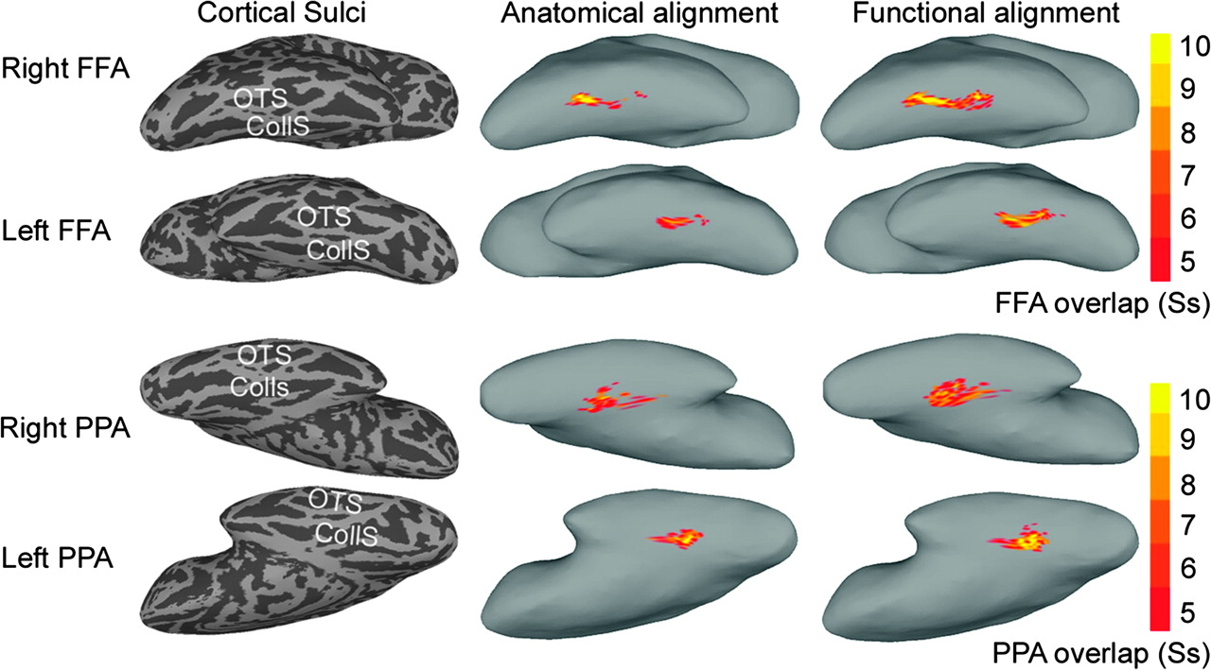
Figure 6. Illustration of the location and amount of overlap of 2 functionally defined regions—the FFA and the ...
Notes:
Figure 6. Illustration of the location and amount of overlap of 2 functionally defined regions—the FFA and the PPA—across subjects. Only nodes that were identified for 5 or more subjects are shown. The images that illustrate PPA overlap are tipped to provide a better view of this region that is located more medially than the FFA. The images on the left show the locations of sulci in these inflated cortex images (OTS—occipitotemporal sulcus; CollS—collateral sulcus). The images in the middle column show overlap among subjects after alignment based on sulcal anatomy. The images on the right show overlap among subjects after functional alignment based on a warp derived from the movie data.
Unless provided in the caption above, the following copyright applies to the content of this slide: © 2009 The AuthorsThis is an Open Access article distributed under the terms of the Creative Commons Attribution Non-Commercial License (http://creativecommons.org/licenses/by-nc/2.0/uk/) which permits unrestricted non-commercial use, distribution, and reproduction in any medium, provided the original work is properly cited.

