Slide 1
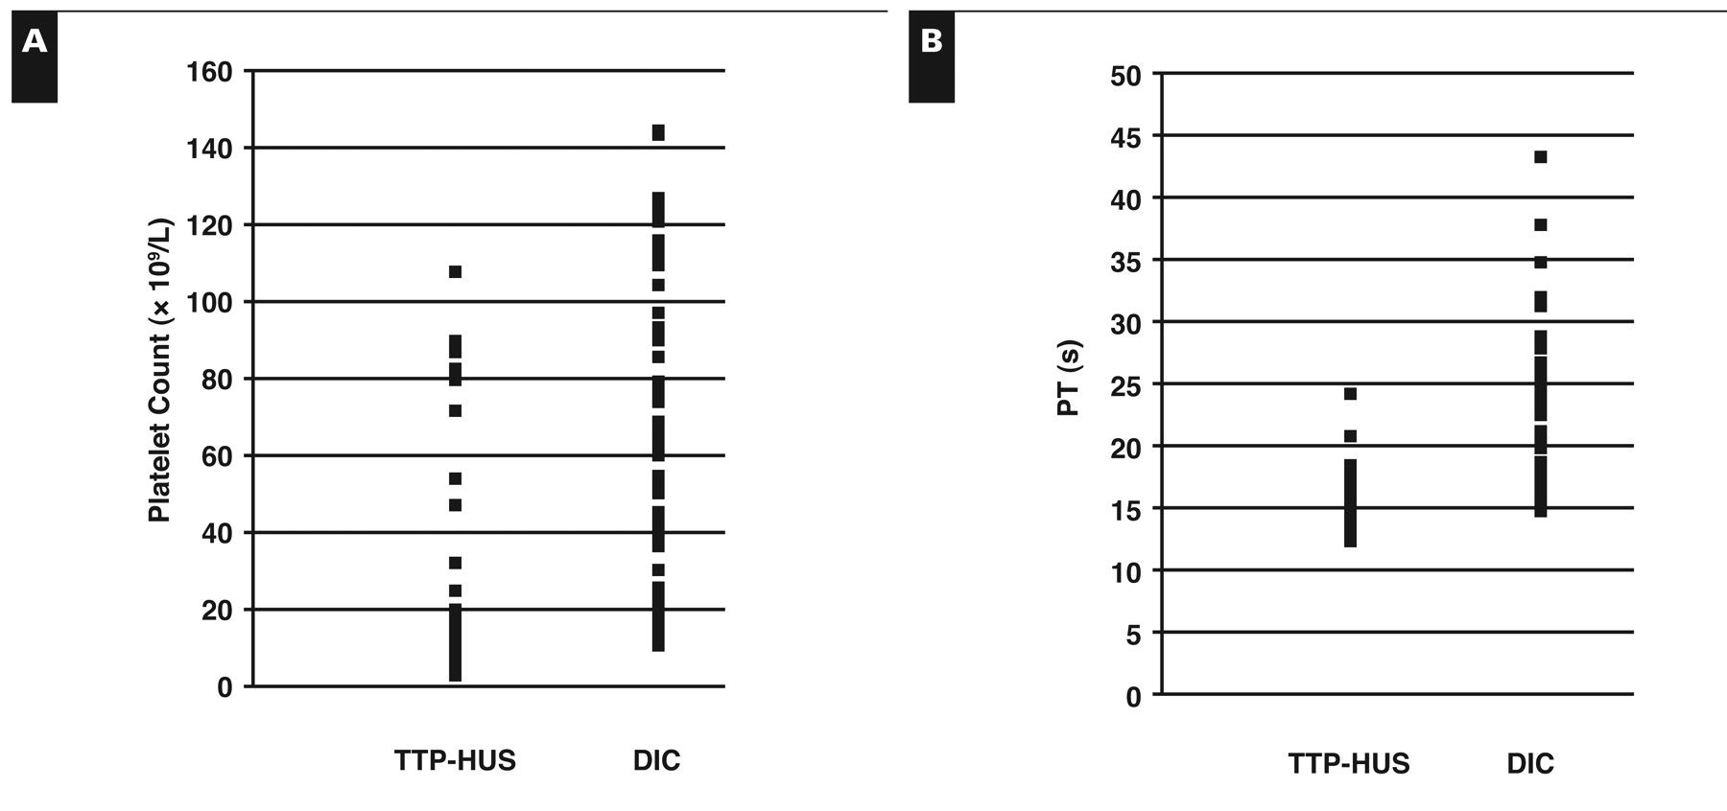
Figure 1 Comparison of platelet count (A) and prothrombin time (PT) (B) in the thrombotic thrombocytopenic ...
Notes:
Figure 1 Comparison of platelet count (A) and prothrombin time (PT) (B) in the thrombotic thrombocytopenic purpura–hemolytic uremic syndrome (TTP-HUS) and disseminated intravascular coagulation (DIC) groups. Each point represents 1 patient at admission. Platelet counts are shown in Système International units; to convert to conventional units (× 103/μL), divide by 1.0. PT reference range, 12–14 s.
Unless provided in the caption above, the following copyright applies to the content of this slide: © American Society for Clinical Pathology

