Slide 1
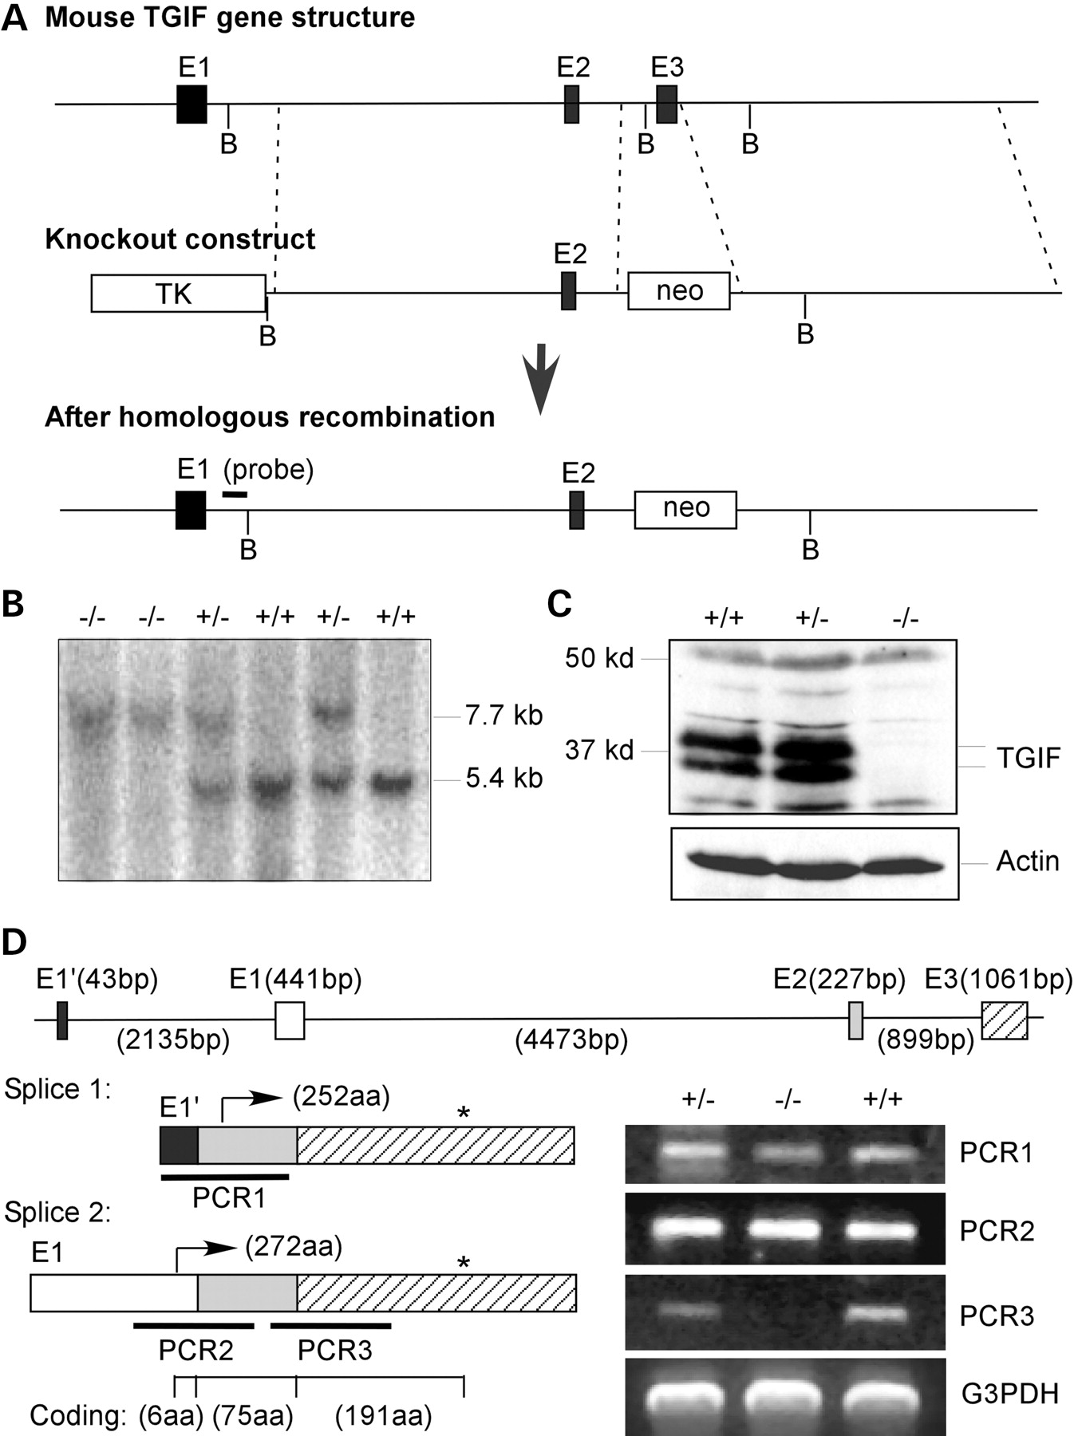
Figure 1. Generation and characterization of Tgif^{Δexon3} mutant mice. (A) Schematic illustration of the mouse ...
Notes:
Figure 1. Generation and characterization of TgifΔexon3 mutant mice. (A) Schematic illustration of the mouse Tgif gene structure, the Tgif deletion construct and the predicted TgifΔexon3 allele following homologous recombination. B stands for BamHI restriction site. The black bar (bottom) indicates the position of the probe used for Southern blotting. (B) Southern blotting with genomic DNA digested by BamHI. The wild-type Tgif allele is shown at 5.4 kb and the targeted allele is at 7.7 kb. (C) Western blot analysis with mouse brain proteins. Tgif protein doublet is indicated and an actin antibody was used as a loading control. (D) Analysis of splicing variants of the Tgif gene. Detailed exon/intron information is illustrated with nucleotide length. Two splicing options are illustrated with alternative use of the first exon (E1′ and E1). The arrows indicate the translation start sites and the asterisk marks the position of stop codon. In Splice 1, translation starts in exon 2. The amino acids encoded by each exon in Splice 2 are labeled underneath. RT-PCR was performed using total RNA isolated from the brain. PCR1 and PCR2 detect regions spanning exon 1 to exon 2 for both splice isoforms as indicated. PCR3 is for the region spanning exon 2 and exon 3 of Tgif.
Unless provided in the caption above, the following copyright applies to the content of this slide: © The Author 2006. Published by Oxford University Press. All rights reserved. For Permissions, please email: journals.permissions@oxfordjournals.org

Slide 2
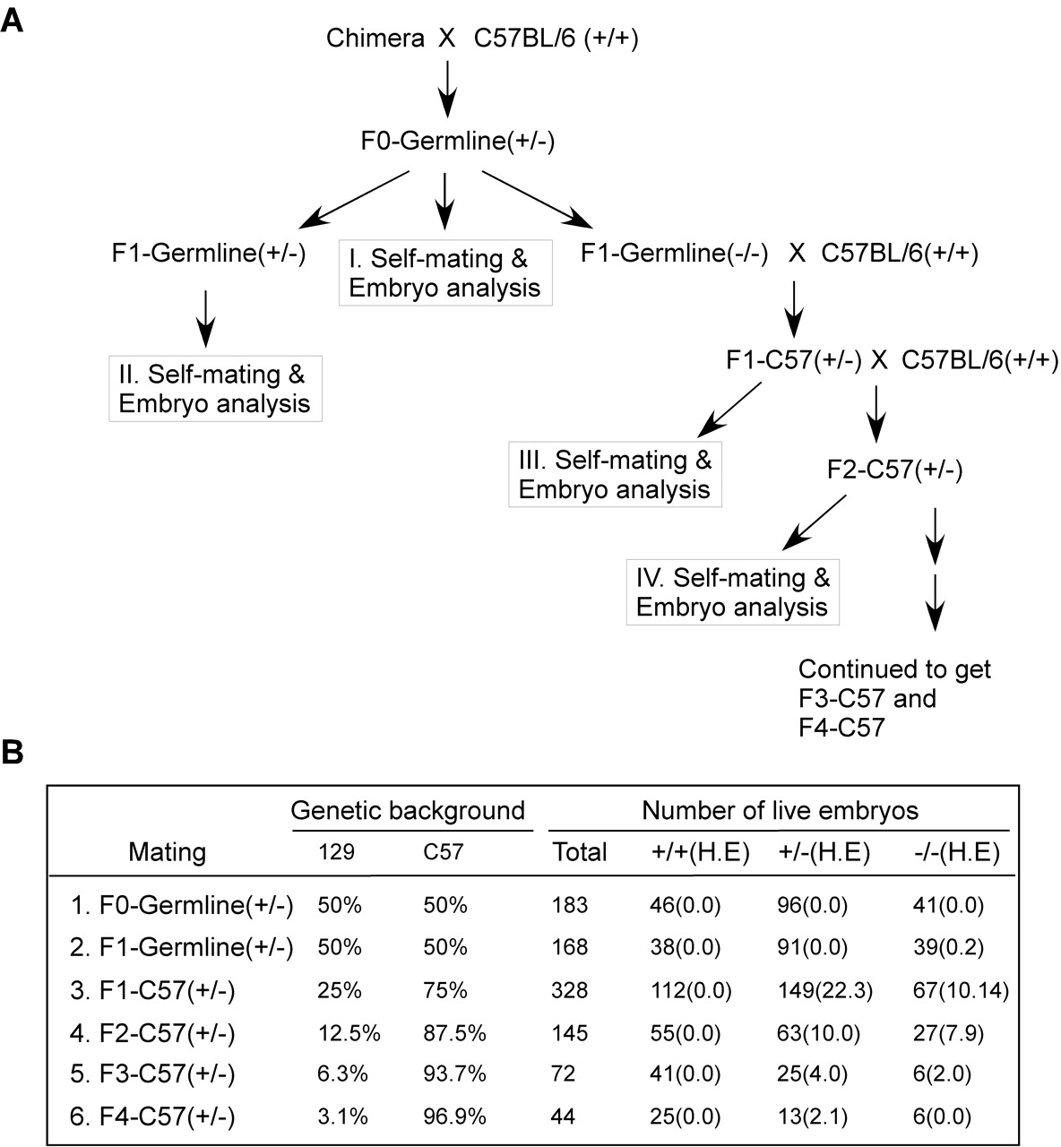
Figure 2. Breeding scheme and summary of phenotypes. (A) Breeding scheme of the Tgif^{Δexon3} mouse colonies. ...
Notes:
Figure 2. Breeding scheme and summary of phenotypes. (A) Breeding scheme of the TgifΔexon3 mouse colonies. The C57BL/6 genetic background is enriched by outbreeding with wild-type C57BL/6 strain. (B) Summary of live embryos with various phenotypes in different generations. The expected percentage of 129SVJ (labeled as 129) or C57BL/6 (labeled as C57) genetic background is indicated. The genotype of each embryo was identified by PCR with genomic DNA and is marked in the table. H stands for hypoplastic head phenotype and E is for exencephaly.
Unless provided in the caption above, the following copyright applies to the content of this slide: © The Author 2006. Published by Oxford University Press. All rights reserved. For Permissions, please email: journals.permissions@oxfordjournals.org

Slide 3
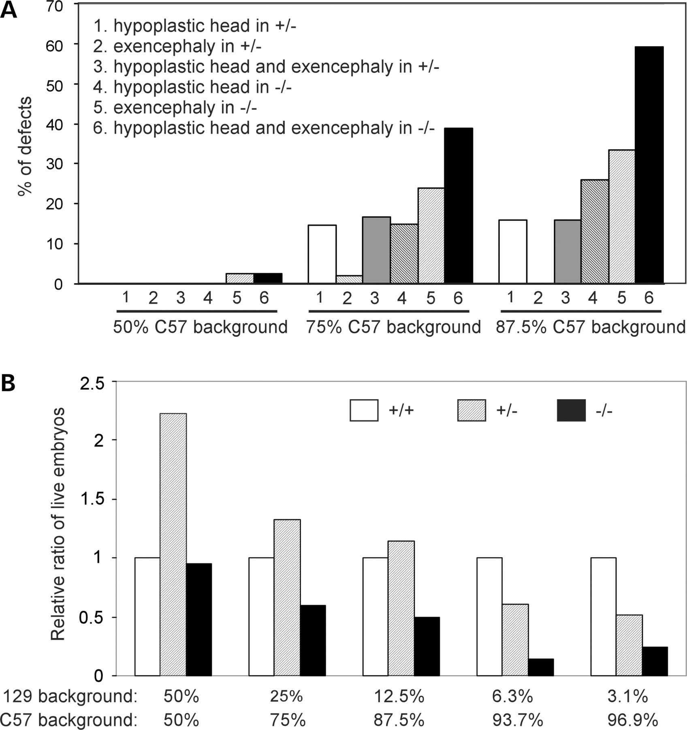
Figure 3. Effect of genetic background on the phenotype and lethality. (A) Exencephaly and hypoplastic brain phenotypes ...
Notes:
Figure 3. Effect of genetic background on the phenotype and lethality. (A) Exencephaly and hypoplastic brain phenotypes increased with elevating C57BL/6 background. The percentage of abnormal embryos is illustrated and categorized by the expected percentage of C57BL/6 background. The data of 50% C57BL/6 background group are from a combination of Mating I and Mating II groups shown in Figure 2B. (B) Embryonic lethality. The ratio of live embryos in each genotype is compared with the wild-type (TgifΔexon3+/+) which is set to 1. Note that the percentage of live TgifΔexon3+/− and TgifΔexon3−/− embryos decreases as the C57BL/6 genetic background increases.
Unless provided in the caption above, the following copyright applies to the content of this slide: © The Author 2006. Published by Oxford University Press. All rights reserved. For Permissions, please email: journals.permissions@oxfordjournals.org

Slide 4
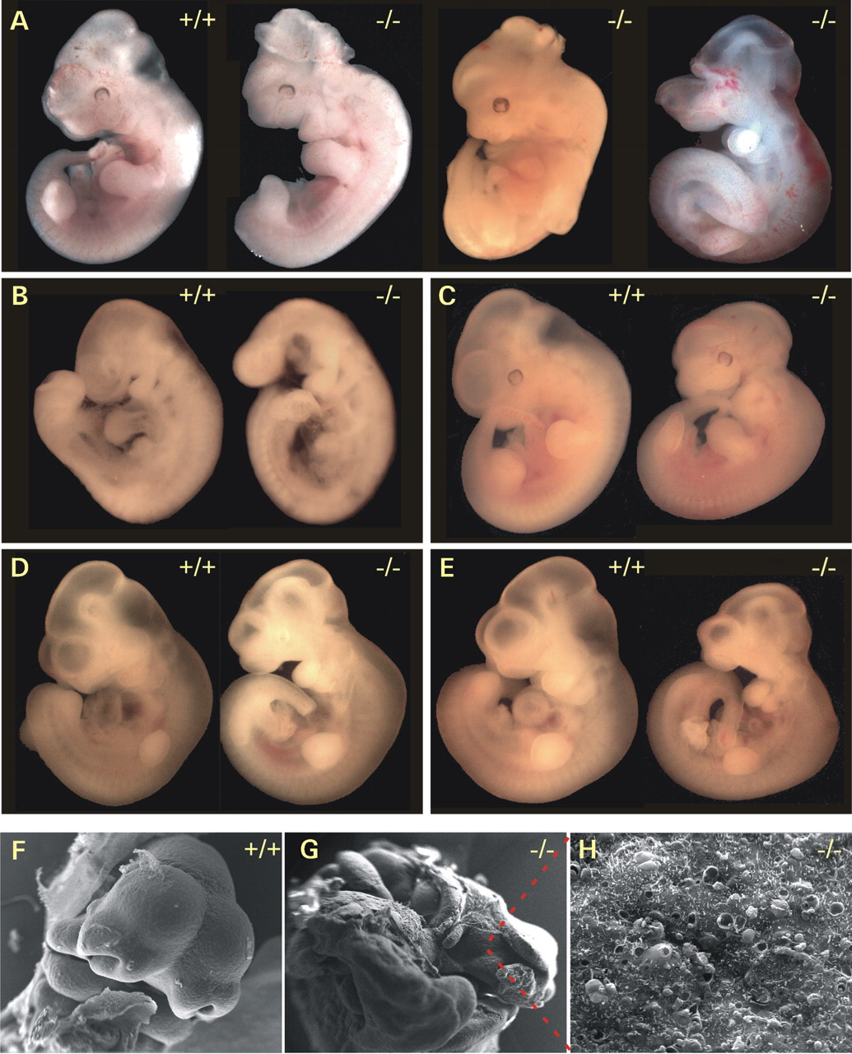
Figure 4. Morphological abnormalities in Tgif^{Δexon3} deletion mice. (A) Exencephaly in ...
Notes:
Figure 4. Morphological abnormalities in TgifΔexon3 deletion mice. (A) Exencephaly in TgifΔexon3−/− mice as compared to wild-type control (left) at E12.5. (B) Microcephaly in Tgif mutant embryo (right) at E11 in comparison with a wild-type littermate (left). (C–E) Hypoplastic head phenotype at E11.5 or E12.5 in TgifΔexon3−/− embryos (right). Wild-type littermates are shown in each case (left). Note the development of both the forebrain and hindbrain is reduced with decreased ventricles in TgifΔexon3 mutant embryos. (F) Scanning electron microscopy showing normal brain development in a wild-type embryo at E11.5. (G,H) Scanning electron microscopy of exencephaly in a TgifΔexon3 mutant embryo at E11.5. Note that the cobble-like neuroepithelium lining the ventricle was exposed outward when viewed at high magnification.
Unless provided in the caption above, the following copyright applies to the content of this slide: © The Author 2006. Published by Oxford University Press. All rights reserved. For Permissions, please email: journals.permissions@oxfordjournals.org

Slide 5
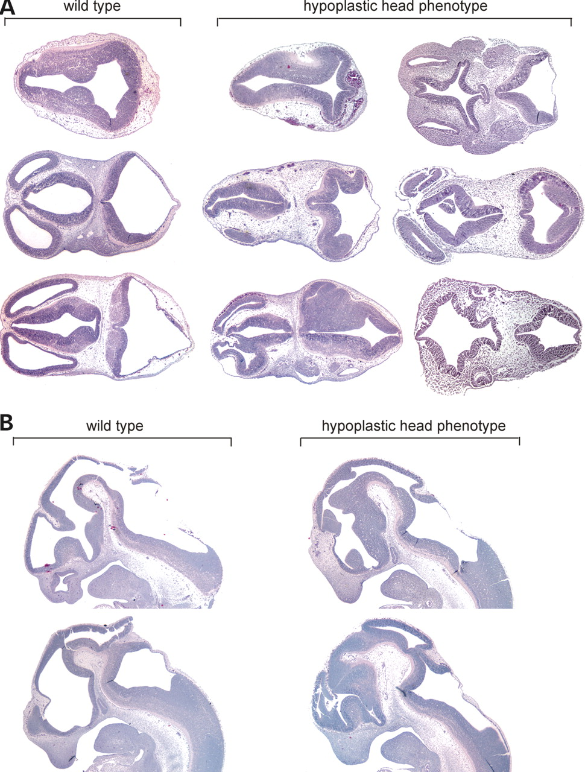
Figure 5. Histological analyses of Tgif^{Δexon3} mice with hypoplastic head phenotype. (A) H&E staining of ...
Notes:
Figure 5. Histological analyses of TgifΔexon3 mice with hypoplastic head phenotype. (A) H&E staining of transverse sections at E11.5 and E12.5. Note that various abnormalities of neuroepithelium folding and formation are evident in the forebrain and hindbrain of the TgifΔexon3 mutant embryos. (B) H&E staining of sagittal sections at E11.5. Note that thickening of ventricular neuroepithelium is evident in the ventral region of forebrain.
Unless provided in the caption above, the following copyright applies to the content of this slide: © The Author 2006. Published by Oxford University Press. All rights reserved. For Permissions, please email: journals.permissions@oxfordjournals.org

Slide 6
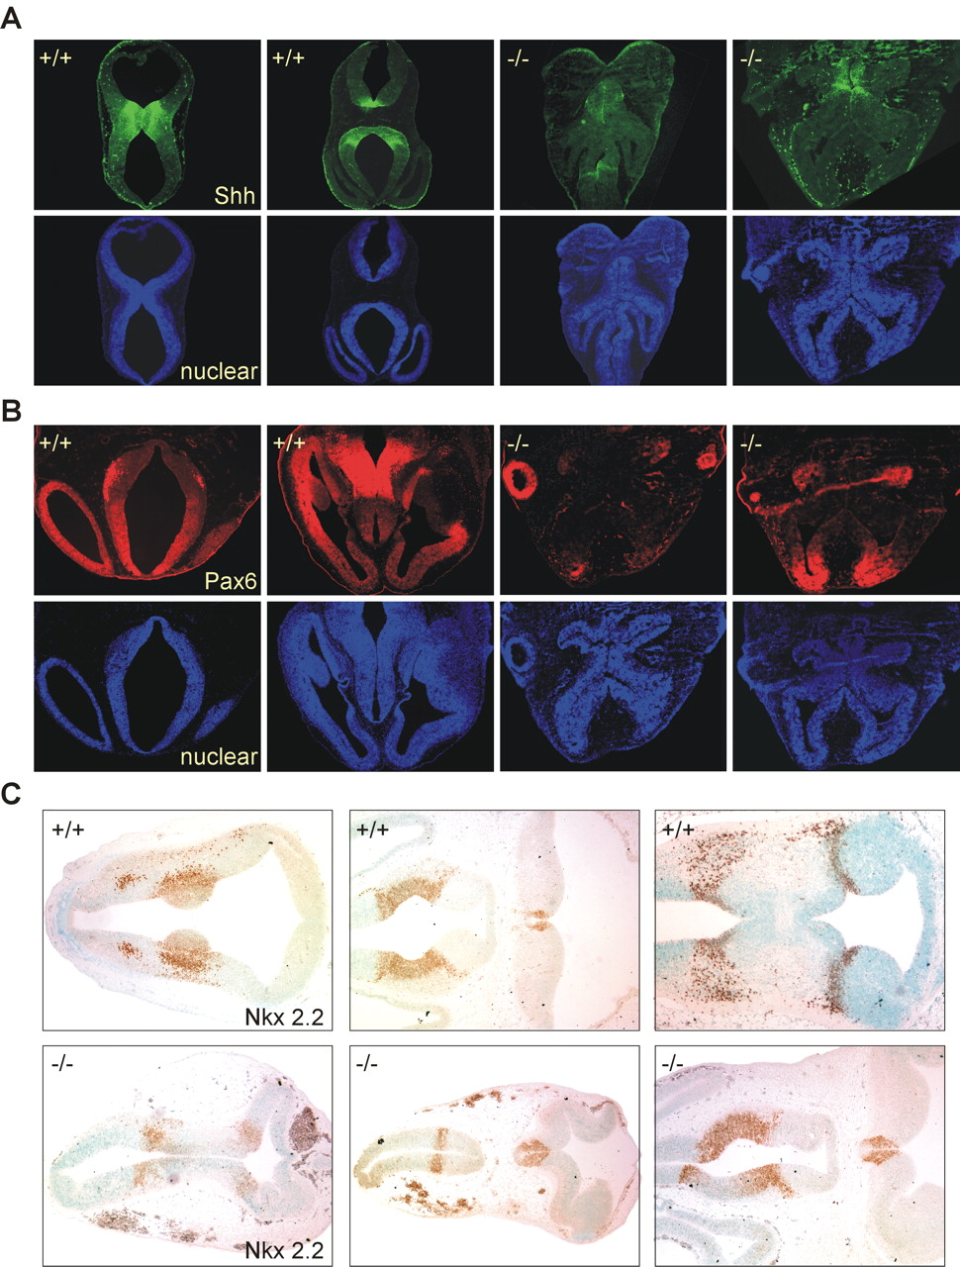
Figure 6. Analyses of dorsal–ventral patterning markers. (A) Immunofluorescent staining of Shh with transverse sections ...
Notes:
Figure 6. Analyses of dorsal–ventral patterning markers. (A) Immunofluorescent staining of Shh with transverse sections of the embryonic brain. In wild-type embryos at E11.5, Shh is expressed in the ventral midline portions of both forebrain and hindbrain. In TgifΔexon3 mutant embryos, Shh expression was markedly reduced and only residual signals could be detected in the midline regions of the brain. Nuclear staining was performed with Hoechst 33342 to help visualize the neuroepithelium. (B) Immunofluorescent staining of Pax6. While Pax6 is mainly expressed in the ventral regions of telencephalon and diencephalon in wild-type embryo, in TgifΔexon3 mutant brains, Pax6 could be detected in eyes and the dorsal region of forebrain that exhibits severe structural abnormalities. (C) Immunohistological staining of Nkx2.2. Note that Nkx2.2 expression marks the dorsal–ventral boundary of the forebrain and hindbrain, but in mutant embryos, the pattern of Nkx2.2 expression was perturbed and not symmetrical within the neuroepithelium.
Unless provided in the caption above, the following copyright applies to the content of this slide: © The Author 2006. Published by Oxford University Press. All rights reserved. For Permissions, please email: journals.permissions@oxfordjournals.org

Slide 7
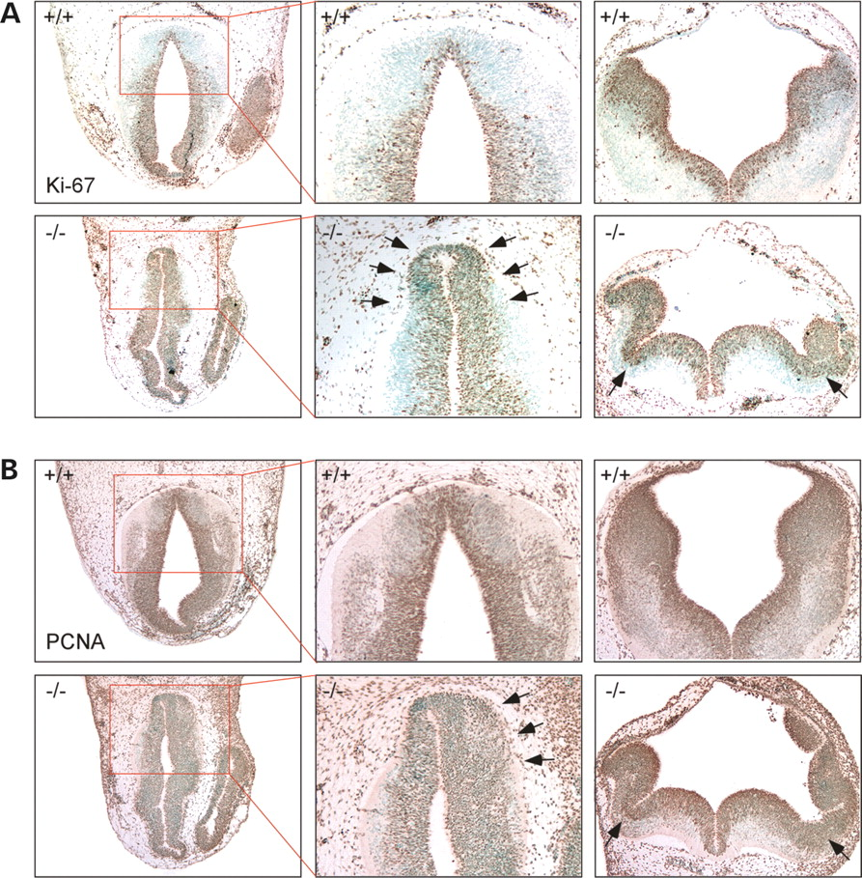
Figure 7. Analysis of cell proliferation with immunohistological staining for Ki-67(A) and PCNA (B). The nuclei were ...
Notes:
Figure 7. Analysis of cell proliferation with immunohistological staining for Ki-67(A) and PCNA (B). The nuclei were counterstained with methyl green. Note that the TgifΔexon3 mutant embryos contain significantly more Ki-67 and PCNA positive cells in the ventral region of forebrain and in the extra folds in hindbrain (indicated by arrows), suggesting accelerated proliferation of neuroepithelium in these areas.
Unless provided in the caption above, the following copyright applies to the content of this slide: © The Author 2006. Published by Oxford University Press. All rights reserved. For Permissions, please email: journals.permissions@oxfordjournals.org

