Slide 1
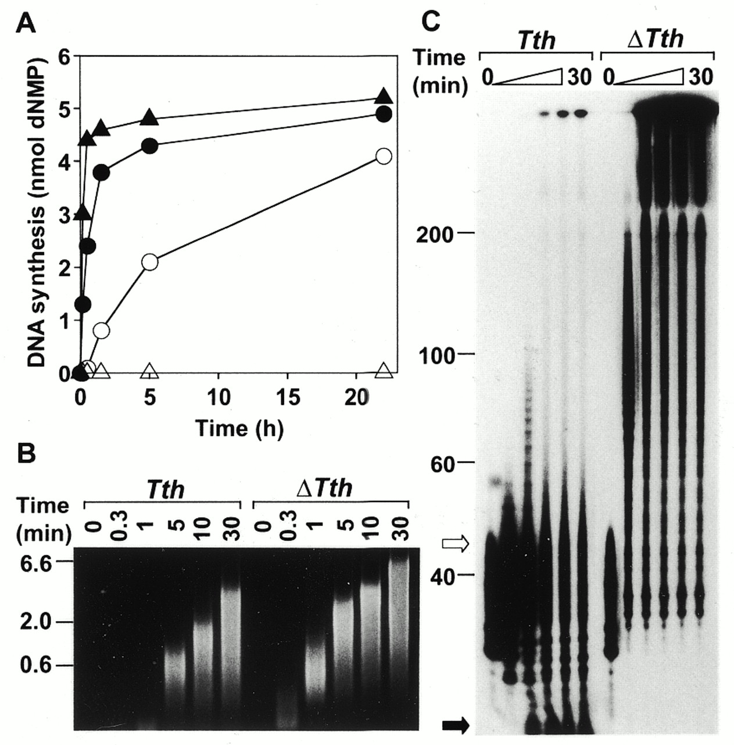
Figure 1. The time course of DNA synthesis by Tth and ΔTth DNA polymerases in the presence of oligoDNA. DNA ...
Notes:
Figure 1. The time course of DNA synthesis by Tth and ΔTth DNA polymerases in the presence of oligoDNA. DNA synthesis was carried out in a standard reaction mixture at 74°C for the various times indicated by Tth DNA polymerase (circles) or ΔTth DNA polymerase (triangles) in the presence (filled symbols) or absence (open symbols) of 1 µg/ml 48mer standard oligoDNA (TACATGTA)6. The amount of DNA synthesized was measured as acid-insoluble radioactivity (A) or the product DNA was electrophoresed on an agarose gel under non-denaturing conditions (B). The size markers for (B) are shown in kb on the left. To monitor elongation of the added oligoDNA, the standard reaction mixture containing 3′-end-labeled standard oligoDNA (TACATGTA)6 and either Tth or ΔTth DNA polymerase was incubated as above for 0, 0.3, 1, 5, 10 and 30 min. The reaction mixture was next electrophoresed on a polyacrylamide gel under denaturing conditions and the gel was subjected to autoradiography (C). The size markers for (C) are shown in bases on the left. The positions of (TACATGTA)6 (open arrow) and dNMP (filled arrow) are also shown.
Unless provided in the caption above, the following copyright applies to the content of this slide:

Slide 2
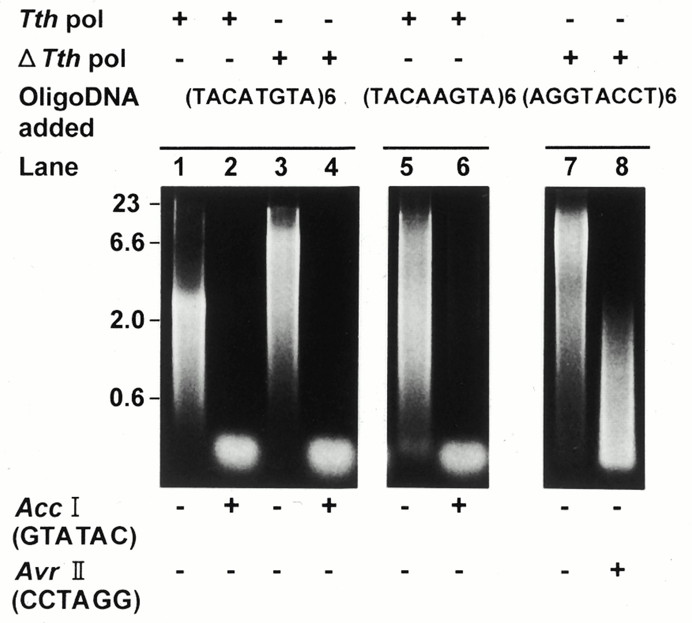
Figure 2. The analysis of DNA product synthesized by Tth and ΔTth DNA polymerases by restriction enzymes. The ...
Notes:
Figure 2. The analysis of DNA product synthesized by Tth and ΔTth DNA polymerases by restriction enzymes. The DNA product synthesized in the standard reaction mixture at 74°C for 30 min by Tth or ΔTth DNA polymerase in the presence of 1 µg/ml of the indicated oligoDNA (third line) was electrophoresed on an agarose gel under non-denaturing conditions before (lanes 1, 3, 5 and 7) or after (lanes 2, 4, 6 and 8) treatment with 1 U/ml of the restriction enzyme indicated at the bottom. The size markers are shown in kb on the left. The recognition sequence of the restriction enzyme is shown below each enzyme.
Unless provided in the caption above, the following copyright applies to the content of this slide:

Slide 3
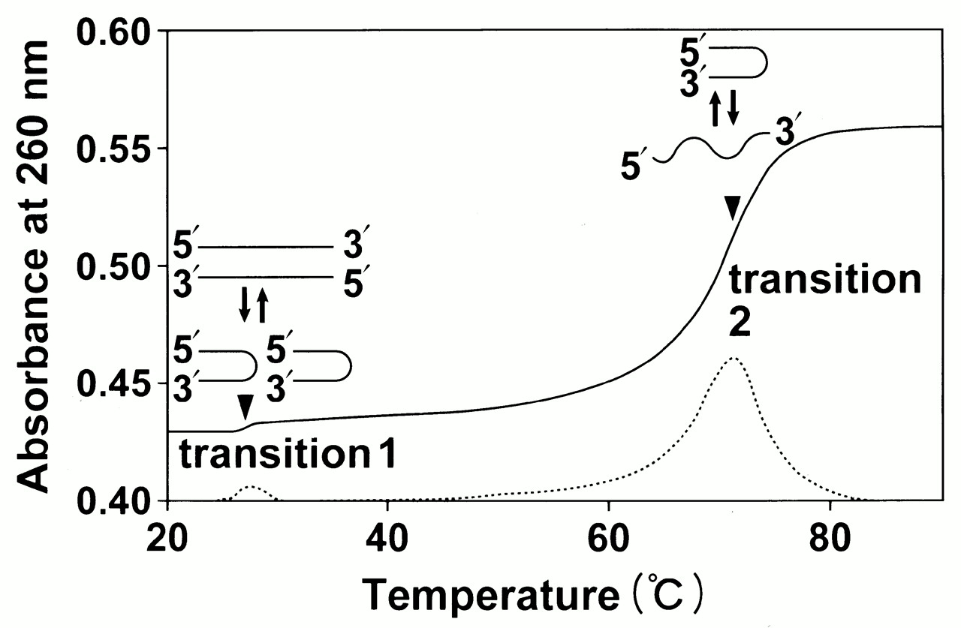
Figure 3. The spectroscopic thermal melting profile of oligoDNA. The absorption spectrum (260 nm) of oligoDNA ...
Notes:
Figure 3. The spectroscopic thermal melting profile of oligoDNA. The absorption spectrum (260 nm) of oligoDNA (TACTAGTA)6 was measured at a concentration of 10 µg/ml by increasing the temperature at a rate of 0.25°C/min. The solid line represents the absorbance as a function of temperature and the dotted line represents its derivative. The melting temperatures of the duplex–hairpin (transition 1) and hairpin–coil (transition 2) transitions are shown by arrowheads. Structures of DNA are shown schematically above each transition point.
Unless provided in the caption above, the following copyright applies to the content of this slide:

Slide 4
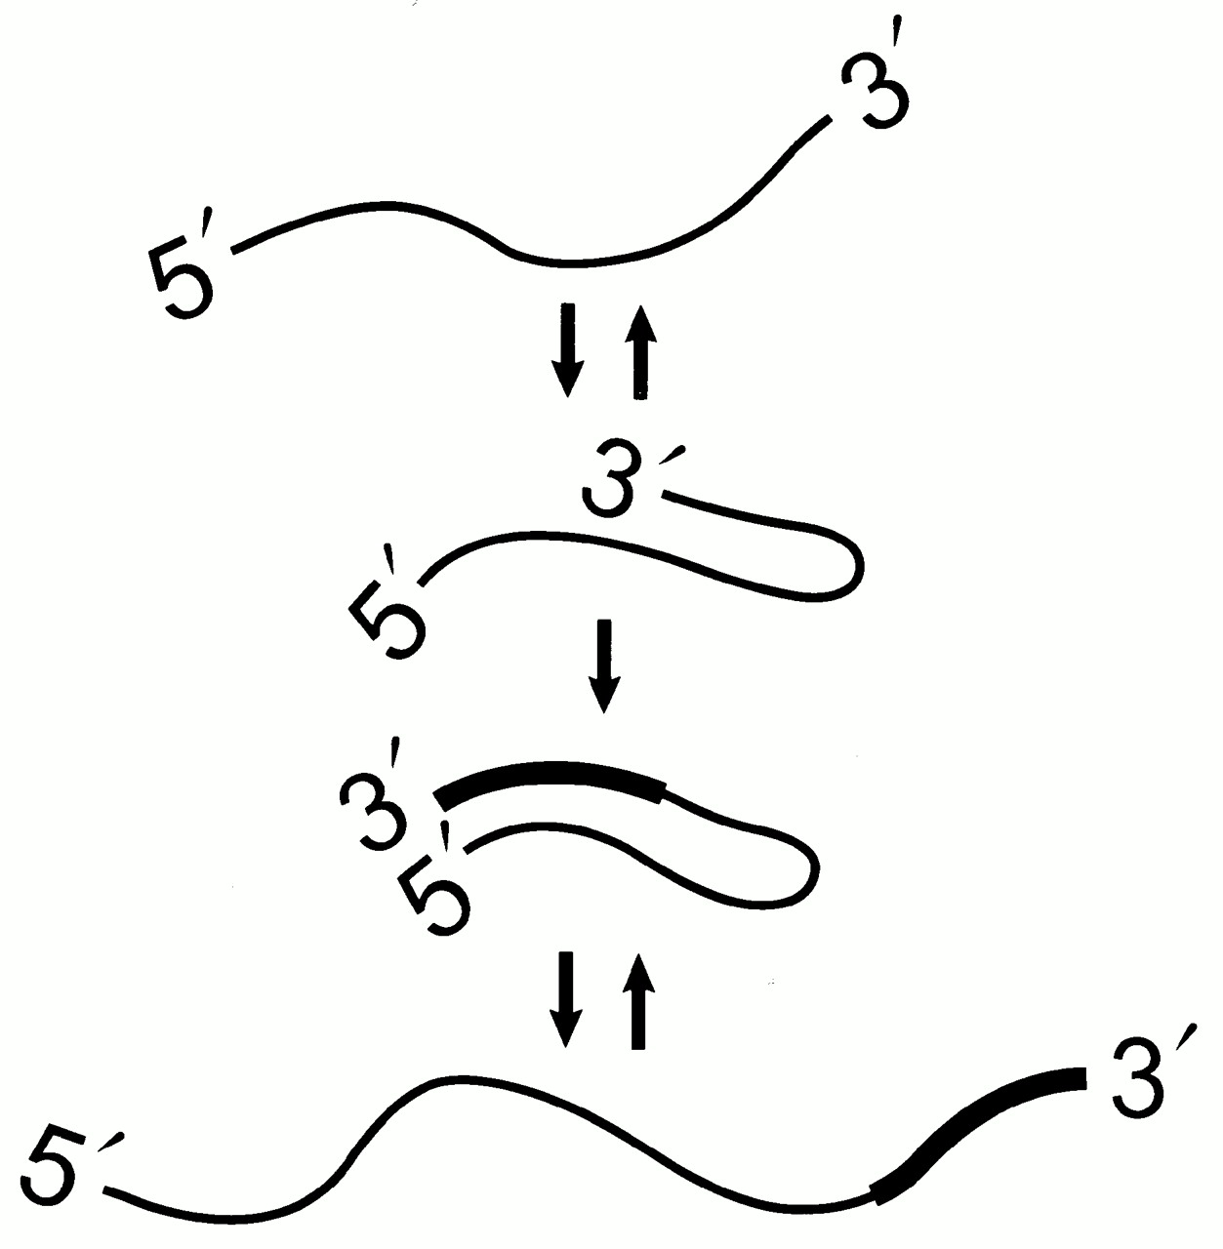
Figure 4. A proposed model of ‘hairpin elongation’ for the expansion of a tandem repetitive sequence with a ...
Notes:
Figure 4. A proposed model of ‘hairpin elongation’ for the expansion of a tandem repetitive sequence with a palindromic or quasi-palindromic sequence through hairpin–coil transitions near the melting temperature. The newly elongated stretch of DNA is shown by a thick line. According to this model, DNA is elongated by repeating such a hairpin–coil interconversion. While the scheme shows complete melting of the hairpin, the melting may be incomplete.
Unless provided in the caption above, the following copyright applies to the content of this slide:

