Slide 1
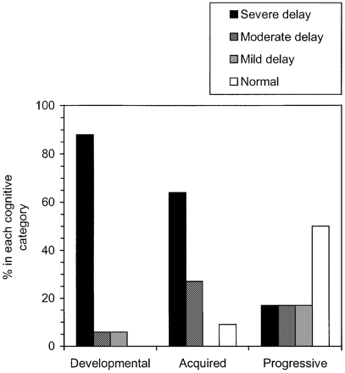
Fig. 1 Summary of pre‐operative developmental categories of patients. The percentage of individuals in each ...
Notes:
Fig. 1 Summary of pre‐operative developmental categories of patients. The percentage of individuals in each developmental category on the vertical axis is plotted against underlying pathology on the horizontal axis.
Unless provided in the caption above, the following copyright applies to the content of this slide:

Slide 2
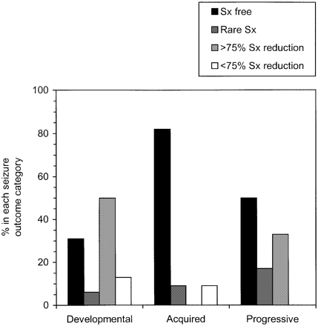
Fig. 2 Seizure outcome after hemisphericectomy. The percentage of individuals in each seizure outcome ...
Notes:
Fig. 2 Seizure outcome after hemisphericectomy. The percentage of individuals in each seizure outcome category on the vertical axis plotted against the underlying pathology on the horizontal axis.
Unless provided in the caption above, the following copyright applies to the content of this slide:

