Slide 1
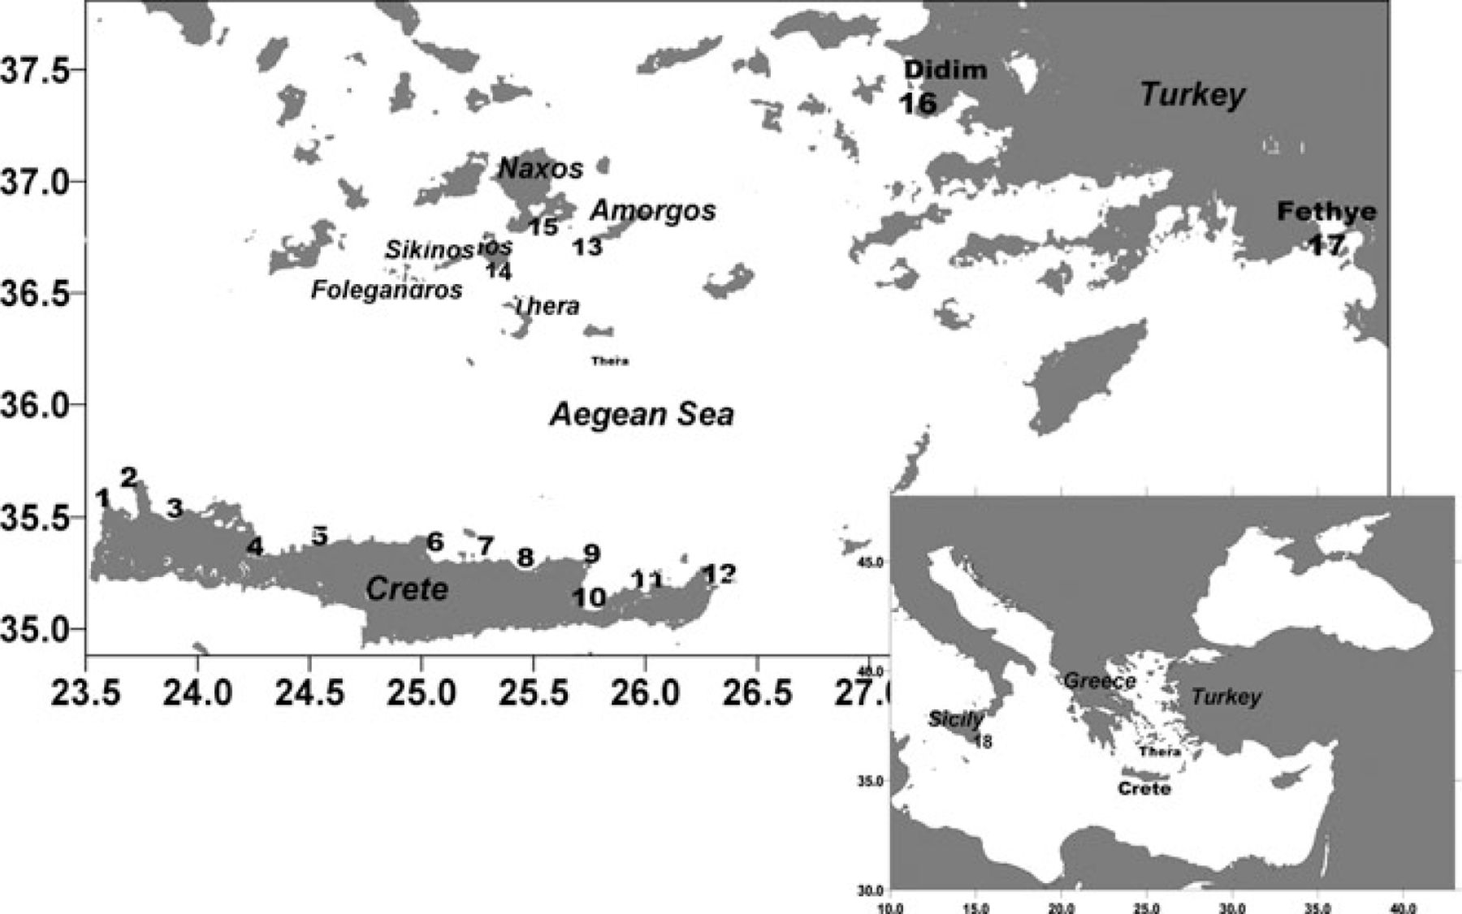
Figure 1 Map of study area and locations of 18 synthetic tide-gauge stations used in numerical modelling. Local names ...
Notes:
Figure 1 Map of study area and locations of 18 synthetic tide-gauge stations used in numerical modelling. Local names for stations indicated by numbers can be found in the text (Table 2).
Unless provided in the caption above, the following copyright applies to the content of this slide: ©2011 The Authors Geophysical Journal International © 2011 RAS

Slide 2
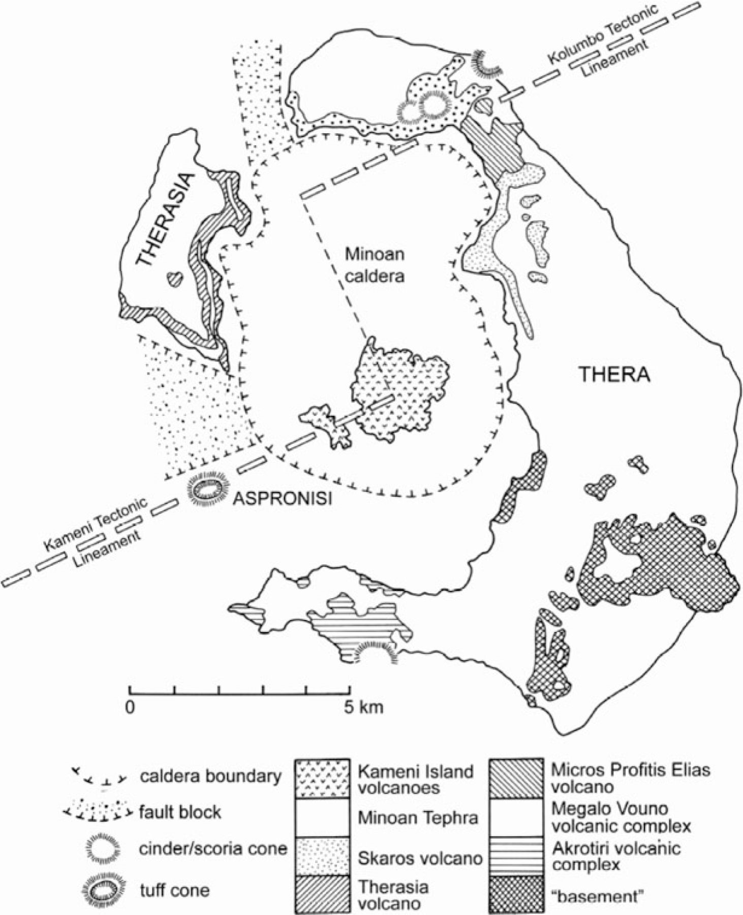
Figure 2 Map identifying the generalized geology of Thera (after McCoy & Heiken 2000).
Notes:
Figure 2 Map identifying the generalized geology of Thera (after McCoy & Heiken 2000).
Unless provided in the caption above, the following copyright applies to the content of this slide: ©2011 The Authors Geophysical Journal International © 2011 RAS

Slide 3
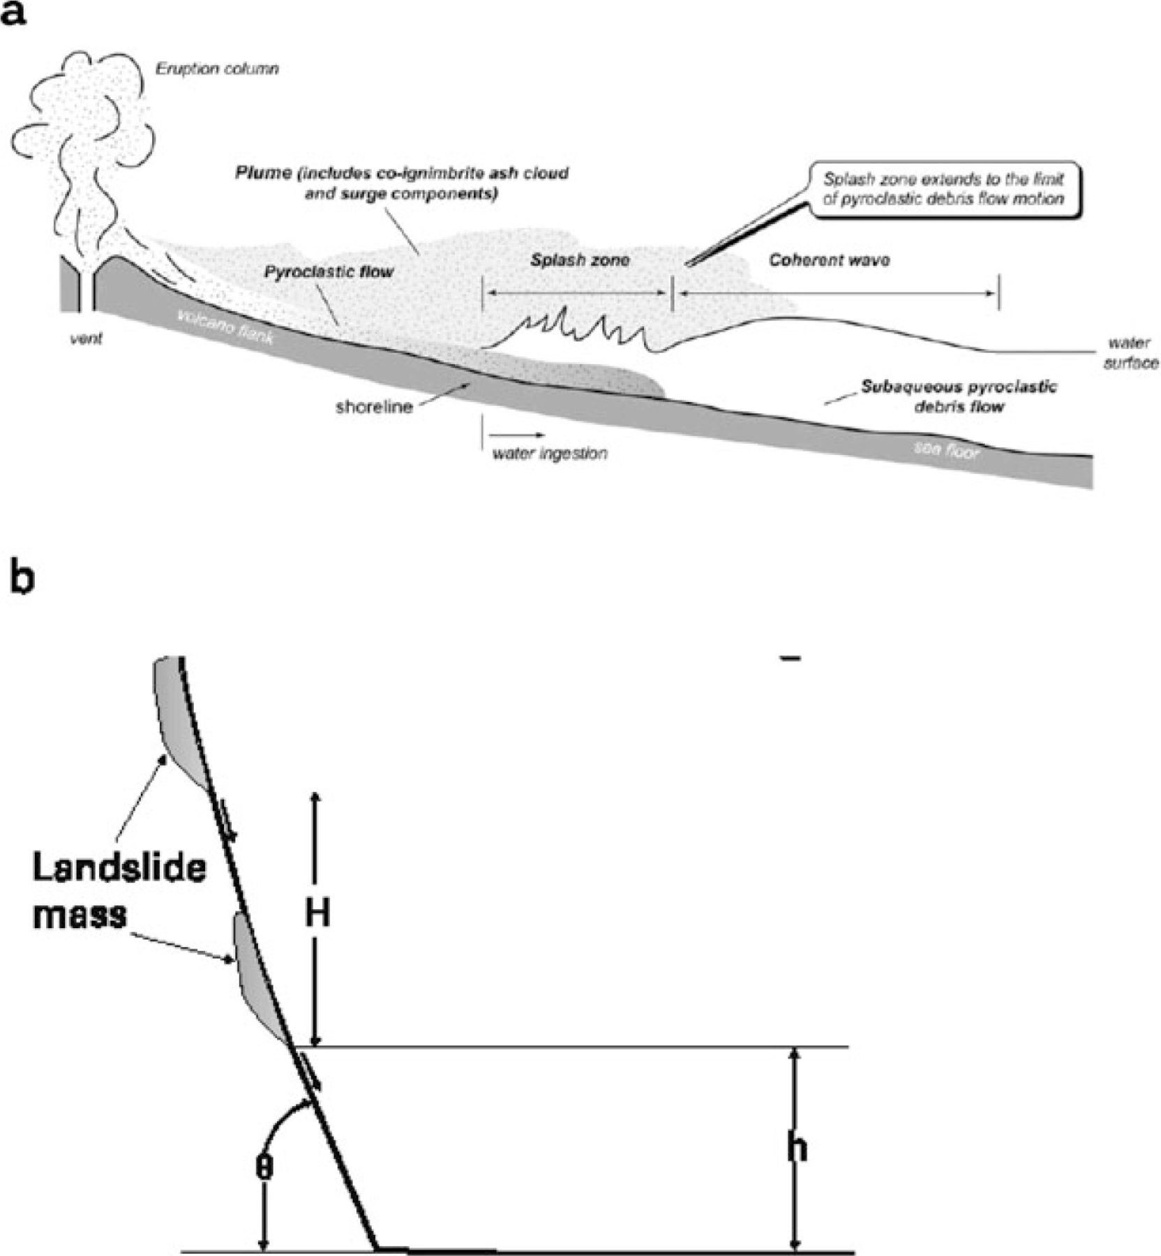
Figure 3 The two tsunamigenic mechanisms considered in this study. (a) Schematic diagrams of a pyroclastic flow ...
Notes:
Figure 3 The two tsunamigenic mechanisms considered in this study. (a) Schematic diagrams of a pyroclastic flow tsunamigenic mechanism with plume entering the water; (b) a landslide mass released either at the shore or at a height H above water level accelerates down a steep slope and only decelerates when it reaches the bottom. Redrafted from Watts and Waythomas (2003) and Walder et al. (2003). For the caldera collapse tsunamigenic mechanism we consider a dynamic series of landslides.
Unless provided in the caption above, the following copyright applies to the content of this slide: ©2011 The Authors Geophysical Journal International © 2011 RAS

Slide 4
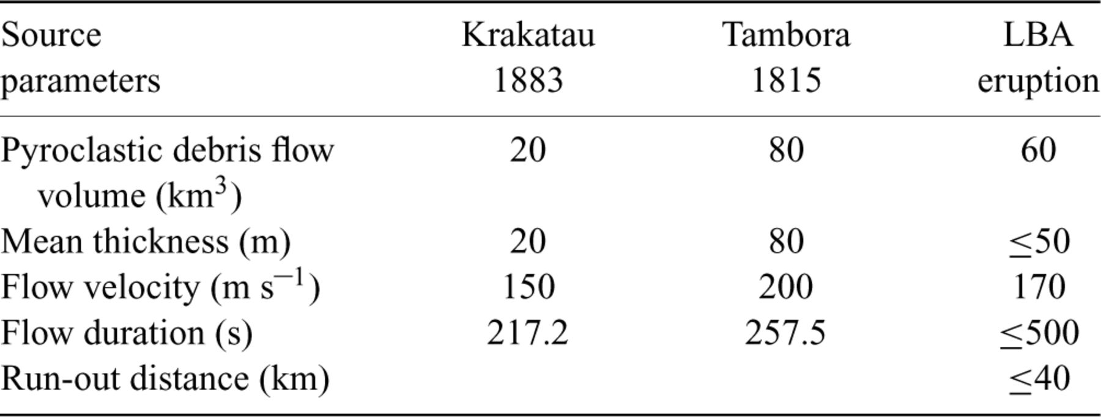
Table 1 Comparison of the pyroclastic flow parameters between the LBA Thera eruption and those of Krakatau et al. and ...
Notes:
Table 1 Comparison of the pyroclastic flow parameters between the LBA Thera eruption and those of Krakatau et al. and Tambora 1815 eruptions (see text for more details).
Unless provided in the caption above, the following copyright applies to the content of this slide: ©2011 The Authors Geophysical Journal International © 2011 RAS

Slide 5
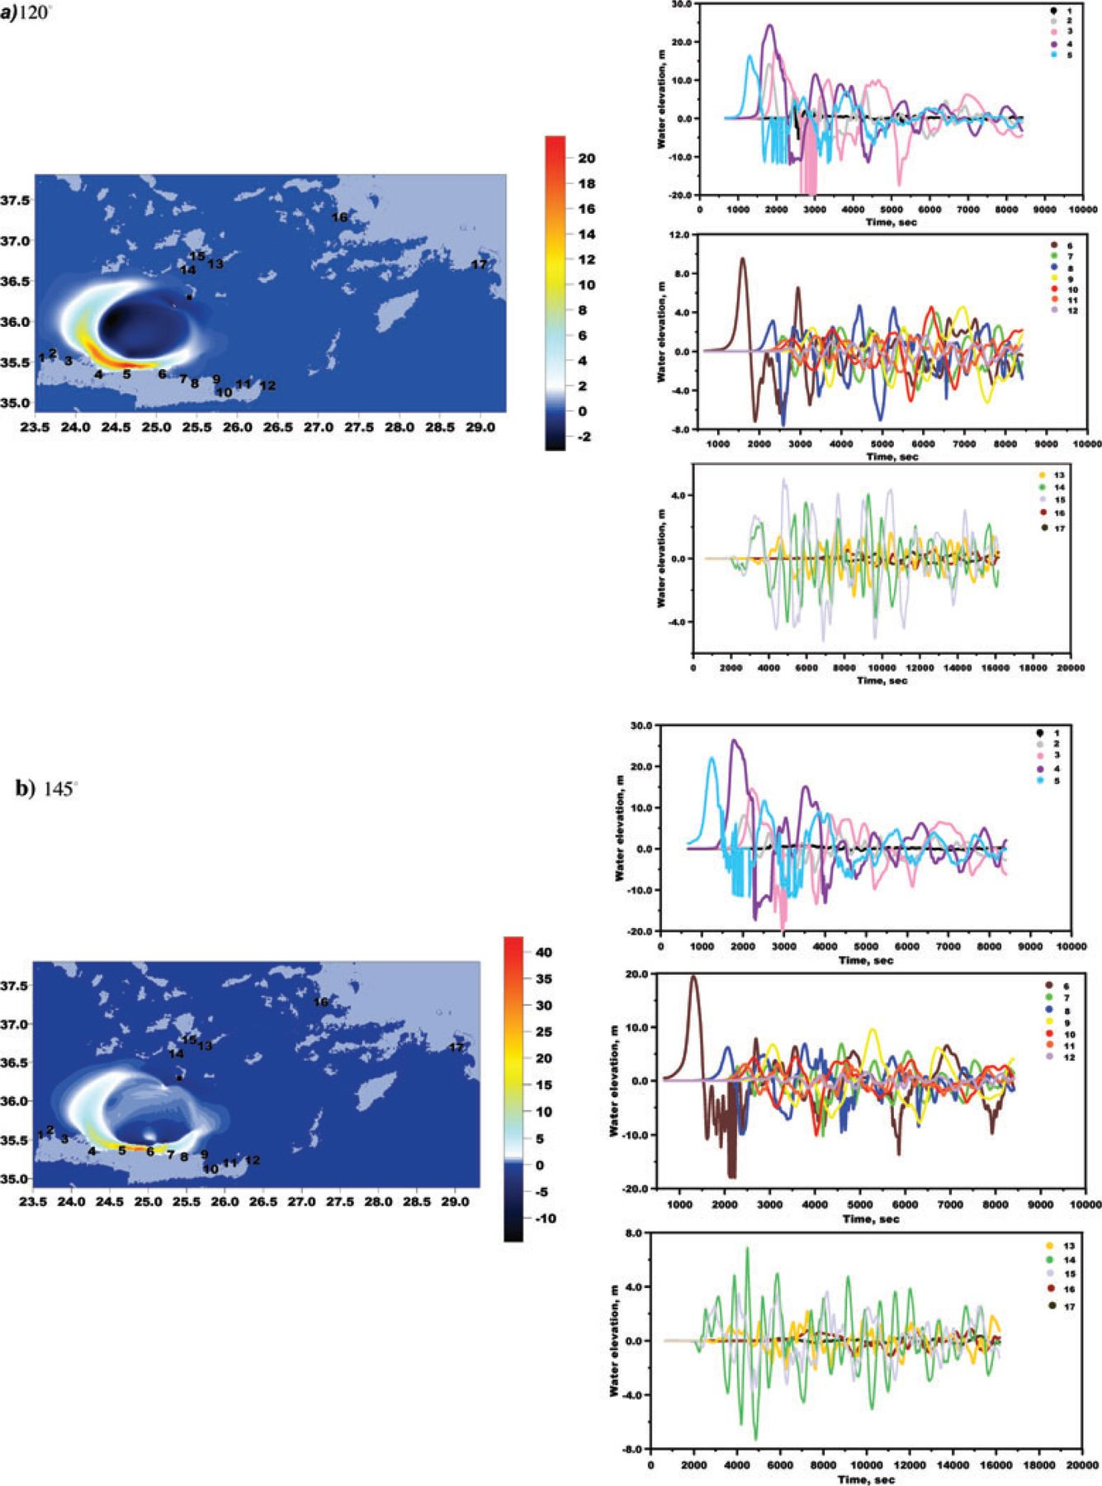
Figure 4 Snapshots of simulated tsunami wave about 13 min after its generation (left-hand panel) produced by thick ...
Notes:
Figure 4 Snapshots of simulated tsunami wave about 13 min after its generation (left-hand panel) produced by thick (∼55 m) pyroclastic flow entering the sea from the south of Thera with three characteristic directions measured from north counter-clockwise. Coloured scales are in metres. The location of pyroclastic flow at Thera shore is marked by symbol. Wave profiles from synthetic tide-gauge records are shown at the right-hand side. Tide-gauge stations are placed offshore above sea depth of ∼20 m and their locations are explained in the text.
Unless provided in the caption above, the following copyright applies to the content of this slide: ©2011 The Authors Geophysical Journal International © 2011 RAS

Slide 6
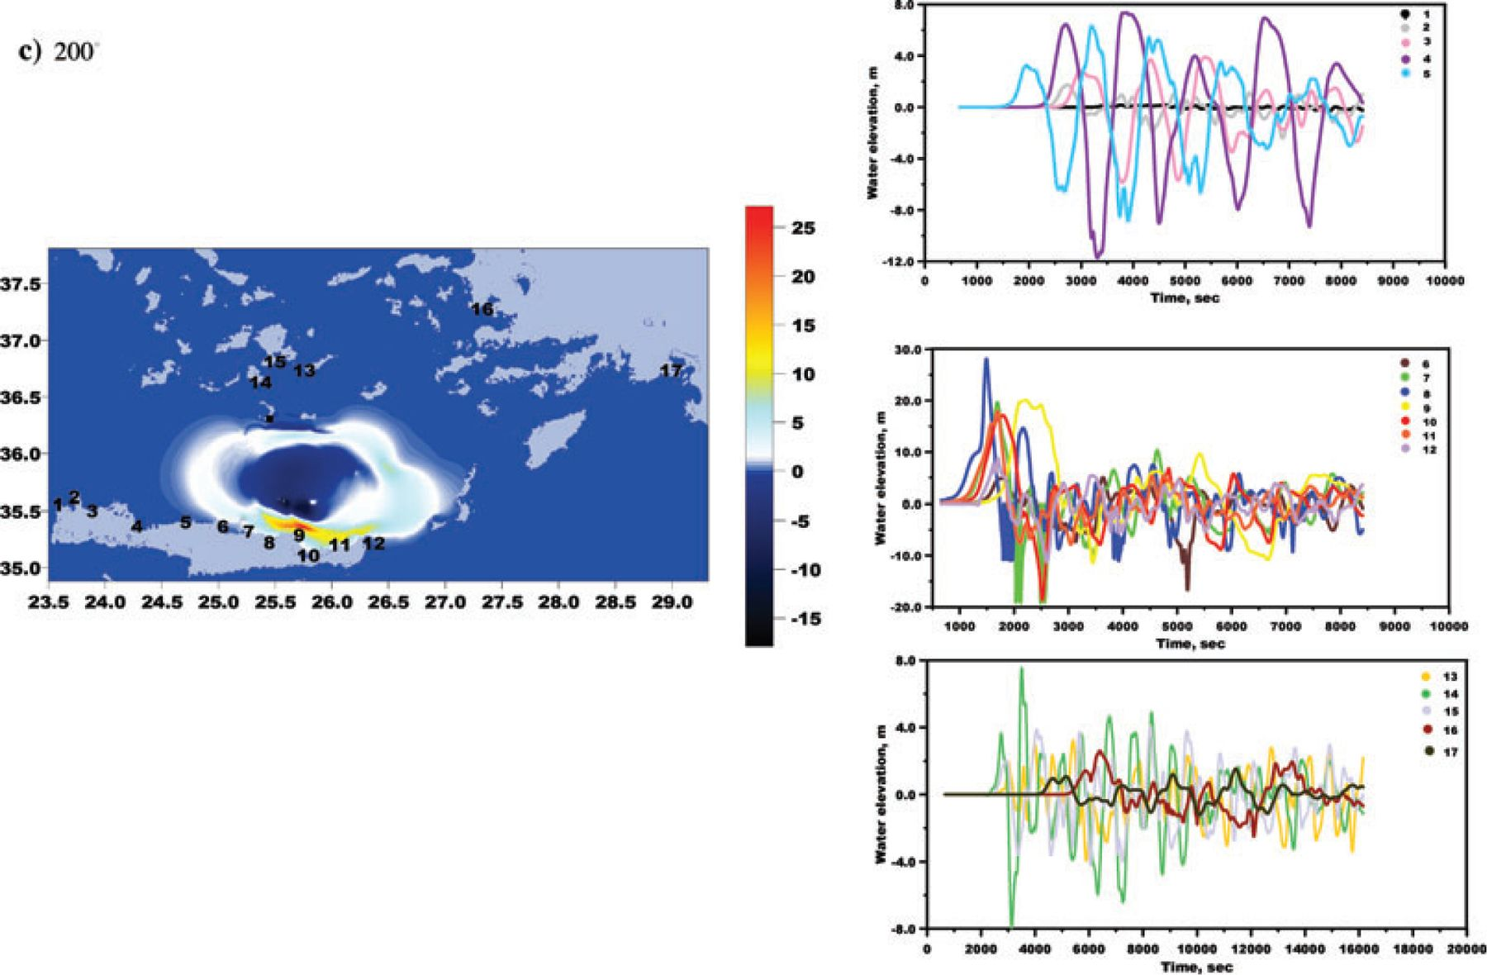
Figure 4 Snapshots of simulated tsunami wave about 13 min after its generation (left-hand panel) produced by thick ...
Notes:
Figure 4 Snapshots of simulated tsunami wave about 13 min after its generation (left-hand panel) produced by thick (∼55 m) pyroclastic flow entering the sea from the south of Thera with three characteristic directions measured from north counter-clockwise. Coloured scales are in metres. The location of pyroclastic flow at Thera shore is marked by symbol. Wave profiles from synthetic tide-gauge records are shown at the right-hand side. Tide-gauge stations are placed offshore above sea depth of ∼20 m and their locations are explained in the text.
Unless provided in the caption above, the following copyright applies to the content of this slide: ©2011 The Authors Geophysical Journal International © 2011 RAS

Slide 7
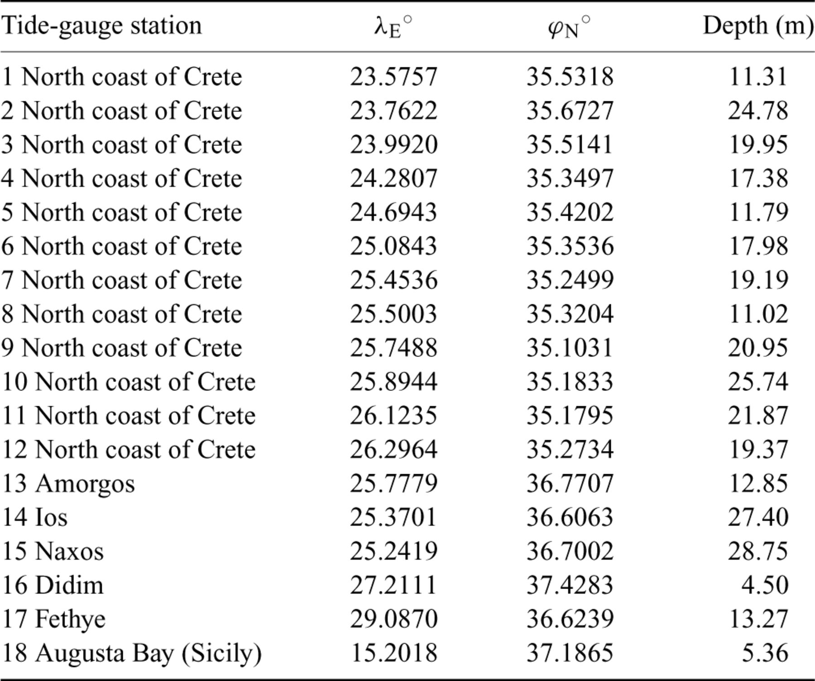
Table 2 Geographic longitude (λ_{E} °) and latitude (ϕ_{N} °) and sea depth of the virtual tide-gauge ...
Notes:
Table 2 Geographic longitude (λE °) and latitude (ϕN °) and sea depth of the virtual tide-gauge stations used in the tsunami numerical simulation.
Unless provided in the caption above, the following copyright applies to the content of this slide: ©2011 The Authors Geophysical Journal International © 2011 RAS

Slide 8
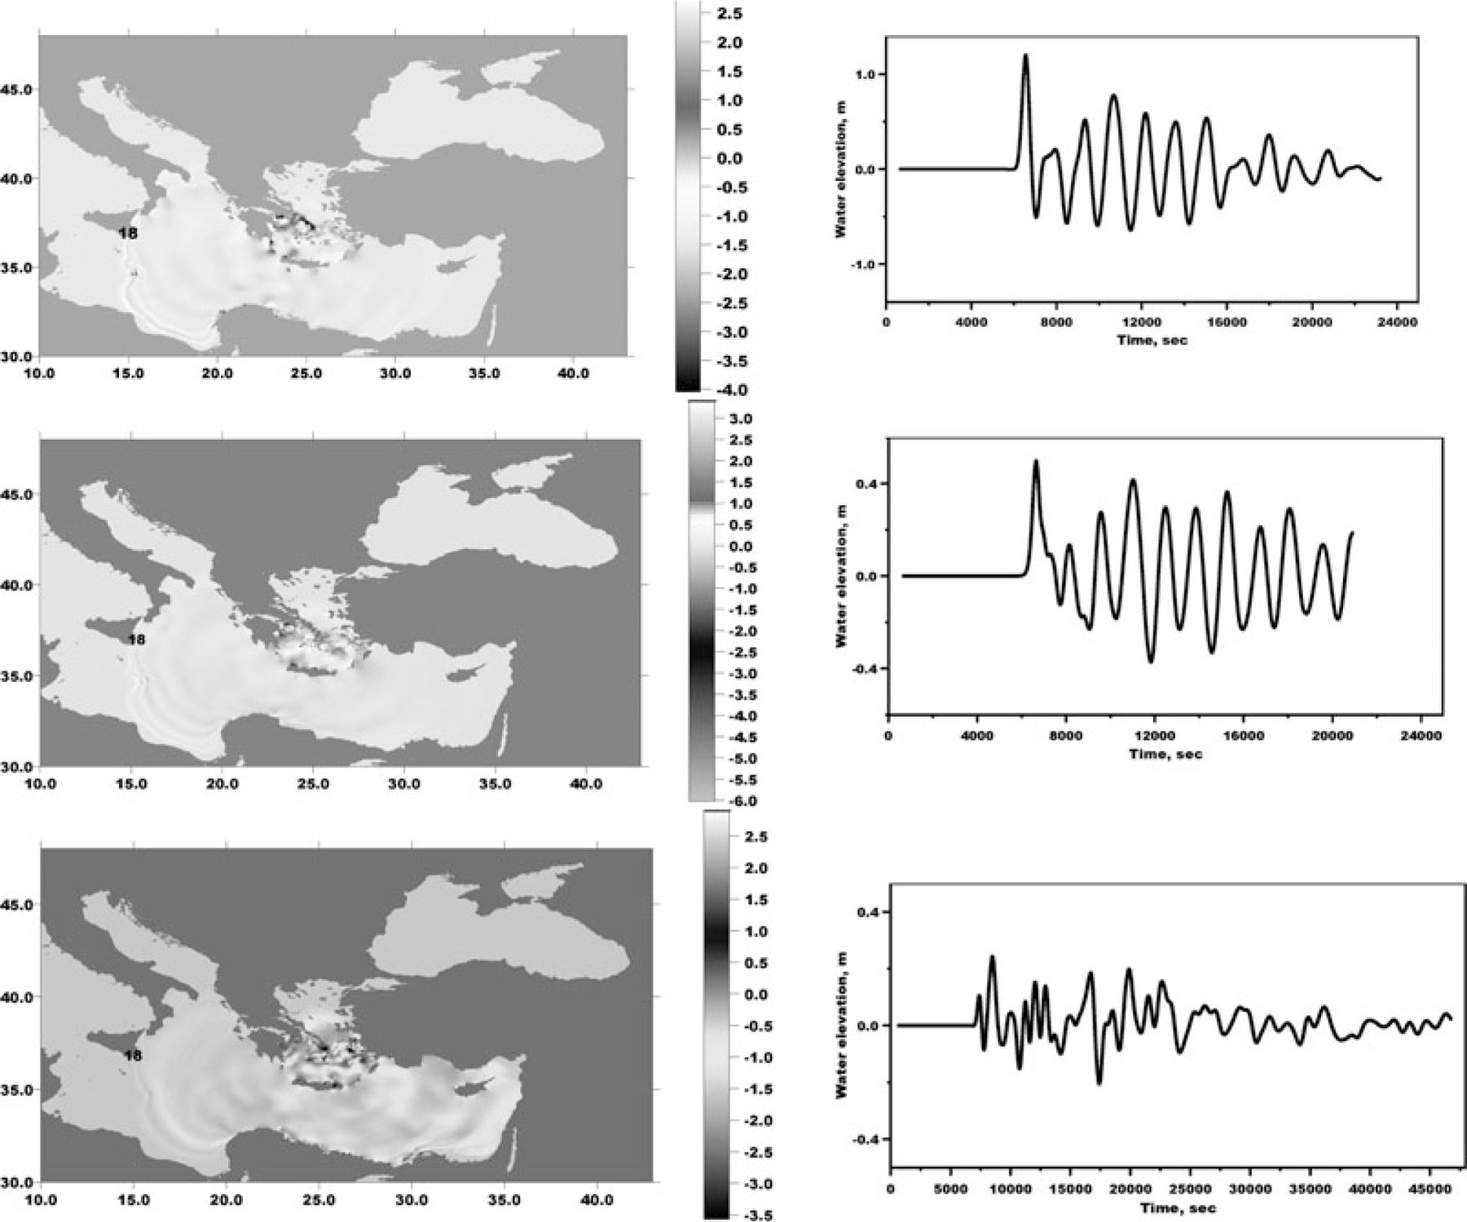
Figure 5 Snapshots of simulated tsunami wave about 1 hr 40 min after its generation (left-hand panel) produced by ...
Notes:
Figure 5 Snapshots of simulated tsunami wave about 1 hr 40 min after its generation (left-hand panel) produced by thick (∼55 m) pyroclastic flow entering the sea from the south of Thera with three characteristic directions measured from north counter-clockwise. The scales are in metres. Wave profiles from synthetic tide-gauge record are shown at the right-hand site.
Unless provided in the caption above, the following copyright applies to the content of this slide: ©2011 The Authors Geophysical Journal International © 2011 RAS

Slide 9
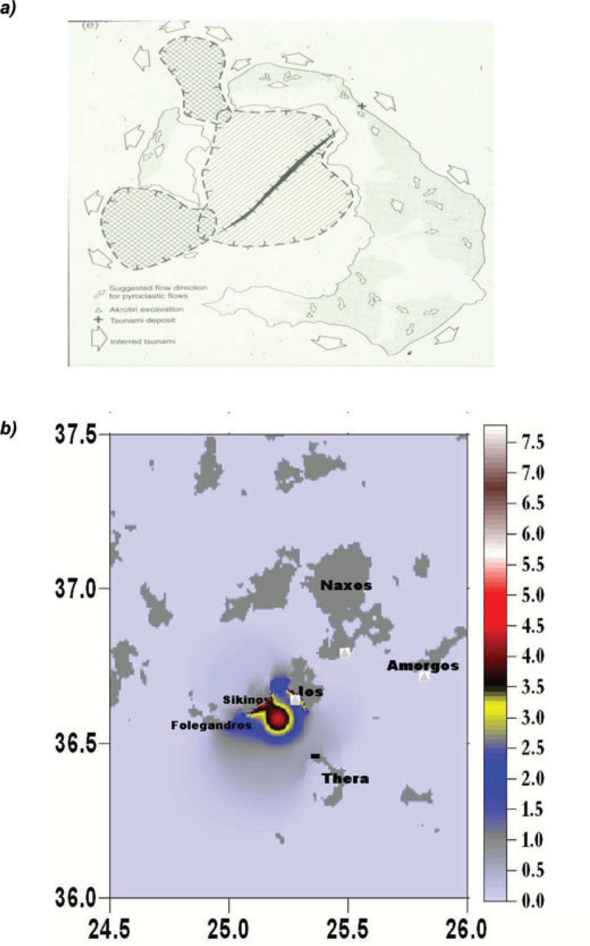
Figure 6 Directions of pyroclastic flows and of inferred tsunamis (after McCoy et al., 2000) (a). Maximum free surface ...
Notes:
Figure 6 Directions of pyroclastic flows and of inferred tsunamis (after McCoy et al., 2000) (a). Maximum free surface elevation (m) at all times obtained around Cyclades for the case of tsunami produced by thin (∼ 1 m) pyroclastic flow from the north side of Thera (b). The location of the flow, the direction of which was towards NW, is marked on Thera by symbol.
Unless provided in the caption above, the following copyright applies to the content of this slide: ©2011 The Authors Geophysical Journal International © 2011 RAS

Slide 10
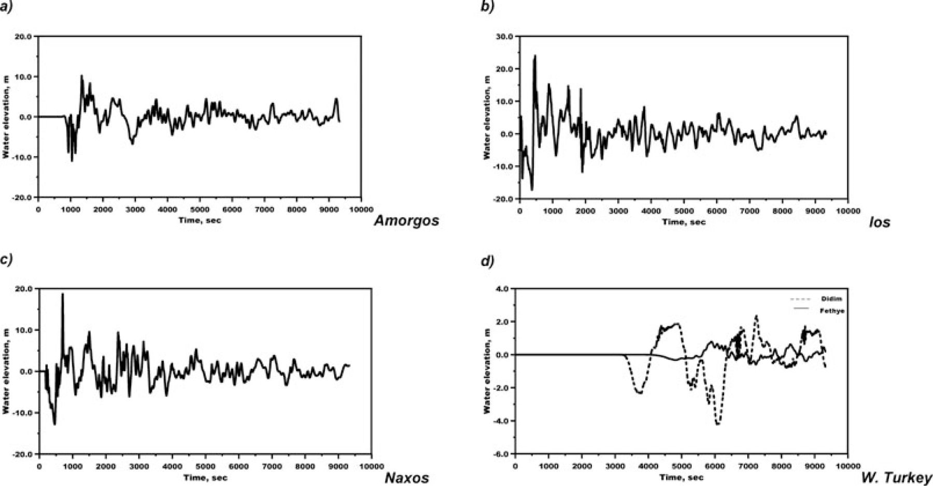
Figure 7 Tsunami wave profiles in the near-field domain in three islands of Cyclades to the north of Thera, and in two ...
Notes:
Figure 7 Tsunami wave profiles in the near-field domain in three islands of Cyclades to the north of Thera, and in two remote locations in SW Turkey where tsunami sediment deposits have been described. The wave was produced by caldera collapse process with total volume of 19 km3 of the material involved.
Unless provided in the caption above, the following copyright applies to the content of this slide: ©2011 The Authors Geophysical Journal International © 2011 RAS

Slide 11
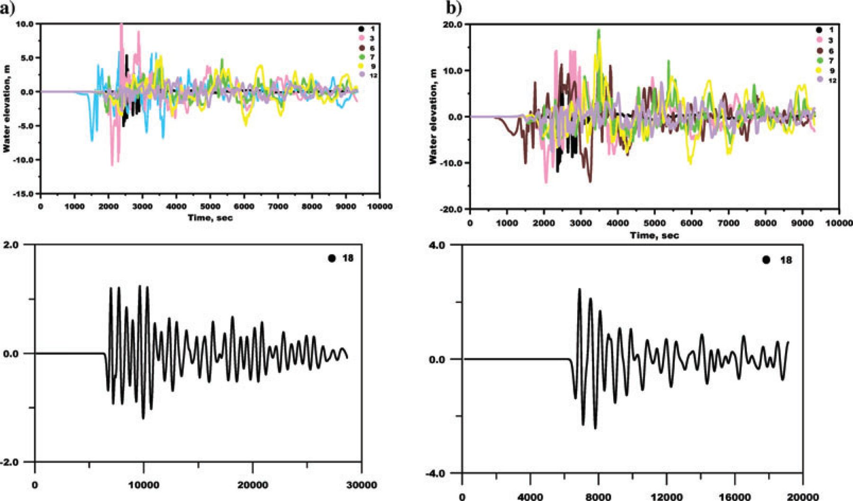
Figure 8 Wave profiles along north Crete (upper panels) and Sicily (lower panels) of tsunami produced by caldera ...
Notes:
Figure 8 Wave profiles along north Crete (upper panels) and Sicily (lower panels) of tsunami produced by caldera collapse process with total volume of the material involved of 19 km3 (a) and of 34 km3 (b). Locations of synthetic tide-gauges are the same as in Figures 1 and 4.
Unless provided in the caption above, the following copyright applies to the content of this slide: ©2011 The Authors Geophysical Journal International © 2011 RAS

