Slide 1
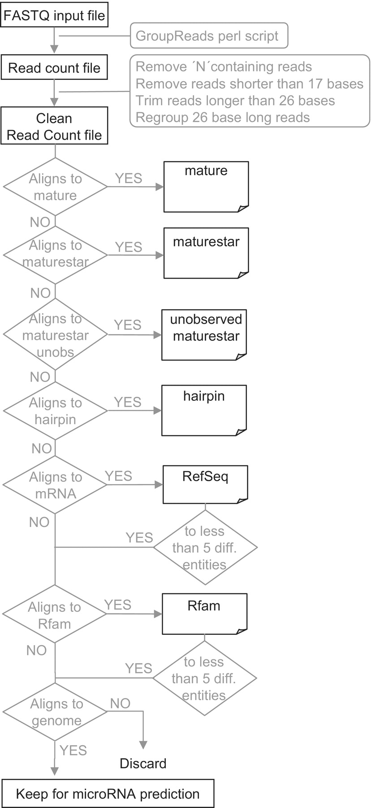
Figure 1. General workflow of miRanalyzer. The fastq file is transformed into a read count file, which is filtered to ...
Notes:
Figure 1. General workflow of miRanalyzer. The fastq file is transformed into a read count file, which is filtered to keep only sequences from 17 to 26 bases. These reads are successively mapped to several databases in order to identify known microRNAs, discard messenger RNA contaminations and select sequences for the microRNA prediction step.
Unless provided in the caption above, the following copyright applies to the content of this slide: © The Author(s) 2011. Published by Oxford University Press.This is an Open Access article distributed under the terms of the Creative Commons Attribution Non-Commercial License (http://creativecommons.org/licenses/by-nc/2.5), which permits unrestricted non-commercial use, distribution, and reproduction in any medium, provided the original work is properly cited.

Slide 2
Figure 2. Selection of longest alignments performed by miRanalyzer. The example shows the best alignments for two reads ...
Notes:
Figure 2. Selection of longest alignments performed by miRanalyzer. The example shows the best alignments for two reads obtained with Bowtie, and the one selected (light grey square). The 17 nt seed is outlined and the longest alignment maintaining the number of observed mismatches within the seed is highlighted in red. Note that for Read2, the chosen alignment is not the one that contains the least total number of mismatches.
Unless provided in the caption above, the following copyright applies to the content of this slide: © The Author(s) 2011. Published by Oxford University Press.This is an Open Access article distributed under the terms of the Creative Commons Attribution Non-Commercial License (http://creativecommons.org/licenses/by-nc/2.5), which permits unrestricted non-commercial use, distribution, and reproduction in any medium, provided the original work is properly cited.

