Slide 1
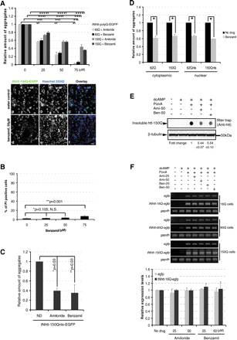
Figure 1. Ami and Ben reduce Nhtt-polyQ aggregation in a dose-dependent manner via a post-transcriptional mechanism. ...
Notes:
Figure 1. Ami and Ben reduce Nhtt-polyQ aggregation in a dose-dependent manner via a post-transcriptional mechanism. (A) Ami or Ben reduces Nhtt-polyQ aggregation in a dose-dependent manner. The reduction of Nhtt-150Q-EGFP aggregation by Ben was shown visually in the lower panel (d–f). n = 5, * and **P = 0.019; *** and ****P < 0.0001, comparison between treated and non-treated. Scale bar = 80 µm. (B) Addition of Ben up to 50 µm does not cause significant toxicity to Neuro2a cells. Neuro2a cells that were treated with various concentrations of Ben for 24 h as indicated were subsequently stained with 5 µg/ml proprium iodide (PI). The number of PI-positive cells were quantified with ArrayScan. n = 3, *P = 0.105; **P = 0.001. N.S., not significant. (C) Ami or Ben at 50 µm reduces Nhtt-150Qnls-EGFP nuclear aggregates, quantified by ArrayScan. n = 3, * and **P = 0.03. ND, no drug. (D) Ben reduces the amount of aggregates formed by Nhtt-polyQ (+/− nls) in a transient expression system. The number of EGFP-positive aggregates was counted 12 h after transfection with ArrayScan. n = 3, *P< 0.0001. nls, nuclear localization signal. (E) A FTA illustrates the reduction of aggregates by Ami and Ben. n = 4, fold change shows mean ± SEM. (F) Semi-quantitative PCR shows virtually unaltered expression of Nhtt-polyQ-EGFP in cells that were treated with various concentrations of Ami and Ben. Expression levels of the transgene were amplified with primers targeting either EGFP or Nhtt-polyQ-EGFP. Gapdh shows equal cDNA input. Quantification of the PCR results for that of Nhtt-16Q-EGFP is shown in the lower panel. n = 3.
Unless provided in the caption above, the following copyright applies to the content of this slide: © The Author 2008. Published by Oxford University Press. All rights reserved. For Permissions, please email: journals.permissions@oxfordjournals.org

Slide 2
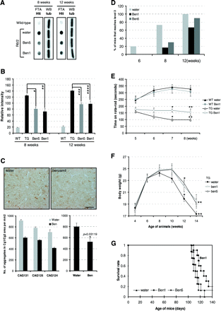
Figure 2. Ben ameliorates brain pathology, motor deficits and increases life span of R6/2 mice. (A and B) Ben reduces ...
Notes:
Figure 2. Ben ameliorates brain pathology, motor deficits and increases life span of R6/2 mice. (A and B) Ben reduces the amount of SDS-resistant aggregates in the brain of R6/2 mice. (A) Shows the SDS insoluble aggregates on a cellulose acetate membrane (β-tubulin shows the equal amount of protein in each sample) and (B) shows the quantification results from the average of three animals in each treatment. *P = 0.009; **P = 0.004; *** and ****P = 0.007. (C) Ben reduces the number of visible, ubiquitin-positive aggregates in the cerebral cortex (Cg1/Cg2 area) of R6/2 mice. Upper panels show the immunohistochemical micrographs and lower panels show the quantification of visible aggregates in the Cg1/Cg2 area of the cerebral cortex of R6/2 at 8 weeks of age carrying different length of polyQ repeats. The number of aggregates was normalized to the area of each micrograph that corresponded to 0.325 mm2 of the brain section. Scale bar = 0.02 mm, *P = 0.03119. (D) Clasping score. Ben treatment markedly reduces the number of mice reaching clasping score level 3 at both 8 weeks and 12 weeks. Tg-water, n = 11; tg-Ben1, n = 13, tg-Ben5, n = 10. (E) Rota-rod test. Ben of 1 mg/kg alleviates the motor deficit of R6/2 mice by decreasing their latency to fall on rotating rod at and after 7 weeks of age. n = 5 in each group. *P = 0.0015 and **P = 0.042. (F) Ben treatment increases body weight of R6/2 mice. Tg-water, n = 11; tg-Ben1, n = 13, tg-Ben5, n = 10. *P = 0.034 and **P = 0.044. (G) Ben significantly extends the lifespan of R6/2 mice. Survival data from each treatment was analyzed by Kaplan–Meier method followed by log-rank testing. Tg-water, n = 9; tg-Ben1, n = 11 and tg-Ben5, n = 10.
Unless provided in the caption above, the following copyright applies to the content of this slide: © The Author 2008. Published by Oxford University Press. All rights reserved. For Permissions, please email: journals.permissions@oxfordjournals.org

Slide 3
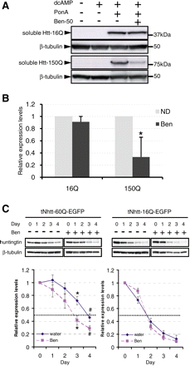
Figure 3. Ben induces a polyQ length-dependent degradation of soluble mutant huntingtin. (A and B) Ben treatment leads ...
Notes:
Figure 3. Ben induces a polyQ length-dependent degradation of soluble mutant huntingtin. (A and B) Ben treatment leads to a decreased expression of soluble mutant htt-polyQ at the protein level. There was a 40–50% decrease of soluble Nhtt-150Q expression 1 day after treatment with Ben at 50 µm, while that of Nhtt-16Q remained virtually unchanged. n = 3, *P < 0.001. (C) Ben enhances the degradation of soluble mutant Nhtt-60Q-EGFP. Neuro2a cells were induced to express Nhtt-60Q-EGFP for 1 day, and the inducer was removed and Ben was added. The addition of Ben enhanced the degradation of soluble Nhtt-60Q-EGFP while that of Nhtt-16Q-EGFP was not significantly altered. The absolute amount of 60Q protein was significantly reduced 3 and 4 days after the addition of Ben as revealed by the anti-htt antibodies. n = 3, *P = 0.037 and #P = 0.039.
Unless provided in the caption above, the following copyright applies to the content of this slide: © The Author 2008. Published by Oxford University Press. All rights reserved. For Permissions, please email: journals.permissions@oxfordjournals.org

Slide 4
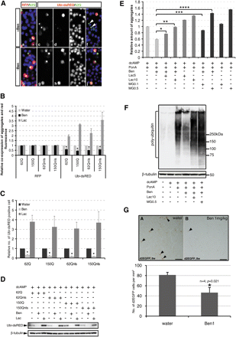
Figure 4. Ben alleviates the inhibition of UPS in vivo. (A–D) Ben attenuates the blockade of UPS caused by mutant ...
Notes:
Figure 4. Ben alleviates the inhibition of UPS in vivo. (A–D) Ben attenuates the blockade of UPS caused by mutant Nhtt-polyQ. Fluorescence micrographs showing the effect of Ben on the co-expression of RFP or ubi-dsRED and Nhtt-62Q aggregates (A). The addition of Ben reduced the accumulation of ubi-dsRED in cells that contain aggregates (Ac–f, arrowheads and B, Ubi-dsRED) while that of RFP (Aa and B, RFP) was virtually unaltered. ArrayScan counting also revealed that the number of ubi-dsRED-positive cells (C) was reduced in the presence of Ben. Furthermore, the reduced accumulation of ubi-dsRED was shown by a western blot that analyzed with anti-RFP antibodies (D). Lactacystin (10 µm) was used as a positive control for the inhibition of UPS. n = 3, *P < 0.0001 compared with the water control. (E) Blocking the UPS markedly abolishes the effect of Ben. On top of ponasterone A induction of Nhtt-150Q, Neuro2a cells were incubated with Ben and proteasome inhibitor lactacystin or MG-132, at two different concentrations (in μm). Lactacystin or MG-132 markedly abolished the effect of Ben suggesting that the UPS was the degradation system primarily employed by Ben for Nhtt-polyQ clearance. n = 3, *P = 0.006; **, *** and ****P < 0.0001. (F) Western blotting analysis with anti-ubiquitin antibodies also revealed that proteasome inhibition was enough to abolish the effect of Ben. Ben reduced the amount of ubiquitinated proteins in the presence of Nhtt-150Q, while the co-incubation with proteasome inhibitors abolished this effect. Beta-tubulin shows equal protein loading. n = 3. (G) Ben increases brain UPS activity. Feeding d2EGFP mice with 1 mg/kg Ben for 4 weeks reduced the number of d2EGFP cells in the somatosensory cortex (A and B; arrowheads, d2EGFP cells; scale bar = 50 µm). Lower panel shows the quantification (number per mm2). n = 4; P = 0.021.
Unless provided in the caption above, the following copyright applies to the content of this slide: © The Author 2008. Published by Oxford University Press. All rights reserved. For Permissions, please email: journals.permissions@oxfordjournals.org

Slide 5
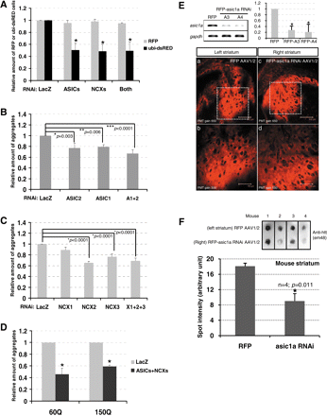
Figure 5. Silencing the expression of asic1a reduces Nhtt-polyQ aggregation in vivo. (A) Silencing the expression of ...
Notes:
Figure 5. Silencing the expression of asic1a reduces Nhtt-polyQ aggregation in vivo. (A) Silencing the expression of asics, ncxs or both leads to a significant increase of UPS activity. Neuro2a cells were first transfected with the corresponding shRNAs for 2 days to allow gene silencing. Seventy nanogram of RFP or ubi-dsRED construct was subsequently transfected for the determination of UPS activity. The number of RFP or ubi-dsRED cells was quantified by ArrayScan. The number of RFP or ubi-dsRED cells in the LacZ RNAi-transfected condition was set at 1 and the others were compared to this control accordingly. While there was no significant change of the number of RFP cells, that of ubi-dsRED was markedly decreased when the expression of asics and/or ncxs was blocked. n = 3, *P < 0.0001 compared with the LacZ control. (B) Silencing the expression of asic1a or asic2a reduces the aggregation of Nhtt-150Q. n = 9, *P = 0.03; **P = 0.006 and ***P < 0.0001. (C) Silencing the expression of ncx2 or ncx3 reduces the aggregation of Nhtt-150Q. n = 9, *P < 0.0001. (D) Silencing the expression of both the asics and ncxs reduces the aggregation of Nhtt-60Q and Nhtt-150Q. n = 5, *P < 0.0001. (E) The knockdown efficiency of asic1a miR RNAi (upper) and the infection efficiency of AAV1/2 in the mouse striatum (lower). (b and d) Are the magnified images of (a and c), respectively. RFP and RFP-asic1a RNAi show comparable infection efficiency both intensity and anatomy-wise. Scale bars in (a and c) = 300 µm and (b and d) = 150 µm; PMT represents photo multiplier tubes. (F) Suppressing the expression of asic1a reduces htt-polyQ aggregation in R6/2 mice. AAV1/2 encoding RFP or RFP-asic1a RNAi was stereostaxically injected into the striatum of R6/2 mice at 4 weeks of age and the striatal area was collected for filter trap analysis at 8 weeks of age. Inhibition of asic1a expression reduces htt-polyQ aggregation as revealed by anti-htt antibodies. Quantifying the spots intensity on filter trap shows a 60% of reduction of polyQ aggregation, normalized to β-tubulin. n = 4, P = 0.0048.
Unless provided in the caption above, the following copyright applies to the content of this slide: © The Author 2008. Published by Oxford University Press. All rights reserved. For Permissions, please email: journals.permissions@oxfordjournals.org

