Slide 1
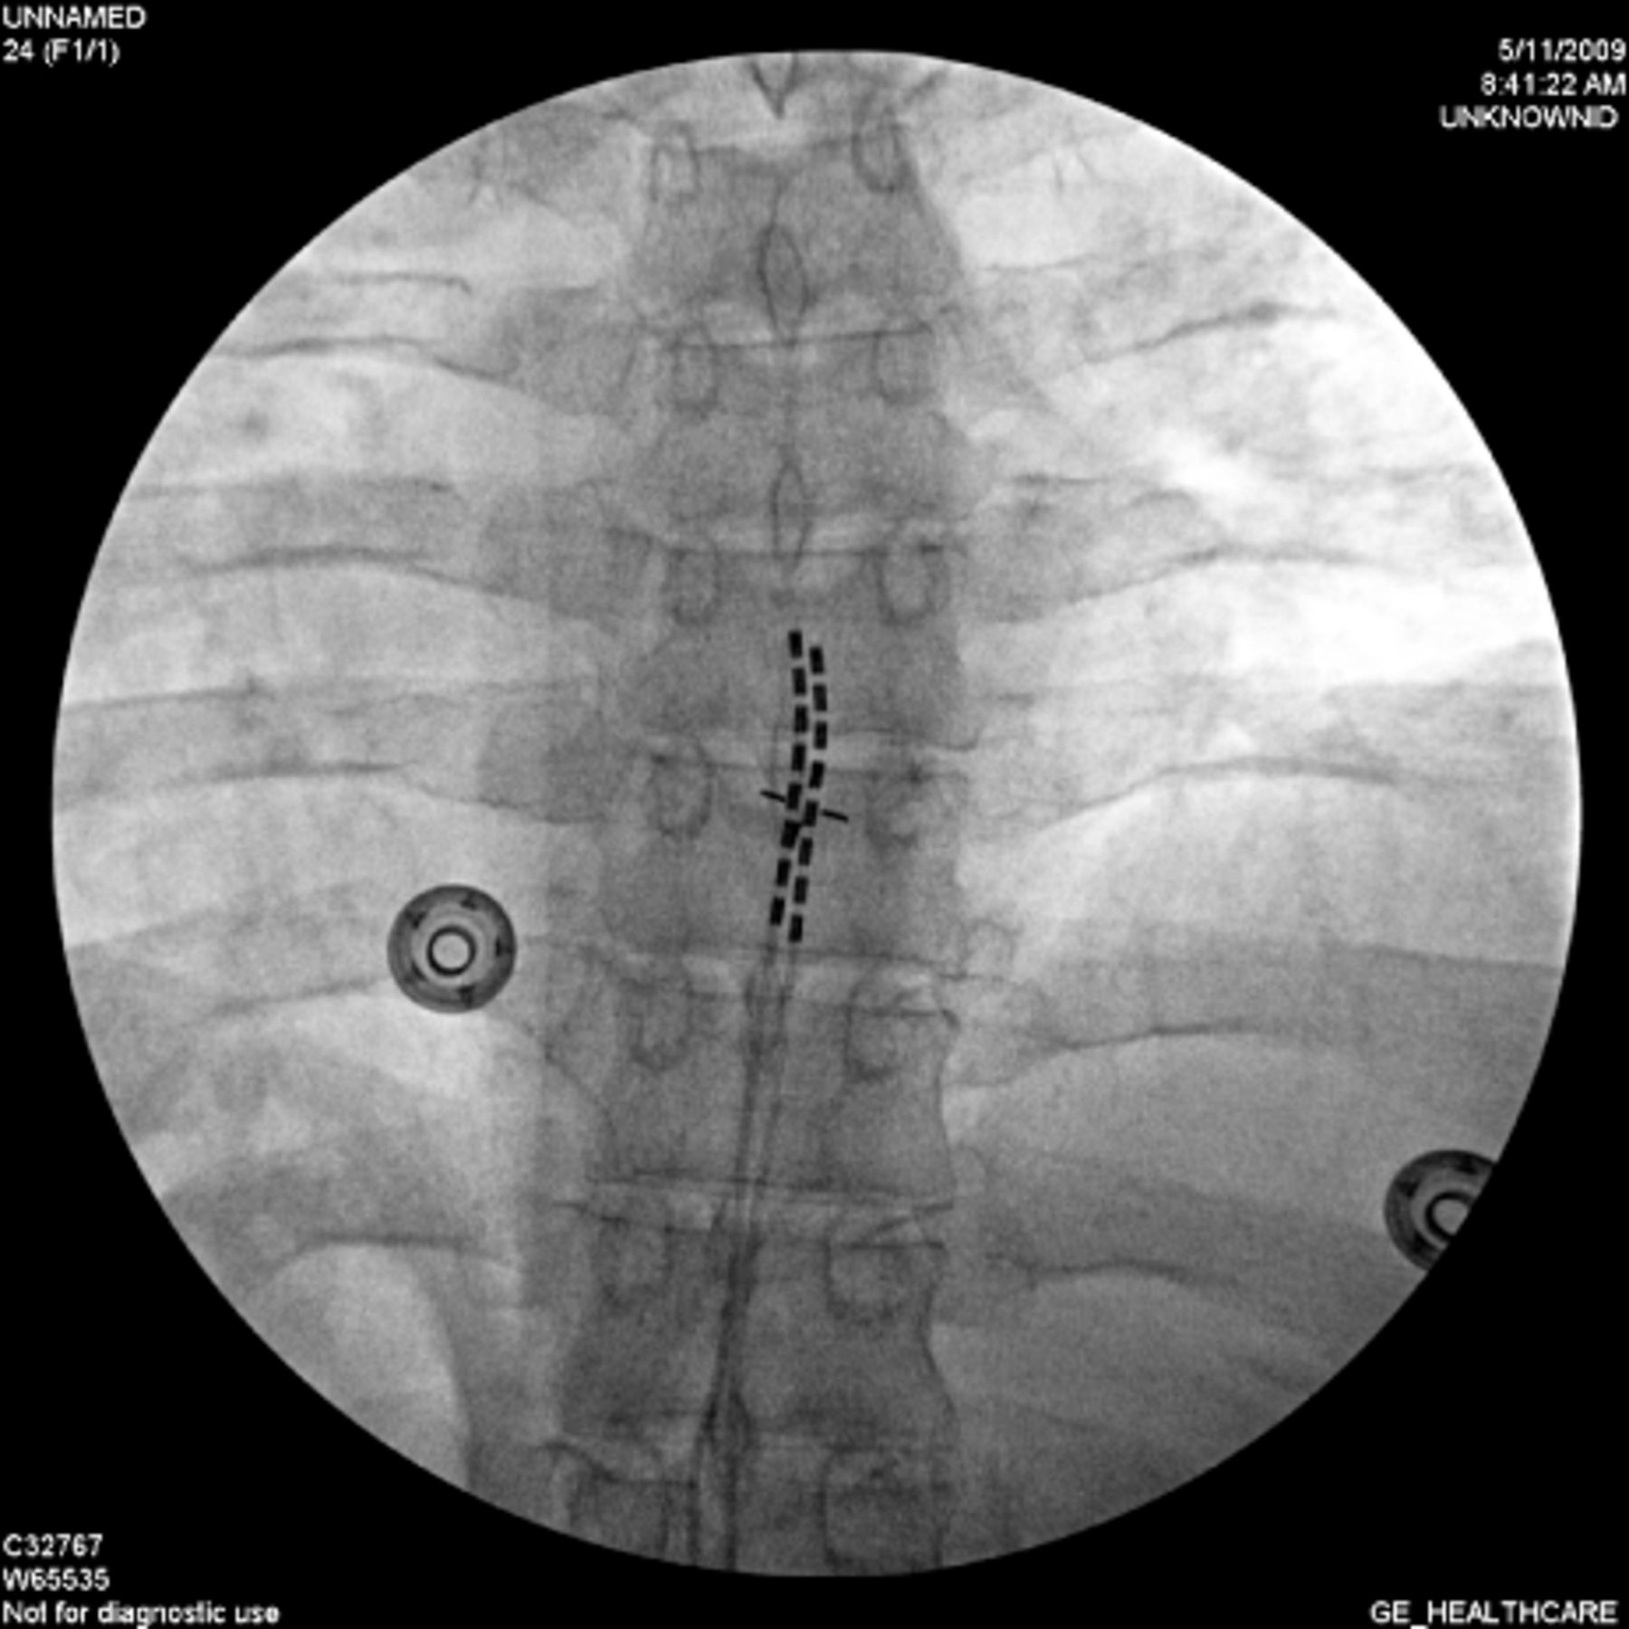
Figure 1 Antero-posterior fluoroscopic view of the two leads positioned in the epidural space. Shown is the most ...
Notes:
Figure 1 Antero-posterior fluoroscopic view of the two leads positioned in the epidural space. Shown is the most frequent position of the tip of the leads: at the T5 vertebral body and midline.
Unless provided in the caption above, the following copyright applies to the content of this slide: Wiley Periodicals, Inc.

Slide 2
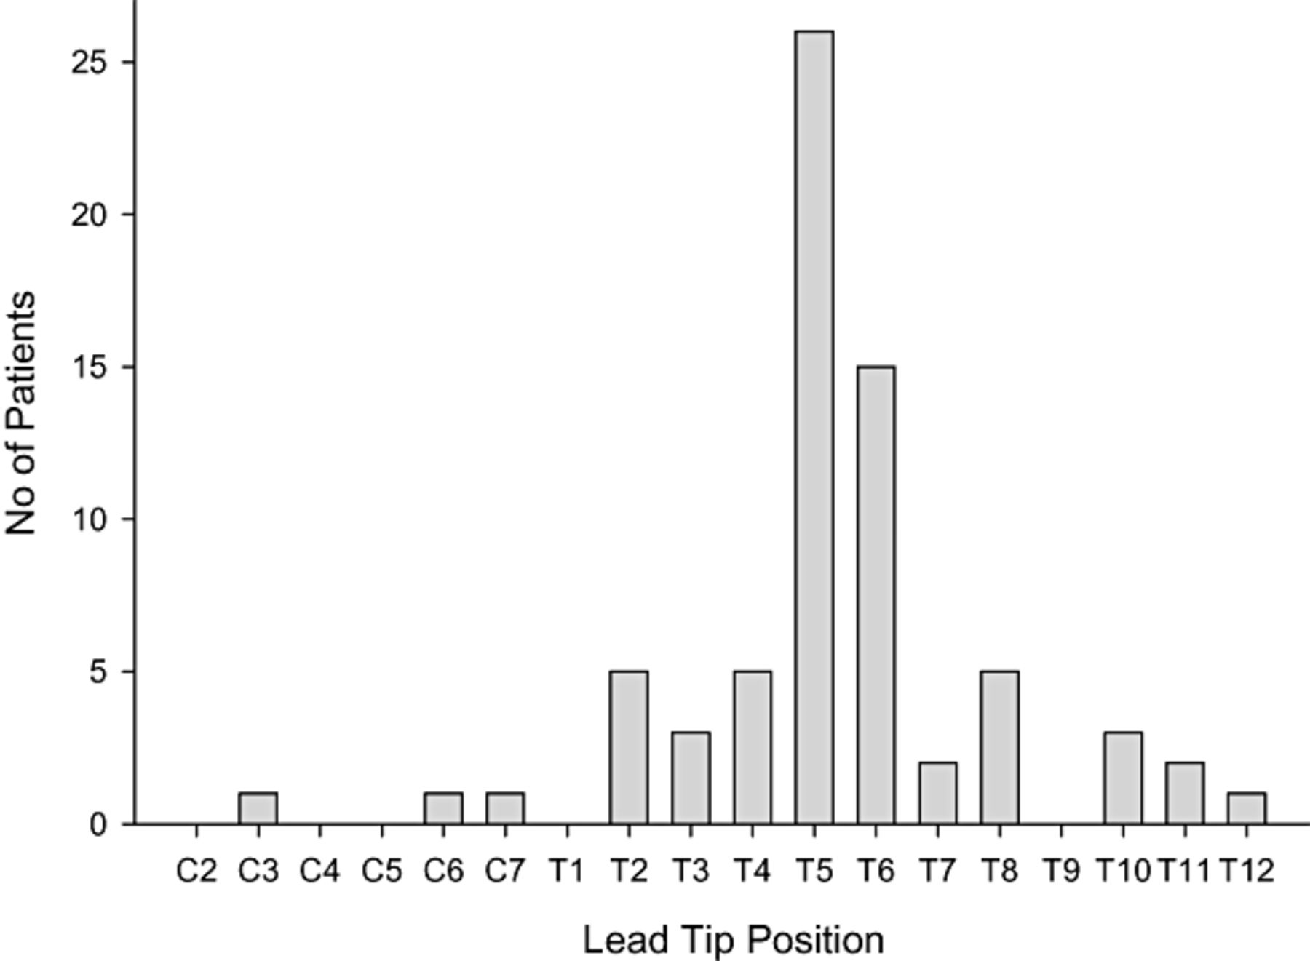
Figure 2 The graph illustrates the distribution of the leads tip position in 70 cases properly reported in this ...
Notes:
Figure 2 The graph illustrates the distribution of the leads tip position in 70 cases properly reported in this survey. The most frequent positions of the tip of the leads inserted during the SCS trial where the optimal paresthesias to cover area of the patients pain was achieved were at T5 (26 patients) and T6 (15 patients) vertebral level.
Unless provided in the caption above, the following copyright applies to the content of this slide: Wiley Periodicals, Inc.

Slide 3
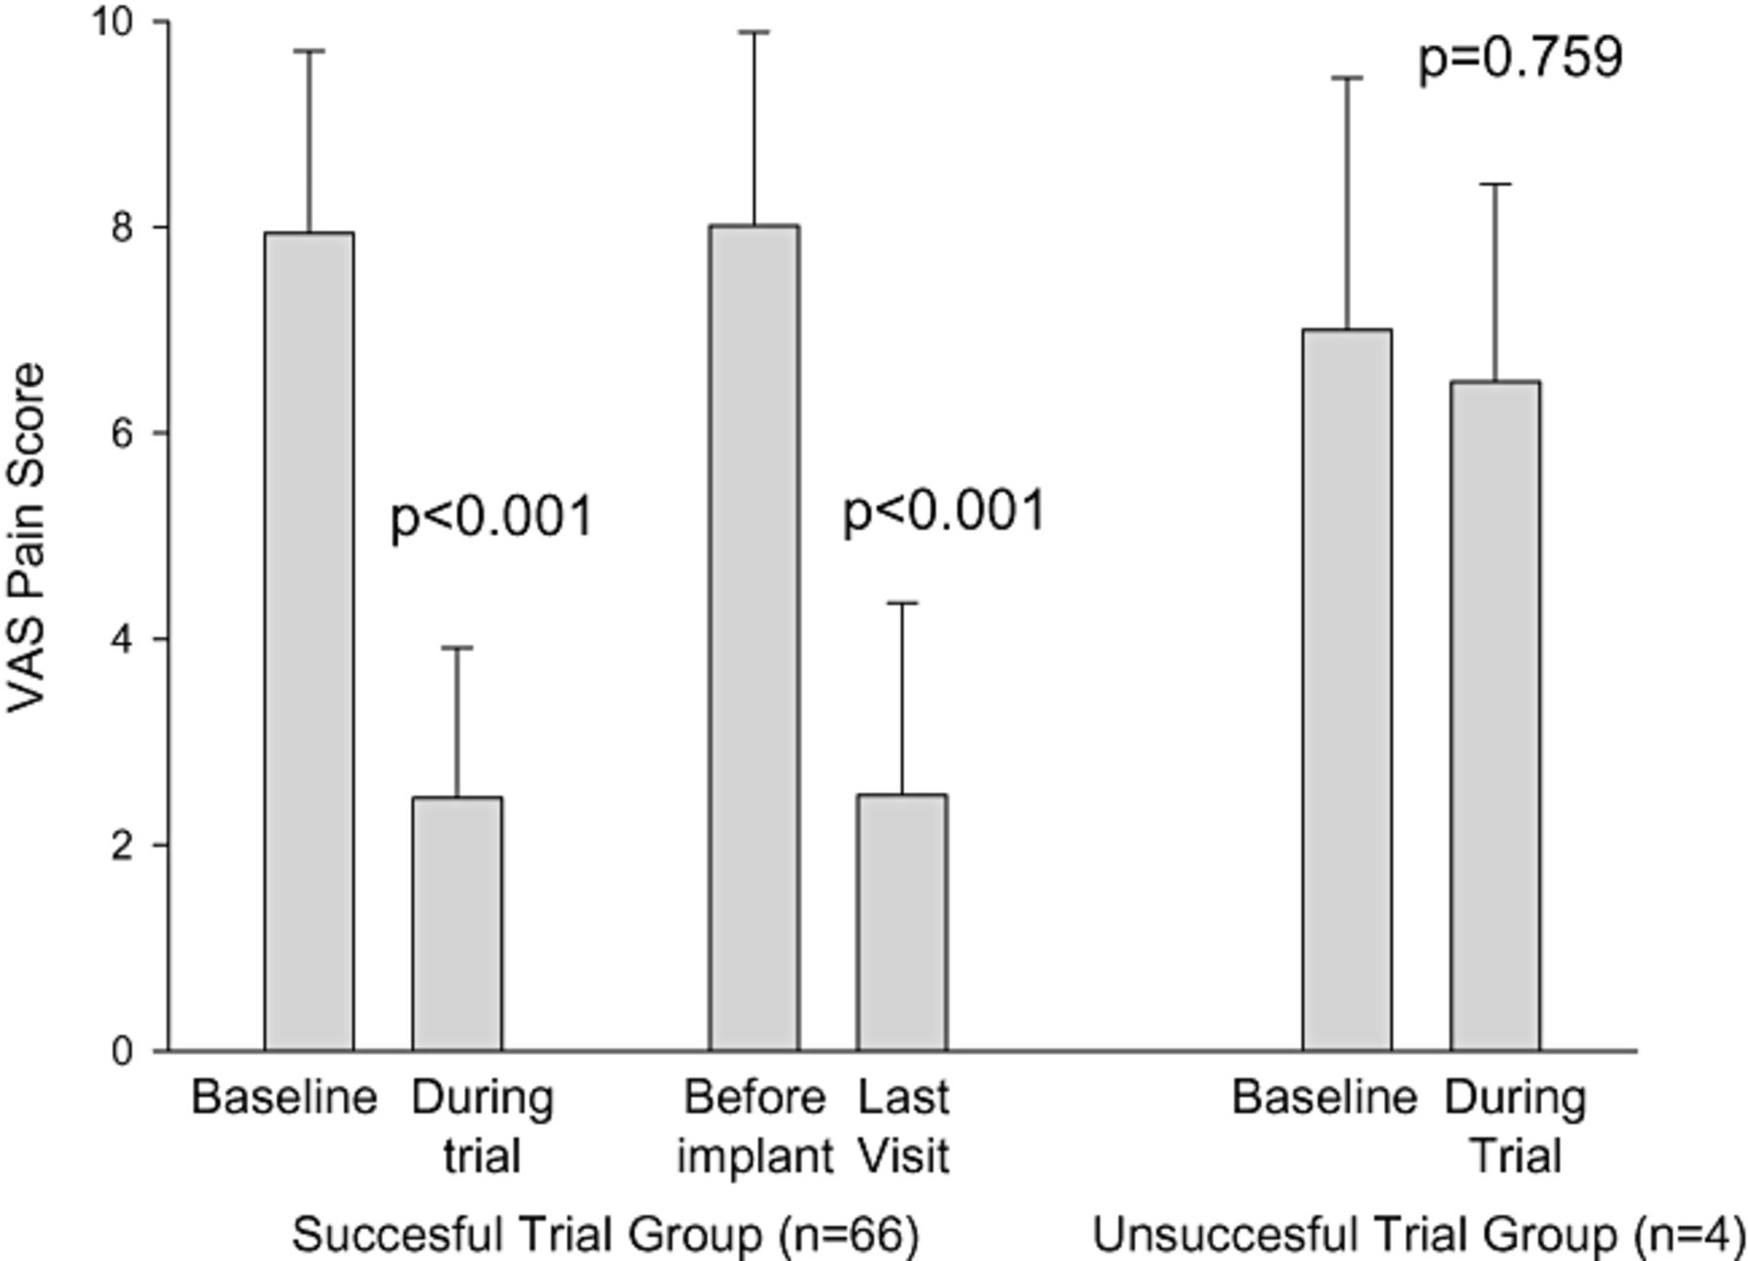
Figure 3 Improvement in pain scores during the trial and following the implantation of SCS for the visceral abdominal ...
Notes:
Figure 3 Improvement in pain scores during the trial and following the implantation of SCS for the visceral abdominal pain. The group on the left side of the graph (N = 66) are those patients who received more than 50% improvement in their VAS pain scores. Right is a group of the patients who had unsuccessful SCS trial (N = 4). The average pain score in the first group improved significantly (P < 0.001 during the trial and after the implantation), while the group of nonresponders did not have improvement in their VAS pain scores (P = 0.759).
Unless provided in the caption above, the following copyright applies to the content of this slide: Wiley Periodicals, Inc.

Slide 4
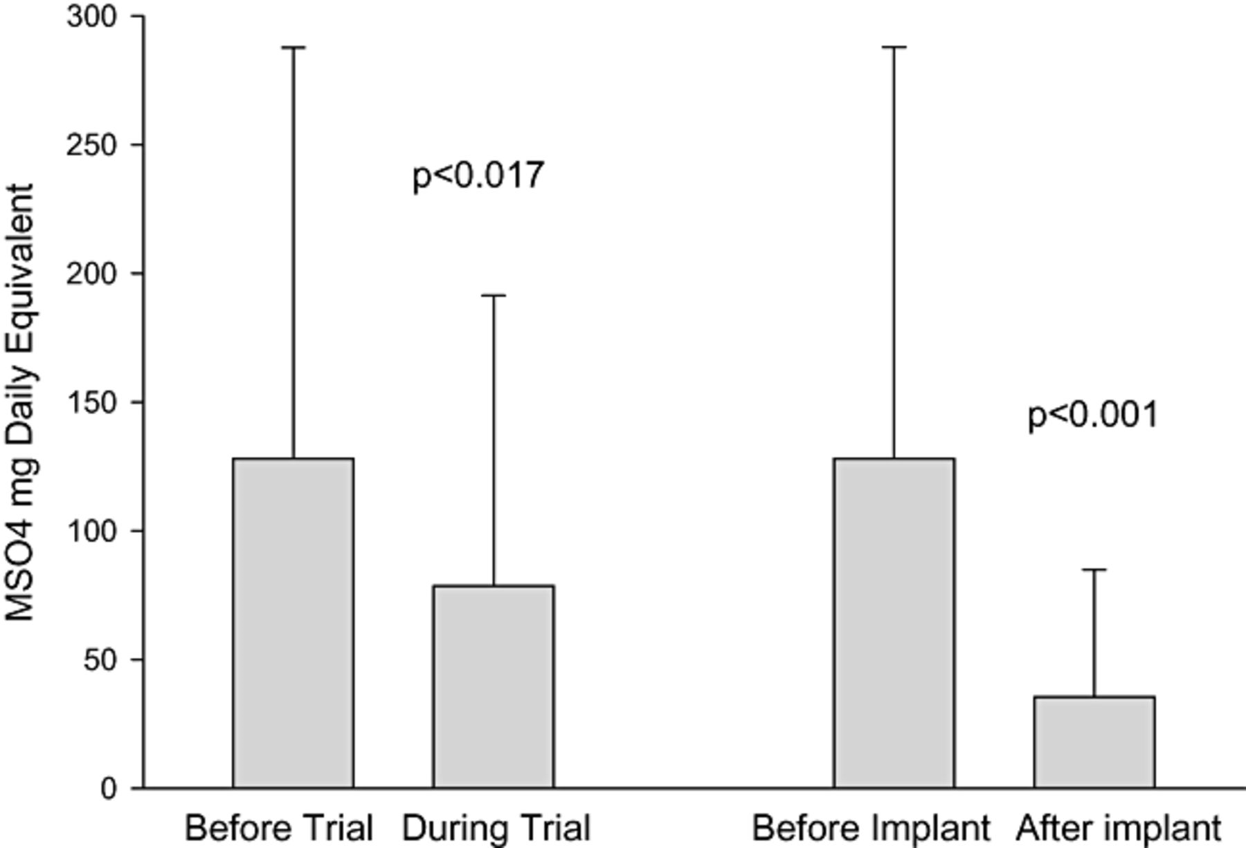
Figure 4 Decrease of the opioid use expressed in an average mg of MSO4 daily equivalent dose change in 66 patients ...
Notes:
Figure 4 Decrease of the opioid use expressed in an average mg of MSO4 daily equivalent dose change in 66 patients that had a successful trial of SCS.
Unless provided in the caption above, the following copyright applies to the content of this slide: Wiley Periodicals, Inc.

Slide 5
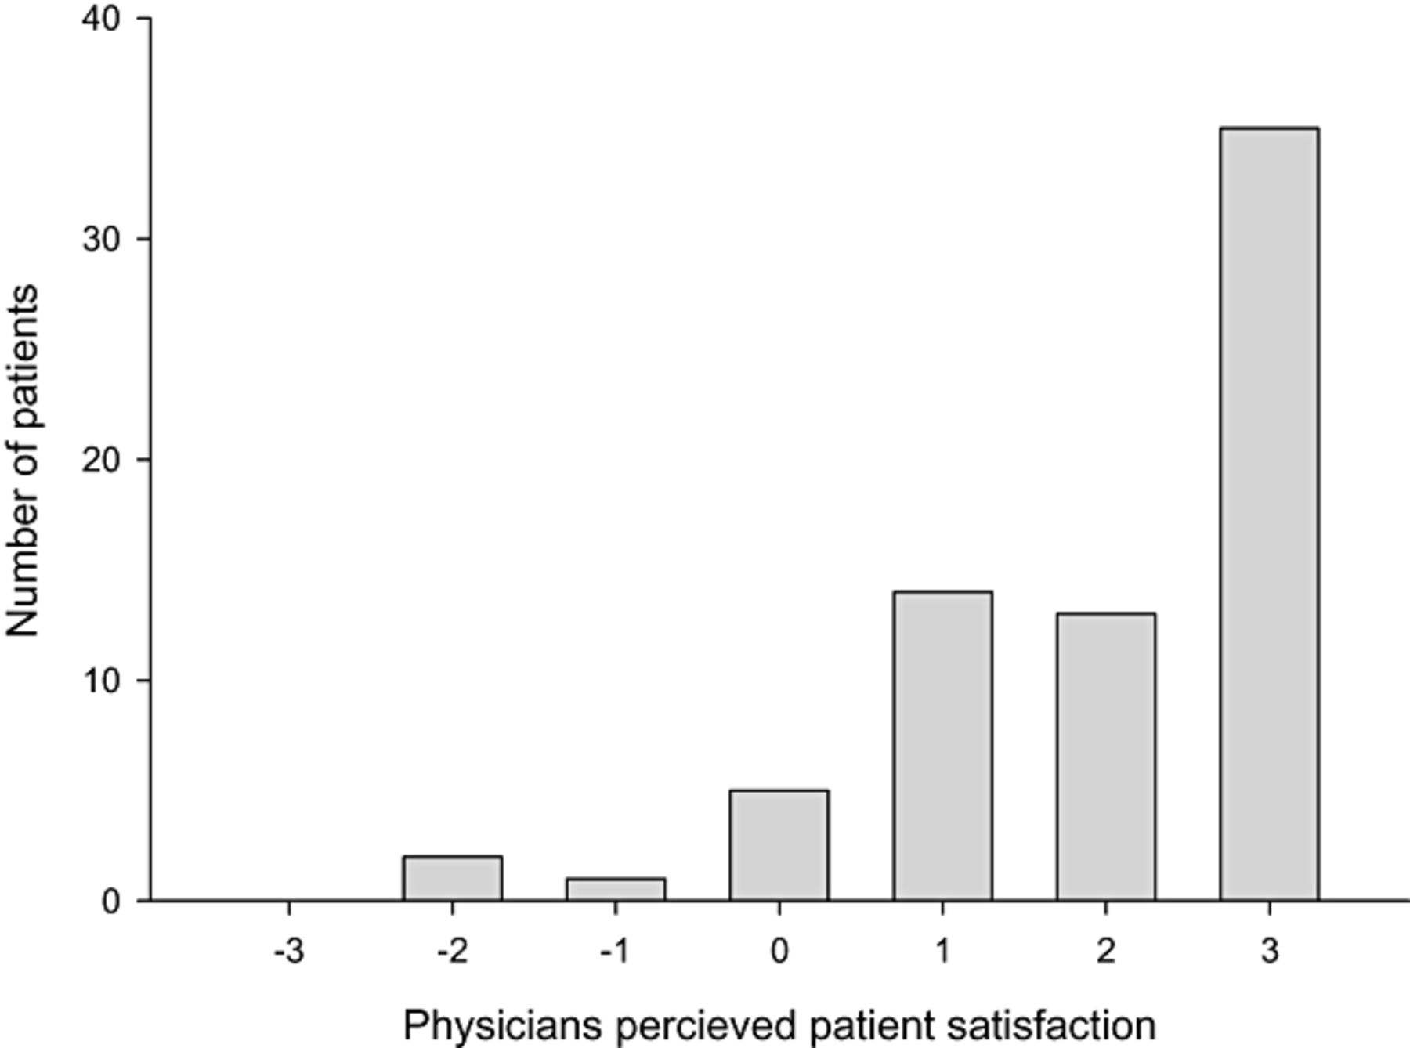
Figure 5 The graph illustrates overall physicians perception of the patients satisfaction with SCS treatment for the ...
Notes:
Figure 5 The graph illustrates overall physicians perception of the patients satisfaction with SCS treatment for the chronic visceral abdominal pain. The majority of the patients seemed to be considered very satisfied with the treatment.
Unless provided in the caption above, the following copyright applies to the content of this slide: Wiley Periodicals, Inc.

