Slide 1
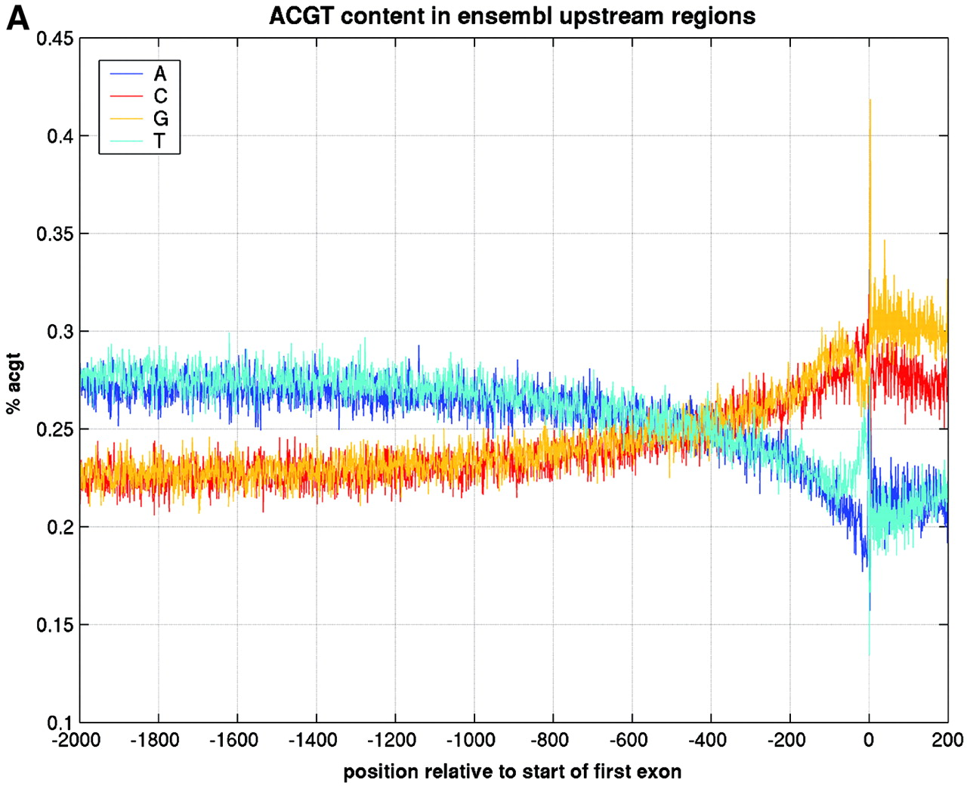
Figure 1. Representation of the genomic region 2000 bp upstream of Exon 1 annotation in Ensembl and 200 bp ...
Notes:
Figure 1. Representation of the genomic region 2000 bp upstream of Exon 1 annotation in Ensembl and 200 bp after the start of Exon 1, taken from 4000 randomly selected genes from the human genome (homo_sapiens_8_30a database at kaka.sanger.ac.uk). The relative position of 0 on the x ‐axis is the start of Exon 1. ( A ) Percentages of A, C, G and T at each position. ( B ) Number of instances of a SP1 binding site at each position.
Unless provided in the caption above, the following copyright applies to the content of this slide:

Slide 2
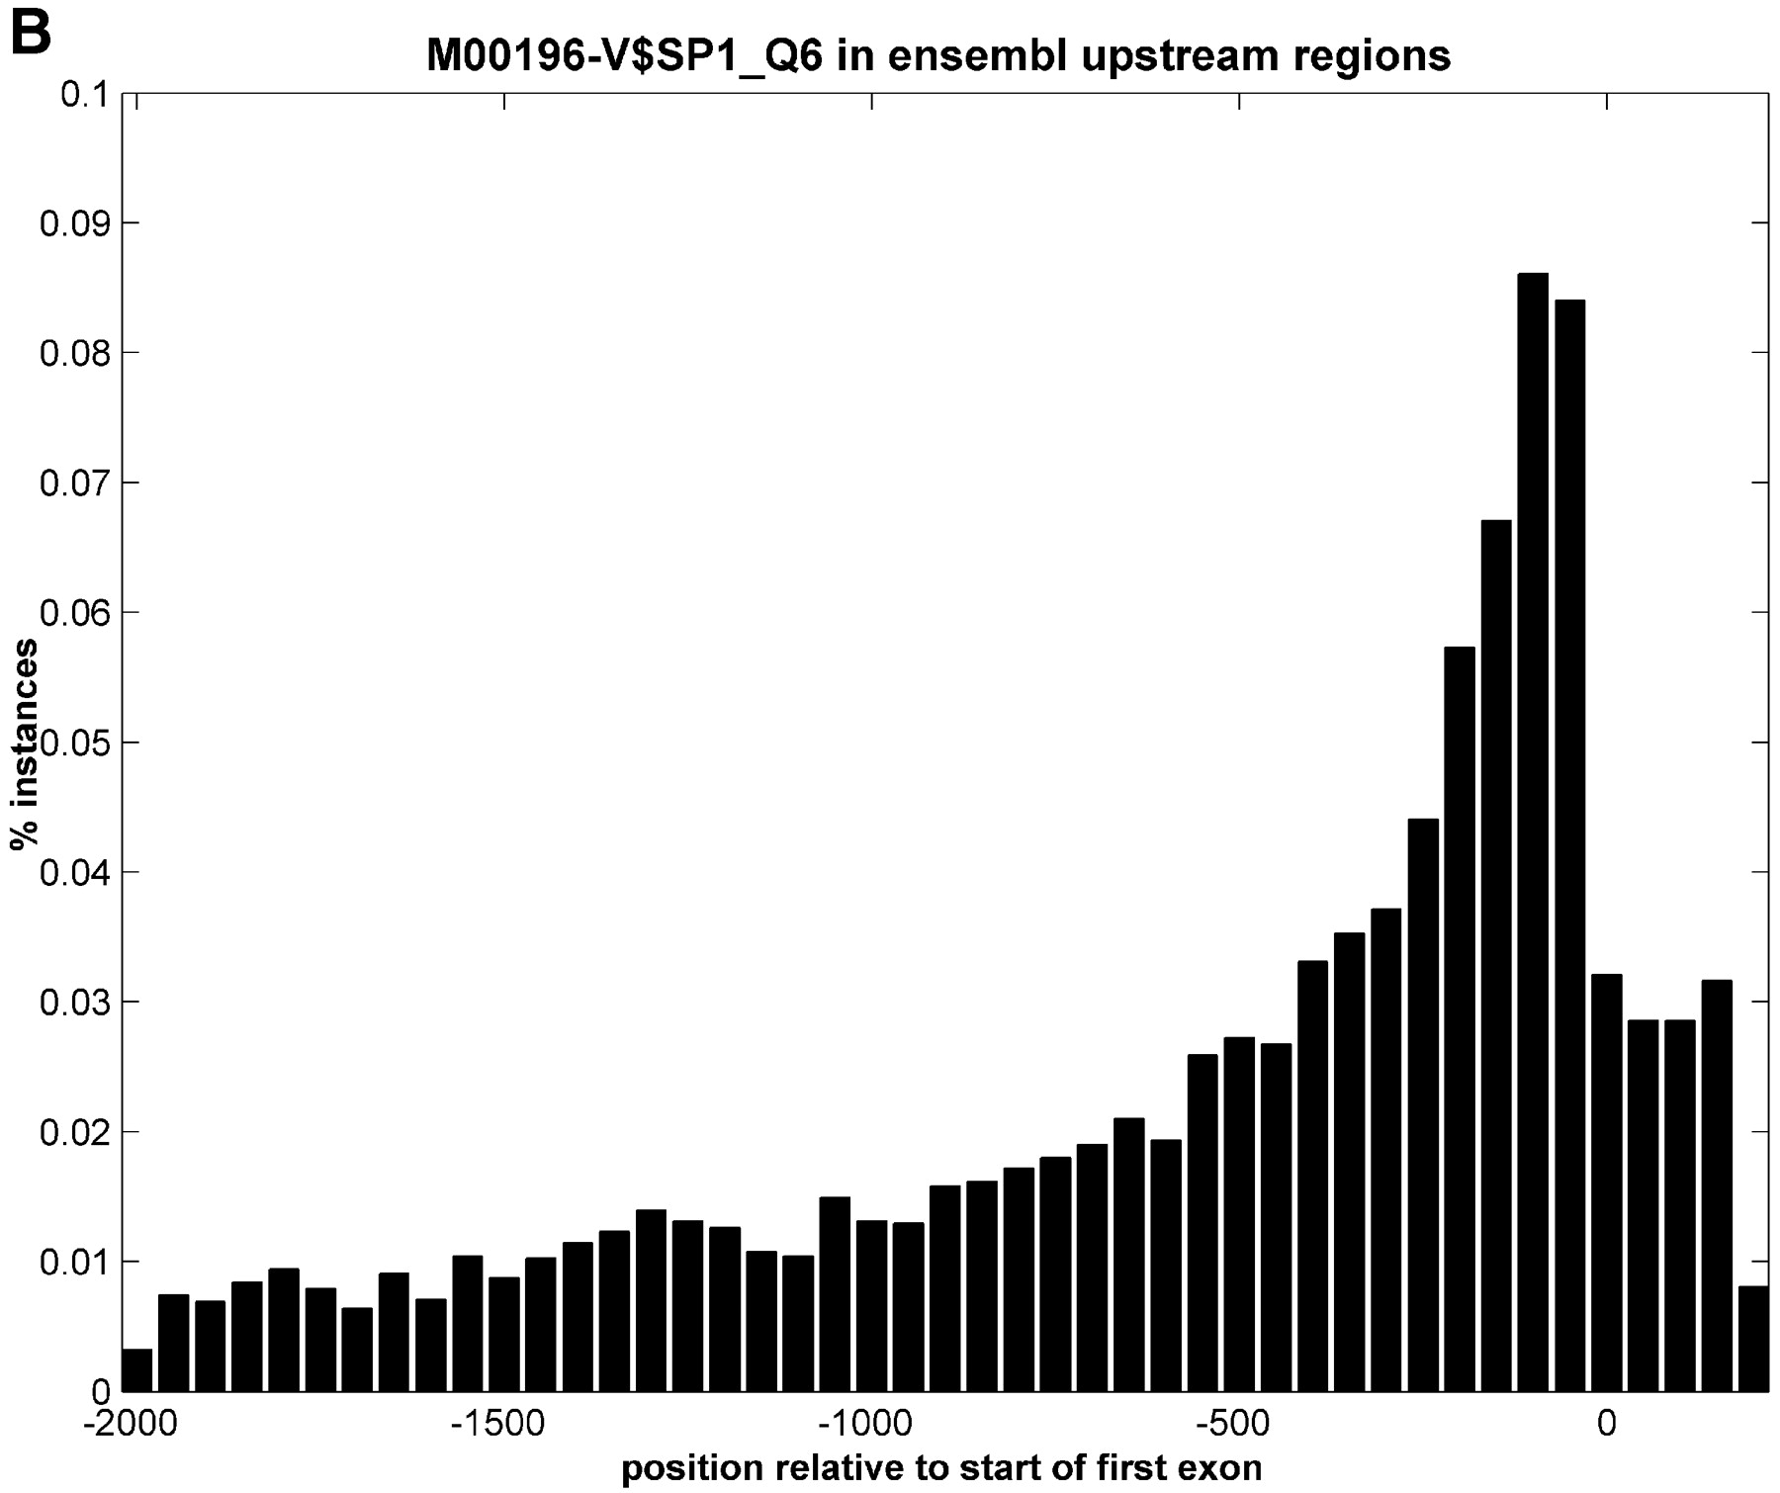
Figure 1. Representation of the genomic region 2000 bp upstream of Exon 1 annotation in Ensembl and 200 bp ...
Notes:
Figure 1. Representation of the genomic region 2000 bp upstream of Exon 1 annotation in Ensembl and 200 bp after the start of Exon 1, taken from 4000 randomly selected genes from the human genome (homo_sapiens_8_30a database at kaka.sanger.ac.uk). The relative position of 0 on the x ‐axis is the start of Exon 1. ( A ) Percentages of A, C, G and T at each position. ( B ) Number of instances of a SP1 binding site at each position.
Unless provided in the caption above, the following copyright applies to the content of this slide:

Slide 3
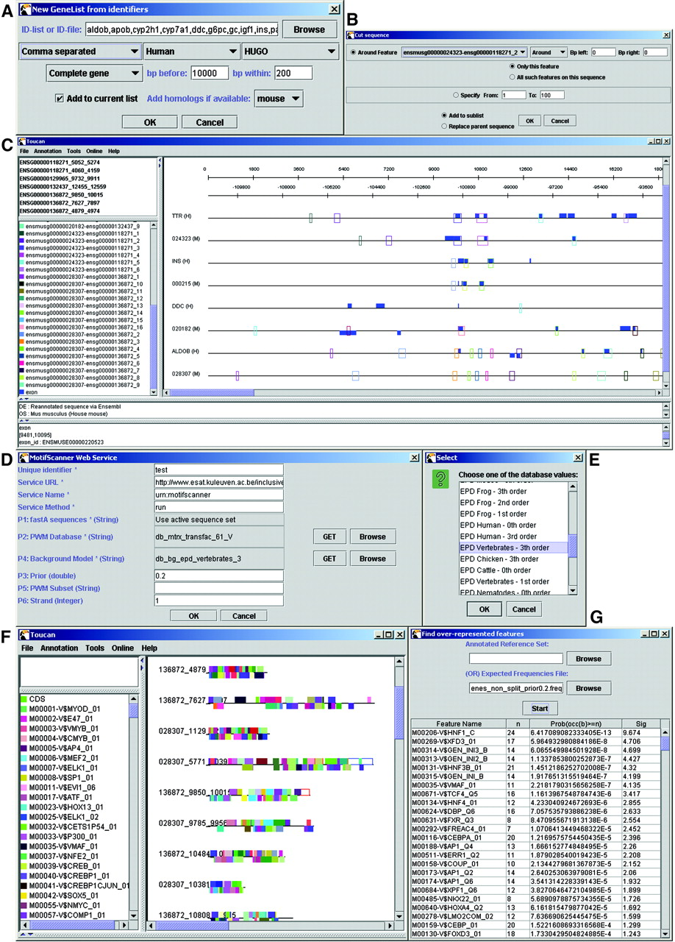
Figure 2. (Previous page) Screenshots of Toucan during the analysis of liver‐specific genes. ( A ) Dialog ...
Notes:
Figure 2. (Previous page) Screenshots of Toucan during the analysis of liver‐specific genes. ( A ) Dialog where all gene names (HUGO symbols) are entered as a comma separated list. In the second drop‐down box ‘Human’ is selected to search for and retrieve human genes. All organisms that are available in Ensembl (see http://www.ensembl.org ) can be chosen from this list, and in the ‘Preferences’ menu the user can update these settings if Ensembl were to add new organisms. Depending on which organism is chosen, the third drop‐down box shows all available external database identifiers that can be mapped to a stable Ensembl gene. The fourth drop‐down box allows to choose between ‘complete gene’, ‘upstream of CDS’ and ‘upstream of Exon 1’. The latter corresponds in most cases to the region upstream of the TSS. The text boxes labeled with ‘bp before’ and ‘bp within’ state how many base pairs should be retrieved as flanking sequence upstream or around the specified region. In the last drop‐down menu ‘mouse’ is selected to retrieve also the mouse orthologous sequences for each human gene in the list. ( B ) Every region that seems likely to contain putative regulatory modules (e.g., because it is conserved between species or because it contains a CpG island) can be selected and added to a sequence sublist. ( C ) Feature map. All open boxes represent regions that are at least 75% similar with their respective orthologous region, resulting from the AVID/VISTA web service. ( D ) Matrices, background model, and all other parameters are set in the dialog box of the MotifScanner. ( E ) Dialog showing the background models on our server. The values are retrieved transparently through the web service when the user presses the ‘GET’ button. ( F ) The results of the MotifScanner can either be saved or can be automatically added as features on the currently active sequence set. ( G ) Results of using the binomial formula to detect over‐represented motifs. n is the number of occurrences of a binding site within this set, the third column is the p value for this motif, the fourth column the sig value (see Methods). The top scoring motifs for the human–mouse conserved regions in 10 kb upstream sequence of liver‐specific genes are shown.
Unless provided in the caption above, the following copyright applies to the content of this slide:

Slide 4
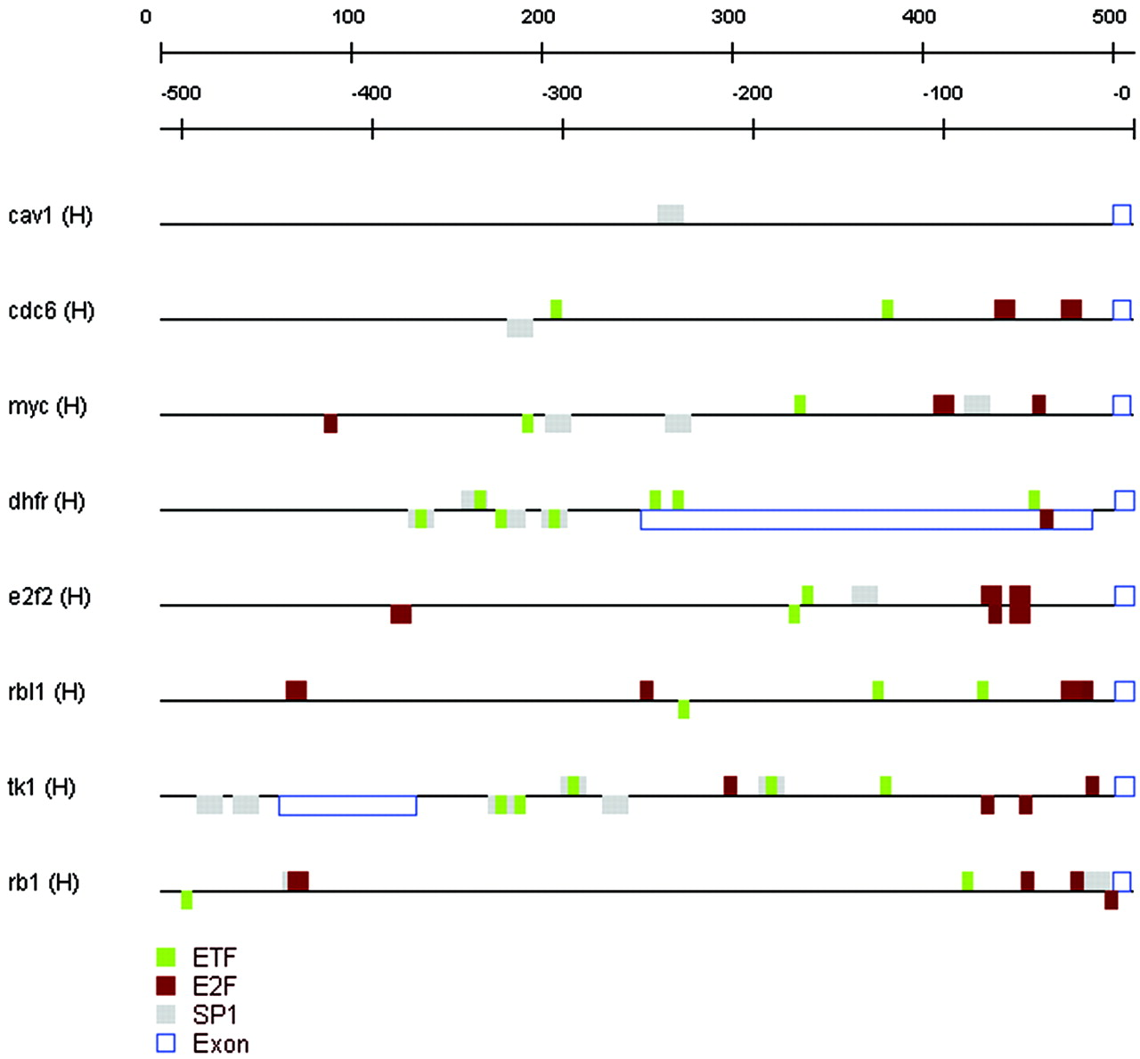
Figure 3. Promoter regions of eight E2F target genes with the over‐represented TFBMs. The sequences were ...
Notes:
Figure 3. Promoter regions of eight E2F target genes with the over‐represented TFBMs. The sequences were retrieved from Ensembl starting from a comma separated list of HUGO symbols and choosing ‘upstream of Exon 1’, 500 ‘bp before’ and 10 ‘bp within’.
Unless provided in the caption above, the following copyright applies to the content of this slide:

Slide 5
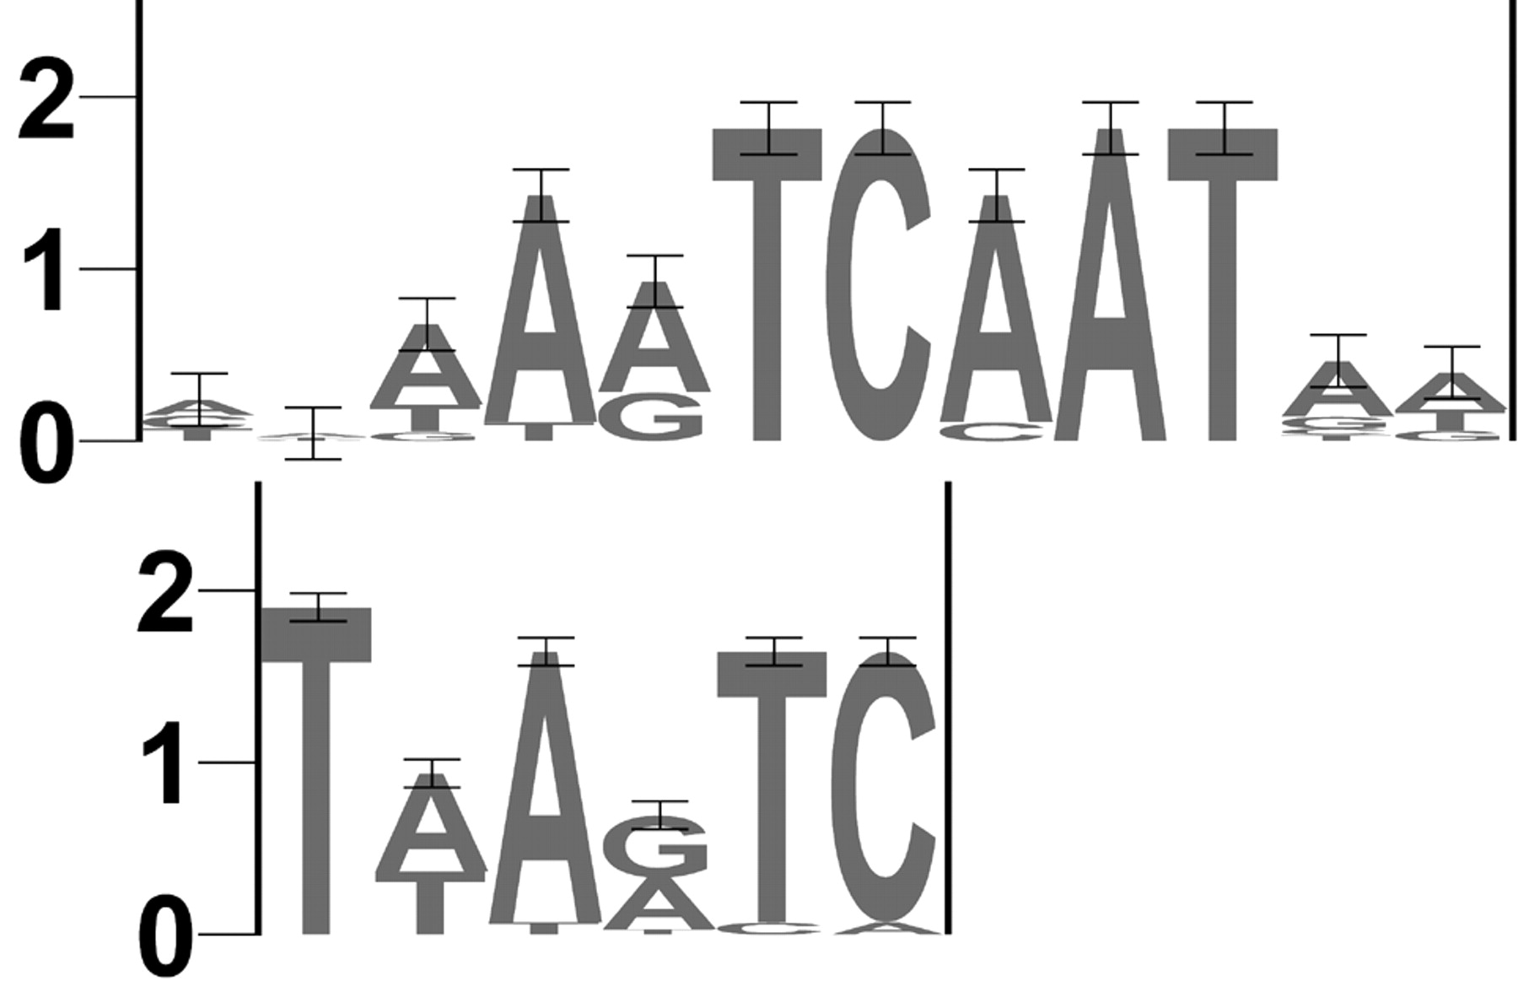
Figure 4. Sequence logos (40) of a pair of similar motifs (see Table 2), one motif derived from the scoring ...
Notes:
Figure 4. Sequence logos (40) of a pair of similar motifs (see Table 2), one motif derived from the scoring matrix M00639 (HNF‐6, upper logo) of the TRANSFAC database and one motif found by the MotifSampler (lower logo). The first is based on 13 binding sites in TRANSFAC, the second is based on 16 motif instances in our liver regulatory dataset. Positions 2–6 of the new motif match perfectly with the known motif. Position 1 of the new motif is certainly a T while the known motif has no information at that position.
Unless provided in the caption above, the following copyright applies to the content of this slide:

