Slide 1
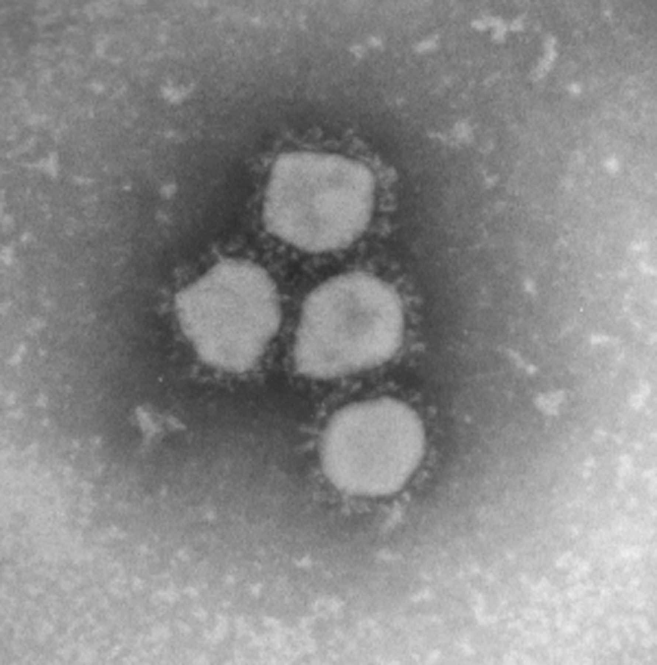
Figure 1 Negatively stained electron micrograph of HCoV-NL63. Courtesy of Dr Bermingham and Dr Hoschler and the EM ...
Notes:
Figure 1 Negatively stained electron micrograph of HCoV-NL63. Courtesy of Dr Bermingham and Dr Hoschler and the EM unit of the Health Protection Agency, Colindale, London.
Unless provided in the caption above, the following copyright applies to the content of this slide: © 2006 Federation of European Microbiological Societies.

Slide 2
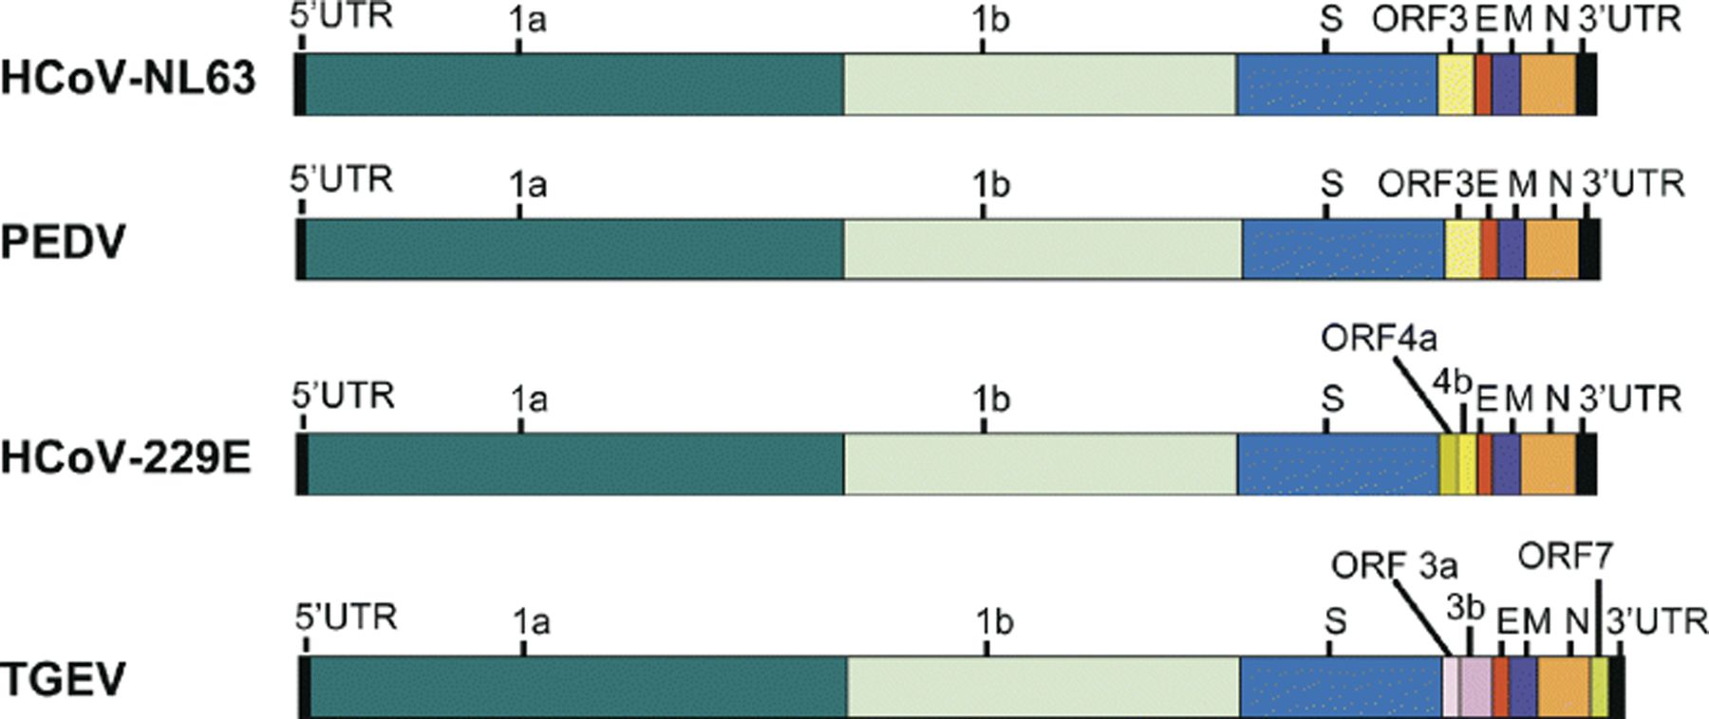
Figure 2 Genome organization of HCoV-NL63 and other group I coronaviruses.
Notes:
Figure 2 Genome organization of HCoV-NL63 and other group I coronaviruses.
Unless provided in the caption above, the following copyright applies to the content of this slide: © 2006 Federation of European Microbiological Societies.

Slide 3
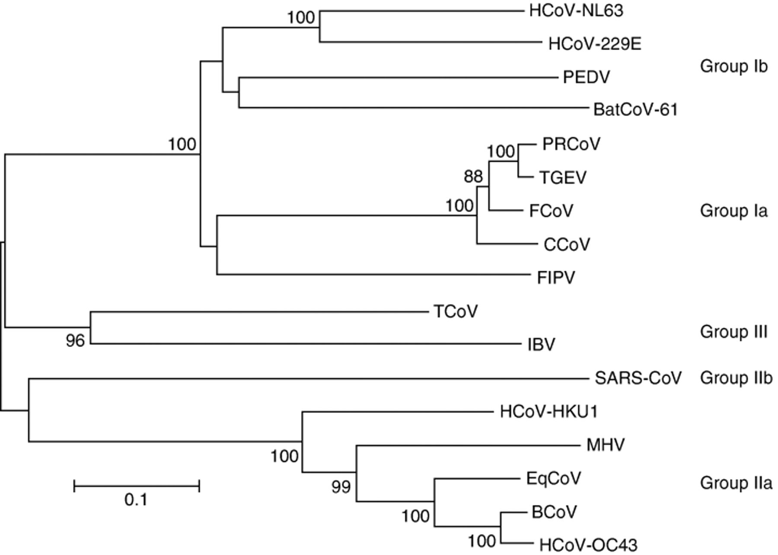
Figure 3 Phylogenetic analysis of coronaviruses. Analysis was carried out with the nucleotide sequences of a part of ...
Notes:
Figure 3 Phylogenetic analysis of coronaviruses. Analysis was carried out with the nucleotide sequences of a part of the spike gene (HCoV-NL63 position 22854–24319) using the neighbour-joining method of the mega program. Bootstrap resampling (1000 replicates) was employed to place approximate confidence limits on individual branches; bootstrap values above 80 are shown. The GenBank accession number of the sequences used in this phylogenetic analysis are HCoV-229E: n; CCoV (canine coronavirus) n; FIPV (feline infectious peritonitis virus) n; PEDV (porcine epidemic diarrhea virus) n; TGEV (transmissible gastroenteritis virus): n; PRCoV (porcine respiratory coronavirus) n; MHV (mouse hepatitis virus) n; BCoV (bovine coronavirus) n; HCoV-OC43: n; SARS-CoV: n; IBV (avian infectious bronchitis virus) n; TCoV (turkey coronavirus) n; BatCoV strain61: n and HCoV-HKU1: n.
Unless provided in the caption above, the following copyright applies to the content of this slide: © 2006 Federation of European Microbiological Societies.

Slide 4
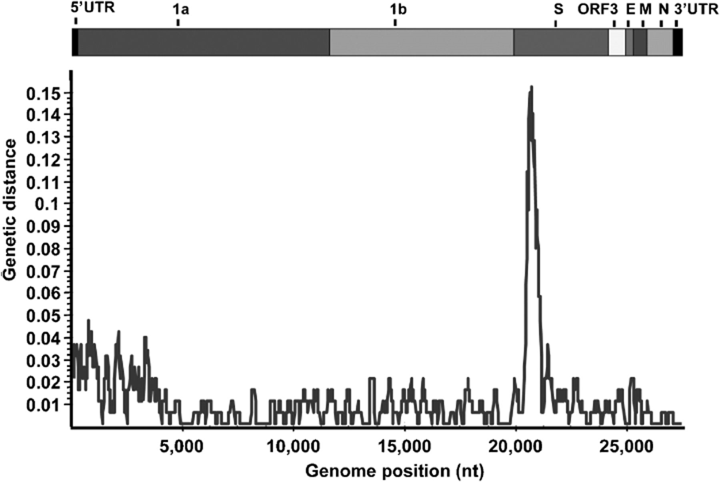
Figure 4 Nucleotide distance between HCoV-NL63 isolate Amsterdam 1 and isolate NL. Each point plotted as the ...
Notes:
Figure 4 Nucleotide distance between HCoV-NL63 isolate Amsterdam 1 and isolate NL. Each point plotted as the percentage genetic distance between the two isolates along the genome with a sliding window of 200 nt wide and a step size of 20 nt.
Unless provided in the caption above, the following copyright applies to the content of this slide: © 2006 Federation of European Microbiological Societies.

Slide 5
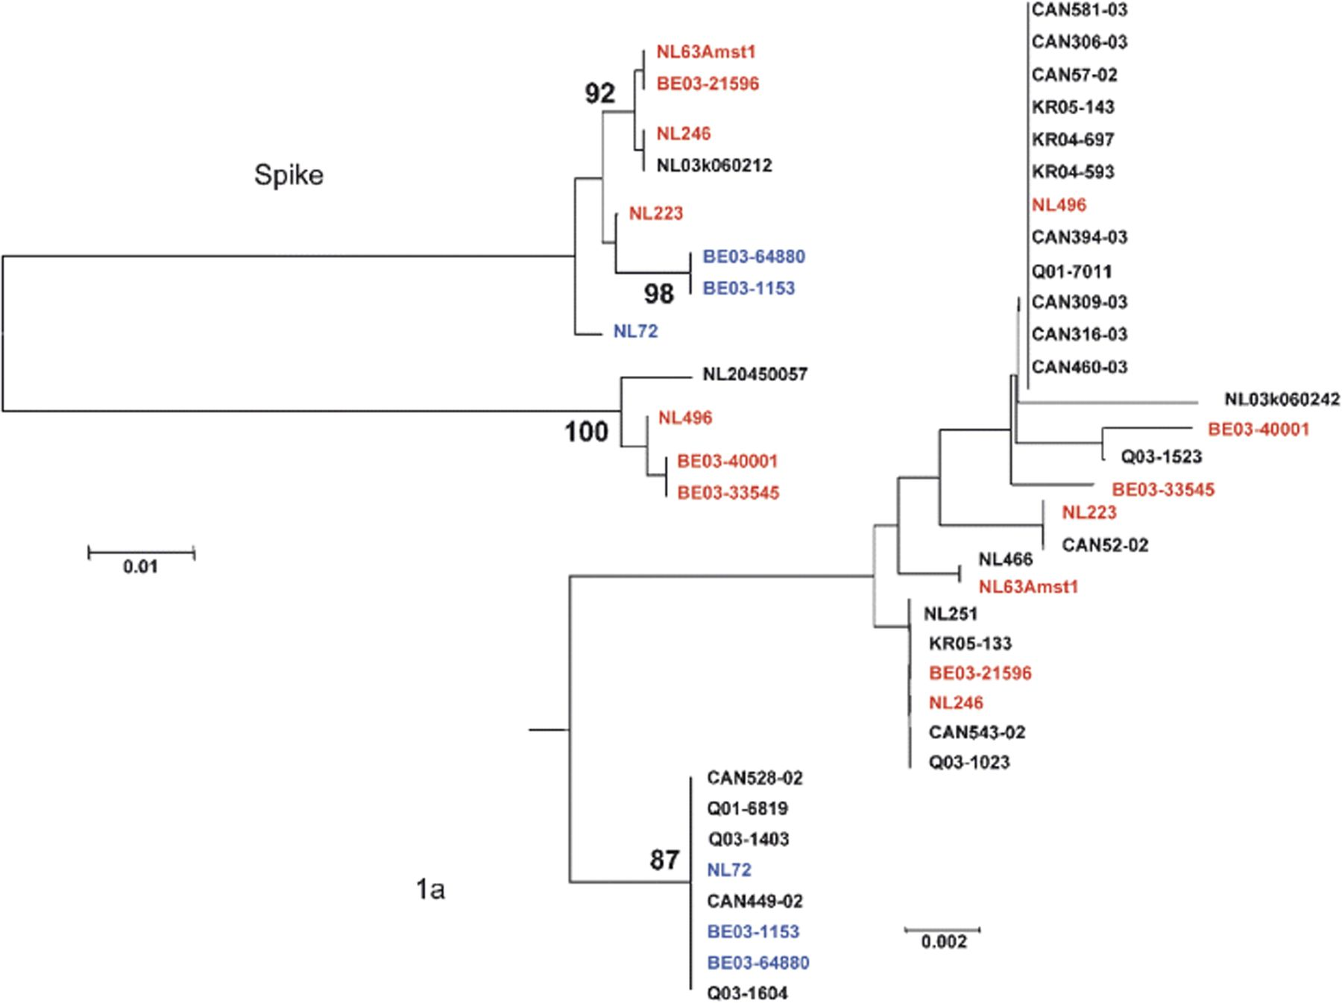
Figure 5 Phylogenetic analysis of partial 1a and partial spike gene sequences of HCoV-NL63 isolates. HCoV-229E was ...
Notes:
Figure 5 Phylogenetic analysis of partial 1a and partial spike gene sequences of HCoV-NL63 isolates. HCoV-229E was used to root the tree for the 1a gene sequences. The neighbour-joining method of the mega program was used with bootstrap resampling (1000 replicates) to place approximate confidence limits on individual branches; only bootstrap values above 80 are shown. GenBank numbers: n–n–n–n–n–n–n–n. CAN, Canada; Q, Australia; NL, the Netherlands; BE, Belgium; KR, Korea. NL63-Amst1 is the prototype sequence of HCoV-NL63. Red and blue indicate the strains that cluster for the 1a region and for which spike sequences are also available.
Unless provided in the caption above, the following copyright applies to the content of this slide: © 2006 Federation of European Microbiological Societies.

