Slide 1
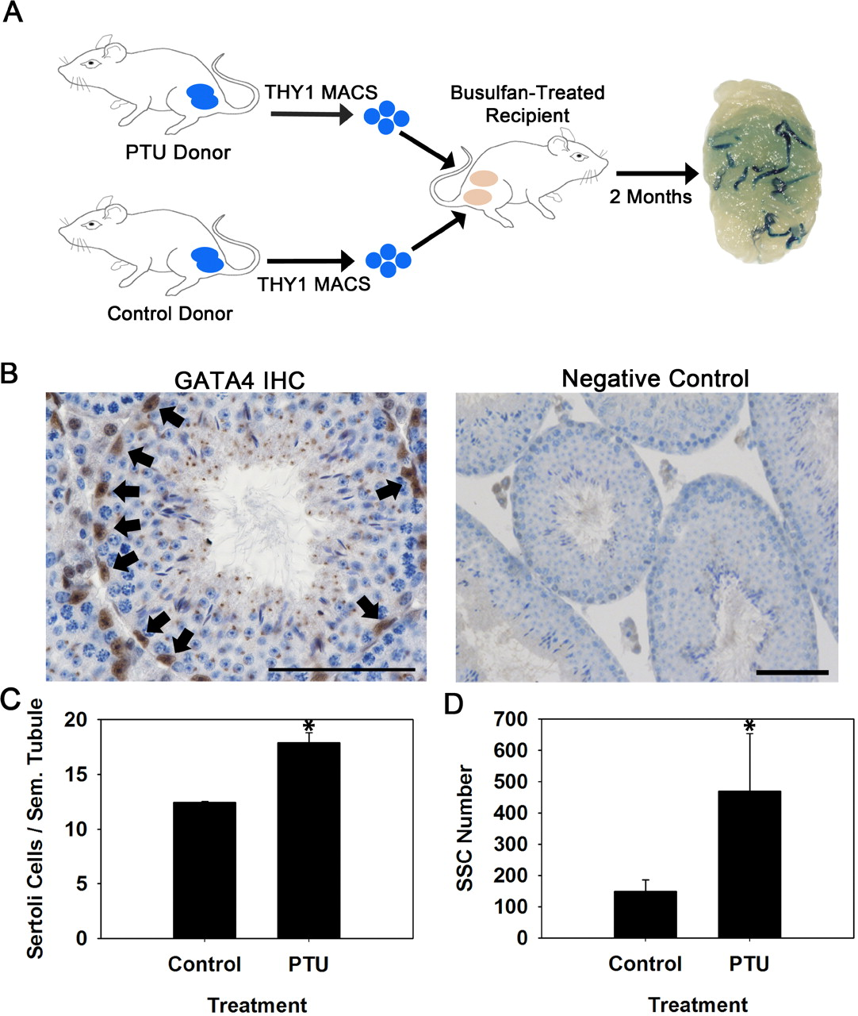
Fig. 1 Evaluation of the number of SSCs in testes of mice with experimentally induced increase of Sertoli cell ...
Notes:
Fig. 1 Evaluation of the number of SSCs in testes of mice with experimentally induced increase of Sertoli cell numbers. A) Experimental strategy using PTU treatment during the neonatal period to increase Sertoli cell numbers at puberty in Rosa donor mice and transplantation analyses to assay for SSC numbers. Each recipient mouse received MACS-isolated THY1+ germ cells from a PTU-treated donor in one testis and MACS-isolated THY1+ germ cells from a control donor in the other testis. The numbers of blue colonies of spermatogenesis are a measure of SSC content in the microinjected donor cell suspension. B) Immunohistochemistry staining for GATA4+ nuclei (arrows) in cross sections of testis from a PTU-treated Rosa mouse. Within seminiferous tubules, GATA4 expression is localized specifically to Sertoli cell nuclei. Bar = 50 μm. C) Numbers of GATA4+ nuclei within cross sections of seminiferous tubules from PTU-treated and control Rosa mice. Data are mean ± SEM for three testes from different mice; *P = 0.01. D) Numbers of SSCs in testes of PTU-treated and control Rosa donor mice. SSC number is derived from quantification of colonies within recipient testes arising from 1 × 105 THY1+ donor germ cells microinjected and normalized to the number of THY1+ cells isolated by MACS. Data are mean ± SEM for three independent experiments using different donors for each treatment and 10–12 recipient testes for each replicate experiment; *P = 0.05.
Unless provided in the caption above, the following copyright applies to the content of this slide: © 2011 by the Society for the Study of Reproduction, Inc.

Slide 2
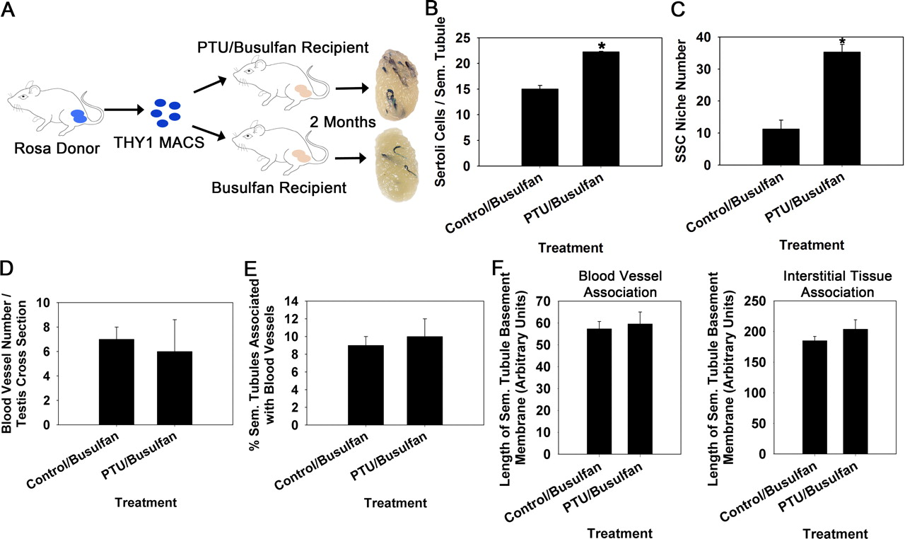
Fig. 3 Evaluation of SSC niche numbers in testes of mice with experimentally induced increase of Sertoli cell ...
Notes:
Fig. 3 Evaluation of SSC niche numbers in testes of mice with experimentally induced increase of Sertoli cell numbers. A) Experimental strategy using germ cell transplantation to assay for numbers of niches in recipient mice with normal numbers of Sertoli cells and recipient mice treated with PTU during postnatal development to increase Sertoli cell content. MACS-isolated THY1+ germ cells from normal Rosa donors were used as a source of SSCs for microinjection into PTU and non-PTU-treated recipient testes. B) Numbers of GATA4+ nuclei within cross sections of seminiferous tubules from PTU/busulfan-treated and control busulfan-treated 129XC57 mice. Data are mean ± SEM for three different replicate samples of each treatment; *P = 0.05. C) Numbers of donor-derived colonies of spermatogenesis, a reflection of colonized SSC niches, in testes of PTU/busulfan-treated and control busulfan-treated recipient mice 2 mo after transplantation. Data are mean ± SEM for three independent transplantation experiments and 10–12 recipient testes for each treatment; *P = 0.01. D) Number of blood vessels within the interstitial space in cross sections of testes from PTU/busulfan-treated and control busulfan-treated mice. Data are mean ± SEM for three different mice in each treatment. E) Percentage of seminiferous tubules in close association with blood vessels in testes of PTU/busulfan-treated and busulfan-treated control mice. Data are mean ± SEM for three different mice of each treatment. F) Length of seminiferous tubule basement membrane bordered by blood vessels or interstitial tissue in testes of PTU/busulfan-treated and busulfan-treated control mice. Data are mean ± SEM for three different mice in each treatment.
Unless provided in the caption above, the following copyright applies to the content of this slide: © 2011 by the Society for the Study of Reproduction, Inc.

Slide 3
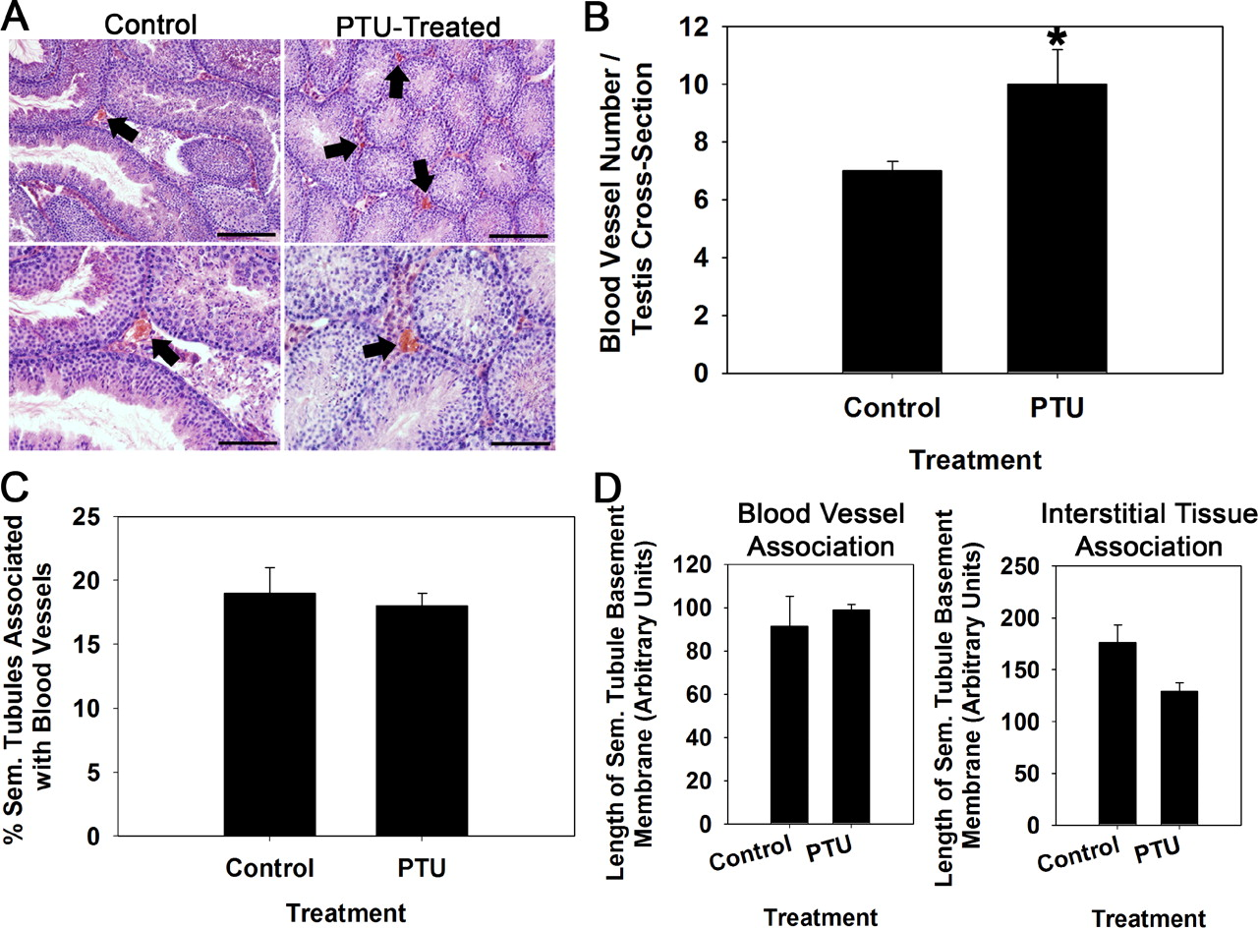
Fig. 2 Effects of increased Sertoli cell numbers on vascularization of the interstitial space within testes of adult ...
Notes:
Fig. 2 Effects of increased Sertoli cell numbers on vascularization of the interstitial space within testes of adult mice. A) Cross sections of testes from PTU-treated mice and non PTU-treated control mice stained with hematoxylin and eosin to identify blood vessels within the interstitial space (arrows). Bottom images are 10× magnification of top images. Bars = 100 μm for top images and 50 μm for bottom images. B) Numbers of blood vessels in cross sections of testes from PTU-treated and non-PTU-treated control mice. Data are mean ± SEM for three different mice in each treatment; *P = 0.01. C) Percentage of seminiferous tubules in close association with blood vessels in testes of PTU-treated and non-PTU-treated control mice. Data are mean ± SEM for three different mice in each treatment. D) Length of seminiferous tubule basement membrane bordered by blood vessels or interstitial tissue in testes of PTU-treated and non-PTU-treated control mice. Data are mean ± SEM for three different mice in each treatment.
Unless provided in the caption above, the following copyright applies to the content of this slide: © 2011 by the Society for the Study of Reproduction, Inc.

