Slide 1
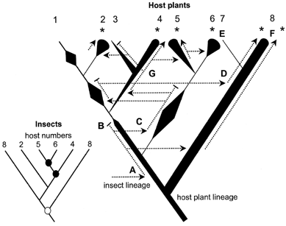
Figure 1 A hypothetical fluctuating host plant lineage (right), illustrating the factors that may influence how an ...
Notes:
Figure 1 A hypothetical fluctuating host plant lineage (right), illustrating the factors that may influence how an insect lineage interacts with a fluctuating plant lineage and an interpretation of the resultant phylogenetic patterns (left). This model takes into account the susceptibility factors for host switching suggested by examination of the ecology of Canary Island psyllids and their legume hosts. Host abundance is indicated by line width. Examples of different events are labeled: A = colonization of preexisting host lineage by insect lineage; B = loss of insect due to extinction; C = increase in host abundance after bottleneck leads to vacant host, usually filled by near host switching from related plants; D = abundant host and geographical proximity may lead to wide host switching; E = rare plants are unlikely to be colonized; F = temporally stable host lineages may sustain multiple insect lineages; G = occasional cospeciation events. The asterisks indicate extant insect taxa, whose phylogeny is shown (left). Given the two phylogenies, certain events would be misinterpreted in a TreeMap analysis: the solid circles are cospeciation events, and the open circle is a duplication event (speciation of parasites in situ on the host).
Unless provided in the caption above, the following copyright applies to the content of this slide: © 2004 Society of Systematic BiologistsThis article is published and distributed under the terms of the Oxford University Press, Standard Journals Publication Model (https://academic.oup.com/journals/pages/open_access/funder_policies/chorus/standard_publication_model)

Slide 2
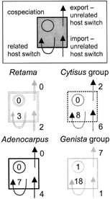
Figure 4 The levels of different types of host switching and cospeciation implied for the four major legume lineages, ...
Notes:
Figure 4 The levels of different types of host switching and cospeciation implied for the four major legume lineages, on the assumption that the presence of asynchronous nodes rules out cospeciation over most of the association. The legume lineages are coded as in Figure 2: Retama (double gray line), Cytisus (dotted black line), Adenocarpus (thick black line), and Genista (thick gray line). The only possible cospeciation events are found in the Genista group, abundant in the Canary Islands and Madeira, where there has been a recent radiation of both legumes and psyllids. The majority of the host switching (61%) apparently occurred between related hosts (within major legume lineages) and produced some shared phylogenetic patterns that can be misinterpreted as cospeciation.
Unless provided in the caption above, the following copyright applies to the content of this slide: © 2004 Society of Systematic BiologistsThis article is published and distributed under the terms of the Oxford University Press, Standard Journals Publication Model (https://academic.oup.com/journals/pages/open_access/funder_policies/chorus/standard_publication_model)

Slide 3
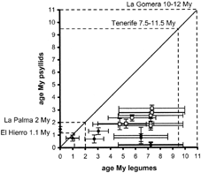
Figure 3 Comparative ages of 16 putative cospeciation events suggested by TreeMap (□ = continental; ♦ = island). ...
Notes:
Figure 3 Comparative ages of 16 putative cospeciation events suggested by TreeMap (□ = continental; ♦ = island). Reconciled psyllid and legume phylogenies, without considering dates of divergence, produce associated legume nodes that are much older than the putatively synchronous psyllid nodes. This plot shows the cospeciation events determined by TreeMap, which optimizes a psyllid node onto the most recent common ancestor of all its host plants (i.e., no assumption of host switching). All but one of the results are temporally implausible. The dates plotted represent the means and SDs of 100 bootstrap replicates.
Unless provided in the caption above, the following copyright applies to the content of this slide: © 2004 Society of Systematic BiologistsThis article is published and distributed under the terms of the Oxford University Press, Standard Journals Publication Model (https://academic.oup.com/journals/pages/open_access/funder_policies/chorus/standard_publication_model)

Slide 4
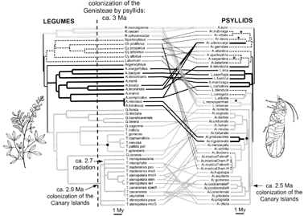
Figure 2 A tanglegram of the insect–host-plant relationships of a group of legume-feeding psyllids (right) and their ...
Notes:
Figure 2 A tanglegram of the insect–host-plant relationships of a group of legume-feeding psyllids (right) and their Genisteae (broom) hosts (left). Four main legume lineages are distinguished: Retama (double gray line), Cytisus (dotted black line), Adenocarpus (thick black line), and Genista (thick gray line). The psyllids on these hosts are indicated by the same type of branches. Most of the psyllids on each host group are from a single psyllid group, but some psyllid–legume associations have involved a wide host switch between legume groups. The dates on the psyllid tree are much younger than the dates on the legume tree, indicating a colonizing, not a cospeciating, psyllid, lineage. Calibration points are indicated by solid circles. Of several independent colonizations of the Canary Islands by legumes and psyllids, only one could have been contemporaneous (around 2.5 and 2.9 MY ago), with a single potential cospeciation event during the radiation of legumes and psyllids in the Canary Islands (Fig. 3). The evolution of other island psyllid lineages (indicated by asterisks) substantially postdate the evolution of their island legume hosts. Psyllid genera: Arytaina (Ar.), Arytainilla (A.), Arytinnis (Ai.), Livilla (L.); legume genera: Chamaecytisus (Ch.), Cytisus (Cy.), Genista (G.), Teline (T.).
Unless provided in the caption above, the following copyright applies to the content of this slide: © 2004 Society of Systematic BiologistsThis article is published and distributed under the terms of the Oxford University Press, Standard Journals Publication Model (https://academic.oup.com/journals/pages/open_access/funder_policies/chorus/standard_publication_model)

