Slide 1
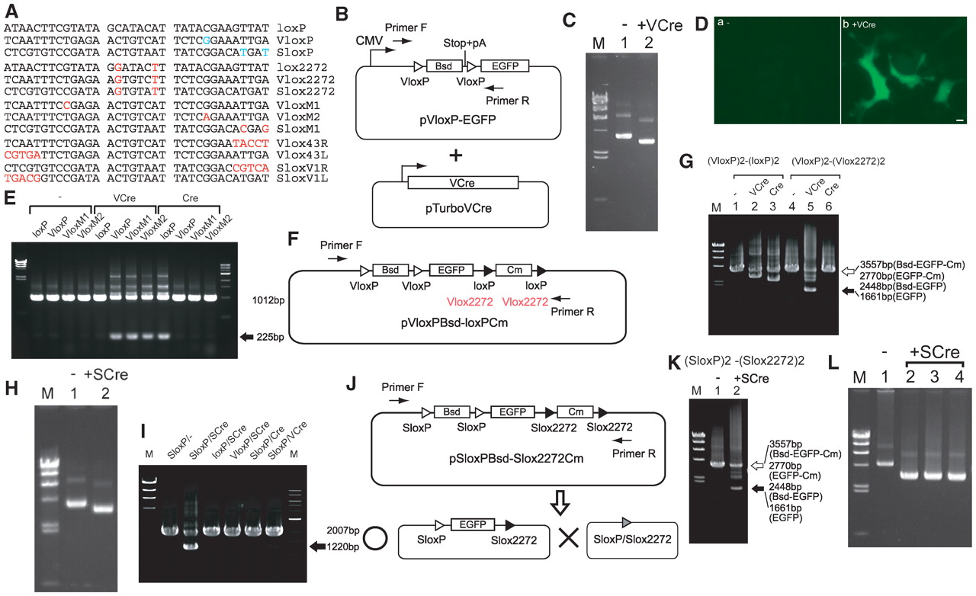
Figure 1. VCre/VloxP and SCre/SloxP site-specific recombination systems. ( A ) Comparison of loxP, VloxP and SloxP ...
Notes:
Figure 1. VCre/VloxP and SCre/SloxP site-specific recombination systems. ( A ) Comparison of loxP, VloxP and SloxP sites with three mutant sites (lox2272, Vlox2272 and Slox2272) and various other mutant sites. ( B ) Schematic diagram of expression and tester plasmids. ( C ) Recovery of the tester plasmid from cells expressing VCre protein. Both expression and tester plasmids shown in (B) were simultaneously transfected into cells. The size of the original tester plasmid and the plasmid eliminated via VloxP were 5545 and 4758 bp, respectively. M, size markers (λ/HindIII; 23, 9.4, 6.6, 4.4, 2.3 and 2.0 kb). ( D ) EGFP expression was induced by removing a stop codon and poly-A cassette via VCre/VloxP. The VCre-expressing plasmid and tester plasmid shown in (B) were transfected into HEK293 cells. Scale bar, 10 µm. ( E ) Site-specific recombination using VCre and Cre. Either the VCre- or Cre-expressing plasmid and a tester plasmid harboring loxP, VloxP or mutant VloxP sites were introduced into cells. The arrow indicates the PCR product with the DNA flanked by loxP, VloxP, VloxM1 and VloxM2 eliminated. ( F ) Schematic diagram of a tester plasmid containing two VloxP sites and two loxP sites. ( G ) The mutant Vlox2272 site functions as an inconvertible mutant site. The tester plasmids shown in (F) and the VCre- or Cre-expressing plasmids were transfected into cells. The open arrow indicates the PCR product containing DNA flanked by VloxP and Vlox2272. Reaction with only VloxP or loxP(Vlox2272) produced 2770- or 2448-bp PCR products, respectively. The solid arrow indicates the PCR product in which both of the two DNA regions flanked by VloxP and Vlox2272 were eliminated. ( H ) Recovery of tester plasmid from cells expressing SCre protein. The tester plasmids, pSloxP-EGFP and SCre-expressing plasmid and pTurboSCre were simultaneously transfected into cells. The sizes of the tester plasmid containing SloxP and the tester plasmid without SloxP were 5545 and 4758 bp, respectively. ( I ) Site-specific recombination using SCre, VCre and Cre. The tester plasmids (pSloxP-EGFP, ploxP-EGFP or pVloxP-EGFP) and SCre-, Cre- or VCre-expressing plasmids were transfected into cells in various combinations. The arrow indicates the PCR product in which DNA flanked by SloxP was eliminated in a SCre-dependent manner. ( J ) Schematic diagram of a tester plasmid containing two SloxP sites and Slox2272 sites. ( K ) The mutant Slox2272 site functions as an inconvertible mutant site. The tester plasmid shown in (J) and the SCre-expressing plasmid were transfected into cells. The open arrow indicates the PCR product without the eliminated DNA. Reaction with only SloxP or Slox2272 produced 2770- or 2448-bp PCR products, respectively. The solid arrow indicates the PCR product in which both of the two DNA regions flanked by SloxP and Slox2272 were eliminated. ( L ) Recovery of the tester plasmid containing two SloxP sites and Slox2272 sites from cells expressing SCre protein. The tester plasmid (pSloxPBsd–Slox2272Cm) and the SCre-expressing plasmid (pTurboSCre) were simultaneously transfected into cells. The sizes of the original tester plasmid and the eliminated plasmid were 6648 and 4752 bp, respectively. Lanes 2–4 contain the plasmids of independent colonies recovered from cells expressing SCre.
Unless provided in the caption above, the following copyright applies to the content of this slide: © The Author(s) 2011. Published by Oxford University Press.This is an Open Access article distributed under the terms of the Creative Commons Attribution Non-Commercial License (http://creativecommons.org/licenses/by-nc/2.5), which permits unrestricted non-commercial use, distribution, and reproduction in any medium, provided the original work is properly cited.

Slide 2
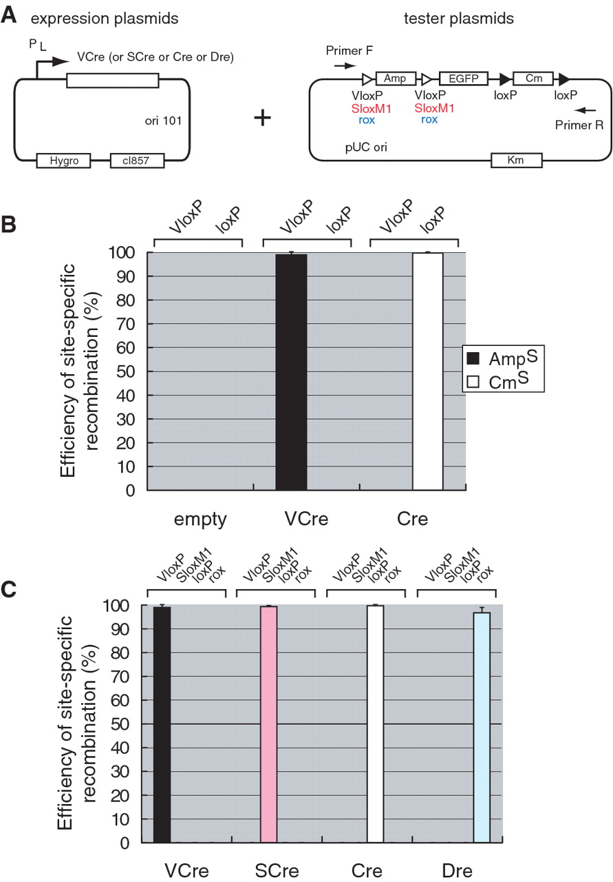
Figure 2. Site-specific recombination of VCre or SCre recombinase in E. coli . (A ) Illustrations of plasmids ...
Notes:
Figure 2. Site-specific recombination of VCre or SCre recombinase in E. coli . (A ) Illustrations of plasmids expressing VCre or SCre recombinase under the control of temperature-shift and tester plasmids for site-specific recombination. ( B ) Efficiency and specificity of site-specific recombination of VCre and Cre recombinase. After electroporation of the tester plasmid (A) into E. coli DH10B cells that express either VCre or Cre, we selected Km-resistant colonies, which were then replicated on Amp, Cm or Km agar plates to test their ability to grow. The empty vector contains a backbone plasmid that does not express recombinase. ( C ) Efficiency and specificity of site-specific recombination of VCre, SCre, Cre and Dre recombinases. The efficiency and specificity of four recombinases were examined in E. coli . In experiments testing various pairs of VCre, SCre, Cre and Dre with VloxP, SloxM1, loxP and rox, we detected no cross-reactivity. The recombination efficiencies of VCre and SCre were almost the same as those of Cre and Dre in an E. coli site-specific recombination assay.
Unless provided in the caption above, the following copyright applies to the content of this slide: © The Author(s) 2011. Published by Oxford University Press.This is an Open Access article distributed under the terms of the Creative Commons Attribution Non-Commercial License (http://creativecommons.org/licenses/by-nc/2.5), which permits unrestricted non-commercial use, distribution, and reproduction in any medium, provided the original work is properly cited.

Slide 3
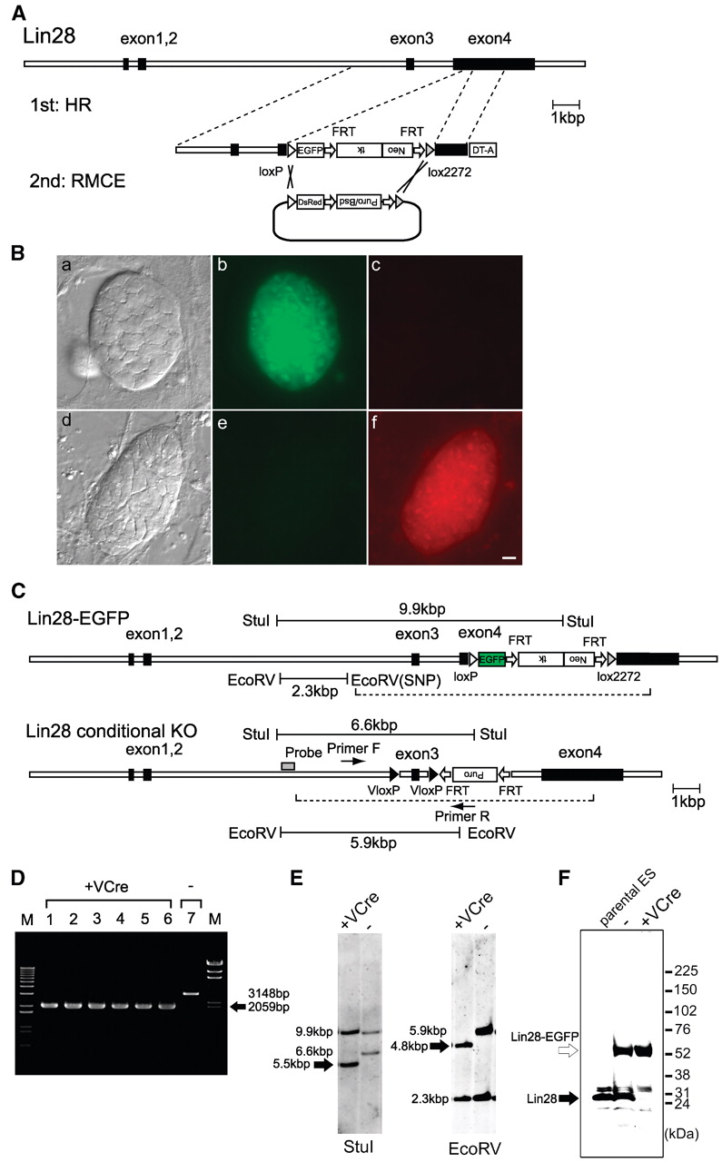
Figure 3. Genome engineering using mouse ES cells. ( A ) C-terminal protein-tag exchange in ES cells using the RMCE ...
Notes:
Figure 3. Genome engineering using mouse ES cells. ( A ) C-terminal protein-tag exchange in ES cells using the RMCE method. ( B ) Mouse ES cells expressing Lin28 with an EGFP tag fused at its C terminus. The EGFP tag was replaced with a DsRed tag. Fluorescence microscopy images showing the intracellular distribution of Lin28-EGFP (b, e) and Lin28-DsRed (c, f). The corresponding differential interference microscopy images are shown in (a, d). Scale bar, 10 µm. ( C ) Schematic diagram of genetically modified alleles of Lin28. The dashed lines indicate the location of the targeting vectors. ( D ) PCR analysis of mouse ES cell genome engineered using VCre. The arrow indicates the PCR products in which VloxP-flanked exon 3 was eliminated from ES cells producing VCre. Lanes 1–6 show independently isolated ES colonies after the introduction of VCre. ( E ) Southern-hybridization analysis of mouse ES cell genome engineered using VCre. The arrows indicate VloxP-eliminated DNA fragments (5.5 or 4.8 kbp, respectively) in StuI- or EcoRV-digested genomic DNA from ES cells producing VCre. The 1.1-kbp DNA fragment containing exon 3-flanked VloxP was eliminated. ( F ) Immunoblot analysis of conditional knockout ES-cell genome engineered using the VCre/VloxP system. Only EGFP-tagged lin28 was detected in the VCre-mediated conditional knockout ES cells. Blots were probed with anti-lin28 antibody. The solid arrow indicates intact VCre protein; the open arrow indicates Lin28-fused EGFP.
Unless provided in the caption above, the following copyright applies to the content of this slide: © The Author(s) 2011. Published by Oxford University Press.This is an Open Access article distributed under the terms of the Creative Commons Attribution Non-Commercial License (http://creativecommons.org/licenses/by-nc/2.5), which permits unrestricted non-commercial use, distribution, and reproduction in any medium, provided the original work is properly cited.

