Slide 1
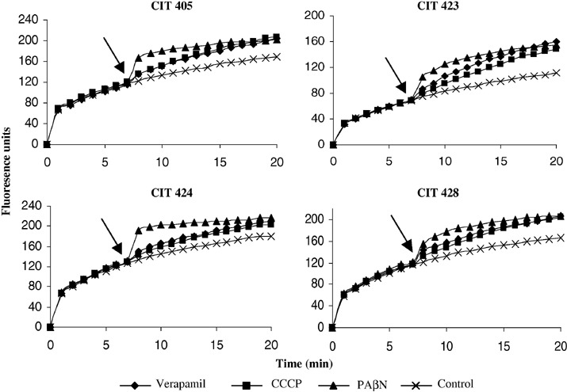
3 Accumulation of the EtdBr dye in C. coli CIT-405, C. jejuni CIT-423, CIT-424 and CIT-428. EtdBr (2 μg/ml) was ...
Notes:
3 Accumulation of the EtdBr dye in C. coli CIT-405, C. jejuni CIT-423, CIT-424 and CIT-428. EtdBr (2 μg/ml) was added to the bacterial cell suspension at time zero. Three efflux pump inhibitors: verapamil (100 μg/ml), carbonyl cyanide m-chlorophenyl hydrazone (CCCP, 21 μg/ml) and PAβN (20 μg/ml) were added at 7 min, as indicated by the arrow in the figure. Fluorescence units (y-axis) represent the accumulation of EtdBr. The experiment was replicated four times and each data point represents a mean value of all four experiments.
Unless provided in the caption above, the following copyright applies to the content of this slide: © 2005 Federation of European Microbiological Societies

Slide 2
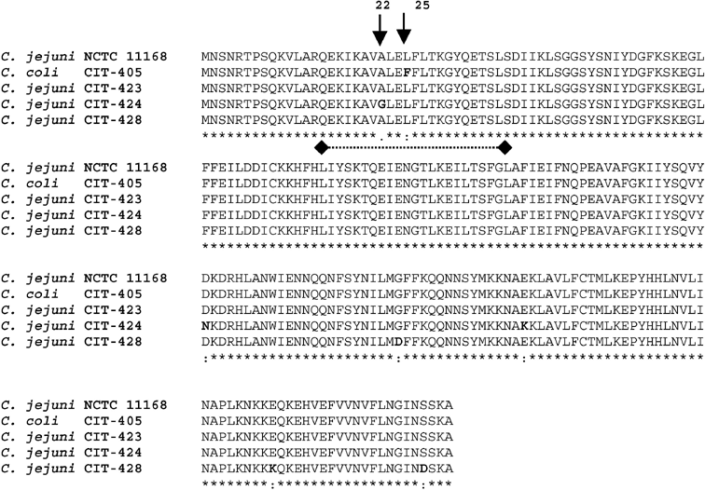
2 CLUSTALW alignment of the deduced CmeR amino acid sequence form C. jejuni NCTC 11168 (F81379), C. coli ...
Notes:
2 CLUSTALW alignment of the deduced CmeR amino acid sequence form C. jejuni NCTC 11168 (F81379), C. coli CIT-405 (AAT06777), C. jejuni CIT-423 (AAU43760), C. jejuni CIT-424 (AAU43761) and C. jejuni CIT-428 (AAU43763). Amino acid substitutions are indicated in bold. The position of the helix-turn-helix DNA binding motif of the cmeR genes are identified by the broken line flanked by the diamond shapes.
Unless provided in the caption above, the following copyright applies to the content of this slide: © 2005 Federation of European Microbiological Societies

Slide 3
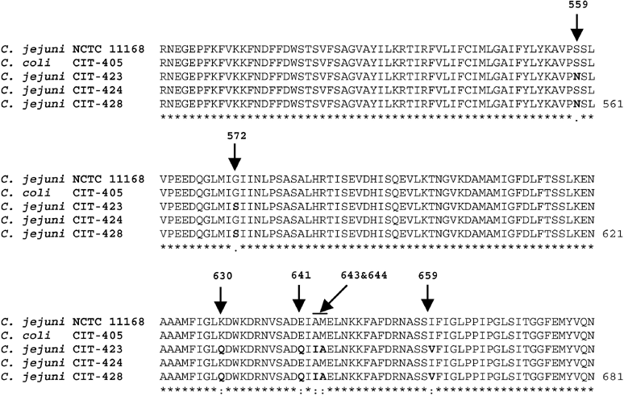
1 CLUSTALW alignment of a fragment of the deduced CmeB amino acid sequence form C. jejuni NCTC 11168, C. coli ...
Notes:
1 CLUSTALW alignment of a fragment of the deduced CmeB amino acid sequence form C. jejuni NCTC 11168, C. coli CIT-405, C. jejuni CIT-423, C. jejuni CIT-424 and C. jejuni CIT-428. Arrows identify the positions of the seven amino acid substitutions, which are indicated in bold.
Unless provided in the caption above, the following copyright applies to the content of this slide: © 2005 Federation of European Microbiological Societies

