Slide 1
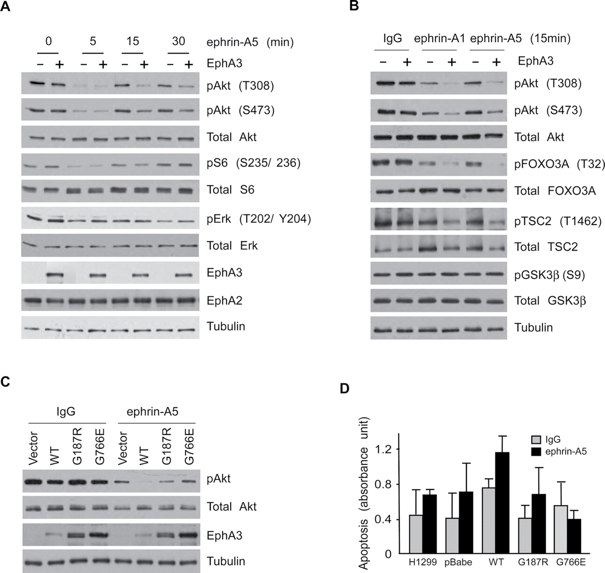
Figure 4. EPHA3 signaling, AKT activity, and apoptosis. A) Time course of EPHA3 receptor signaling in response to ...
Notes:
Figure 4. EPHA3 signaling, AKT activity, and apoptosis. A) Time course of EPHA3 receptor signaling in response to ephrin-A5. H1299 cells expressing EPHA3 (“+”) or carrying control vector (“−”) were stimulated with ephrin-A5 (100ng/mL) for 0, 5, 15, and 30 minutes. Cell lysates were subjected to western blot analyses using anti-phosphopeptide-specific and total protein-directed antibodies as indicated. Immunoblots representative of three independent experiments are shown. B) EPHA3 receptor signaling in response to ephrin-A1 vs ephrin-A5. H1299 cells expressing EPHA3 or carrying control vector were stimulated for 15 minutes with 100ng/mL of either ephrin-A1, ephrin-A5, or control IgG, after which cell lysates were analyzed by immunoblotting with the indicated anti-phosphopeptide-specific and total protein-directed antibodies. Shown are representative immunoblots of two independent experiments. C) Effect of mutant EPHA3 on AKT activity. H1299 cells expressing either wild-type (WT) or mutant EPHA3, as indicated, were stimulated with either 100ng/mL of ephrin-A5 or with 100ng/mL control IgG for 15 minutes, after which cell lysates were analyzed by immunoblotting with the anti-phospho AKT, anti-total AKT, and anti-EPHA3 antibodies. Shown are representative immunoblots of two independent experiments. D) Effect of wild-type or mutant EPHA3 on apoptosis. H1299 cells expressing WT or mutant EPHA3 were treated with 100ng/mL ephrin-A5 in the presence of 5 µg/mL GST-TRAIL for 24 hours and then apoptosis was analyzed by a Cell Death Detection ELISA kit. Data from one experiment representative of two independent experiments are shown.
Unless provided in the caption above, the following copyright applies to the content of this slide: © The Author 2012. Published by Oxford University Press. All rights reserved. For Permissions, please e-mail: journals.permissions@oup.com.

Slide 2
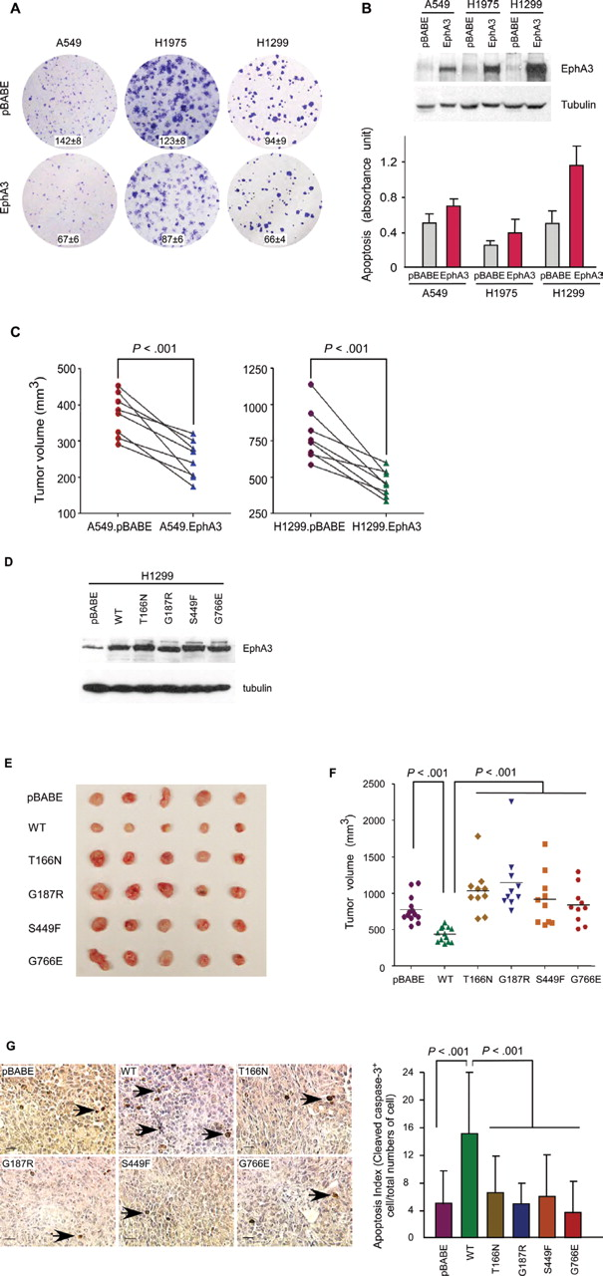
Figure 3. Effects of wild-type EPHA3 on apoptosis and tumor growth. A) Effects of wild-type EPHA3 on colony formation. ...
Notes:
Figure 3. Effects of wild-type EPHA3 on apoptosis and tumor growth. A) Effects of wild-type EPHA3 on colony formation. Three NSCLC lines (A549, H1975, and H1299) were transduced with a retrovirus encoding wild-type EPHA3 or the pBABE vector as a control and were analyzed by colony formation assays. Representative photomicrographs of colony formation are shown from two independent experiments. B) Effects of wild-type EPHA3 on cellular apoptosis. NSCLC lines (A549, H1975, and H1299) were transduced with wild-type EPHA3–encoding or pBABE control vectors and analyzed for cellular apoptosis. Top panel: EPHA3 expression in the transduced cells was assessed by western blotting for levels of EPHA3 and tubulin, as indicated. Bottom panel: cells were treated with GST-TRAIL (5 µg/mL) for 24 hours to induce apoptosis, which was then analyzed using Figure 3 (continued).a Cell Death Detection ELISA kit. Shown are data from triplicate samples in one experiment that are representative of three independent experiments. C) Effects of wild-type EPHA3 on tumor growth in vivo. A549 and H1299 cells with low levels of endogenous EPHA3 were transduced with retroviruses carrying wild-type EPHA3 or pBABE control vector. Five million cells expressing exogenous wild-type EPHA3 were injected into nude mice subcutaneously. Control cells carrying empty vector were injected contralaterally in the same mouse (n = 8 for each line). Tumor volumes were measured 3 weeks after injection and presented as tumor volume for each sample, with pairing of the isogenic samples on the individual mice linked by tie lines. The observed reductions in tumor sizes associated with enforced EPHA3 were statistically significant for both A549 and H1299 cells (Student’s t test, two sided, P < .001 and P < .001, respectively). D–G) Effects of wild-type and mutant EPHA3 on tumor growth in vivo. H1299 cells were transduced with retroviruses carrying either wild-type (WT) or mutant EPHA3 cDNA. In (D), EPHA3 expression in the transduced cells was assessed by western blotting relative to tubulin, as a control. In (E) and (F), H1299 cells expressing WT or mutant EPHA3 were injected subcutaneously into nude mice (5 million cells per mouse, n = 10 per experimental groups in two independent experiments) and harvested after 3 weeks. E) shows a photograph of five representative samples for each line and F) shows tumor volume quantitation for each of the 10 mouse samples for each line. Statistical analyses of the data indicated that the volumes of tumors from WT EPHA3–expressing cells were lower than those from pBABE control cells and cells transduced with cancer-associated EPHA3 mutants (P < .001, two-sided Kruskal–Wallis test followed by individual two-sided Mann–Whitney tests). Trends toward larger tumor volumes in comparing mutant EPHA3-expressing NSCLC cells with controls (most apparent for T166N and G187R) did not achieve statistical significance (Mann–Whitney test). G) Effect of wild-type vs mutant EPHA3 on apoptosis in tumor sections. Frequencies of cellular apoptosis in tumor sections were evaluated by cleaved-caspase 3 immunohistochemistry. Representative photomicrographs of the indicated samples are shown. The percentage of cleaved caspase 3–positive nuclei relative to total nuclei in four random ×40 tumor fields per sample was calculated and presented as apoptosis index in the right panel. Data are a representation of three to five independent samples per condition with 95% confidence intervals (P < .001, two-sided ANOVA, followed by individual two-sided t tests). Arrows indicate cleaved caspase 3–positive cells. Scale bar: 20 µm.
Unless provided in the caption above, the following copyright applies to the content of this slide: © The Author 2012. Published by Oxford University Press. All rights reserved. For Permissions, please e-mail: journals.permissions@oup.com.

Slide 3
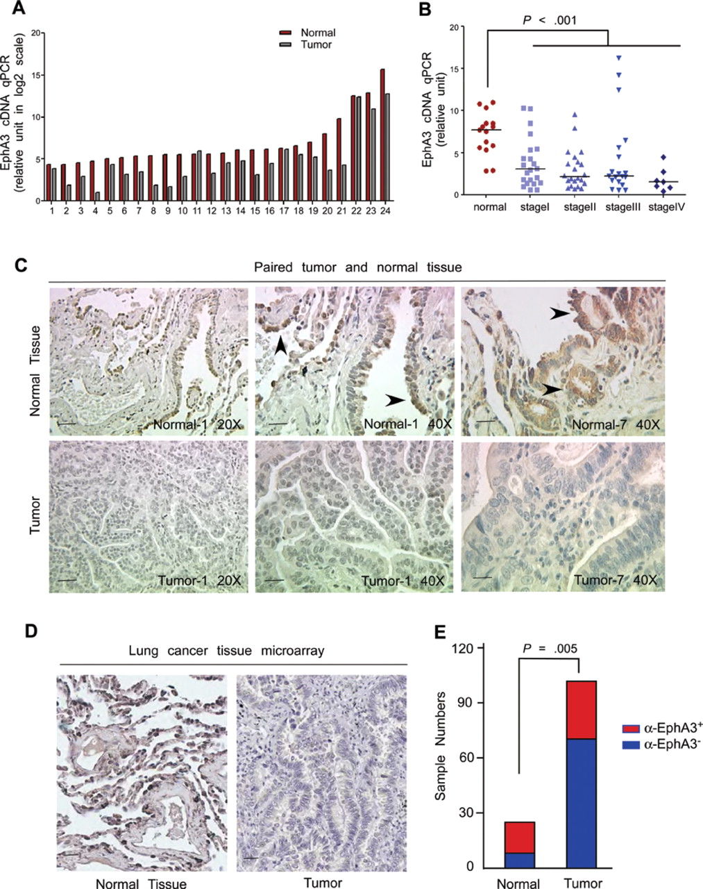
Figure 2. EPHA3 expression in human non–small cell lung cancer (NSCLC). A) EPHA3 expression in paired human lung tumors ...
Notes:
Figure 2. EPHA3 expression in human non–small cell lung cancer (NSCLC). A) EPHA3 expression in paired human lung tumors and normal tissues. A panel of cDNAs from 24 paired samples of human lung tumors and normal lung tissue was purchased from Origene Technologies Inc (TissueScan lung cancer tissue qPCR array IV-matched pairs). EPHA3 expression in these patient samples was measured by quantitative polymerase chain reaction (qPCR) and presented as relative expression level normalized to glyceraldehyde 3-phosphate dehydrogenase (GAPDH) on a log2 scale. B) EPHA3 expression in different stages of lung cancer. Two panels of cDNAs from 15 normal lung tissue and 70 cancer samples were purchased from Origene Technologies Inc (TissueScan lung cancer tissue qPCR array III and V). EPHA3 expression was measured by quantitative PCR and is presented as the relative expression level normalized to GAPDH. Shown are the data from individual samples (each symbol representing one patient) and the median values stratified according to clinical stage and plotted relative to similar analyses of a tissue collection of normal lung samples Figure 2 (continued).(P < .001, two-sided Kruskal–Wallis test followed by two-sided individual Mann–Whitney tests). C) EPHA3 protein expression in paired tumor and normal lung tissues. EPHA3 expression was analyzed in nine paired lung cancer and nontumor lung tissues by immunohistochemistry using a monoclonal anti-EPHA3 antibody, the specificity of which was verified in Supplementary Figure 3, 3B (available online). Shown are representative photomicrographs from two out of a total of nine pairs of tumor samples that could be matched with non-tumor lung tissue from the same patient. Arrowheads indicate examples of EPHA3-positive cells (brown) in normal lung tissues. Scale bar on the left two panels: 50 µm; scale bar on the right four panels: 20 µm. D and E) EPHA3 expression in a human lung cancer tissue microarray. EPHA3 expression in tumor samples was assessed by immunohistochemistry in a tissue microarray containing tumor tissue from 104 lung cancer micro-samples and 26 normal lung samples. A representative photomicrograph of EPHA3 immunohistochemistry in tumor or normal tissue is shown in (D). Scale bar: 20 µm. The aggregate numbers of anti-EPHA3 positive (red) and negative (blue) samples in normal and cancer samples are shown in (E) (P = .005, two-sided χ2 test).
Unless provided in the caption above, the following copyright applies to the content of this slide: © The Author 2012. Published by Oxford University Press. All rights reserved. For Permissions, please e-mail: journals.permissions@oup.com.

Slide 4
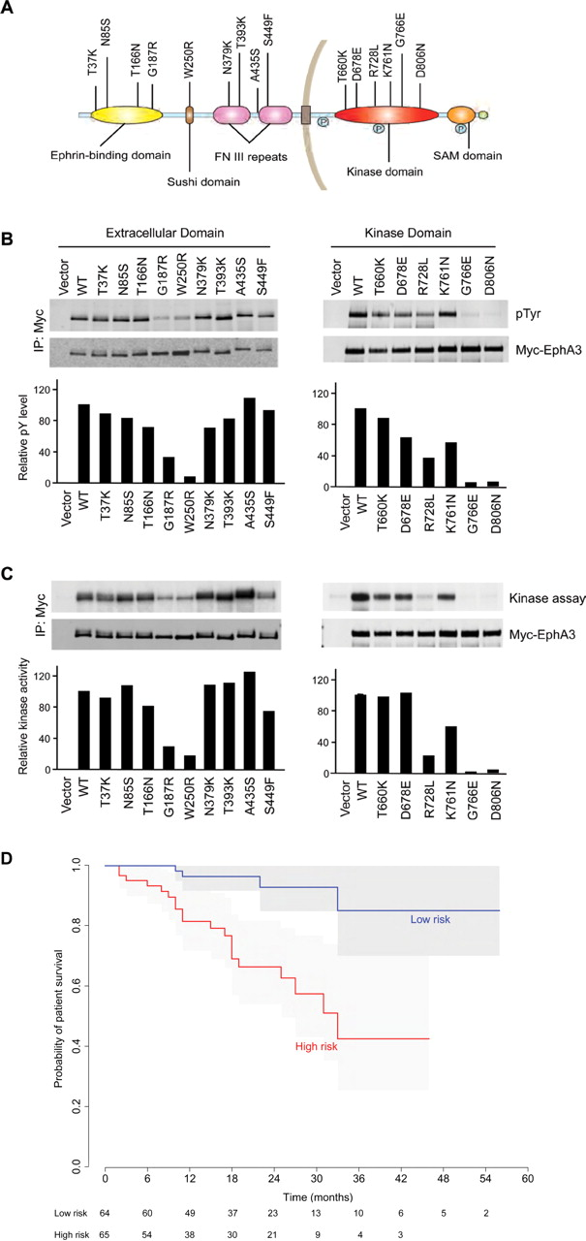
Figure 1. Cancer-associated EPHA3 mutants, receptor kinase activity, and patient prognosis. A) Diagram showing ...
Notes:
Figure 1. Cancer-associated EPHA3 mutants, receptor kinase activity, and patient prognosis. A) Diagram showing locations of EPHA3 mutations relative to structural domains of the full length protein. Nine cancer-associated mutations mapped to the extracellular domain of EPHA3 and six mutations mapped to the intracellular kinase domain. B) Tyrosine phosphorylation of mutant EPHA3 receptors. Myc-tagged wild-type (WT) or mutant EPHA3 constructs were transfected into 293T cells. EPHA3 proteins were immunoprecipitated with anti-Myc antibodies, run on sodium Figure 1 (continued).dodecyl sulfate polyacrylamide gels, and immunoblotted. Representative immunoblots in which tyrosine phosphorylation levels were detected using anti-phosphotyrosine antibodies and EPHA3 protein expression was detected by an anti-Myc antibody are shown. Relative levels of phosphotyrosine in these mutants in three independent experiments were quantified in the bar graphs, normalized to wild-type (WT) EPHA3. C) Kinase activity of mutant EPHA3 receptors. Protein tyrosine kinase activity of the receptors was measured by in vitro kinase assays, with autoradiographic results of one representative experiment shown (“kinase assay”). Immunoblots were probed with an anti-Myc antibody to control for levels of protein in each immune precipitate. The relative kinase activity of mutant EPHA3 receptors in three independent experiments was quantified in the bar graphs, normalized to wild-type (WT) EPHA3. D) Kaplan–Meier analysis showing the association of EPHA3 mutation–associated gene signature with patient survival. Three previously published lung cancer datasets were used separately for gene signature development, training, and testing purposes (detailed in “Methods”). Briefly, a linear model for microarray data was used to select genes that are differentially expressed between samples carrying wild-type vs mutant EPHA3. The selected genes were mapped to an independent training set of 104 human lung samples with survival information and tested in a second independent dataset of 129 patient tumor samples. Shown is the Kaplan–Meier analysis of survival data with 95% confidence intervals after stratification according to whether the mutation-associated gene expression signature was present (“high risk”) or not (“low risk”). The number of patients at risk is indicated below the x-axis. For continuous variables, P < .001; for binary variables, “high risk” vs “low risk,” P < .001, two-sided log-rank test.
Unless provided in the caption above, the following copyright applies to the content of this slide: © The Author 2012. Published by Oxford University Press. All rights reserved. For Permissions, please e-mail: journals.permissions@oup.com.

Slide 5
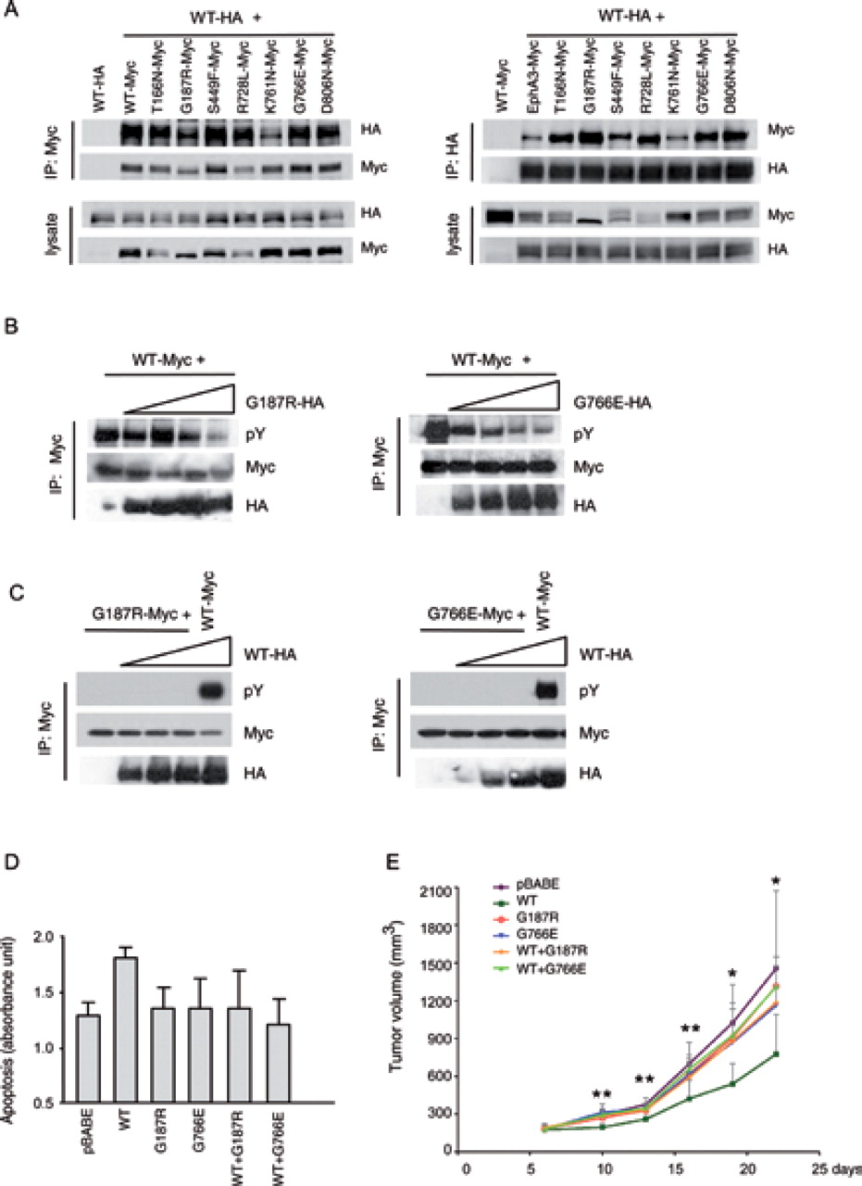
Figure 5. Effect of EPHA3 somatic mutations on tumor suppression. A) Interaction between wild-type and mutant EPHA3 ...
Notes:
Figure 5. Effect of EPHA3 somatic mutations on tumor suppression. A) Interaction between wild-type and mutant EPHA3 receptors. HA-tagged wild-type EPHA3 and Myc-tagged mutants were cotransfected into 293T cells, after which lysates were used for immunoprecipitation with either anti-Myc or anti-HA followed by immunoblotting with each of these antibodies. Shown are blots representative of two independent experiments. B and C) Effect of EPHA3 mutants (G187R or G766E) on wild-type (WT) receptor phosphorylation. B) Myc-tagged WT EPHA3 was cotransfected with HA-tagged mutants at a ratio of 1:0.5, 1:1, 1:2, and 1:4. WT receptors were immunoprecipitated with anti-Myc antibody and subjected to anti-phosphotyrosine blot analysis. Shown are blots representative of two independent experiments. C) Myc-tagged mutant EPHA3 were cotransfected with HA-tagged WT receptors at a ratio of 1:0.5, 1:1, and 1:2. Myc-tagged WT EPHA3 receptors were also cotransfected with HA-tagged WT proteins as a control. Mutant or WT receptors were immunoprecipitated with anti-Myc antibody and subjected to anti-phosphotyrosine blotting.Figure 5 (continued).Shown are blots representative of two independent experiments. Mutant-WT EPHA3 complexes are not phosphorylated. D and E) Effect of mutant EPHA3 on tumor suppression induced by wild-type EPHA3. EPHA3 mutant (G187R or G766E) was introduced into H1299 cells by retroviral transduction in the presence or absence of WT EPHA3. WT and mutant EPHA3 expression in the transduced cells was assessed by western blot analysis (Supplementary Figure 5, available online). D) H1299 cells expressing WT or mutant EPHA3, or coexpressing WT and mutant EPHA3, were treated with GST-TRAIL (5 µg/mL) for 24 hours to induce apoptosis, which was then analyzed using a Cell Death Detection ELISA kit. Shown are data from triplicate samples in one experiment representative of two independent experiments. E) H1299 cells expressing WT or mutant EPHA3, or coexpressing WT and mutant EPHA3, were injected into nude mice subcutaneously (n = 7 per group), as in Figure 3, 3C. Tumor size was measured every 3 days with a digital caliper, and tumor volumes were calculated. Shown are mean tumor volumes with 95% confidence intervals on the indicated dates (*P < .05, **P < .01, P = .001 at day 10, P < .001 at day 13, P = .009 at day 16, P = .030 at day 19, and P = .024 at day 22, two-sided ANOVA followed by individual two-sided t tests).
Unless provided in the caption above, the following copyright applies to the content of this slide: © The Author 2012. Published by Oxford University Press. All rights reserved. For Permissions, please e-mail: journals.permissions@oup.com.

