Slide 1
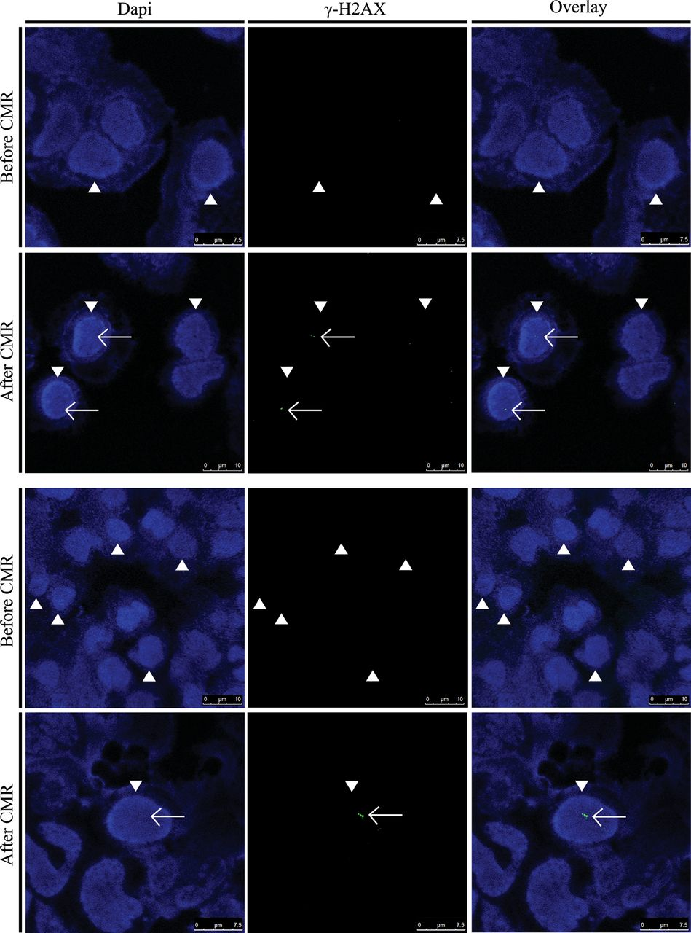
Figure 1 Visualization of double-strand breaks (DSBs) in nuclei (arrow heads) of human lymphocytes of two patients ...
Notes:
Figure 1 Visualization of double-strand breaks (DSBs) in nuclei (arrow heads) of human lymphocytes of two patients before and after cardiac magnetic resonance scans by immunofluorescence microscopy. DSBs (foci, white arrows) are detected by γ-H2AX staining (green).
Unless provided in the caption above, the following copyright applies to the content of this slide: © The Author 2013. Published by Oxford University Press on behalf of the European Society of Cardiology.This is an Open Access article distributed under the terms of the Creative Commons Attribution Non-Commercial License (http://creativecommons.org/licenses/by-nc/3.0/), which permits non-commercial re-use, distribution, and reproduction in any medium, provided the original work is properly cited. For commercial re-use, please contact journals.permissions@oup.com.

Slide 2
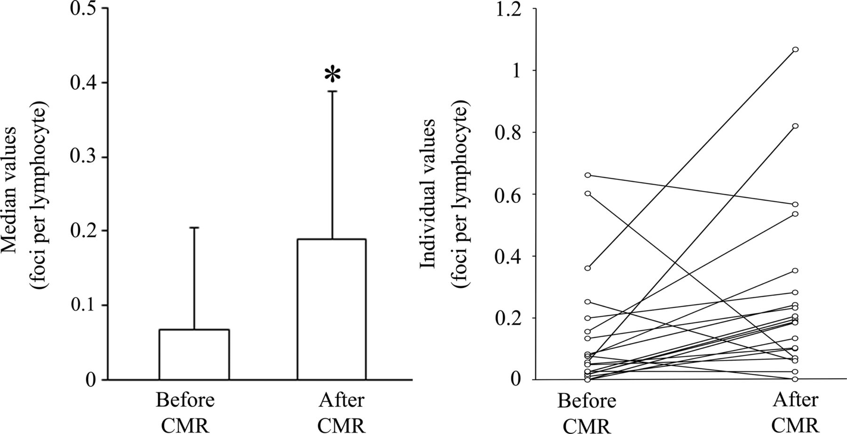
Figure 2 Amount of double-strand breaks before and after cardiac magnetic resonance (CMR) scan by immunofluorescence ...
Notes:
Figure 2 Amount of double-strand breaks before and after cardiac magnetic resonance (CMR) scan by immunofluorescence microscopy. After CMR scanning, there was a significant increase (*P < 0.05) in γ-H2AX foci per lymphocyte by immunofluorescence microscopy. Bars indicate median values with median absolute deviation (left panel) and individual values are interconnected with a line (right panel).
Unless provided in the caption above, the following copyright applies to the content of this slide: © The Author 2013. Published by Oxford University Press on behalf of the European Society of Cardiology.This is an Open Access article distributed under the terms of the Creative Commons Attribution Non-Commercial License (http://creativecommons.org/licenses/by-nc/3.0/), which permits non-commercial re-use, distribution, and reproduction in any medium, provided the original work is properly cited. For commercial re-use, please contact journals.permissions@oup.com.

Slide 3
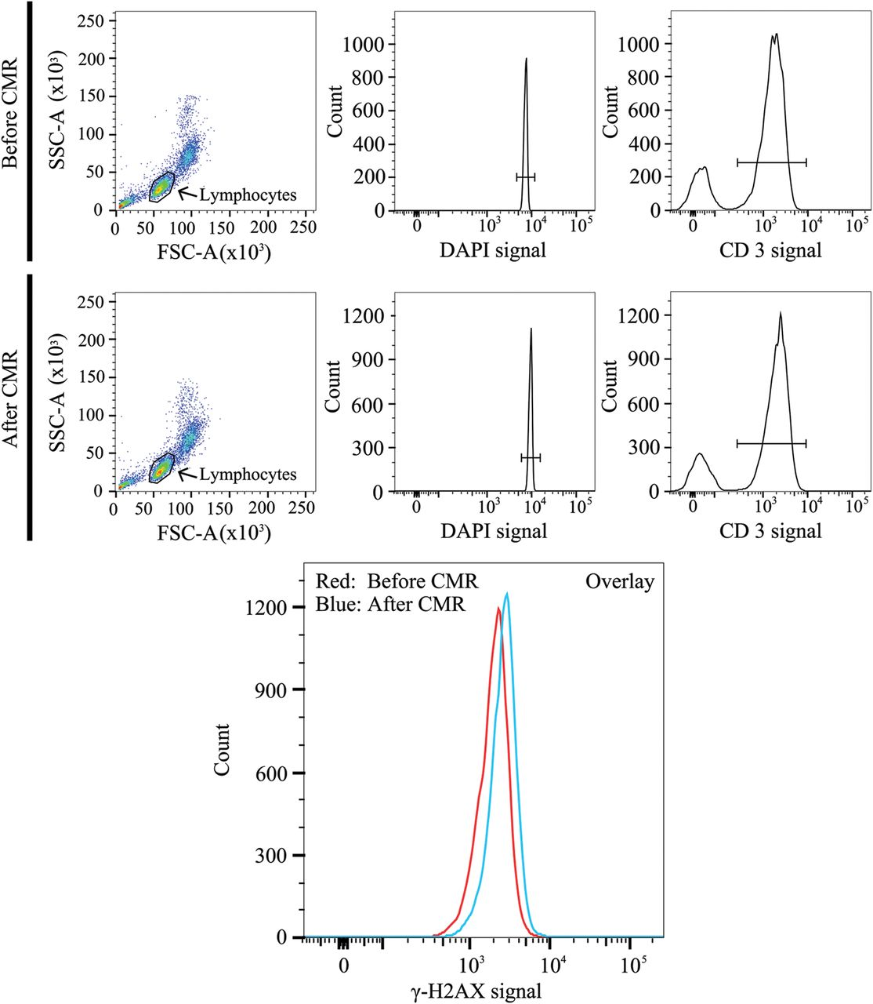
Figure 3 Flow cytometric analysis of double-strand breaks (γ-H2AXpositive T-lymphocytes) before and after cardiac ...
Notes:
Figure 3 Flow cytometric analysis of double-strand breaks (γ-H2AXpositive T-lymphocytes) before and after cardiac magnetic resonance (CMR) scan. T-lymphocytes were readily identified by representative dot plots and histograms (lymphocytes, DAPI, and CD3). The shift of the left curve (red, before CMR) to the right curve (blue, after CMR) in the presented overlay indicates an increase in double-strand breaks (γ-H2AXpositive T-lymphocytes). SSC-A: side scatter channel area. FSC-A: forward scatter channel area. DAPI: 4′,6-diamidino-2-phenylindole, counterstaining cell nuclei. CD3: mouse-anti-human CD3-APC antibody counterstaining specifically the T-lymphocytes.
Unless provided in the caption above, the following copyright applies to the content of this slide: © The Author 2013. Published by Oxford University Press on behalf of the European Society of Cardiology.This is an Open Access article distributed under the terms of the Creative Commons Attribution Non-Commercial License (http://creativecommons.org/licenses/by-nc/3.0/), which permits non-commercial re-use, distribution, and reproduction in any medium, provided the original work is properly cited. For commercial re-use, please contact journals.permissions@oup.com.

Slide 4
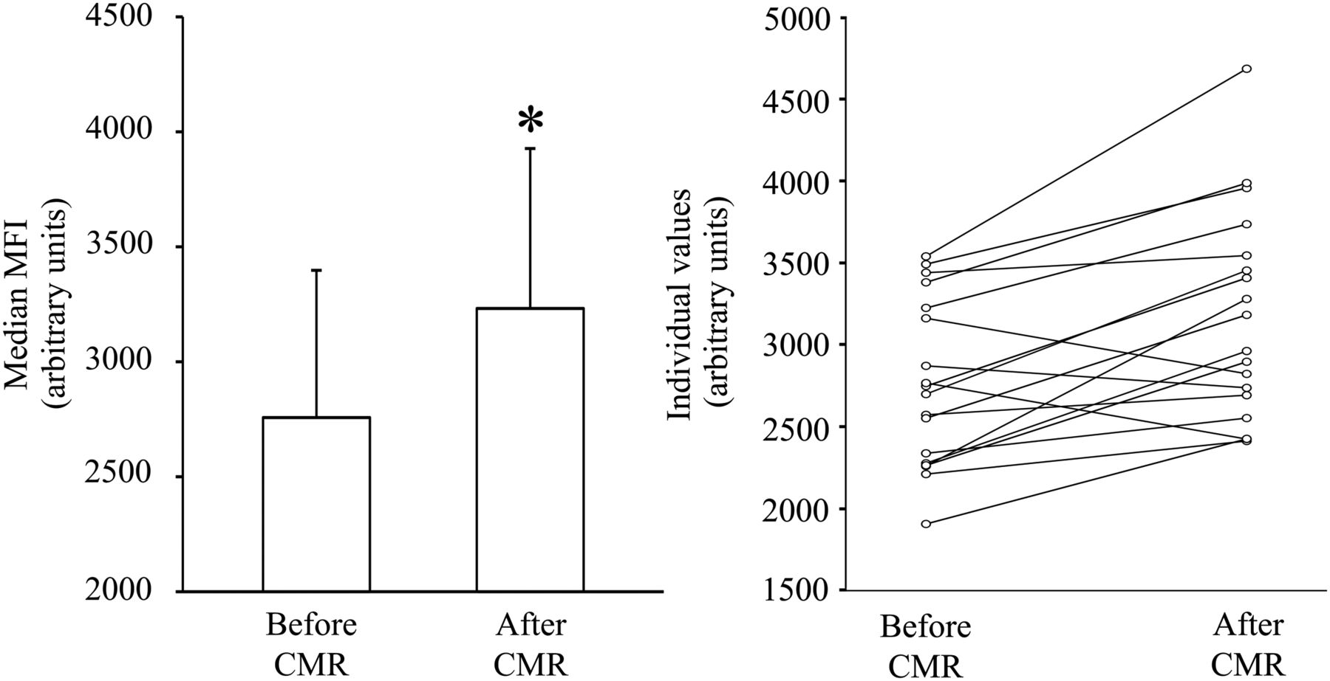
Figure 4 Amount of double-strand breaks before and after cardiac magnetic resonance scan by flow cytometry of ...
Notes:
Figure 4 Amount of double-strand breaks before and after cardiac magnetic resonance scan by flow cytometry of γ-H2AXpositive T-lymphocytes using geometric mean fluorescence intensity (MFI). The median MFI increased significantly after cardiac magnetic resonance scanning (*P < 0.005, left panel). Individual values are interconnected with a line (right panel).
Unless provided in the caption above, the following copyright applies to the content of this slide: © The Author 2013. Published by Oxford University Press on behalf of the European Society of Cardiology.This is an Open Access article distributed under the terms of the Creative Commons Attribution Non-Commercial License (http://creativecommons.org/licenses/by-nc/3.0/), which permits non-commercial re-use, distribution, and reproduction in any medium, provided the original work is properly cited. For commercial re-use, please contact journals.permissions@oup.com.

