Slide 1
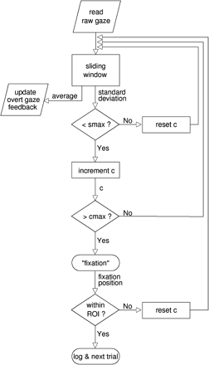
Fig. 1 Flow diagram of gaze data processing. Raw gaze data is stored in a sliding window vector whose average value ...
Notes:
Fig. 1 Flow diagram of gaze data processing. Raw gaze data is stored in a sliding window vector whose average value is shown as a gaze cursor in overt gaze feedback paradigms. A counter (c) increments for each consecutive updated sliding window data vector whose standard deviation is below a prespecified threshold (smax). The gaze status is identified as ‘fixation’ if a prespecified number (cmax) of consecutive sliding windows is reached. The average gaze position is thereafter tested for being within one of a given set of ROIs. The described procedure is typically run until a fixation was found within one of the given ROIs triggering a step forward in the experimental paradigm, e.g. the presentation of a new visual stimulus or the change of the gaze direction of a virtual character.
Unless provided in the caption above, the following copyright applies to the content of this slide: © The Author(s) (2010). Published by Oxford University Press.This is an Open Access article distributed under the terms of the Creative Commons Attribution Non-Commercial License (http://creativecommons.org/licenses/by-nc/4.0/), which permits non-commercial re-use, distribution, and reproduction in any medium, provided the original work is properly cited. For commercial re-use, please contact journals.permissions@oup.com

Slide 2
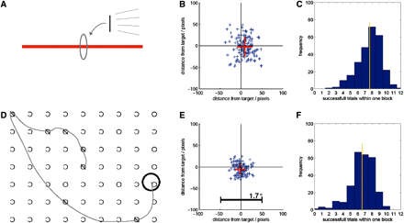
Fig. 2 Overt gaze feedback tasks. (A) While being scanned using ‘dummy’ fMRI scans, a subject was instructed to ...
Notes:
Fig. 2 Overt gaze feedback tasks. (A) While being scanned using ‘dummy’ fMRI scans, a subject was instructed to bisect a horizontal line with a vertical line which is locked to her gaze. In effect, the subject performed the task by fixating the perceived line center. The screen positions of the horizontal lines were randomized. (B) Example of the spatial precision of one subject performing the bisection task. Each of the blue symbols represents one bisection position relative to the true line center. The red cross denotes the average and standard deviation of the spatial bisection error. (C) This histogram shows the frequency distribution of the number of line bisections that subjects were able to perform within one task/block length (21.9 s). On average over 18 subjects, each performing the tasks 15 times, 7.7 line bisections were successfully performed within one block length revealing a rather fluent task performance. (D) In a second task, the subject was asked to cancel targets (‘O’) among distractors by centering the black circle over each target until marked as cancelled. Since the circle's position was locked to the subject's gaze she only had to find and fixate the targets one by one. (E) The spatial precision of the same subject as in (B) performing the cancellation task. (F) On average over 18 subjects, 6.6 cancellations were successfully performed within one block.
Unless provided in the caption above, the following copyright applies to the content of this slide: © The Author(s) (2010). Published by Oxford University Press.This is an Open Access article distributed under the terms of the Creative Commons Attribution Non-Commercial License (http://creativecommons.org/licenses/by-nc/4.0/), which permits non-commercial re-use, distribution, and reproduction in any medium, provided the original work is properly cited. For commercial re-use, please contact journals.permissions@oup.com

Slide 3
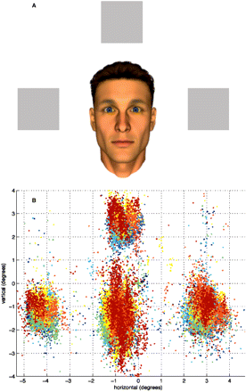
Fig. 3 Covert gaze feedback task. (A) Screenshot (as seen by participants) depicting anthropomorphic virtual ...
Notes:
Fig. 3 Covert gaze feedback task. (A) Screenshot (as seen by participants) depicting anthropomorphic virtual character and three objects. (B) Illustration of gaze samples obtained for one exemplary participant during the experiment.
Unless provided in the caption above, the following copyright applies to the content of this slide: © The Author(s) (2010). Published by Oxford University Press.This is an Open Access article distributed under the terms of the Creative Commons Attribution Non-Commercial License (http://creativecommons.org/licenses/by-nc/4.0/), which permits non-commercial re-use, distribution, and reproduction in any medium, provided the original work is properly cited. For commercial re-use, please contact journals.permissions@oup.com

Slide 4
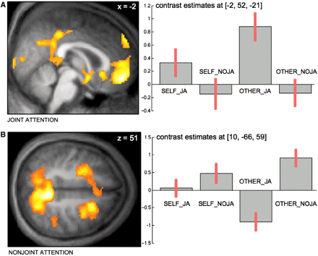
Fig. 4 Neural correlates of joint attention task. (A) Differential increase of neural activity in MPFC, PCC as well ...
Notes:
Fig. 4 Neural correlates of joint attention task. (A) Differential increase of neural activity in MPFC, PCC as well as ventral striatum and anterior temporal poles (latter not illustrated here) for main effect of joint attention. (B) Differential increase of neural activity in medial and lateral parietal as well as frontal cortex bilaterally for main effect of nonjoint attention (taken from: Schilbach et al., in press).
Unless provided in the caption above, the following copyright applies to the content of this slide: © The Author(s) (2010). Published by Oxford University Press.This is an Open Access article distributed under the terms of the Creative Commons Attribution Non-Commercial License (http://creativecommons.org/licenses/by-nc/4.0/), which permits non-commercial re-use, distribution, and reproduction in any medium, provided the original work is properly cited. For commercial re-use, please contact journals.permissions@oup.com

