Slide 1
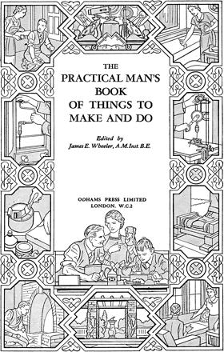
Fig 1. Frontispiece to The Practical Man's Book of Things to Make and Do, Odhams Press, 1935
Notes:
Fig 1. Frontispiece to The Practical Man's Book of Things to Make and Do, Odhams Press, 1935
Unless provided in the caption above, the following copyright applies to the content of this slide: © The Author [2006]. Published by Oxford University Press on behalf of The Design History Society. All rights reserved.

