Slide 1
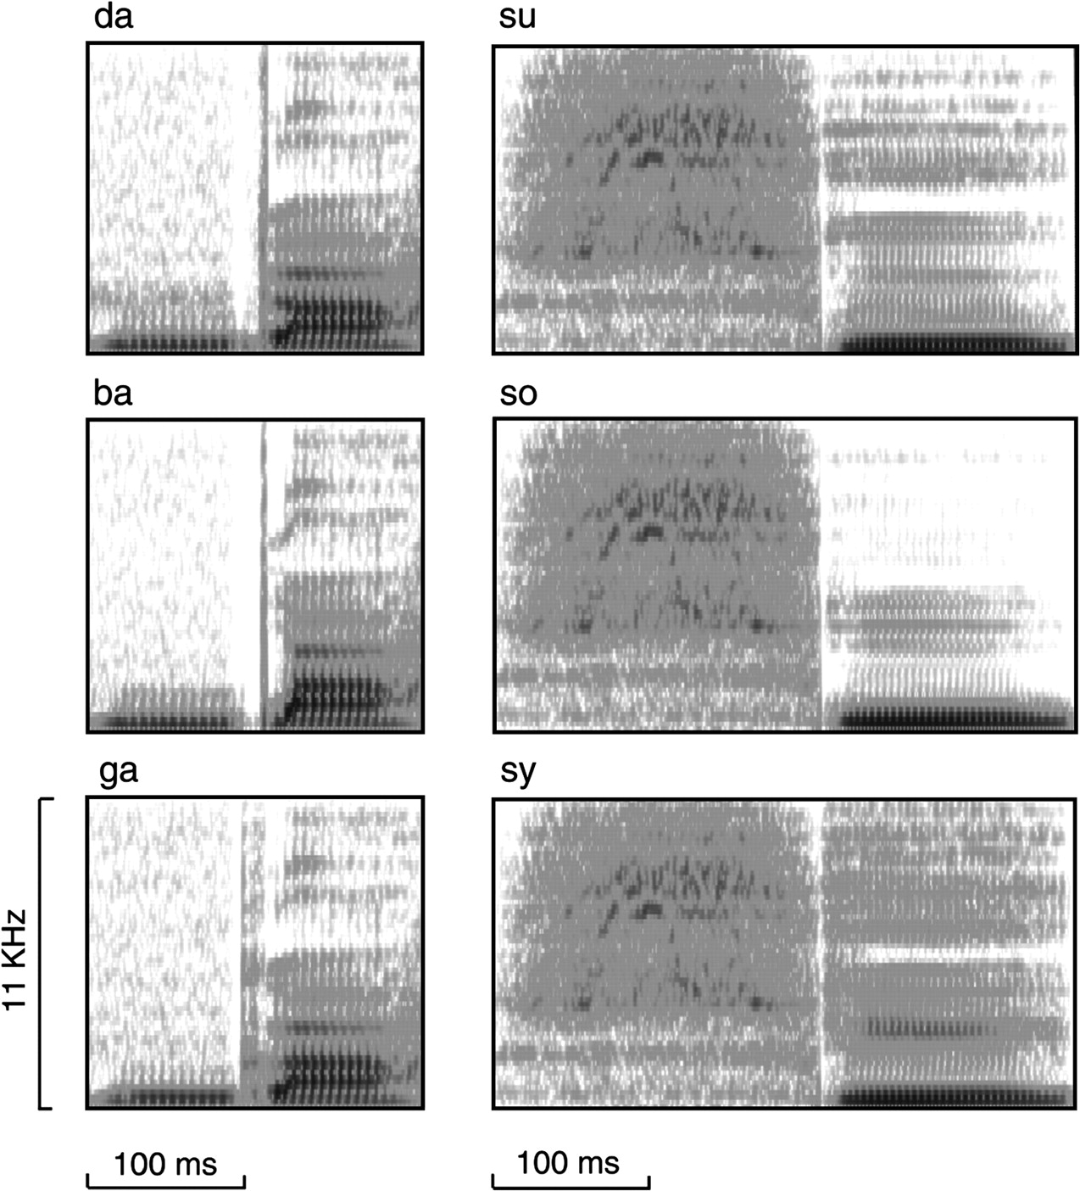
Figure 1. Spectrograms of the sounds used in the behavioral tests and MEG experiments.
Notes:
Figure 1. Spectrograms of the sounds used in the behavioral tests and MEG experiments.
Unless provided in the caption above, the following copyright applies to the content of this slide: © The Author 2006. Published by Oxford University Press. All rights reserved. For permissions, please e-mail: journals.permissions@oxfordjournals.org

Slide 2
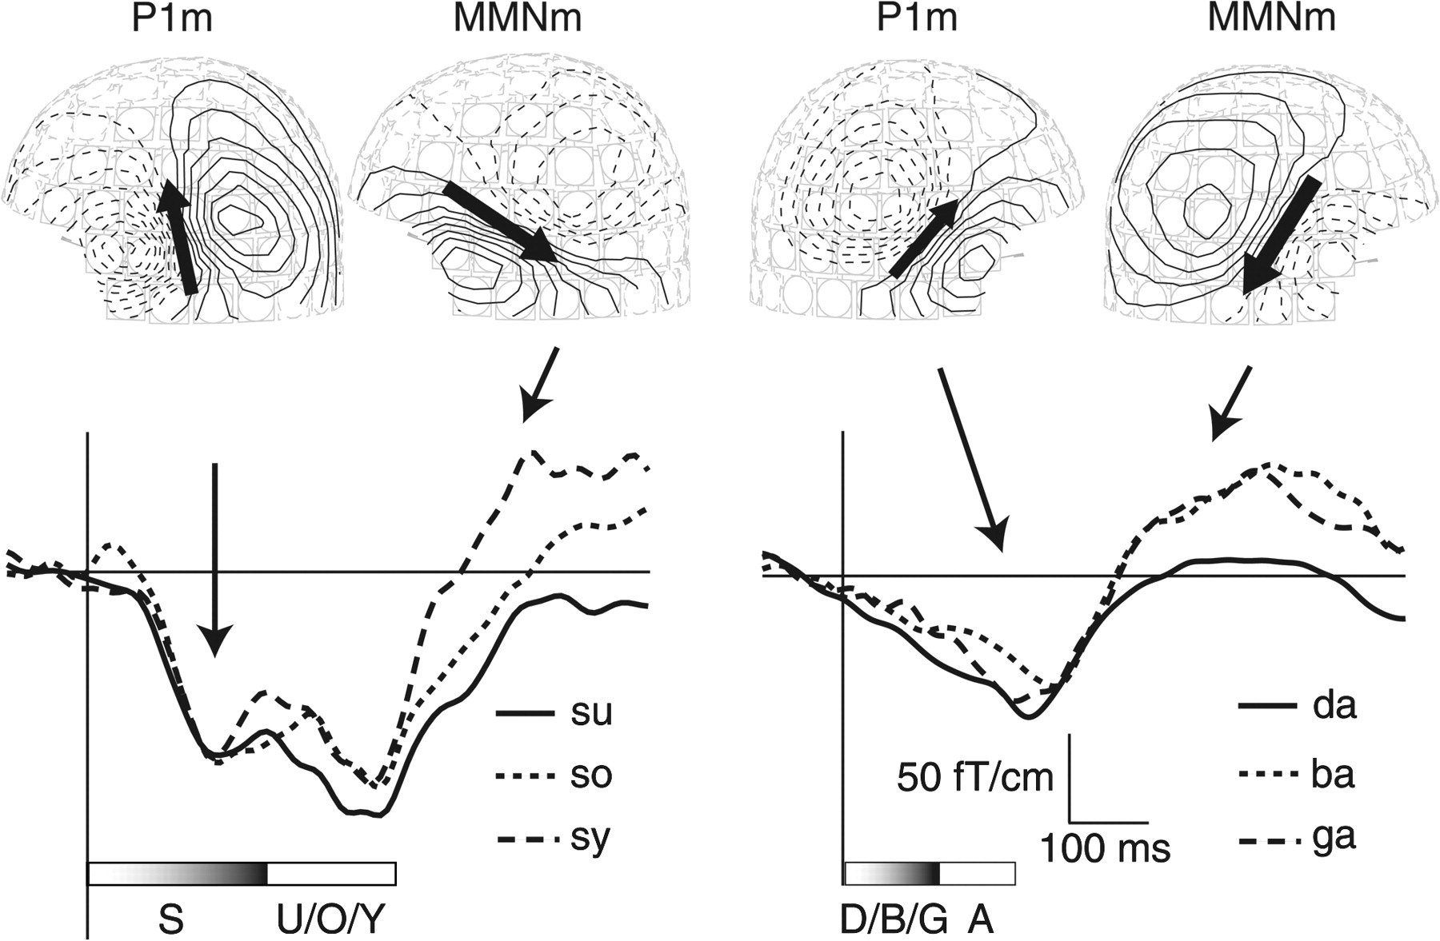
Figure 2. Auditory evoked magnetic fields from one child. On the left, responses to /su/ as standard and /so/ and /sy/ ...
Notes:
Figure 2. Auditory evoked magnetic fields from one child. On the left, responses to /su/ as standard and /so/ and /sy/ as deviants from one MEG channel located over the left temporal area. On the right are shown responses to /da/ as standard and deviants /ba/ and /ga/ from a channel located over the right temporal area. On the top, magnetic field distributions and ECD orientations during the peaks P1m, and mismatch response (MMNm) to the deviants /sy/ and /ga/ on the LH and RH, respectively. Continuous lines indicate magnetic flux going into the head and dashed lines the flux coming out of the head. The horizontal bars indicate the length of the stimuli.
Unless provided in the caption above, the following copyright applies to the content of this slide: © The Author 2006. Published by Oxford University Press. All rights reserved. For permissions, please e-mail: journals.permissions@oxfordjournals.org

Slide 3
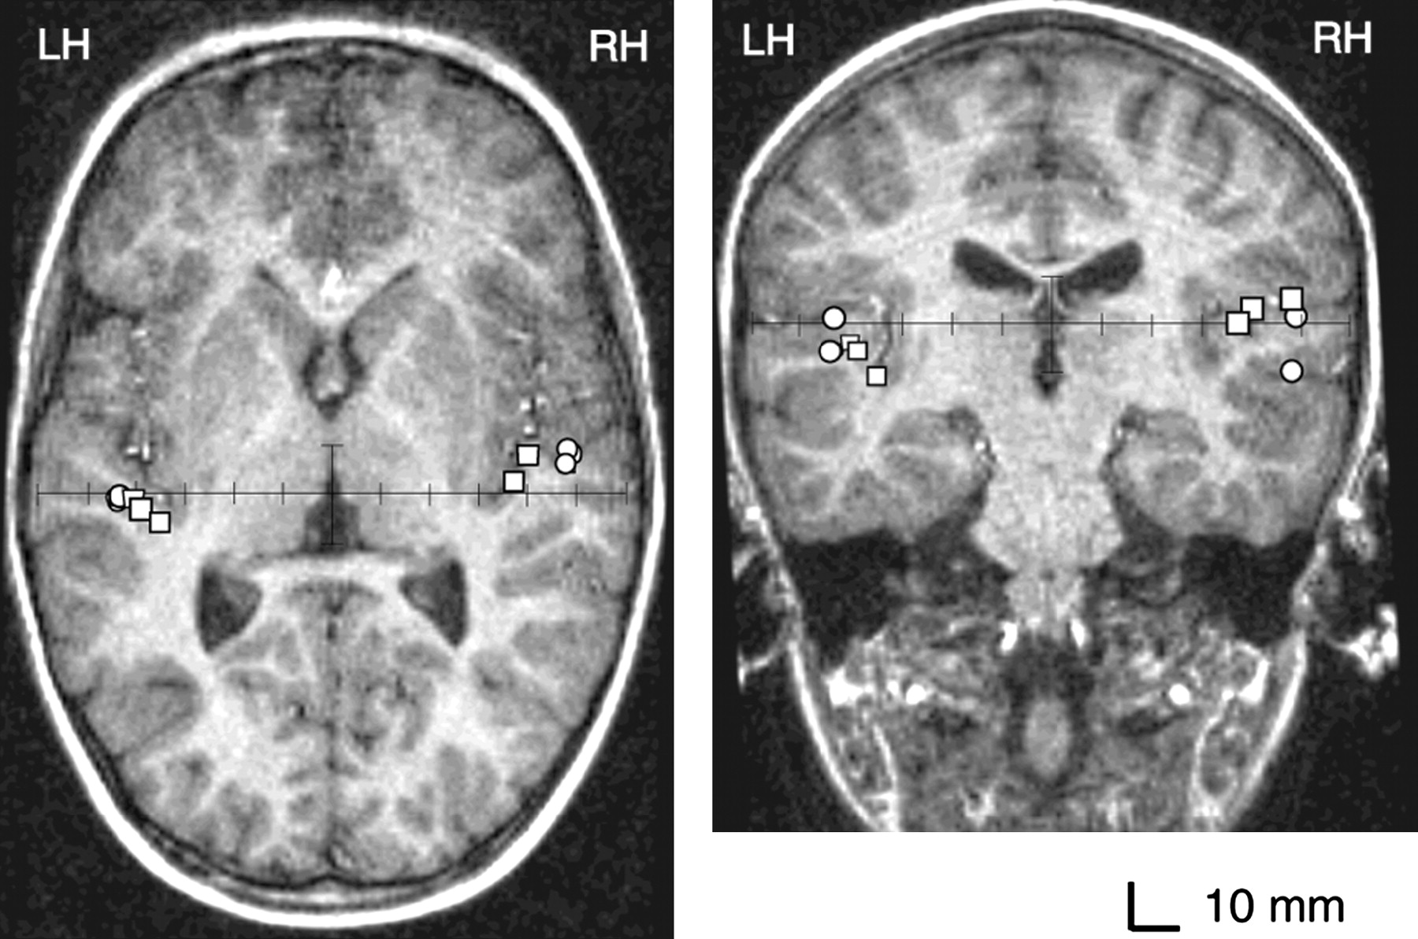
Figure 3. Mean locations of the ECDs of P1m of standards /da/ and /su/ and P2m of /su/ (spheres) and those of MMNm to ...
Notes:
Figure 3. Mean locations of the ECDs of P1m of standards /da/ and /su/ and P2m of /su/ (spheres) and those of MMNm to /ba/, /ga/, and /sy/ (squares) in horizontal (left panel) and coronal (right panel) planes. The magnetic resonance imaging is of one 6-year-old child with normal language development.
Unless provided in the caption above, the following copyright applies to the content of this slide: © The Author 2006. Published by Oxford University Press. All rights reserved. For permissions, please e-mail: journals.permissions@oxfordjournals.org

Slide 4
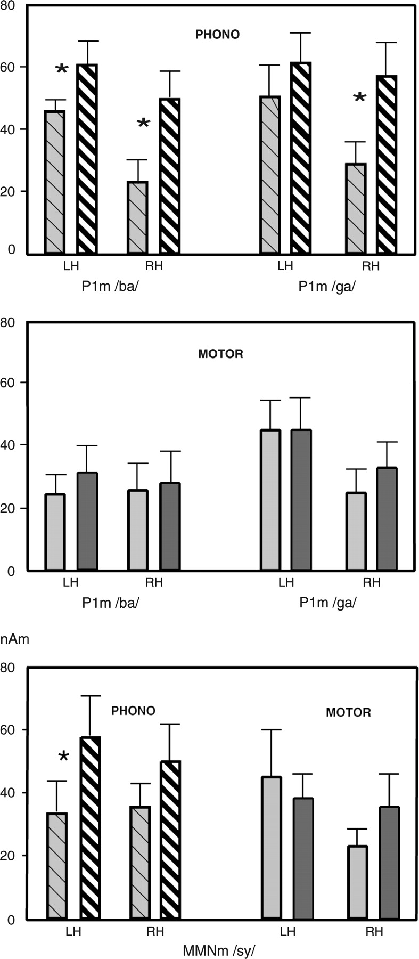
Figure 4. Source strength of the evoked magnetic responses of pre- and postintervention measurements in the PHONO and ...
Notes:
Figure 4. Source strength of the evoked magnetic responses of pre- and postintervention measurements in the PHONO and MOTOR groups in the RH and LH. Bars with grayish color show preintervention and bars with darker color postintervention data. Two upper panels show the strength (in nanoampere meters) of P1m responses to /ba/ and /ga/ and the lower panel the strength of the MMNm to the deviant /sy/. Thin lines indicate standard error of mean. Asterisks indicate significant differences between pre- and postintervention measurements.
Unless provided in the caption above, the following copyright applies to the content of this slide: © The Author 2006. Published by Oxford University Press. All rights reserved. For permissions, please e-mail: journals.permissions@oxfordjournals.org

