Slide 1
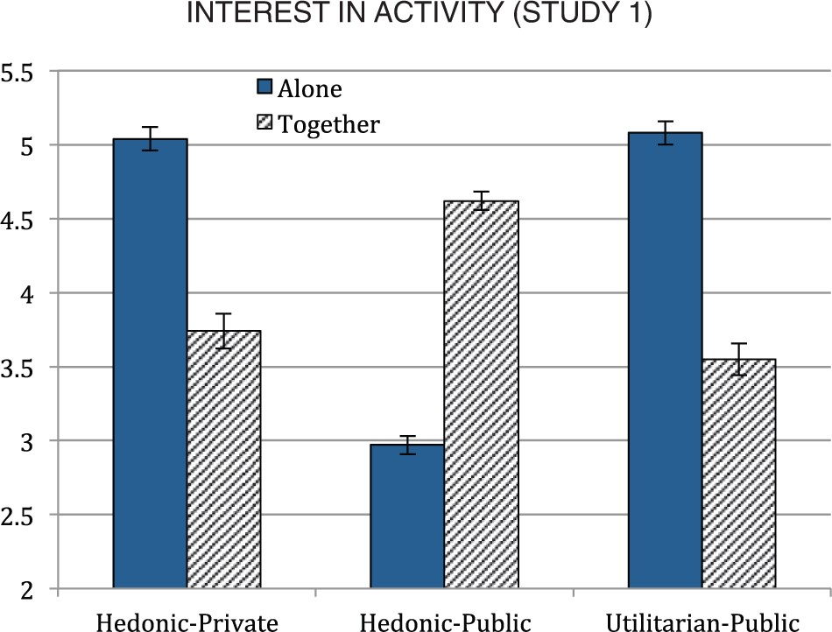
Figure 1 Interest in activity (study 1)
Notes:
Figure 1 Interest in activity (study 1)
Unless provided in the caption above, the following copyright applies to the content of this slide: © The Author 2015. Published by Oxford University Press on behalf of Journal of Consumer Research, Inc. All rights reserved. For permissions, please e-mail: journals.permissions@oup.com

Slide 2
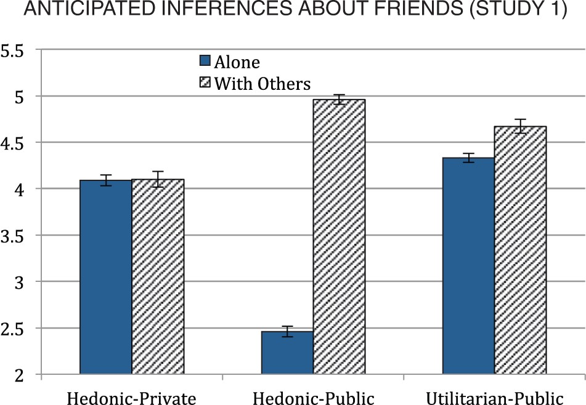
FIGURE 2 ANTICIPATED INFERENCES ABOUT FRIENDS (STUDY 1)
Notes:
FIGURE 2 ANTICIPATED INFERENCES ABOUT FRIENDS (STUDY 1)
Unless provided in the caption above, the following copyright applies to the content of this slide: © The Author 2015. Published by Oxford University Press on behalf of Journal of Consumer Research, Inc. All rights reserved. For permissions, please e-mail: journals.permissions@oup.com

Slide 3
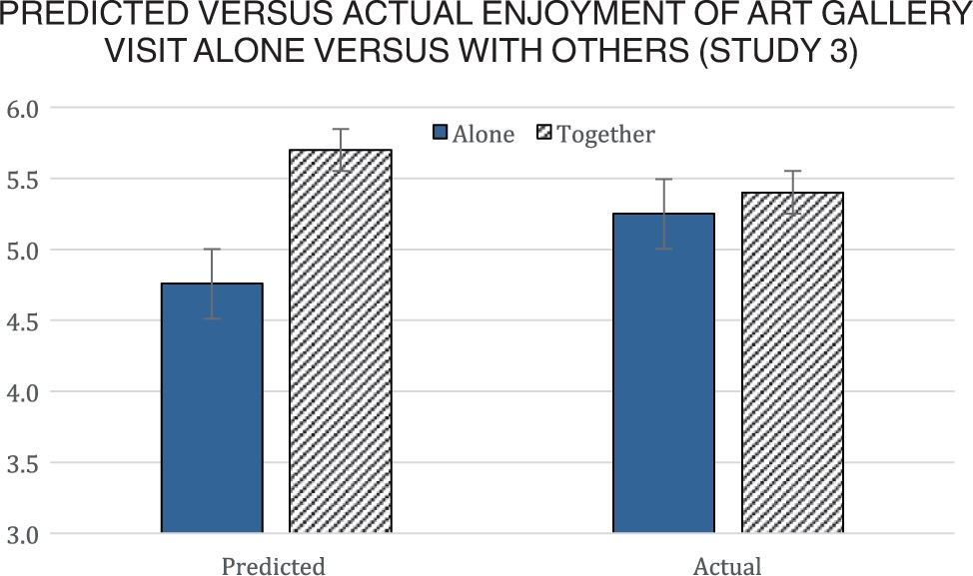
FIGURE 3 PREDICTED VERSUS ACTUAL ENJOYMENT OF ART GALLERY VISIT ALONE VERSUS WITH OTHERS (STUDY 3)
Notes:
FIGURE 3 PREDICTED VERSUS ACTUAL ENJOYMENT OF ART GALLERY VISIT ALONE VERSUS WITH OTHERS (STUDY 3)
Unless provided in the caption above, the following copyright applies to the content of this slide: © The Author 2015. Published by Oxford University Press on behalf of Journal of Consumer Research, Inc. All rights reserved. For permissions, please e-mail: journals.permissions@oup.com

Slide 4
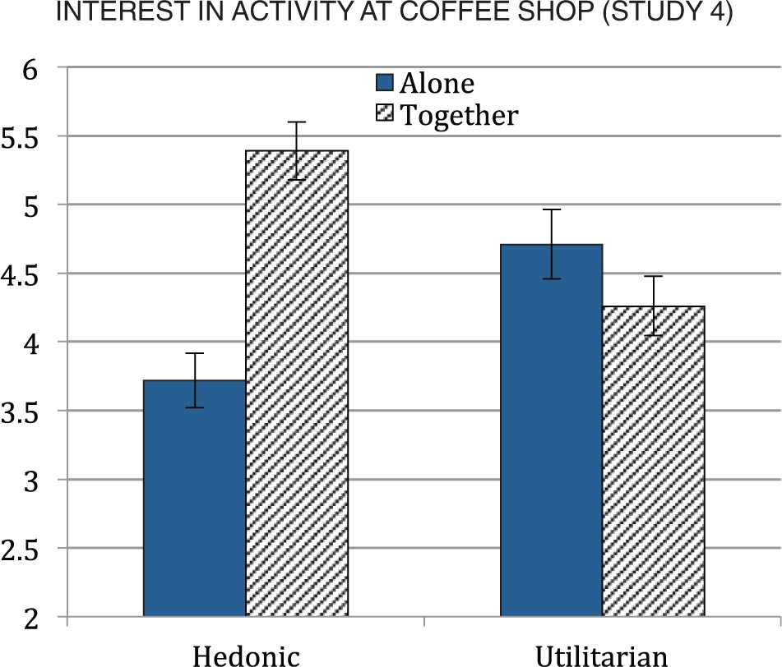
FIGURE 4 INTEREST IN ACTIVITY AT COFFEE SHOP (STUDY 4)
Notes:
FIGURE 4 INTEREST IN ACTIVITY AT COFFEE SHOP (STUDY 4)
Unless provided in the caption above, the following copyright applies to the content of this slide: © The Author 2015. Published by Oxford University Press on behalf of Journal of Consumer Research, Inc. All rights reserved. For permissions, please e-mail: journals.permissions@oup.com

Slide 5
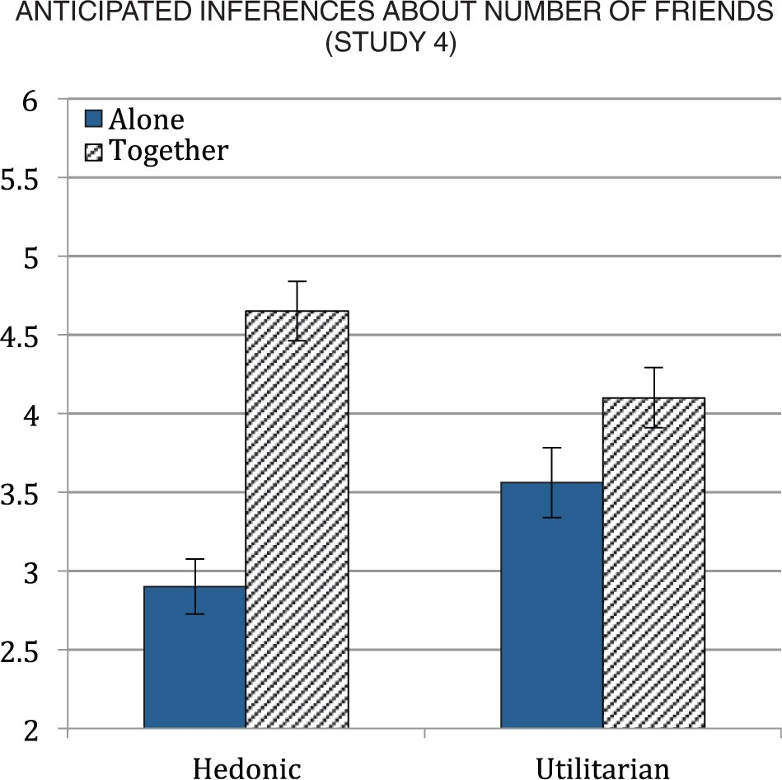
FIGURE 5 ANTICIPATED INFERENCES ABOUT NUMBER OF FRIENDS (STUDY 4)
Notes:
FIGURE 5 ANTICIPATED INFERENCES ABOUT NUMBER OF FRIENDS (STUDY 4)
Unless provided in the caption above, the following copyright applies to the content of this slide: © The Author 2015. Published by Oxford University Press on behalf of Journal of Consumer Research, Inc. All rights reserved. For permissions, please e-mail: journals.permissions@oup.com

