Slide 1
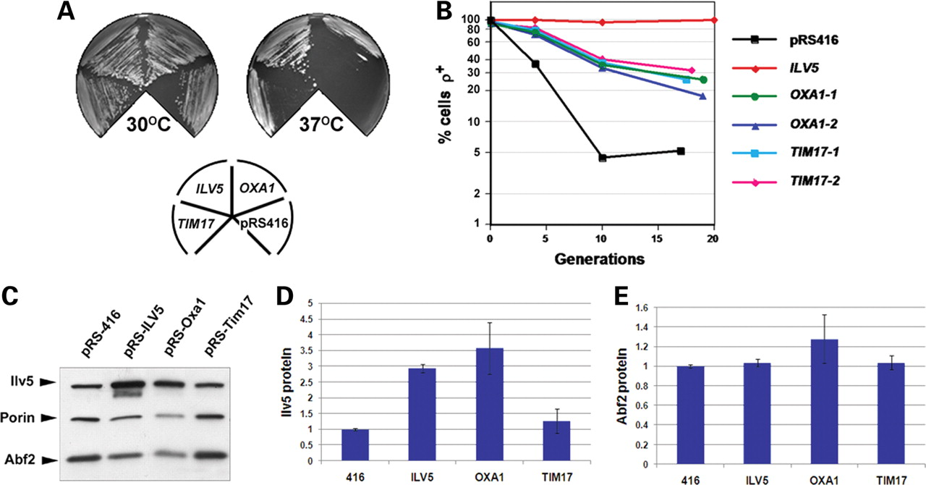
Figure 1. Overexpression of OXA1 and TIM17 suppresses the ts and mtDNA instability phenotypes of the ilv5 mutant W327R. ...
Notes:
Figure 1. Overexpression of OXA1 and TIM17 suppresses the ts and mtDNA instability phenotypes of the ilv5 mutant W327R. (A) W327R cells transformed with either pRS416 (416), pRS-ILV5 (ILV5), pRS-Oxa1 (OXA1) or pRS-Tim17 (TIM17) were streaked onto YPG medium and grown at either 30°C or 37°C. Note the partial suppression of the ts phenotype conferred by OXA1 and TIM17. (B) The same transformants as in (A) were pre-grown in YNBG + cas at 30°C, then shifted to YNBD + cas and aliquots plated out at three time points and scored by TTC overlay for the fraction of petites in the population. Two independent pRS-Oxa1 (OXA1-1 and OXA1-2) or pRS-Tim17 (TIM17-1 and TIM17-2) transformant lines were scored. (C) Representative immunoblot of Ilv5 and Abf2 protein levels in W327R transformants. Quantification of Ilv5 and Abf2 protein levels are shown in (D) and (E), relative to the levels in pRS416 control transformants that was arbitrarily set as 1. (D) Ilv5 levels are increased 3.5-fold in W327R cells transformed with pRS-Oxa1, whereas Ilv5 levels in pRS-Tim17 transformants are similar to controls cells transformed with pRS416. As expected, Ilv5 protein levels were increased (2.7-fold) in pRS-ILV5 transformants. (E) Abf2 protein levels are similar to controls in pRS-Oxa1 and pRS-Tim17 transformants. All cultures were grown overnight in YNBG + cas prior to immunoblot analysis. Expression levels in (D) and (E) are calculated relative to porin-loading control and values shown are the average of two independent experiments (see Materials and Methods). Averages are shown ±1 SEM.
Unless provided in the caption above, the following copyright applies to the content of this slide: © The Author 2008. Published by Oxford University Press. All rights reserved. For Permissions, please email: journals.permissions@oxfordjournals.org

Slide 2
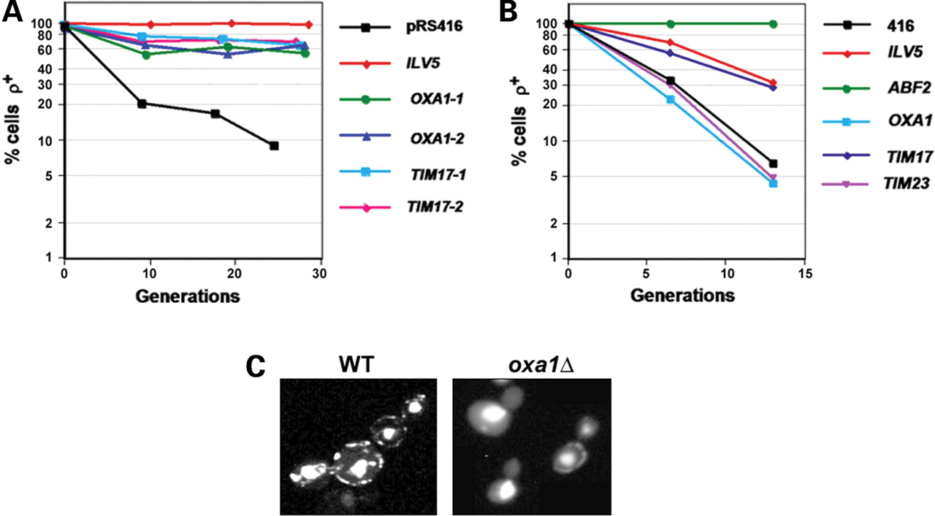
Figure 2. TIM17, but not OXA1, is a general suppressor of mtDNA loss in yeast. (A) ilv5Δ cells transformed with pRS416, ...
Notes:
Figure 2. TIM17, but not OXA1, is a general suppressor of mtDNA loss in yeast. (A) ilv5Δ cells transformed with pRS416, pRS-ILV5 (ILV5), pRS-Oxa1 (two independent transformant lines were used: OXA1-1 and OXA1-2) or pRS-Tim17 (two independent transformant lines were used: TIM17-1 and TIM17-2) were pre-grown in YNBG + cas, then shifted to YNBD + cas, aliquots removed at three time points and the fraction of petites in the population scored as in Figure 1B. (B) mtDNA loss in abf2Δ cells transformed with pRS416, pRS-ILV5 (ILV5), pRS-Oxa1 (OXA1), pRS-Tim17 (TIM17) or pRS-Tim23 (TIM23) was determined as in (A). (C) Wild-type and oxa1Δ cells were grown on YPD and stained with DAPI to identify mtDNA. The strong central staining in all cells is nuclear DNA, whereas the peripheral punctate staining is mtDNA (each punctate body contains one to two mtDNA genomes). oxa1Δ cells may be in the process of losing their mtDNA since, in some cells, a single punctate body can be seen in the mother cell and none in the daughter bud.
Unless provided in the caption above, the following copyright applies to the content of this slide: © The Author 2008. Published by Oxford University Press. All rights reserved. For Permissions, please email: journals.permissions@oxfordjournals.org

Slide 3
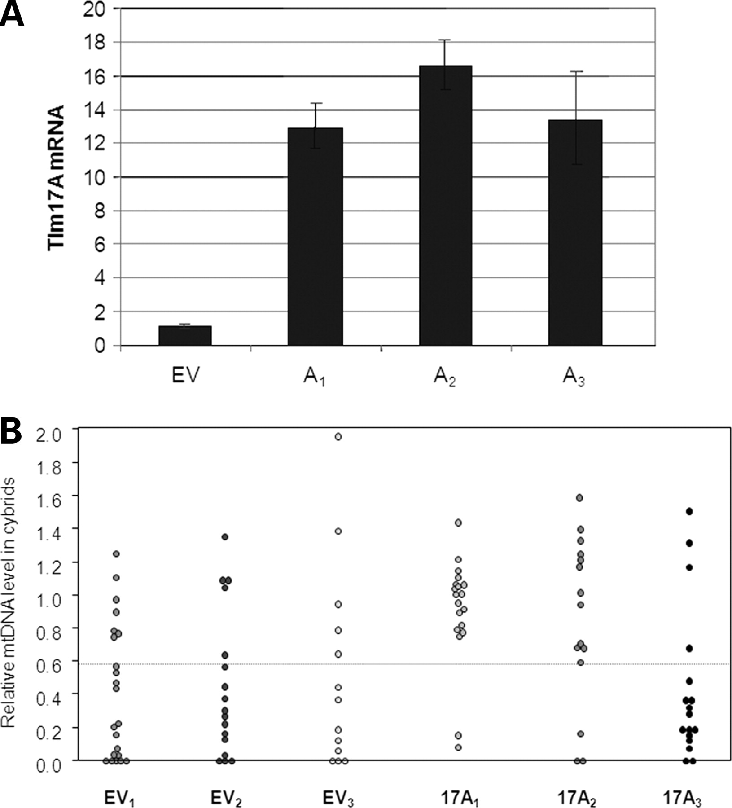
Figure 3. Decreased frequency of mtDNA depletion in two out of three NT2 ρ⁰ cell lines carrying ...
Notes:
Figure 3. Decreased frequency of mtDNA depletion in two out of three NT2 ρ0 cell lines carrying pIIRES.Tim17A. (A) TIM17A overexpression in NT2 ρ0 cells. NT2 ρ0 cells were transfected with pIRES.Hyg3 (empty vector—EV) or with pIRES.Hyg3 containing the human TIM17A gene (A1–A3). Hygromycin-resistant clones were expanded and RNA samples isolated for qPCR of TIM17A mRNA level relative to GAPDH. EV is the combined data from five control cell lines without the TIM17A gene and is arbitrarily set at 1. A1–A3 are the three clones that initially expressed TIM17A at a level >10-fold that of EV cell lines. Other clones showing more modest increases in TIM17A expression were discarded. qPCR and last-cycle PCR analysis failed to detect mtDNA in pIRES.EV and pIRES.17A clones, confirming that they remained devoid of mtDNA after transfection (data not shown). (B) Three NT2 ρ0 cell lines containing empty plasmid (EV1–EV3) and three NT2 ρ0 cell lines containing the TIM17A expressing plasmid (A1–A3) were fused with donor cytoplasts (75% A3243G mtDNA). Cybrids were grown for 5–7 weeks following fusion and mtDNA levels measured using qPCR. Each point represents a clonal cybrid cell line generated from these fusions. Levels of mtDNA are relative to the level of mtDNA in 143B cells that was arbitrarily set as 1.
Unless provided in the caption above, the following copyright applies to the content of this slide: © The Author 2008. Published by Oxford University Press. All rights reserved. For Permissions, please email: journals.permissions@oxfordjournals.org

Slide 4
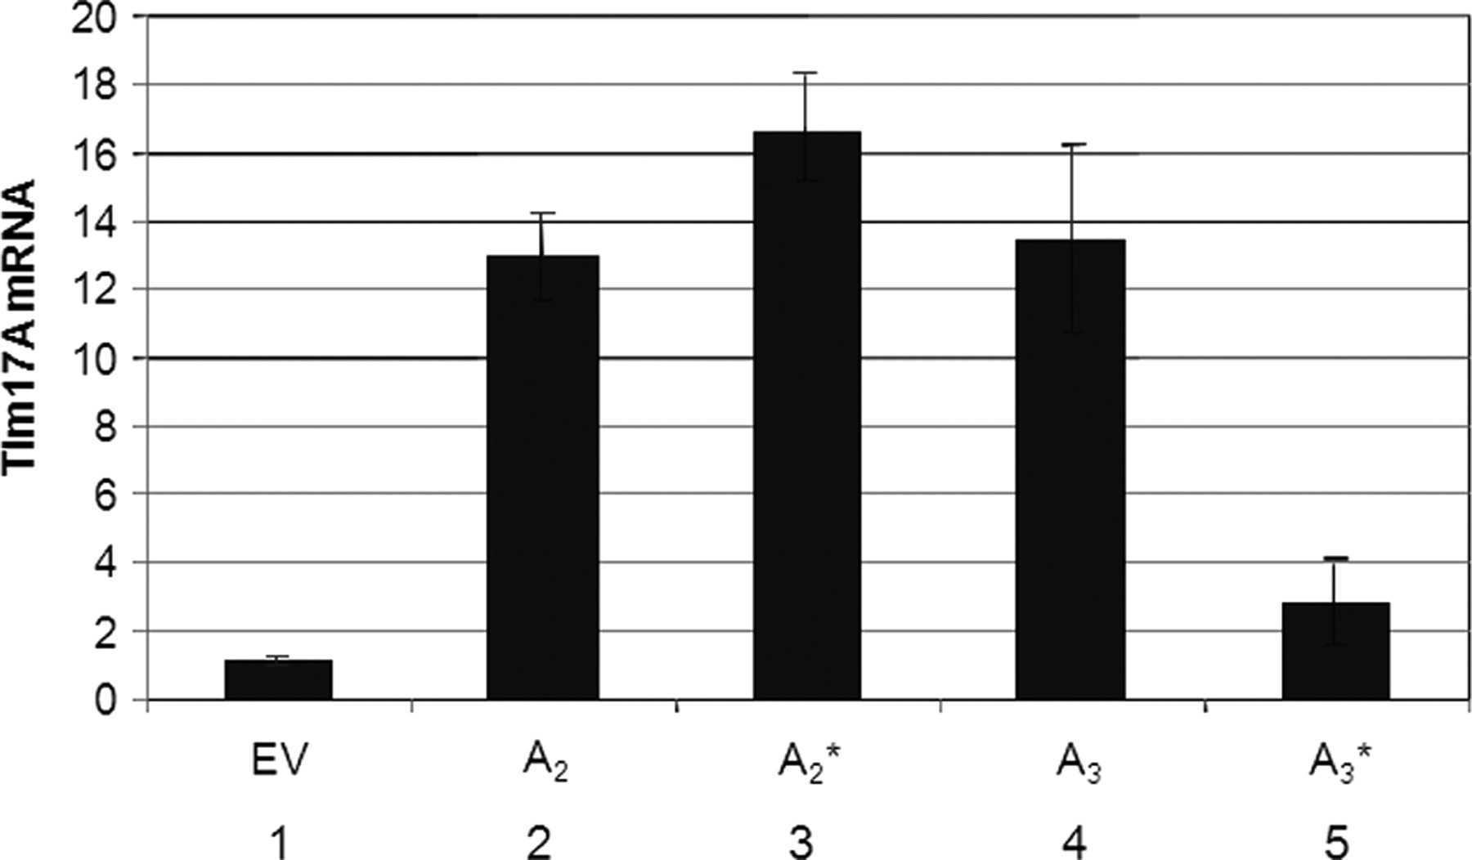
Figure 4. Declining TIM17A expression in NT2 ρ⁰ clone 17A₃. Columns one, two and four: the mean ...
Notes:
Figure 4. Declining TIM17A expression in NT2 ρ0 clone 17A3. Columns one, two and four: the mean level of expression of TIM17A in five clones carrying pIRES.Hyg3 (EV), expression of TIM17A transcript in clones NT2.17A2 (A2) and NT2.17A3 (A3), respectively (reproduced from Fig. 3A). Clones NT2.17A2 and NT2.17A3 were maintained in culture for a further 8 weeks before fusing to cytoplasts carrying A3243G mtDNA; at this time, RNA was again isolated and used to estimate TIM17A mRNA levels by qPCR (columns 3 and 5).
Unless provided in the caption above, the following copyright applies to the content of this slide: © The Author 2008. Published by Oxford University Press. All rights reserved. For Permissions, please email: journals.permissions@oxfordjournals.org

Slide 5
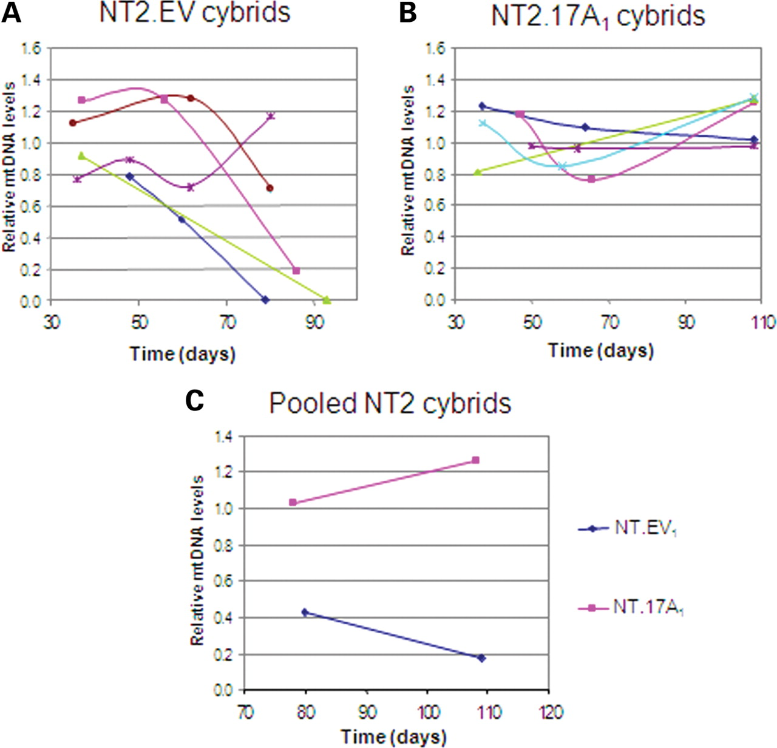
Figure 5. Long-term maintenance of mtDNA in NT2 Tim17A cybrids. (A) and (B) show mtDNA levels in samples taken from ...
Notes:
Figure 5. Long-term maintenance of mtDNA in NT2 Tim17A cybrids. (A) and (B) show mtDNA levels in samples taken from NT2.3243 cybrids cultured for extended periods of time. Cybrids in (A) are derived from the empty vector containing ρ0 cell line EV1, and the cybrids in (B) are derived from the Tim17A-expressing ρ0 cell line A1. (C) shows pooled populations of cybrids from the same fusion experiments. Levels of mtDNA were measured by qPCR and are shown relative to the same control cell line (143B) that was arbitrarily set at 1.
Unless provided in the caption above, the following copyright applies to the content of this slide: © The Author 2008. Published by Oxford University Press. All rights reserved. For Permissions, please email: journals.permissions@oxfordjournals.org

