Slide 1
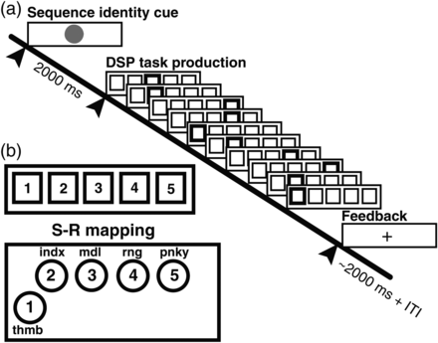
Figure 1. Trial structure and stimulus–response (S-R) mapping. (a) A trial began with the visual presentation of a ...
Notes:
Figure 1. Trial structure and stimulus–response (S-R) mapping. (a) A trial began with the visual presentation of a sequence identity cue (2 s), which was followed by the initial DSP stimulus (go cue). A correct key press led to the immediate succession of DSP target stimuli. Subjects received feedback “+” signaling sequence completion and waited (0–6 s) for the next trial. (b) Direct S-R mapping between response device, either MRI-compatible button box (shown) or keyboard, and the right hand.
Unless provided in the caption above, the following copyright applies to the content of this slide: © The Author 2014. Published by Oxford University Press. All rights reserved. For Permissions, please e-mail: journals.permissions@oup.com

Slide 2
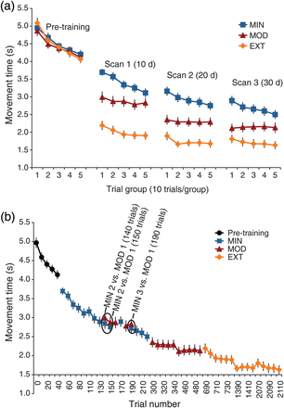
Figure 2. Performance effects during learning. (a) Chronologically ordered MTs from the scanning sessions reveal widely ...
Notes:
Figure 2. Performance effects during learning. (a) Chronologically ordered MTs from the scanning sessions reveal widely different amounts of improvement as a function of prior practice exposure. (b) MTs ordered to show the cumulative effect of practice. Note the similar performance for paired MOD and MIN sequences at 140, 150, and 190 trials of exposure, even though these comparisons span 2–3 weeks of chronologic time.
Unless provided in the caption above, the following copyright applies to the content of this slide: © The Author 2014. Published by Oxford University Press. All rights reserved. For Permissions, please e-mail: journals.permissions@oup.com

Slide 3
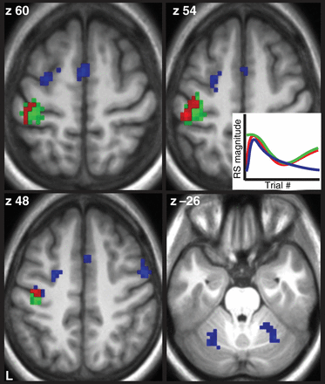
Figure 7. Conjunction of functional timescales of learning. Colors correspond to the timescale curves shown on the ...
Notes:
Figure 7. Conjunction of functional timescales of learning. Colors correspond to the timescale curves shown on the middle-right of the image. Red indicates initial learning, efficiency, and specialization, blue indicates initial learning and efficiency, and green indicates efficiency and specialization.
Unless provided in the caption above, the following copyright applies to the content of this slide: © The Author 2014. Published by Oxford University Press. All rights reserved. For Permissions, please e-mail: journals.permissions@oup.com

Slide 4
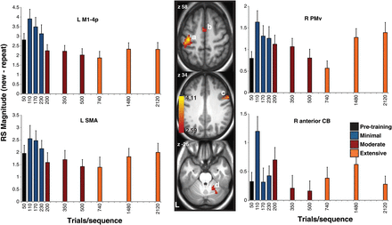
Figure 6. Effects of skill-specific specialization. Motor system regions show a quadratic RS response as a function of ...
Notes:
Figure 6. Effects of skill-specific specialization. Motor system regions show a quadratic RS response as a function of physical practice, with early decreases followed by late increases in RS. Images are displayed at a corrected threshold using topological FDR (q < 0.05), and follow neurological convention (left image is left brain). Bar plots are obtained from local maxima, ordered in terms of practice exposure rather than chronological time. M1, primary motor cortex; PMv, ventral premotor cortex; SMA, supplementary motor area; CB, cerebellum.
Unless provided in the caption above, the following copyright applies to the content of this slide: © The Author 2014. Published by Oxford University Press. All rights reserved. For Permissions, please e-mail: journals.permissions@oup.com

Slide 5
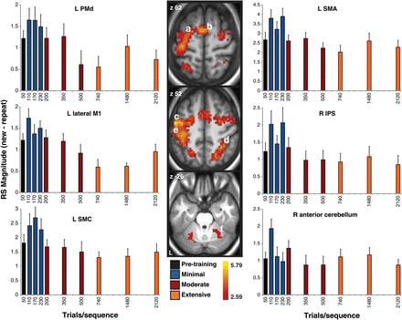
Figure 5. Effects of skill-specific efficiency. Motor system regions reflect skill-specific efficiency as evidenced by ...
Notes:
Figure 5. Effects of skill-specific efficiency. Motor system regions reflect skill-specific efficiency as evidenced by decreasing RS magnitude between 110 and 2120 practice trials. Images are displayed at a corrected threshold using topological FDR (q < 0.05), and follow neurological convention (left image is left brain). Bar plots are obtained from local maxima and extracted from the parameter estimates, ordered in terms of practice exposure rather than chronological time. SMA, supplementary motor area; M1, primary motor cortex; PMd, dorsal premotor cortex; SMC, somatosensory cortex; IPS, intraparietal sulcus.
Unless provided in the caption above, the following copyright applies to the content of this slide: © The Author 2014. Published by Oxford University Press. All rights reserved. For Permissions, please e-mail: journals.permissions@oup.com

Slide 6
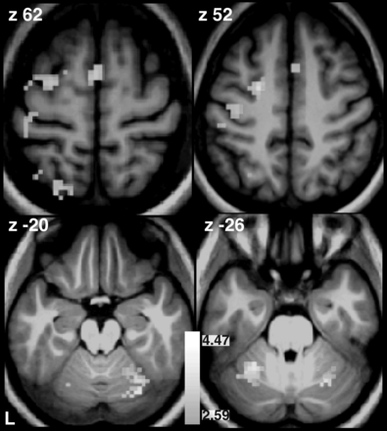
Figure 4. Initial formation of sequence knowledge. Primary and secondary cortical and subcortical motor system regions ...
Notes:
Figure 4. Initial formation of sequence knowledge. Primary and secondary cortical and subcortical motor system regions show increased RS at a rapid timescale (training session 1 MIN > pre-training session). Images are displayed at a corrected threshold using topological FDR (q < 0.05), and follow neurological convention (left image is left brain).
Unless provided in the caption above, the following copyright applies to the content of this slide: © The Author 2014. Published by Oxford University Press. All rights reserved. For Permissions, please e-mail: journals.permissions@oup.com

Slide 7
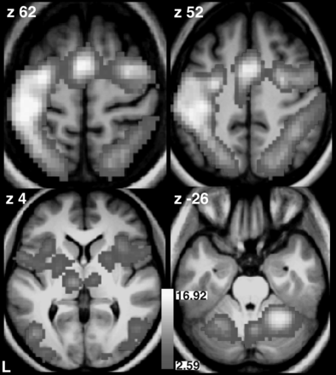
Figure 3. Main effect of RS magnitude for executing the DSP task, collapsed across all sequences, all sessions, and all ...
Notes:
Figure 3. Main effect of RS magnitude for executing the DSP task, collapsed across all sequences, all sessions, and all training intensities. Results are shown at a whole-brain-corrected threshold of P < 0.05 (FWE).
Unless provided in the caption above, the following copyright applies to the content of this slide: © The Author 2014. Published by Oxford University Press. All rights reserved. For Permissions, please e-mail: journals.permissions@oup.com

