Slide 1
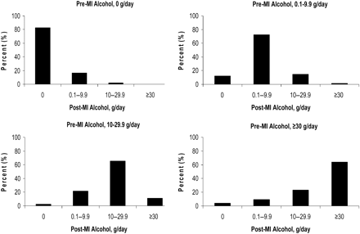
Figure 1 Alcohol consumption in relation to myocardial infarction diagnosis—percentage of participants changing ...
Notes:
Figure 1 Alcohol consumption in relation to myocardial infarction diagnosis—percentage of participants changing alcohol consumption post-myocardial infarction diagnosis compared with their pre-myocardial infarction alcohol consumption.
Unless provided in the caption above, the following copyright applies to the content of this slide: Published on behalf of the European Society of Cardiology. All rights reserved. © The Author 2012. For permissions please email: journals.permissions@oup.com

