Slide 1
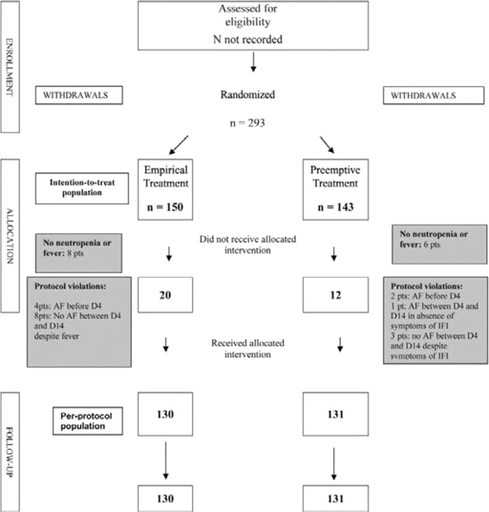
Figure 1 Consort flow chart. AF, antifungal prophylaxis; D4, day 4; D14, day 14; IFI, invasive fungal infection; pts, ...
Notes:
Figure 1 Consort flow chart. AF, antifungal prophylaxis; D4, day 4; D14, day 14; IFI, invasive fungal infection; pts, patients.
Unless provided in the caption above, the following copyright applies to the content of this slide: © 2009 by the Infectious Diseases Society of America

Slide 2
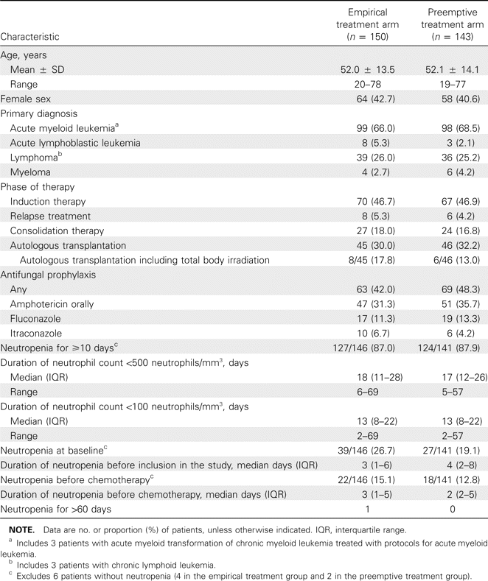
Table 1 Patient characteristics in the intention-to-treat population (n = 293).
Notes:
Table 1 Patient characteristics in the intention-to-treat population (n = 293).
Unless provided in the caption above, the following copyright applies to the content of this slide: © 2009 by the Infectious Diseases Society of America

Slide 3
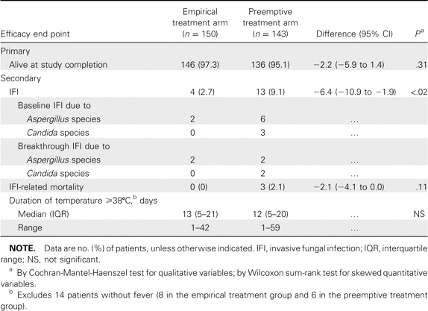
Table 2 Efficacy end points in the intention-to-treat population (n p 293).
Notes:
Table 2 Efficacy end points in the intention-to-treat population (n p 293).
Unless provided in the caption above, the following copyright applies to the content of this slide: © 2009 by the Infectious Diseases Society of America

Slide 4
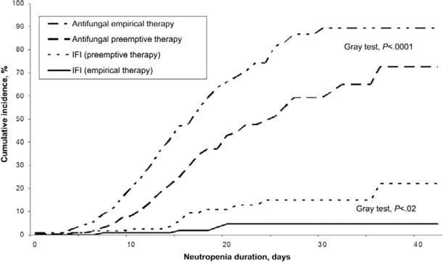
Figure 2 Cumulative incidence of antifungal therapy and invasive fungal infection (IFI) during neutropenia (n=287)
Notes:
Figure 2 Cumulative incidence of antifungal therapy and invasive fungal infection (IFI) during neutropenia (n=287)
Unless provided in the caption above, the following copyright applies to the content of this slide: © 2009 by the Infectious Diseases Society of America

Slide 5
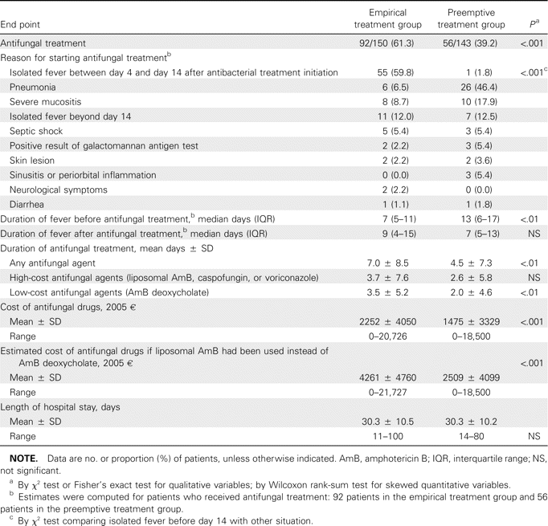
Table 3 Antifungal therapy in the intention-to-treat population (n = 293).
Notes:
Table 3 Antifungal therapy in the intention-to-treat population (n = 293).
Unless provided in the caption above, the following copyright applies to the content of this slide: © 2009 by the Infectious Diseases Society of America

Slide 6
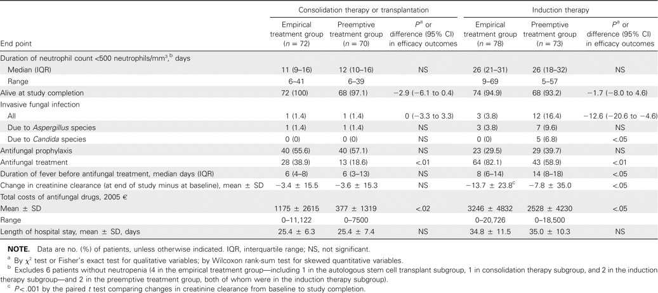
Table 4 Subgroup analysis of patients receiving consolidation therapy or stem cell transplantation compared with ...
Notes:
Table 4 Subgroup analysis of patients receiving consolidation therapy or stem cell transplantation compared with patients receiving induction therapy, in the intentionto- treat population (n = 293).
Unless provided in the caption above, the following copyright applies to the content of this slide: © 2009 by the Infectious Diseases Society of America

