Slide 1
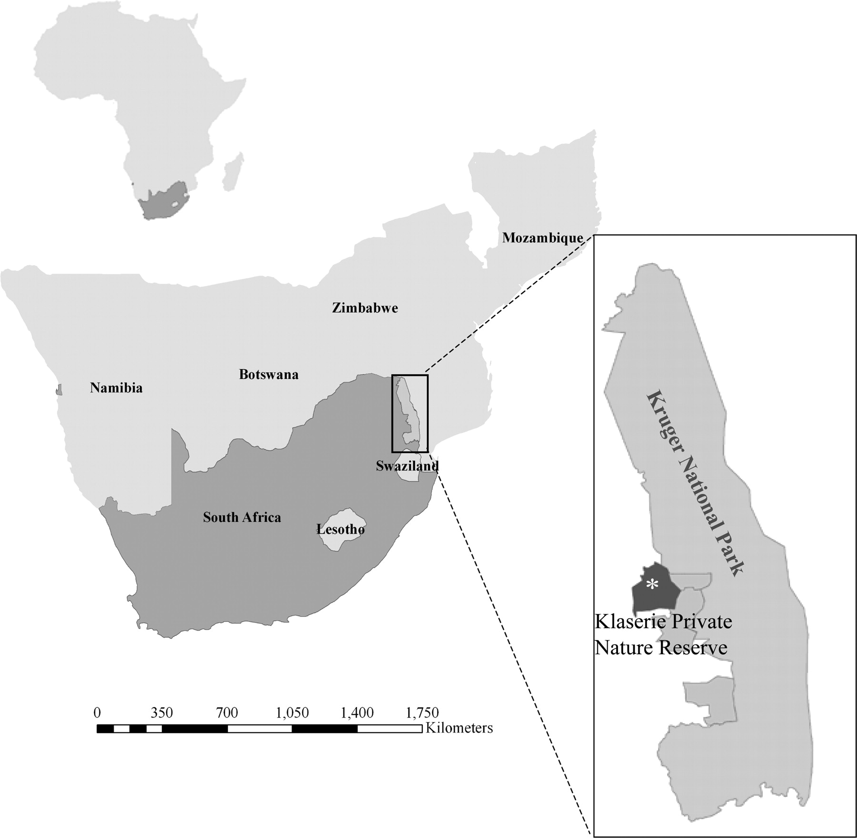
Figure 1 The study site: Klaserie Private Nature Reserve, South Africa.
Notes:
Figure 1 The study site: Klaserie Private Nature Reserve, South Africa.
Unless provided in the caption above, the following copyright applies to the content of this slide: © The Author 2007. Published by Oxford University Press on behalf of the International Society for Behavioral Ecology. All rights reserved. For permissions, please e-mail: journals.permissions@oxfordjournals.org

Slide 2
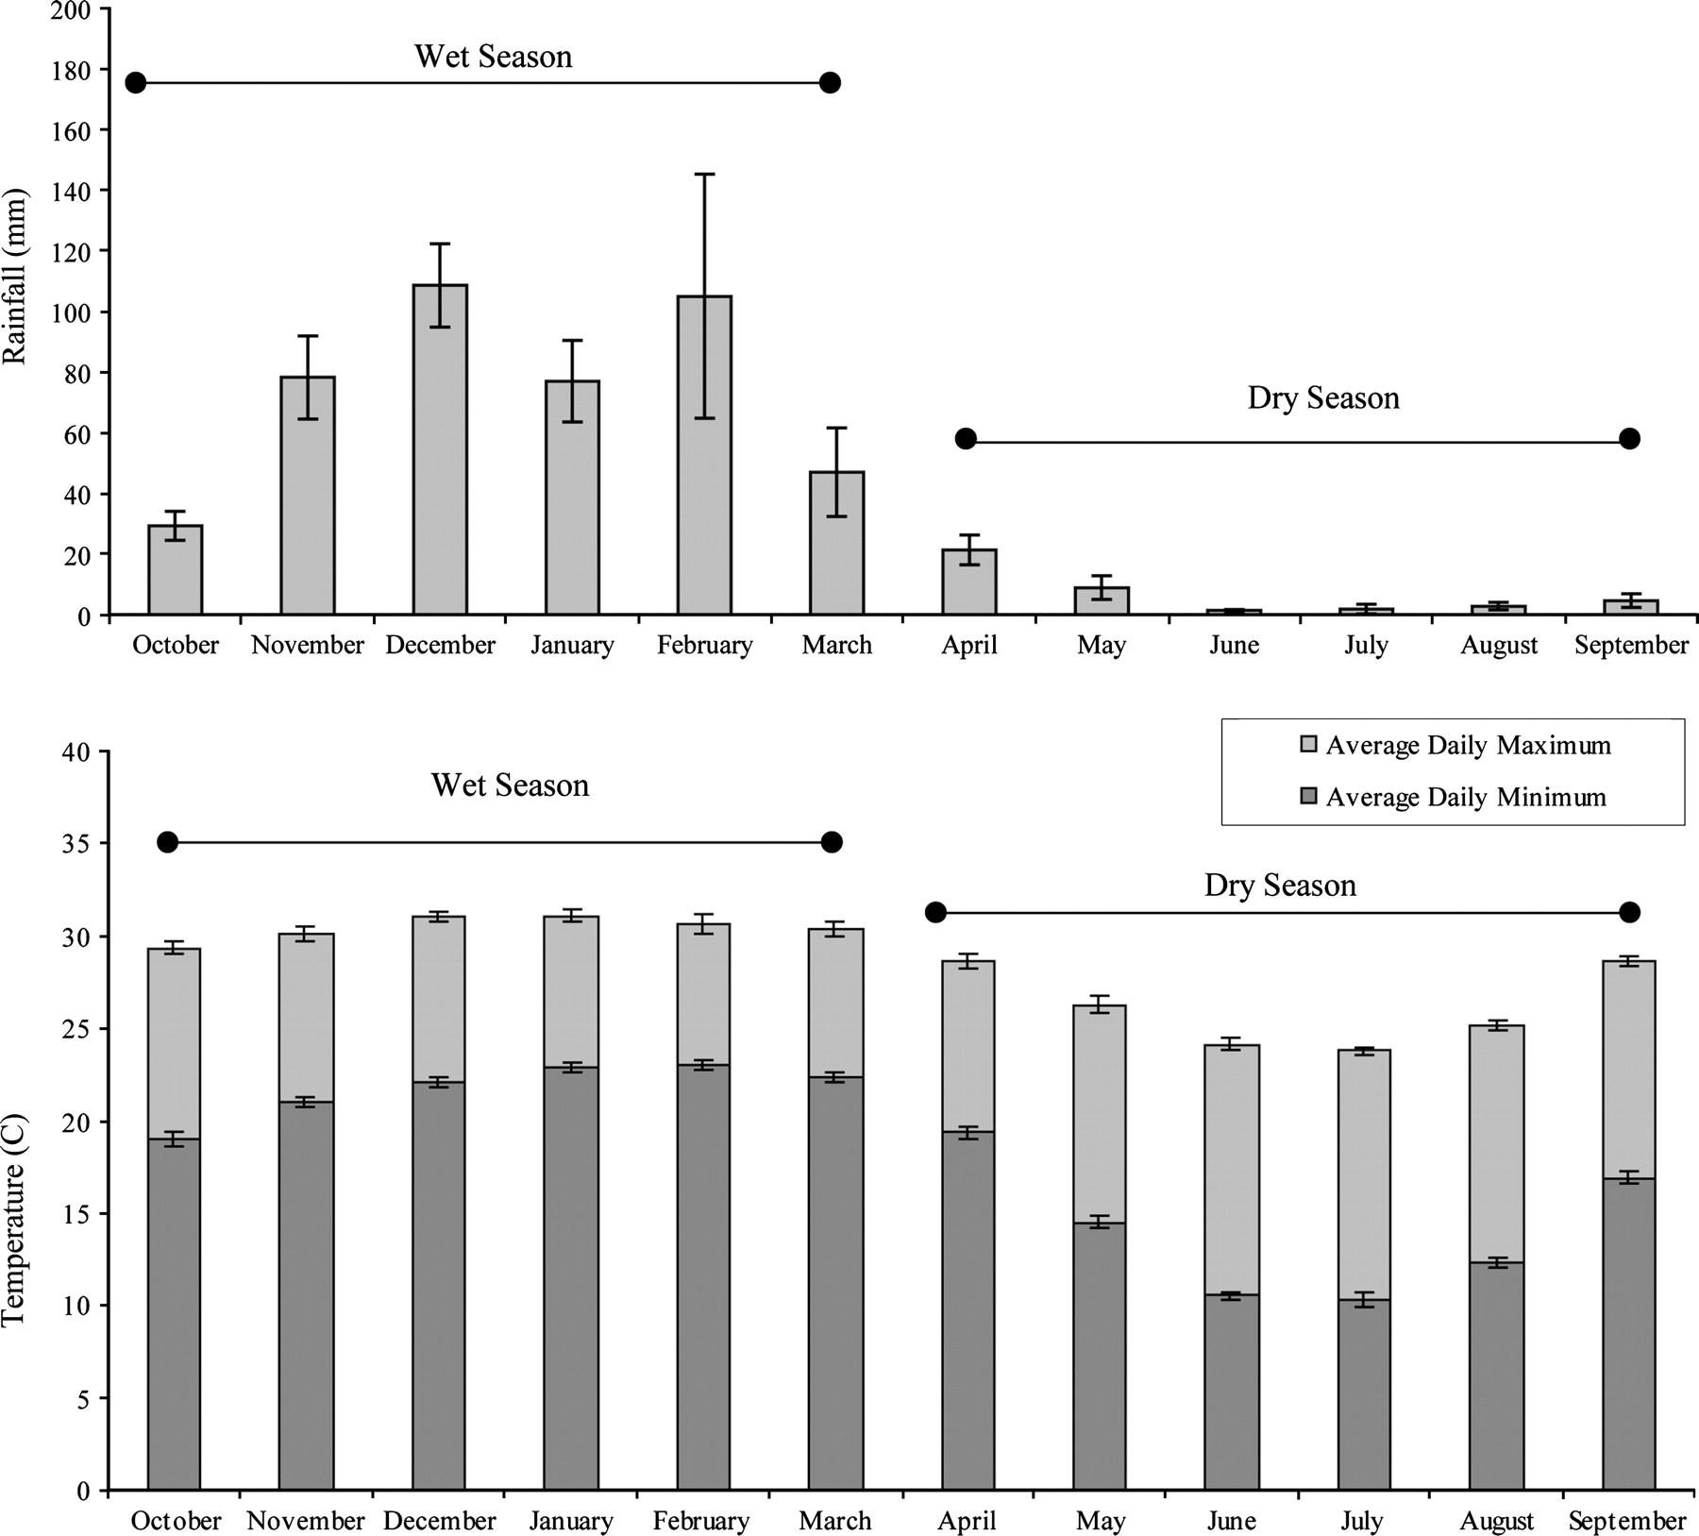
Figure 2 Rainfall and temperature (mean ± SE) of Klaserie Private Nature Reserve, 1991–2000 (adapted from Ryan et al. ...
Notes:
Figure 2 Rainfall and temperature (mean ± SE) of Klaserie Private Nature Reserve, 1991–2000 (adapted from Ryan et al. 2006).
Unless provided in the caption above, the following copyright applies to the content of this slide: © The Author 2007. Published by Oxford University Press on behalf of the International Society for Behavioral Ecology. All rights reserved. For permissions, please e-mail: journals.permissions@oxfordjournals.org

Slide 3
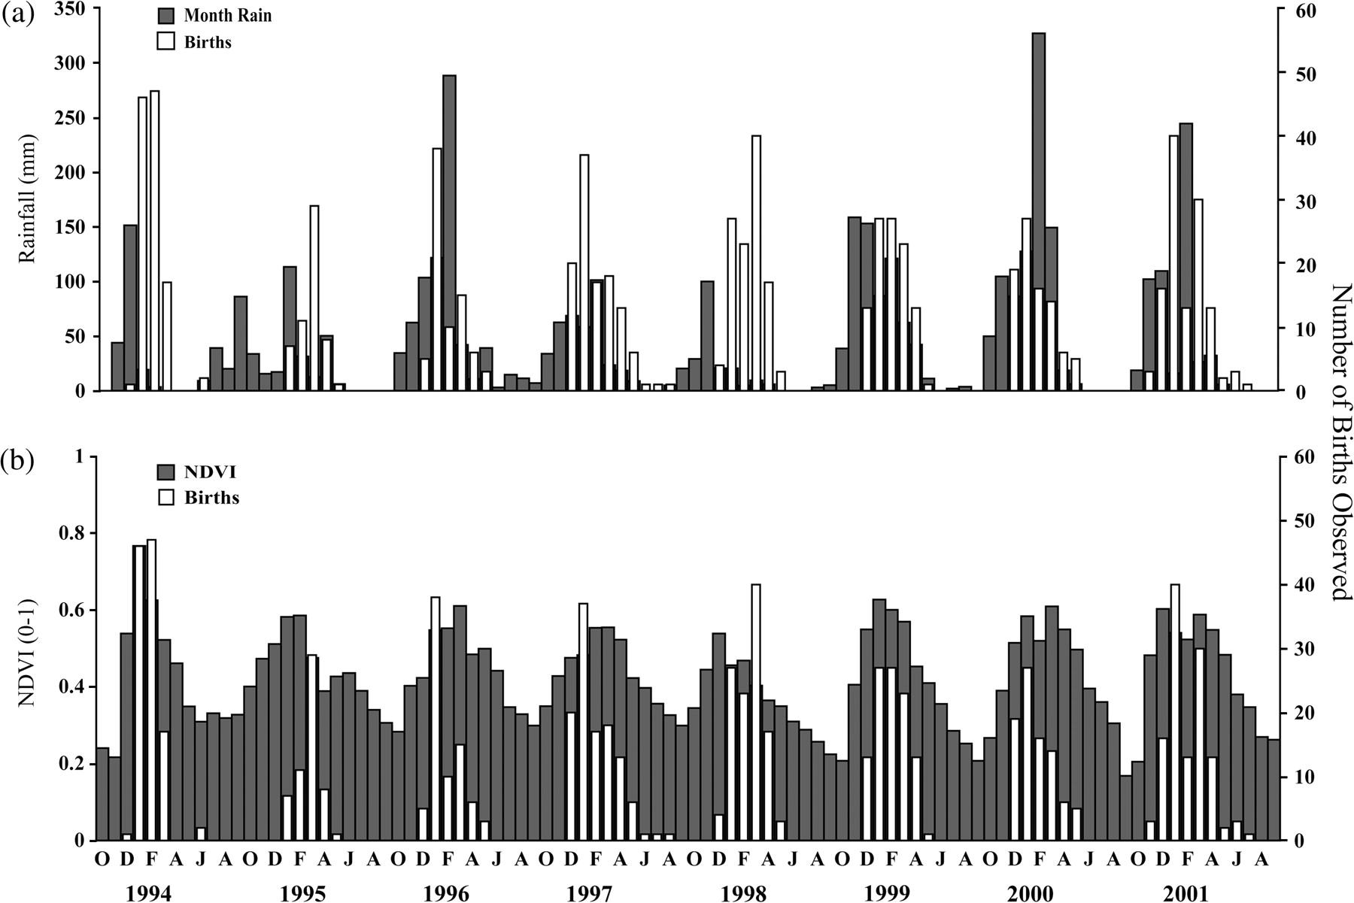
Figure 3 Monthly births (foreground, white), rainfall (millimeter) (background, black) (a), and NDVI (background, ...
Notes:
Figure 3 Monthly births (foreground, white), rainfall (millimeter) (background, black) (a), and NDVI (background, gray) (b) for the study period.
Unless provided in the caption above, the following copyright applies to the content of this slide: © The Author 2007. Published by Oxford University Press on behalf of the International Society for Behavioral Ecology. All rights reserved. For permissions, please e-mail: journals.permissions@oxfordjournals.org

Slide 4
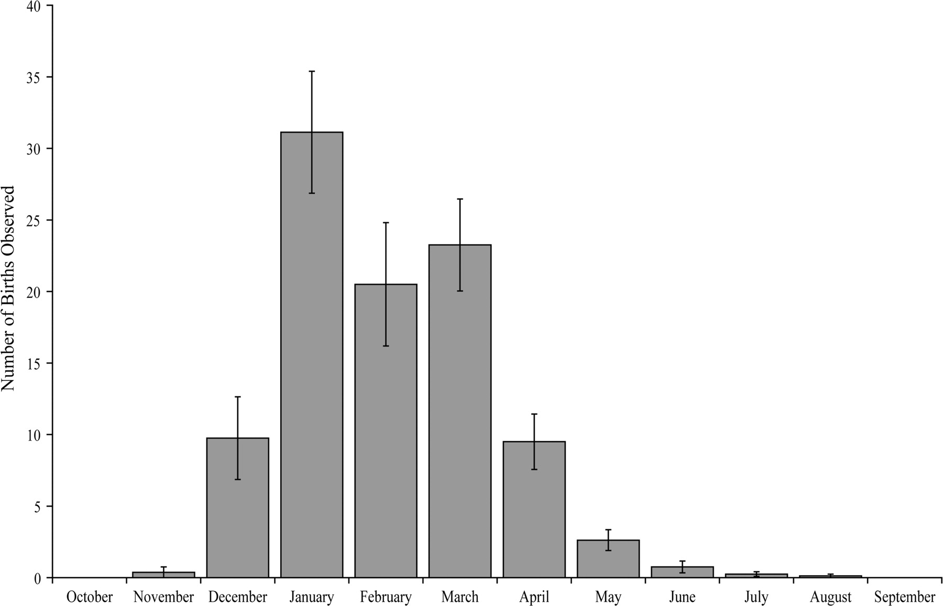
Figure 4 Average monthly proportion of births (mean ± SE) from 1993 to 2001.
Notes:
Figure 4 Average monthly proportion of births (mean ± SE) from 1993 to 2001.
Unless provided in the caption above, the following copyright applies to the content of this slide: © The Author 2007. Published by Oxford University Press on behalf of the International Society for Behavioral Ecology. All rights reserved. For permissions, please e-mail: journals.permissions@oxfordjournals.org

Slide 5
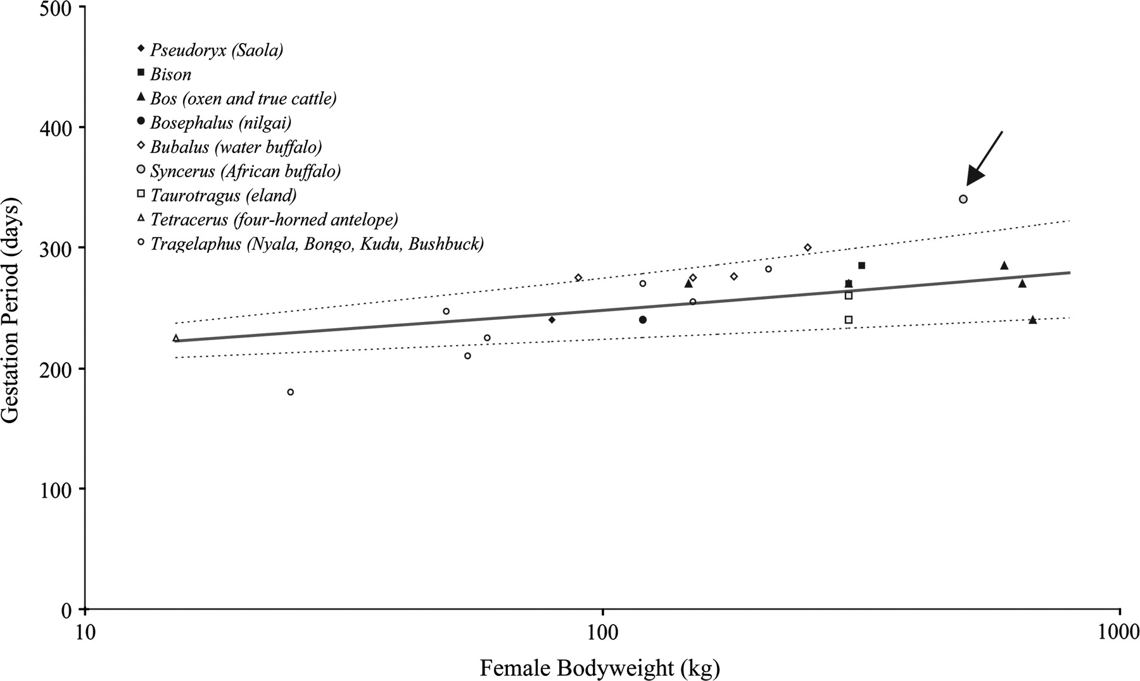
Figure 5 The relationship of gestation period (days) to female bodyweight (kilogram) for the subfamily Bovinae ...
Notes:
Figure 5 The relationship of gestation period (days) to female bodyweight (kilogram) for the subfamily Bovinae excluding African buffalo. The power law of log gestation (days) against log bodyweight (kilogram) at the level of genus is shown (solid line) with 95% PIs (dashed lines), with raw data for the 9 Bovinae genera, depicting the African buffalo (Syncerus caffer) (pointer).
Unless provided in the caption above, the following copyright applies to the content of this slide: © The Author 2007. Published by Oxford University Press on behalf of the International Society for Behavioral Ecology. All rights reserved. For permissions, please e-mail: journals.permissions@oxfordjournals.org

Slide 6
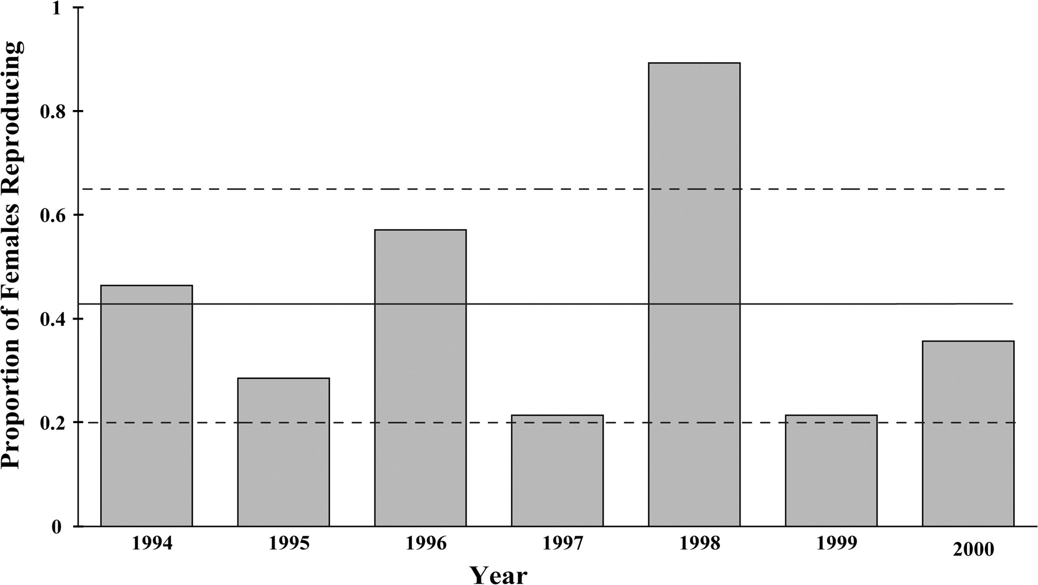
Figure 6 The proportion of 28 individually identified females calving in a given year (gray columns), with mean (solid ...
Notes:
Figure 6 The proportion of 28 individually identified females calving in a given year (gray columns), with mean (solid line) and 95% CI (dashed lines)—note the high proportion of 89% in 1998.
Unless provided in the caption above, the following copyright applies to the content of this slide: © The Author 2007. Published by Oxford University Press on behalf of the International Society for Behavioral Ecology. All rights reserved. For permissions, please e-mail: journals.permissions@oxfordjournals.org

