Slide 1
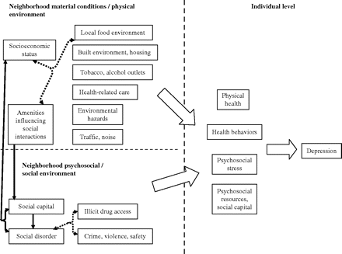
FIGURE 1. Relations between key neighborhood characteristics and adult depression. Double-headed dashed arrows indicate ...
Notes:
FIGURE 1. Relations between key neighborhood characteristics and adult depression. Double-headed dashed arrows indicate conceptually related constructs/indicators. All of the neighborhood constructs shown were explored in relation to individual depression across studies included in the systematic review. In two studies (17, 46), investigators examined potential mediation of the effects of neighborhood socioeconomic/physical environment on depression by social capital/social disorder. No studies investigated individual-level behavioral and/or psychosocial pathways mediating neighborhood effects on depression.
Unless provided in the caption above, the following copyright applies to the content of this slide: Epidemiologic Reviews © The Author 2008. Published by the Johns Hopkins Bloomberg School of Public Health. All rights reserved. For permissions, please e-mail: journals.permissions@oxfordjournals.org.

