Slide 1
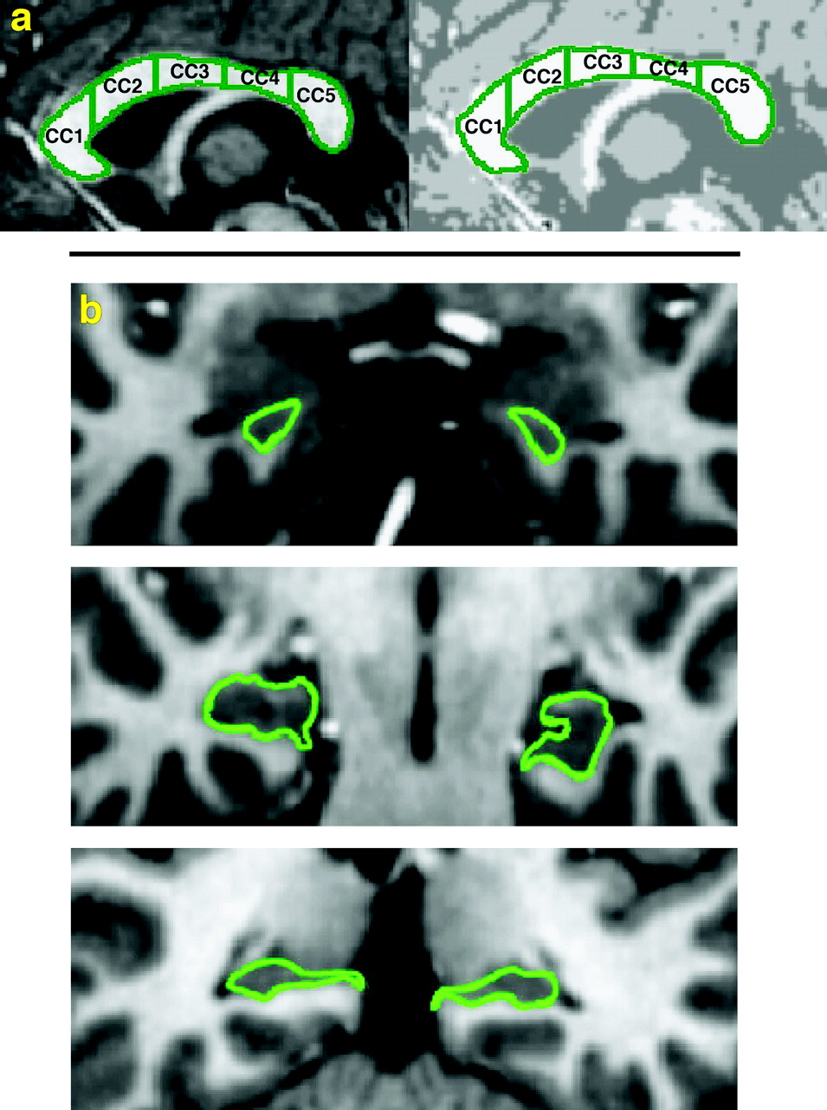
Figure 1. Examples of region demarcations. (a) Five subregions of the corpus callosum on T1-weighted (left) and ...
Notes:
Figure 1. Examples of region demarcations. (a) Five subregions of the corpus callosum on T1-weighted (left) and segmented (right) images with most rostral region to the left. CC1, genu and rostrum; CC2, rostral body; CC3, midbody; CC4, isthmus; CC5, splenium. (b) Anterior hippocampus (top panel), middle hippocampus (middle panel) and posterior hippocampus (bottom panel) on T1-weighted MRI images.
Unless provided in the caption above, the following copyright applies to the content of this slide: Cerebral Cortex V 15 N 6 © Oxford University Press 2004; all rights reserved

Slide 2
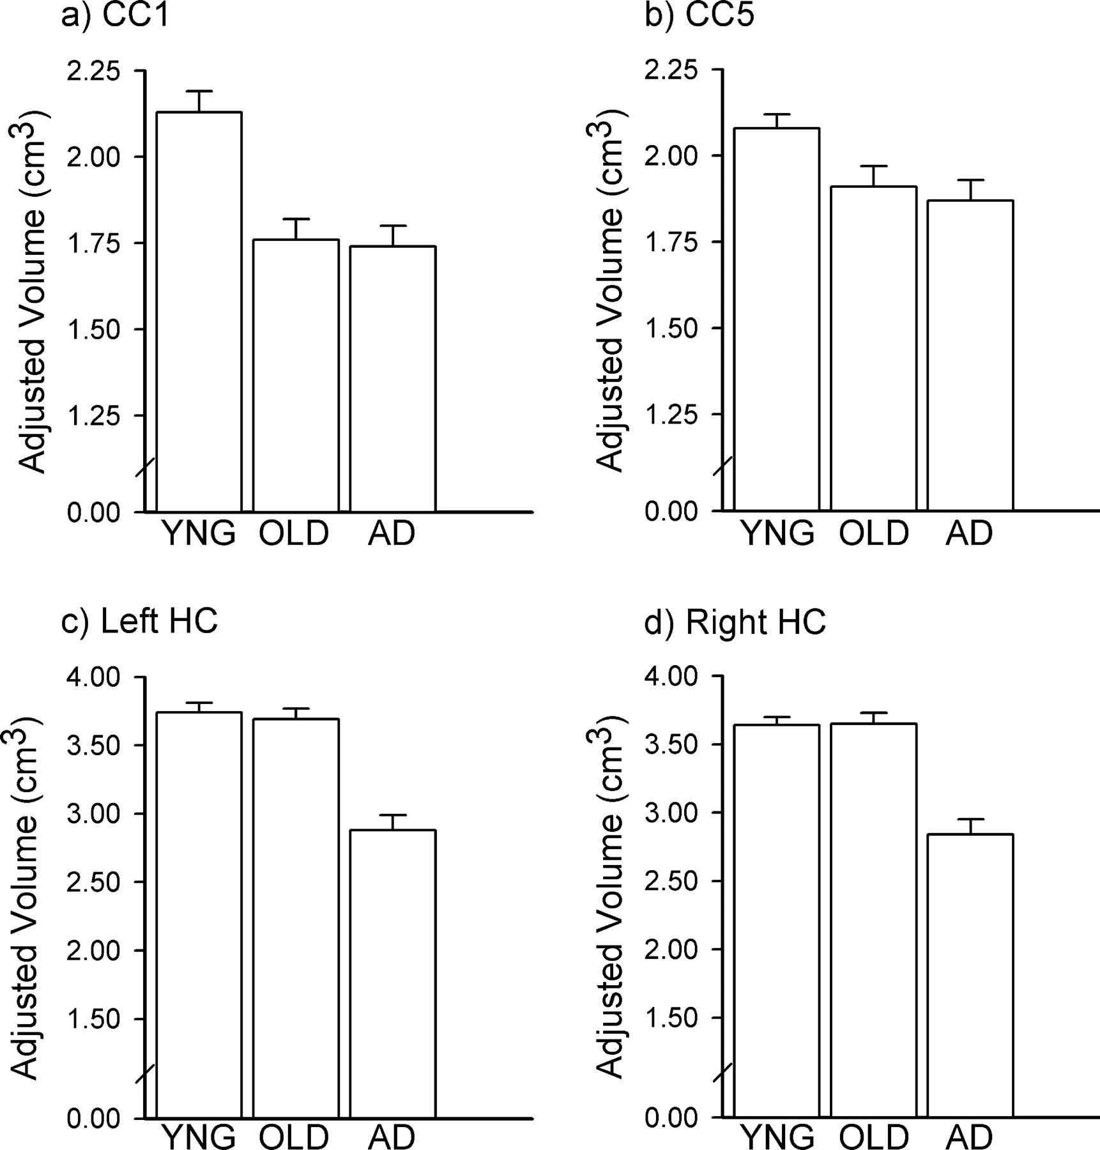
Figure 2. Group differences in corpus callosum and hippocampus volumes for sample 1. Effects of aging in the corpus ...
Notes:
Figure 2. Group differences in corpus callosum and hippocampus volumes for sample 1. Effects of aging in the corpus callosum and early-stage AD in the hippocampus are depicted. Bars indicate the mean regional volumes for each group for (a) CC1, (b) CC5, (c) left hippocampus (HC) and (d) right HC regions. Young, white bars; nondemented older adults, gray bars; and early-stage AD individuals, black bars. Error bars indicate standard error of the mean.
Unless provided in the caption above, the following copyright applies to the content of this slide: Cerebral Cortex V 15 N 6 © Oxford University Press 2004; all rights reserved

Slide 3
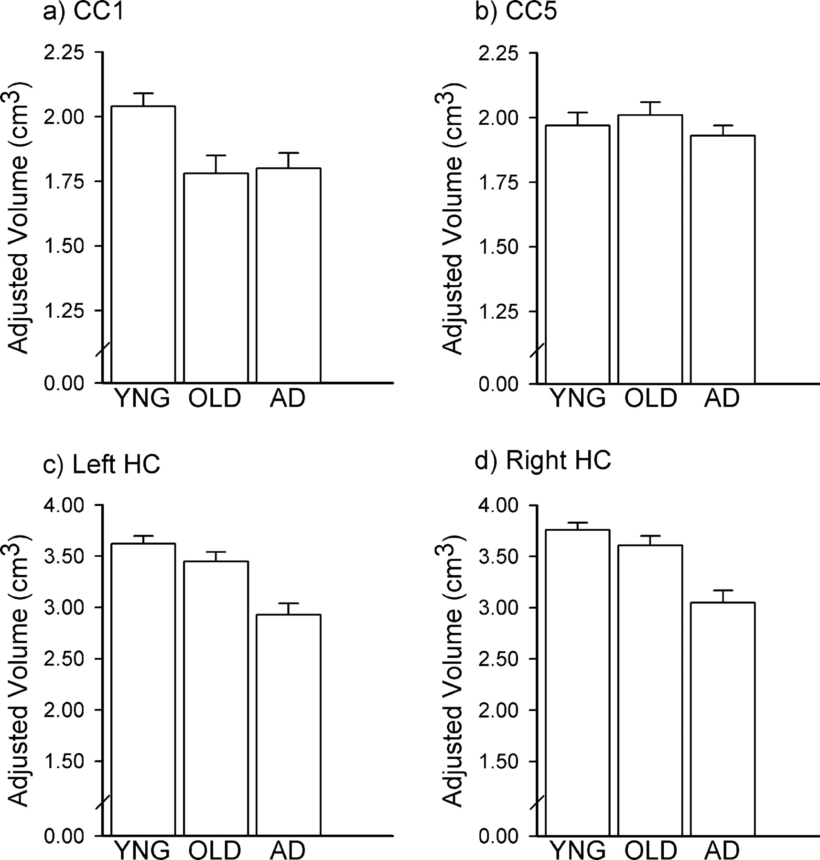
Figure 3. Group differences in corpus callosum and hippocampus volumes for sample 2. Results of sample 2 replicate the ...
Notes:
Figure 3. Group differences in corpus callosum and hippocampus volumes for sample 2. Results of sample 2 replicate the effects of aging in the corpus callosum and early-stage AD in the hippocampus. The format is identical to Figure 2.
Unless provided in the caption above, the following copyright applies to the content of this slide: Cerebral Cortex V 15 N 6 © Oxford University Press 2004; all rights reserved

Slide 4
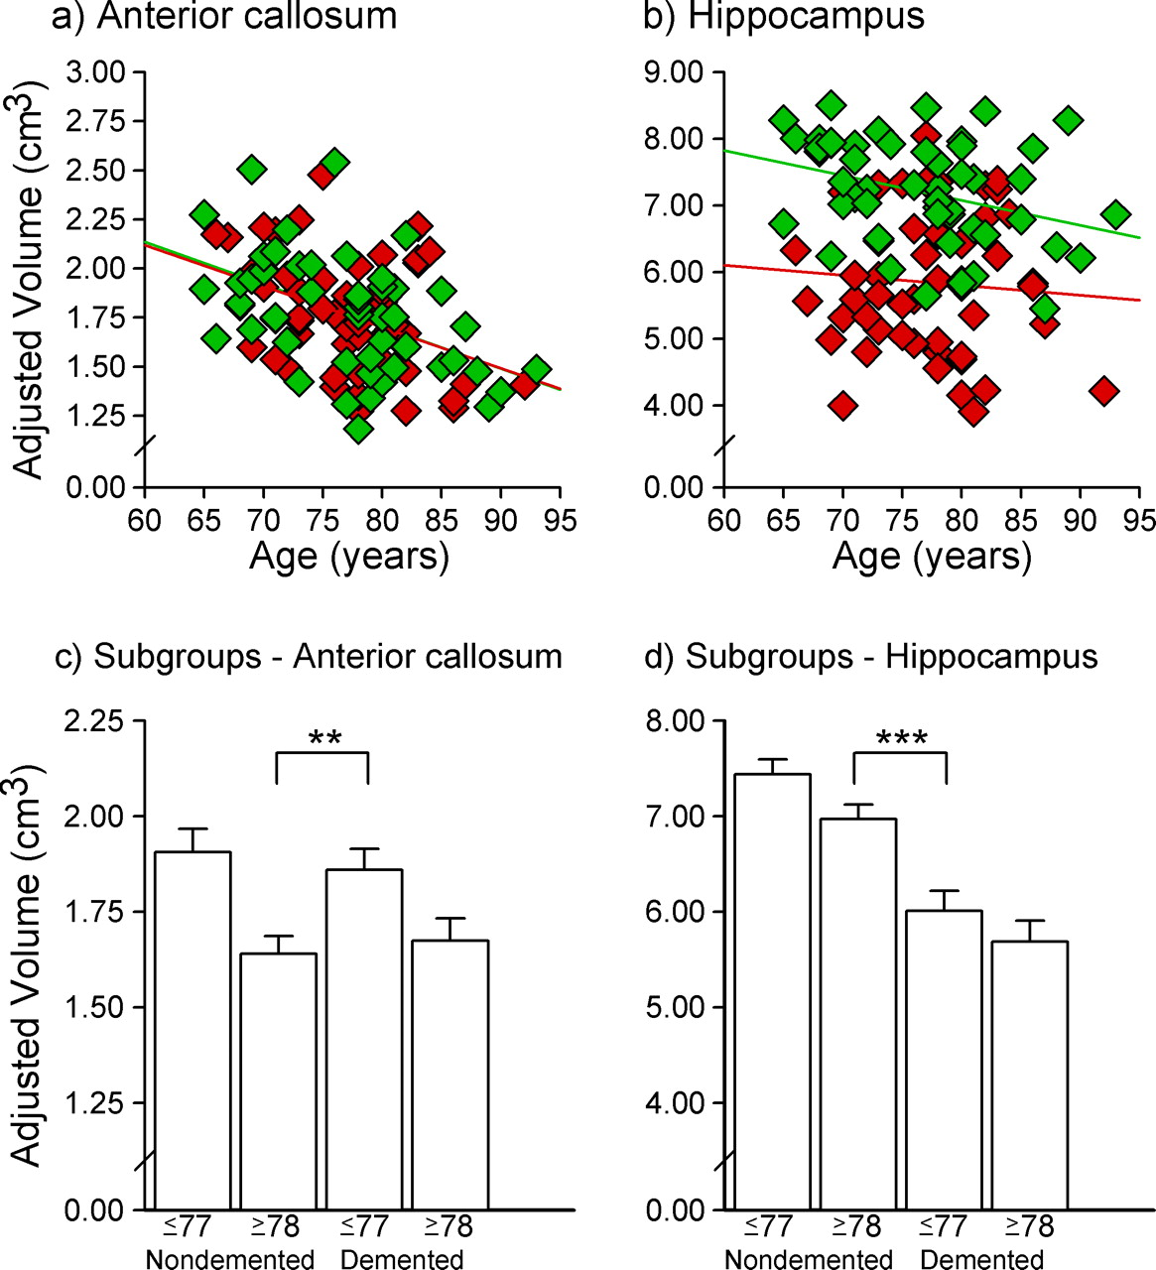
Figure 4. Volume relationships in combined sample of older adults. Volumes for individual participants are represented ...
Notes:
Figure 4. Volume relationships in combined sample of older adults. Volumes for individual participants are represented in panels (a) anterior corpus callosum and (b) hippocampus (left and right hemispheres combined). Nondemented older adults – green diamonds; and early-stage AD individuals – red diamonds. The green and red regression lines apply respectively to the nondemented and demented older adult groups. Subgroup differences in combined sample of older adults are represented in panels (c) anterior corpus callosum and (d) hippocampus (left and right hemispheres combined). Bars indicate the mean regional volumes for each subgroup. Error bars indicate standard error of the mean. **P < 0.01; ***P < 0.001.
Unless provided in the caption above, the following copyright applies to the content of this slide: Cerebral Cortex V 15 N 6 © Oxford University Press 2004; all rights reserved

