Slide 1
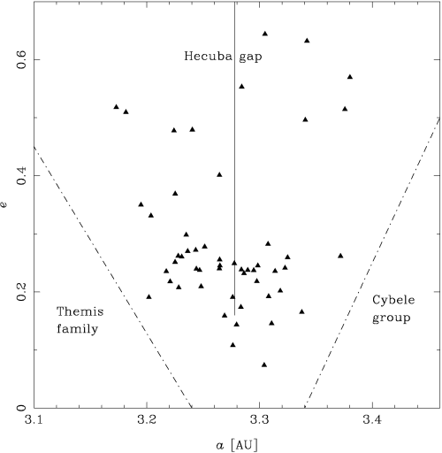
1 The orbital elements of resonant asteroids in the Hecuba gap. The full vertical line marks the approximate ...
Notes:
1 The orbital elements of resonant asteroids in the Hecuba gap. The full vertical line marks the approximate location of the 2 : 1 Jovian resonance. The dashed-dotted lines are the boundaries of our search criteria to identify the resonant bodies.
Unless provided in the caption above, the following copyright applies to the content of this slide: © 2002 RAS

Slide 2
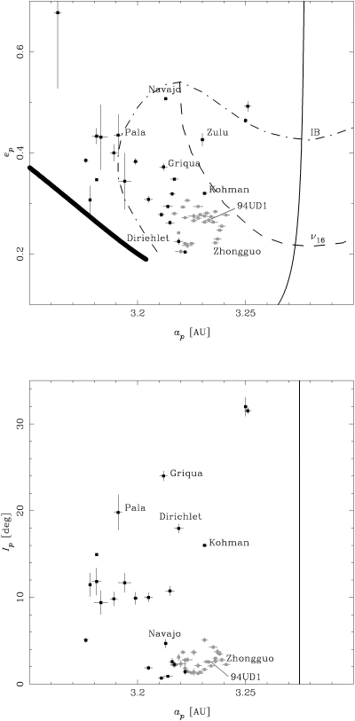
2 Pseudo-proper elements of resonant asteroids in the Hecuba gap. Grey and black dots distinguish asteroids ...
Notes:
2 Pseudo-proper elements of resonant asteroids in the Hecuba gap. Grey and black dots distinguish asteroids according to their lifetimes ( Section 2.2 , Fig. 4 ). The error bars are the standard deviations of the pseudo-proper elements. Both panels show the location of the resonance centres (full vertical line). The top panel also shows the location of the left resonant border (bold line), ν16 secular resonance, and instability border (IB).
Unless provided in the caption above, the following copyright applies to the content of this slide: © 2002 RAS

Slide 3
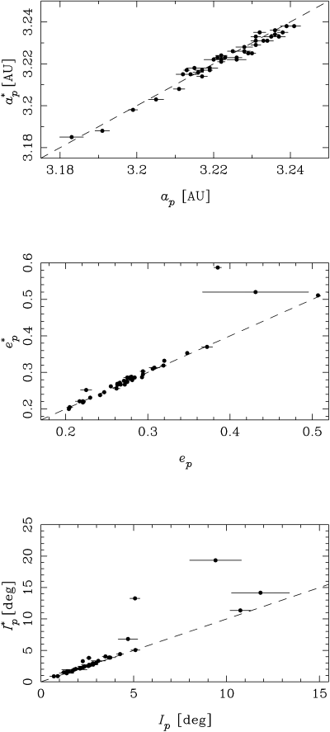
3 Comparison between pseudo-proper elements a_{p} , e_{p} , I_{p} determined using the ...
Notes:
3 Comparison between pseudo-proper elements ap , ep , Ip determined using the representative surface method, and pseudo-proper elements ap *, ep *, Ip * computed as the minimum of a and the maxima of e and I over 10 Myr. The agreement between both independent methods is remarkable.
Unless provided in the caption above, the following copyright applies to the content of this slide: © 2002 RAS

Slide 4
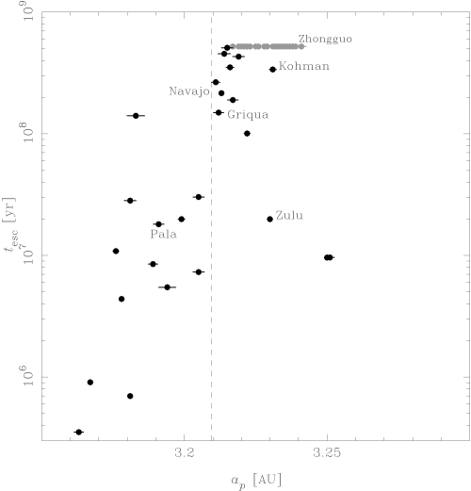
4 Lifetimes of resonant asteroids in the Hecuba gap. Grey dots denote objects that survived over 520 Myr. For ...
Notes:
4 Lifetimes of resonant asteroids in the Hecuba gap. Grey dots denote objects that survived over 520 Myr. For escaping asteroids (black dots), the actual lifetimes inside the 2 : 1 resonance can be smaller than the values shown here. The dashed line at ap ≃ 3.21 au marks the approximate transition limit from marginal to strong instability. See text for details.
Unless provided in the caption above, the following copyright applies to the content of this slide: © 2002 RAS

Slide 5
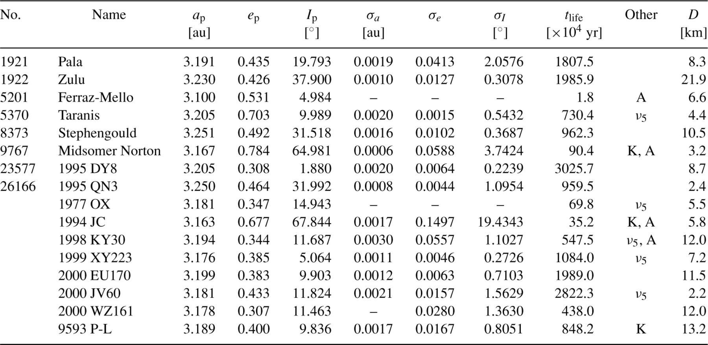
1 The strongly unstable asteroids observed in the 2 : 1 resonance by October 2001. Columns 1 and 2 identify the ...
Notes:
1 The strongly unstable asteroids observed in the 2 : 1 resonance by October 2001. Columns 1 and 2 identify the object. Columns 3 to 5 show the pseudo-proper elements calculated from equation (3) with . Columns 6 to 8 show the standard deviations of the pseudo-proper elements. These are left blank for some asteroids with highly chaotic orbits. Column 9 show the lifetimes. Column 10 indicates other characteristics of the resonant motion: ν5 denotes the secular resonance between the perihelia of the asteroid and Jupiter, ‘K’ stands for the Kozai resonance, ‘A’ means that the asteroid alternatively moves inside and outside the 2 : 1 resonance. Column 11 gives the estimated diameter, assuming an albedo A = 0.05 .
Unless provided in the caption above, the following copyright applies to the content of this slide: © 2002 RAS

Slide 6
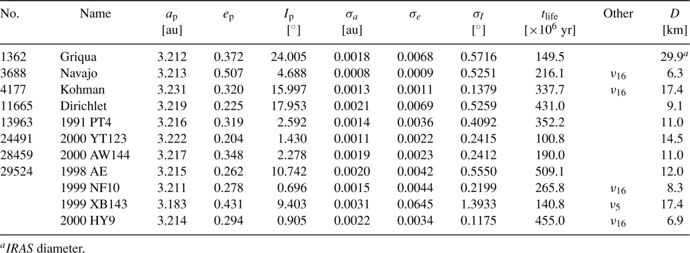
2 The marginally unstable asteroids (Griquas) observed in the 2 : 1 resonance by October 2001. See Table 1 for ...
Notes:
2 The marginally unstable asteroids (Griquas) observed in the 2 : 1 resonance by October 2001. See Table 1 for explanation.
Unless provided in the caption above, the following copyright applies to the content of this slide: © 2002 RAS

Slide 7
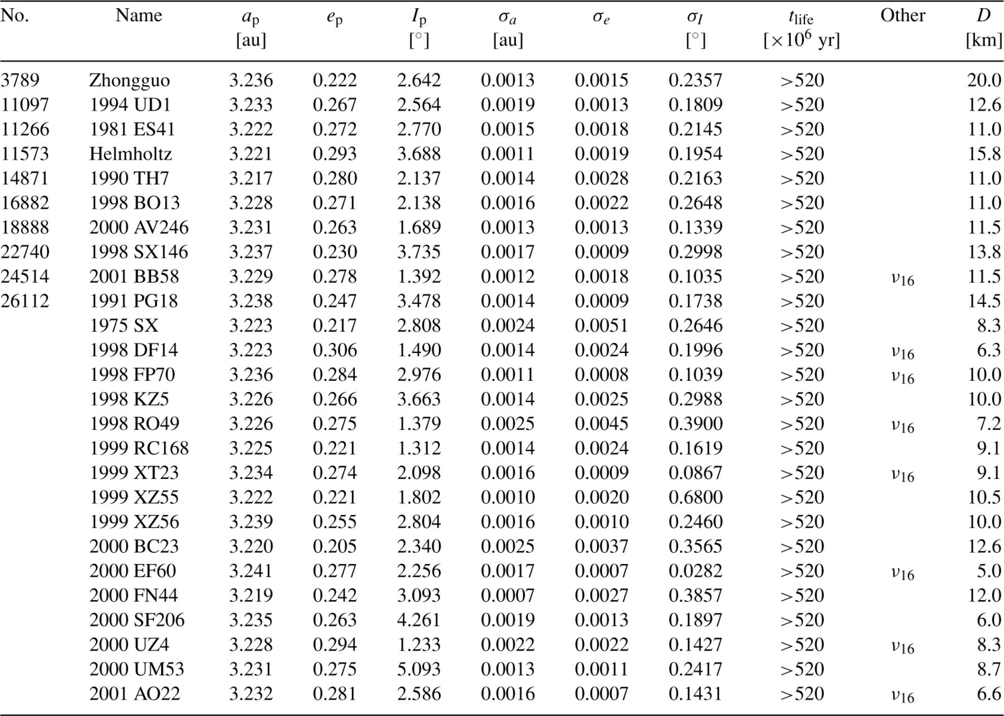
3 The stable asteroids (Zhongguos) observed in the 2 : 1 resonance by October 2001. See Table 1 for ...
Notes:
3 The stable asteroids (Zhongguos) observed in the 2 : 1 resonance by October 2001. See Table 1 for explanation. Asteroids labelled ν16 do not move in this secular resonance but are very close to it (i.e. Ω−ΩJ circulates with a very long period).
Unless provided in the caption above, the following copyright applies to the content of this slide: © 2002 RAS

Slide 8
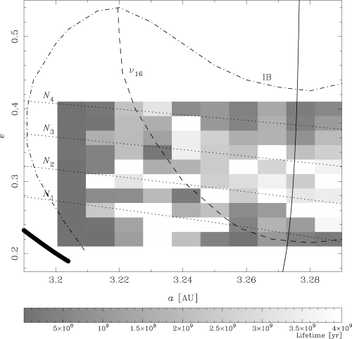
5 The lifetimes of the test orbits in our simulation. Each rectangle corresponds to one initial condition (with ...
Notes:
5 The lifetimes of the test orbits in our simulation. Each rectangle corresponds to one initial condition (with a , e in the centre of the rectangle). About 20 per cent of the test orbits survive over 4 Gyr.
Unless provided in the caption above, the following copyright applies to the content of this slide: © 2002 RAS

Slide 9
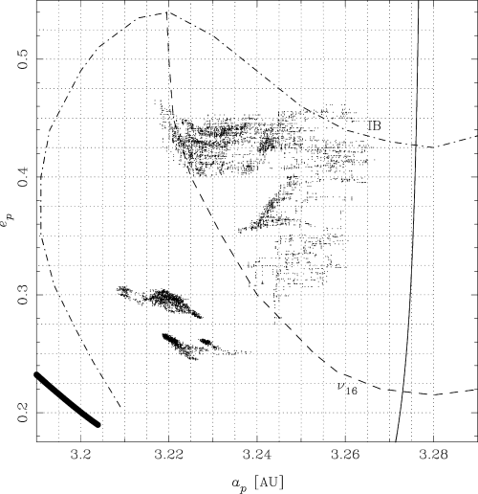
6 Evolution of resonant pseudo-proper elements of four test orbits in our simulation. Two orbits are located at ...
Notes:
6 Evolution of resonant pseudo-proper elements of four test orbits in our simulation. Two orbits are located at the left side of the ν16 resonance, at about e = 0.25 and 0.3, respectively. Other two orbits are (mostly) located at the right side of the ν16 resonance, above and below e = 0.4 , respectively. The cells are indicated by dotted lines. The number of points in a cell is roughly proportional to the residence time in that cell.
Unless provided in the caption above, the following copyright applies to the content of this slide: © 2002 RAS

Slide 10
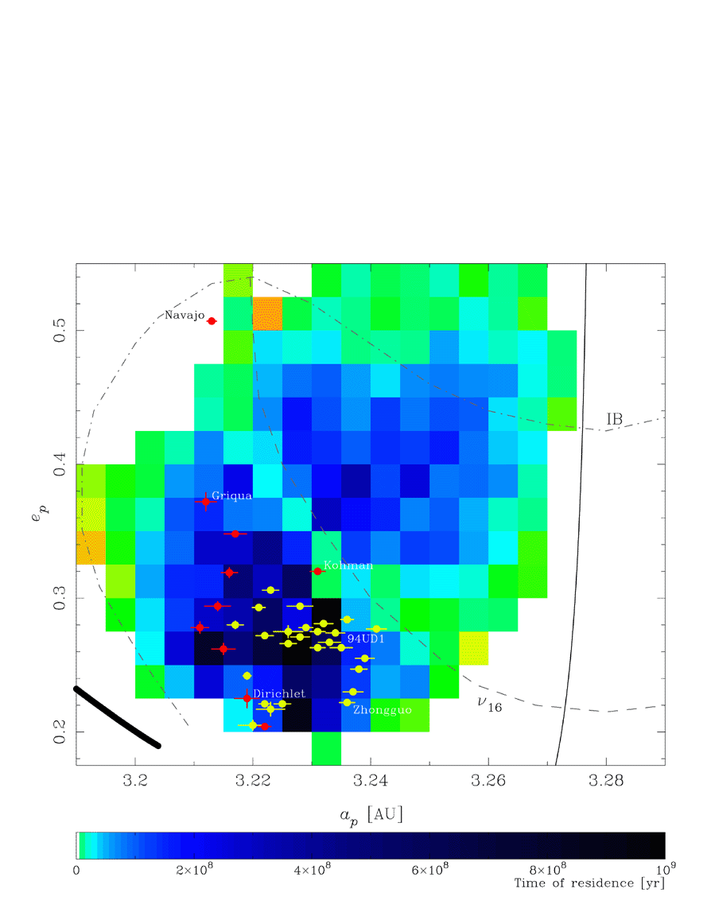
7 Residence times in the 2 : 1 mean motion resonance with Jupiter. The shortest residence times are ≪50 Myr. ...
Notes:
7 Residence times in the 2 : 1 mean motion resonance with Jupiter. The shortest residence times are ≪50 Myr. Blank areas denote cells never visited by any orbit. Zhongguos and Griquas are denoted by light grey and dark grey dots, respectively. The agreement between the longest residence times and the locations of the real asteroids is remarkable. According to this, the cluster around (11097) 1994 UD1 could survive in the resonance over several Gyr. A colour version of this figure can be seen in the online version of the journal on Synergy .
Unless provided in the caption above, the following copyright applies to the content of this slide: © 2002 RAS

Slide 11
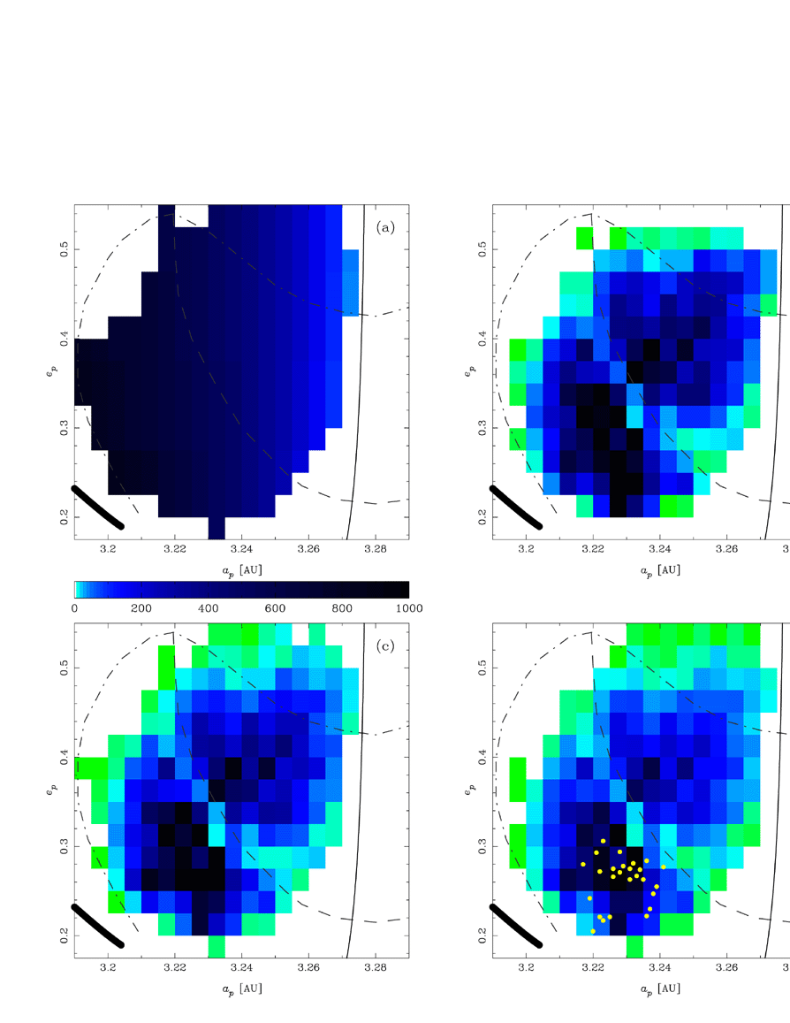
8 Initial distribution of the resonant orbits in our random-walk simulations (panel a), and final distributions ...
Notes:
8 Initial distribution of the resonant orbits in our random-walk simulations (panel a), and final distributions at t = 4.5 Gyr using three different values of pe : 0 (panel b), 0.4 (panel c), and 1 (panel d). The grey scale denotes the number of particles per cell. The darker regions are the most populated ones. Panel (d) shows the location of stable asteroids (dots). A colour version of this figure can be seen in the online version of the journal on Synergy .
Unless provided in the caption above, the following copyright applies to the content of this slide: © 2002 RAS

Slide 12
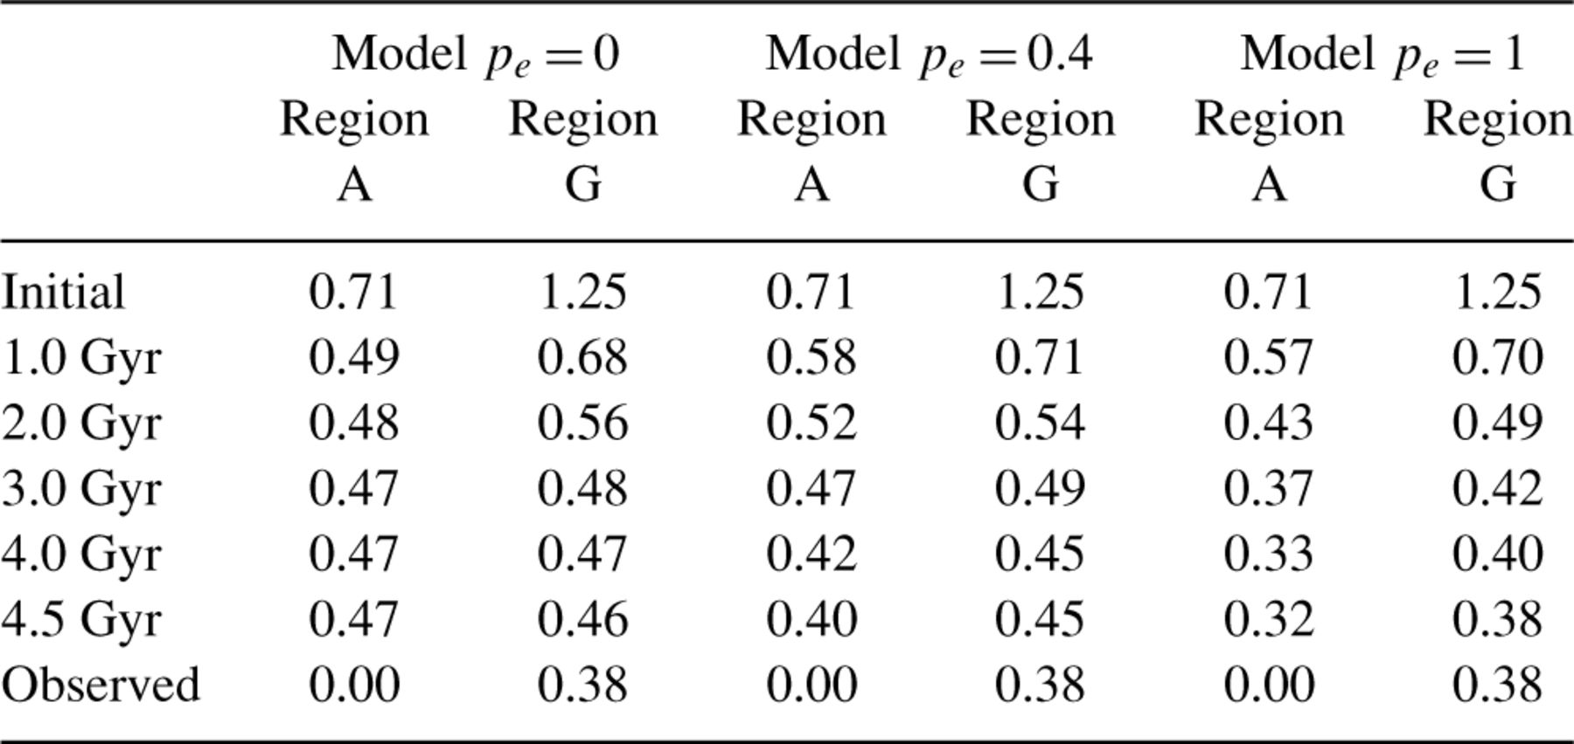
4 The number of surviving test orbits versus time in Regions A and G, for three different models of random walk ...
Notes:
4 The number of surviving test orbits versus time in Regions A and G, for three different models of random walk (see text). The values are normalized to the number of surviving test orbits in Region Z. The last row shows the actual fractions of observed asteroids.
Unless provided in the caption above, the following copyright applies to the content of this slide: © 2002 RAS

Slide 13
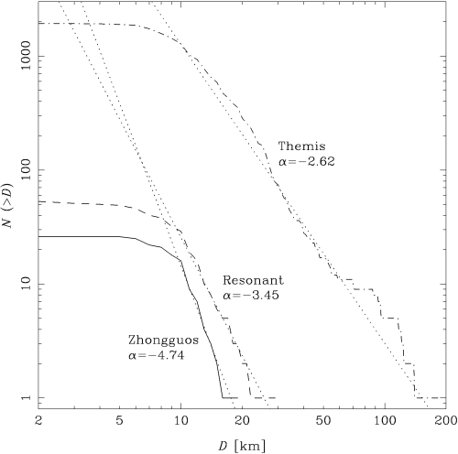
9 The size distributions of the resonant asteroids in the Hecuba gap (solid line and dashed line), and the size ...
Notes:
9 The size distributions of the resonant asteroids in the Hecuba gap (solid line and dashed line), and the size distribution of Themis family (dot-dashed line). For Zhongguos and Resonant asteroids, the power-law N (> D ) ∝ Dα best-fits (dotted lines) were computed for D ≥ 10 km . For the Themis family, the power-law was fitted in the range 24 ≤ D ≤ 70 km . The corresponding values of α are indicated. The diameters were computed either from the IRAS albedo when available, or assuming A = 0.05 when the IRAS albedo was unknown.
Unless provided in the caption above, the following copyright applies to the content of this slide: © 2002 RAS

Slide 14
5 The values of the quantities used in equations (7) and (8) . The values of dV/da_{p} were computed ...
Notes:
5 The values of the quantities used in equations (7) and (8) . The values of dV/dap were computed form equation (5) (see text).
Unless provided in the caption above, the following copyright applies to the content of this slide: © 2002 RAS

Slide 15
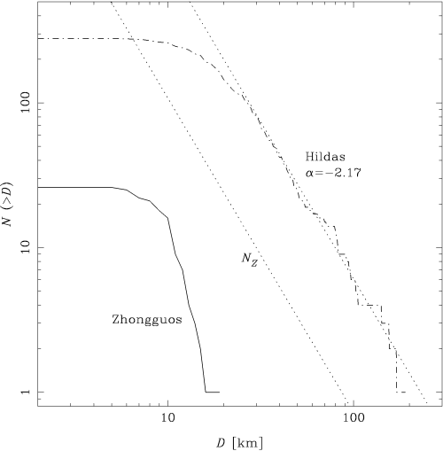
10 The size distributions of the Zhongguos (solid line) and the Hildas (dashed line). In the latter case, the ...
Notes:
10 The size distributions of the Zhongguos (solid line) and the Hildas (dashed line). In the latter case, the power-law N (> D ) ∝ Nα was fitted in the range 40 ≤ D ≤ 126 km . The dotted line labelled NZ is the power-law scaled down to the 2 : 1 resonance ( equation 7 ). The diameters were computed either from the IRAS albedo, or assuming A = 0.05 when the IRAS albedo was unknown.
Unless provided in the caption above, the following copyright applies to the content of this slide: © 2002 RAS

