Slide 1
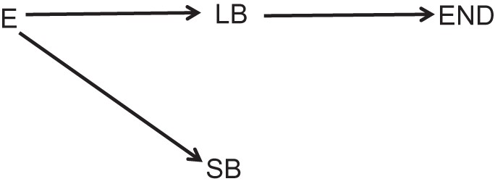
Figure 1. Generic directed acyclic graph for hypothesized effects of exposure (E) on adverse pregnancy outcomes. Total ...
Notes:
Figure 1. Generic directed acyclic graph for hypothesized effects of exposure (E) on adverse pregnancy outcomes. Total births = livebirths (LB) + stillbirths (SB); perinatal death = SB + early neonatal deaths (END).
Unless provided in the caption above, the following copyright applies to the content of this slide: © The Author 2013. Published by Oxford University Press on behalf of the Johns Hopkins Bloomberg School of Public Health. All rights reserved. For permissions, please e-mail: journals.permissions@oup.com.

Slide 2
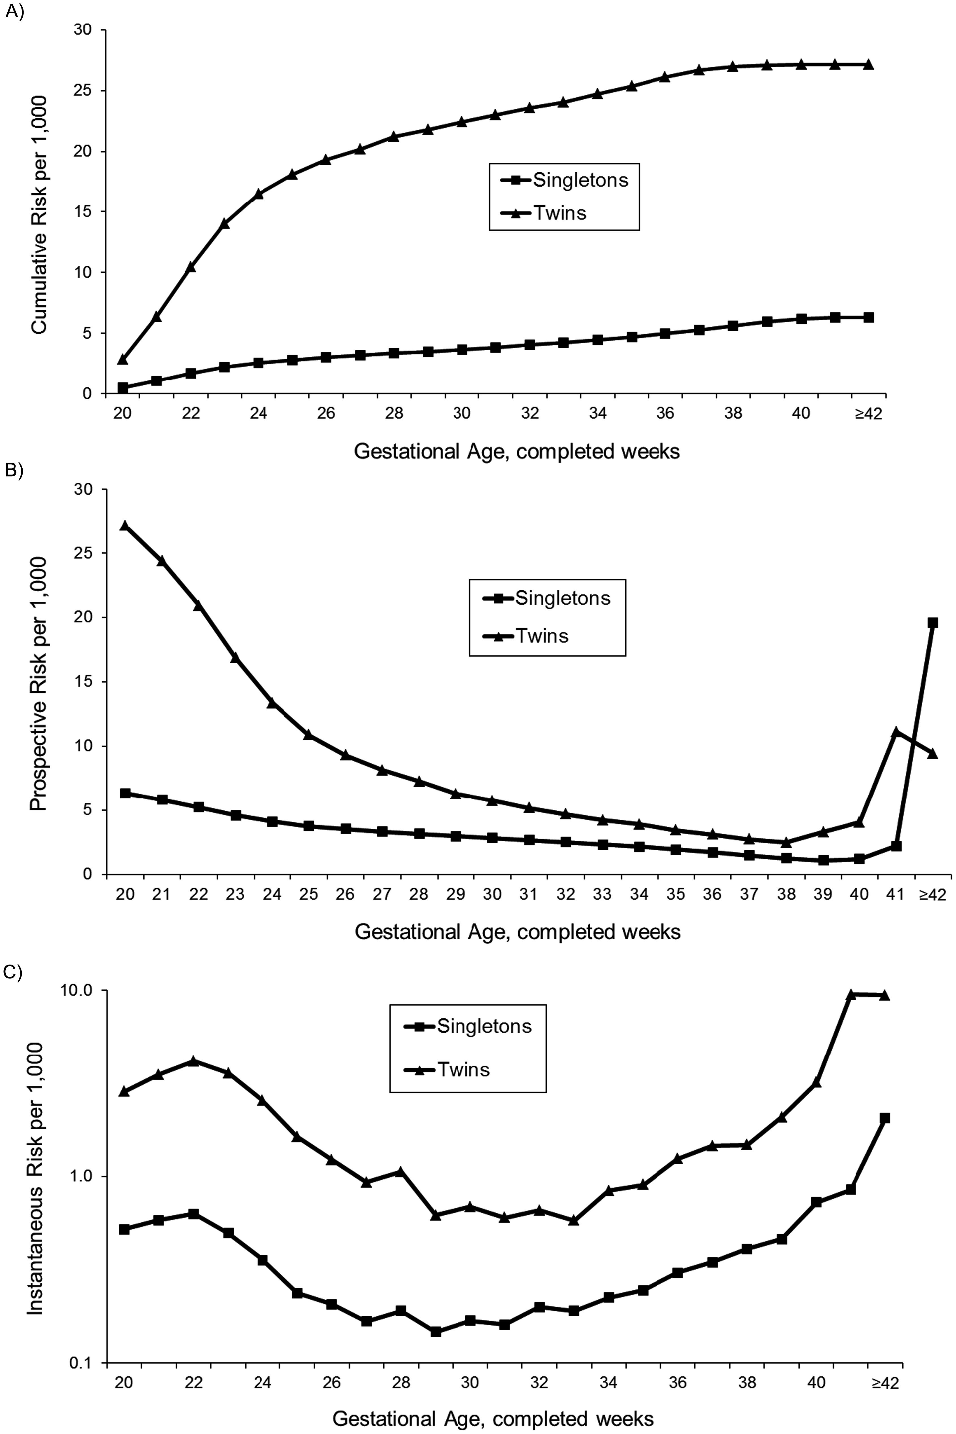
Figure 2. Gestational age–specific A) cumulative, B) prospective, and C) “instantaneous” (weekly) perinatal mortality ...
Notes:
Figure 2. Gestational age–specific A) cumulative, B) prospective, and C) “instantaneous” (weekly) perinatal mortality risk in twin versus singleton births among US non-Hispanic whites.
Unless provided in the caption above, the following copyright applies to the content of this slide: © The Author 2013. Published by Oxford University Press on behalf of the Johns Hopkins Bloomberg School of Public Health. All rights reserved. For permissions, please e-mail: journals.permissions@oup.com.

Slide 3
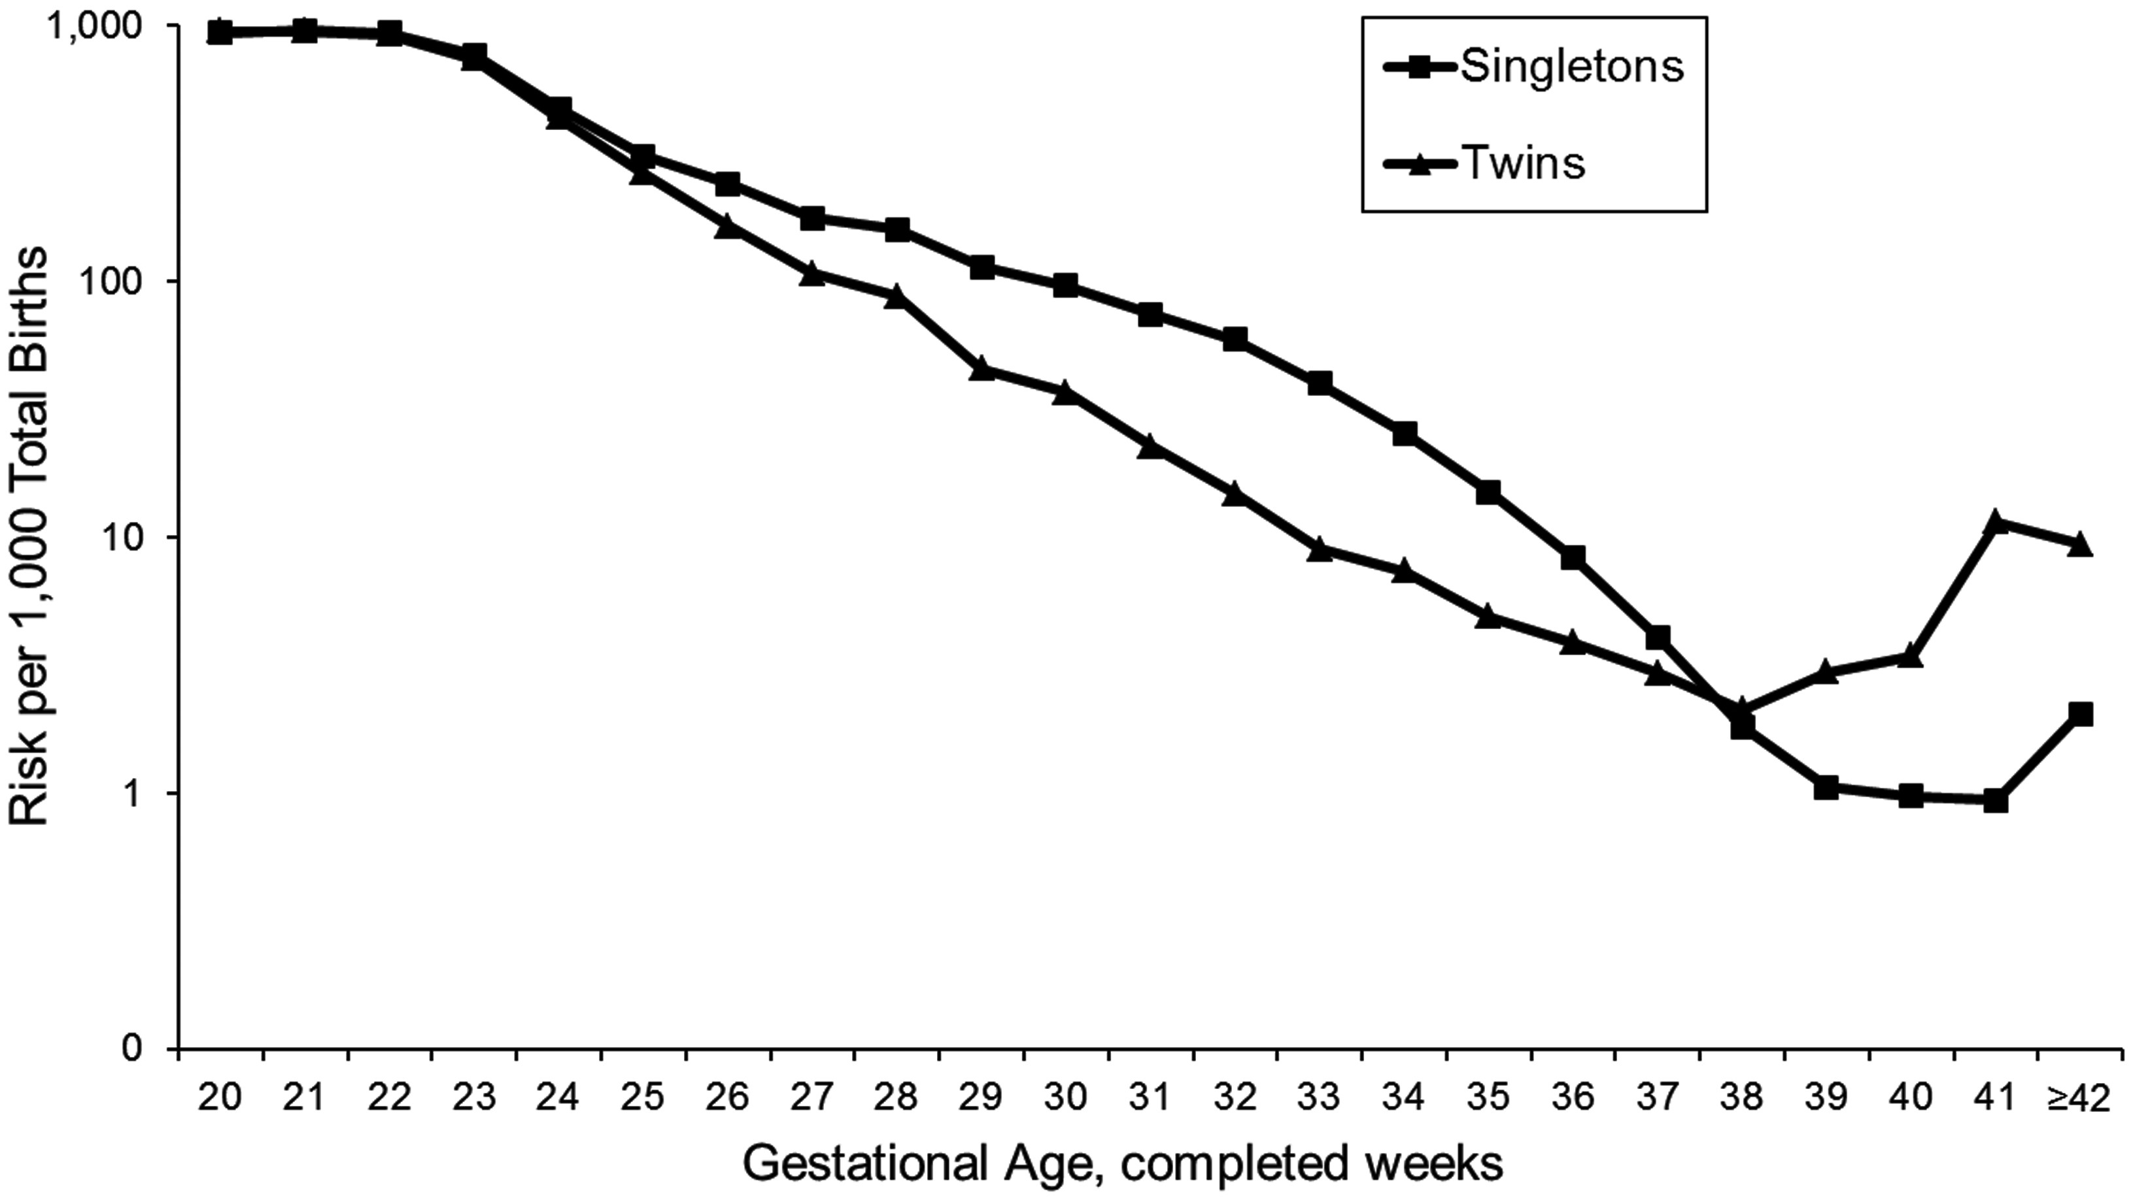
Figure 3. Gestational age–specific perinatal mortality risk conditional on birth at each gestational age in twin versus ...
Notes:
Figure 3. Gestational age–specific perinatal mortality risk conditional on birth at each gestational age in twin versus singleton births among US non-Hispanic whites.
Unless provided in the caption above, the following copyright applies to the content of this slide: © The Author 2013. Published by Oxford University Press on behalf of the Johns Hopkins Bloomberg School of Public Health. All rights reserved. For permissions, please e-mail: journals.permissions@oup.com.

Slide 4
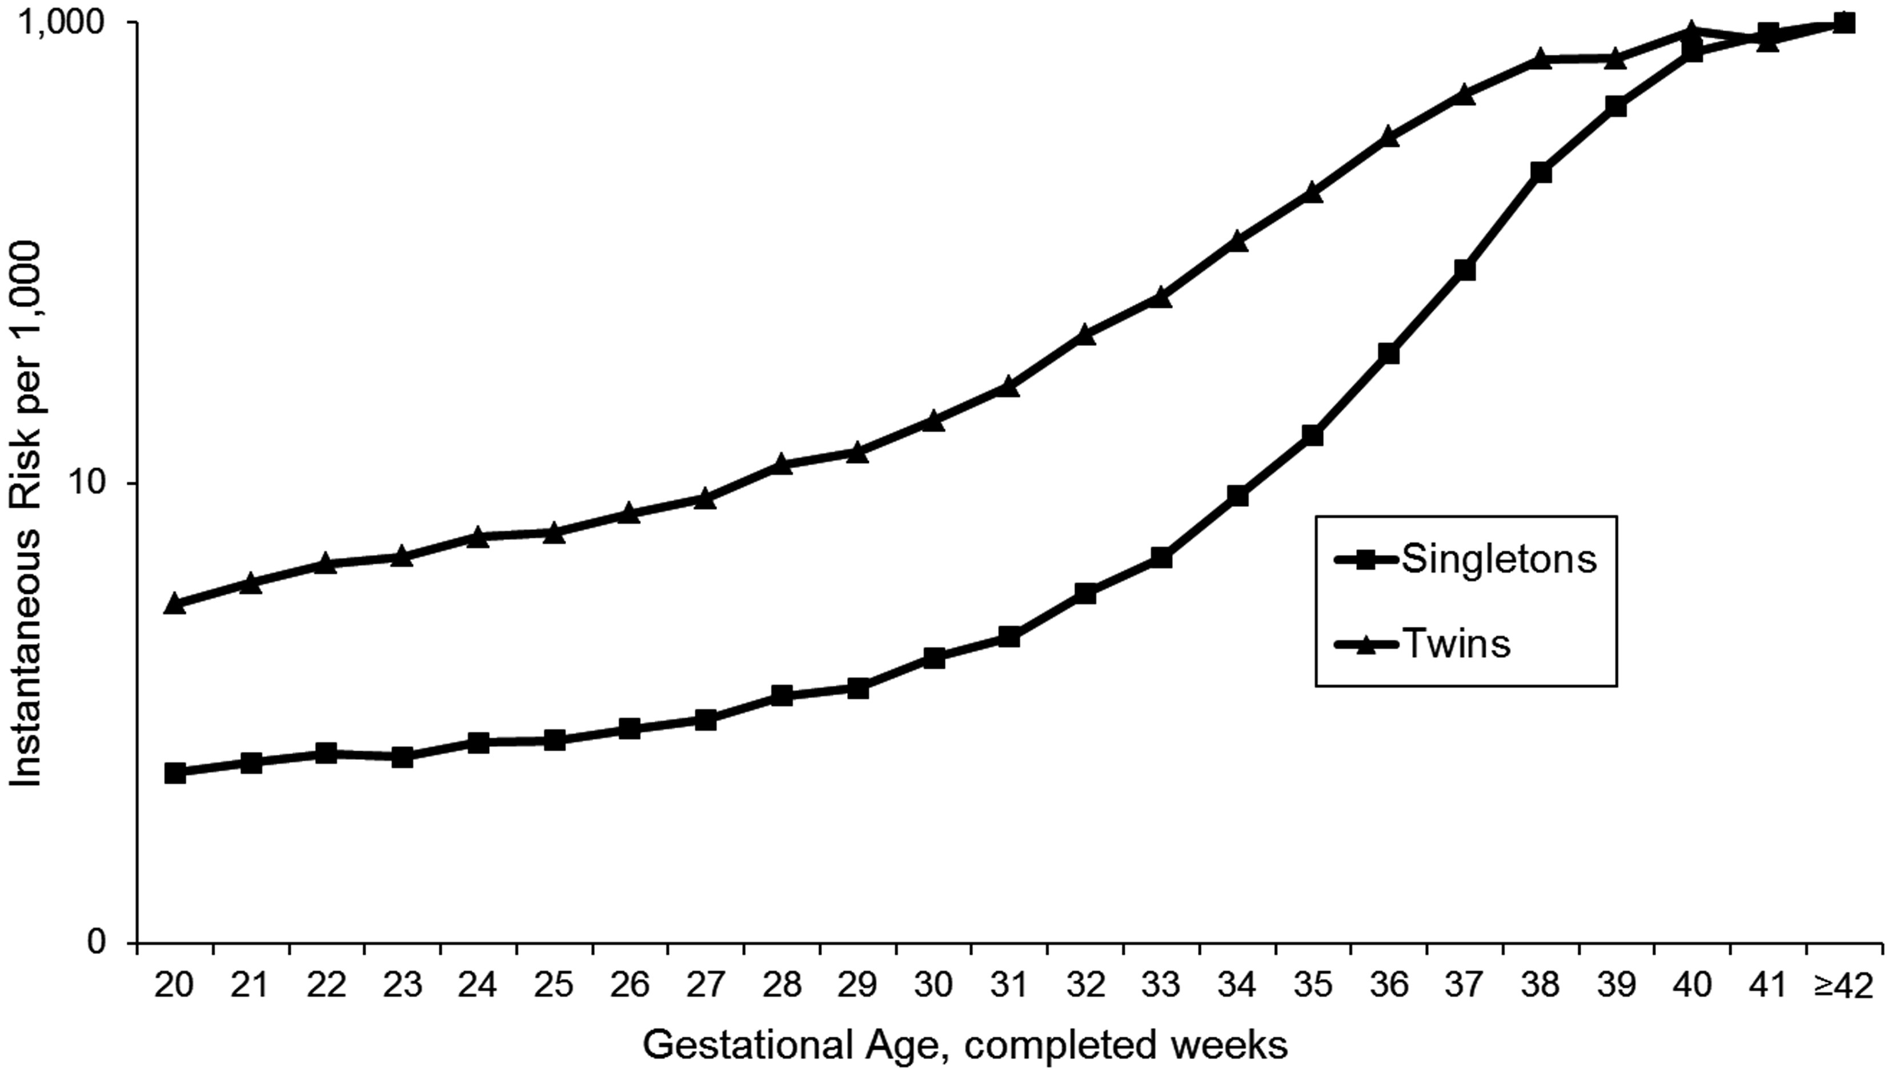
Figure 4. Gestational age–specific birth rates in twin versus singleton births among US non-Hispanic whites.
Notes:
Figure 4. Gestational age–specific birth rates in twin versus singleton births among US non-Hispanic whites.
Unless provided in the caption above, the following copyright applies to the content of this slide: © The Author 2013. Published by Oxford University Press on behalf of the Johns Hopkins Bloomberg School of Public Health. All rights reserved. For permissions, please e-mail: journals.permissions@oup.com.

