Slide 1
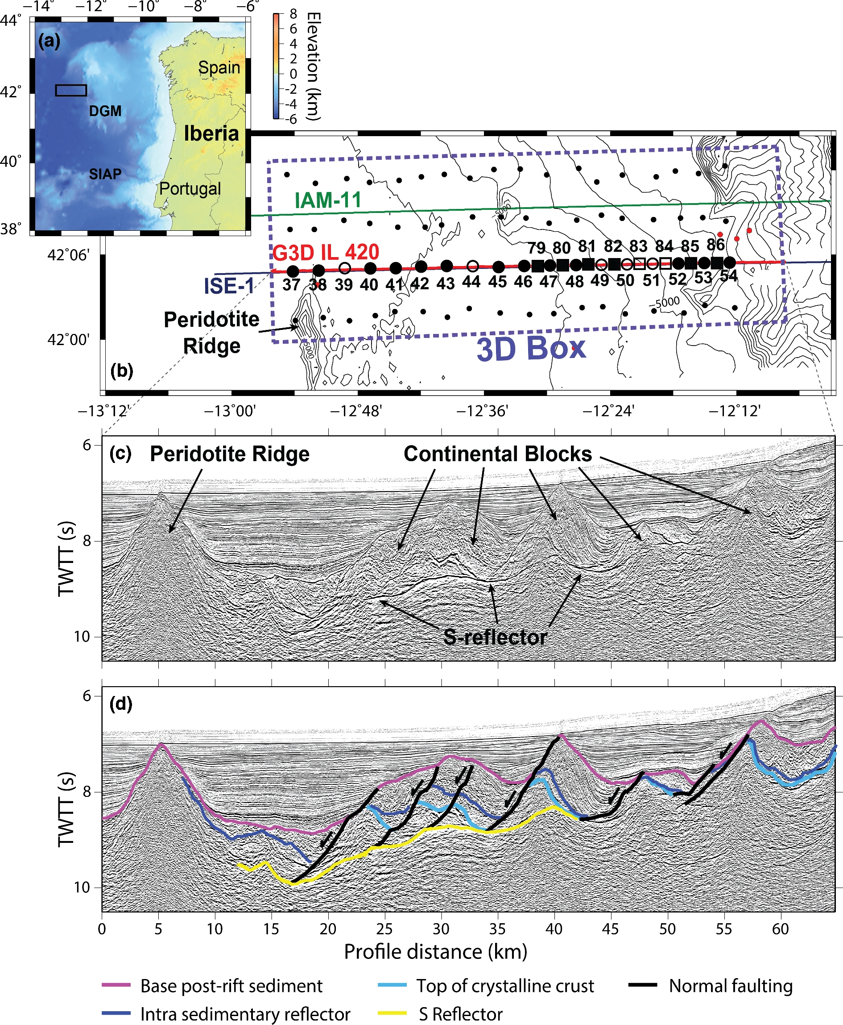
Figure 1. (a) Bathymetric map of the Deep Galicia Margin (DGM) and the Southern Iberia Abyssal Plain (SIAP) with the ...
Notes:
Figure 1. (a) Bathymetric map of the Deep Galicia Margin (DGM) and the Southern Iberia Abyssal Plain (SIAP) with the relative location of (b) (black rectangle). (b) Map of the Galicia-3-D seismic experiment. Galicia 3-D inline 420 seismic profile is illustrated by a red line; large black circles indicate the location of OBIF OBS along seismic inline 420; large black squares indicate GEOMAR OBH; unfilled circles and squares indicate instruments which recovered no data or were excluded from the FWI process. Purple line indicates the ISE-1 seismic profile; green line indicates the IAM-11 seismic profile and ODP Leg 103 sites are indicated by red circles (Boillot et al.1987). (c) Kirchhoff pre-stack time-migrated multichannel seismic reflection image of inline 420, highlighting features of the Deep Galicia Margin. (d) Simplified interpretation of C).
Unless provided in the caption above, the following copyright applies to the content of this slide: © The Authors 2017. Published by Oxford University Press on behalf of The Royal Astronomical Society.

Slide 2
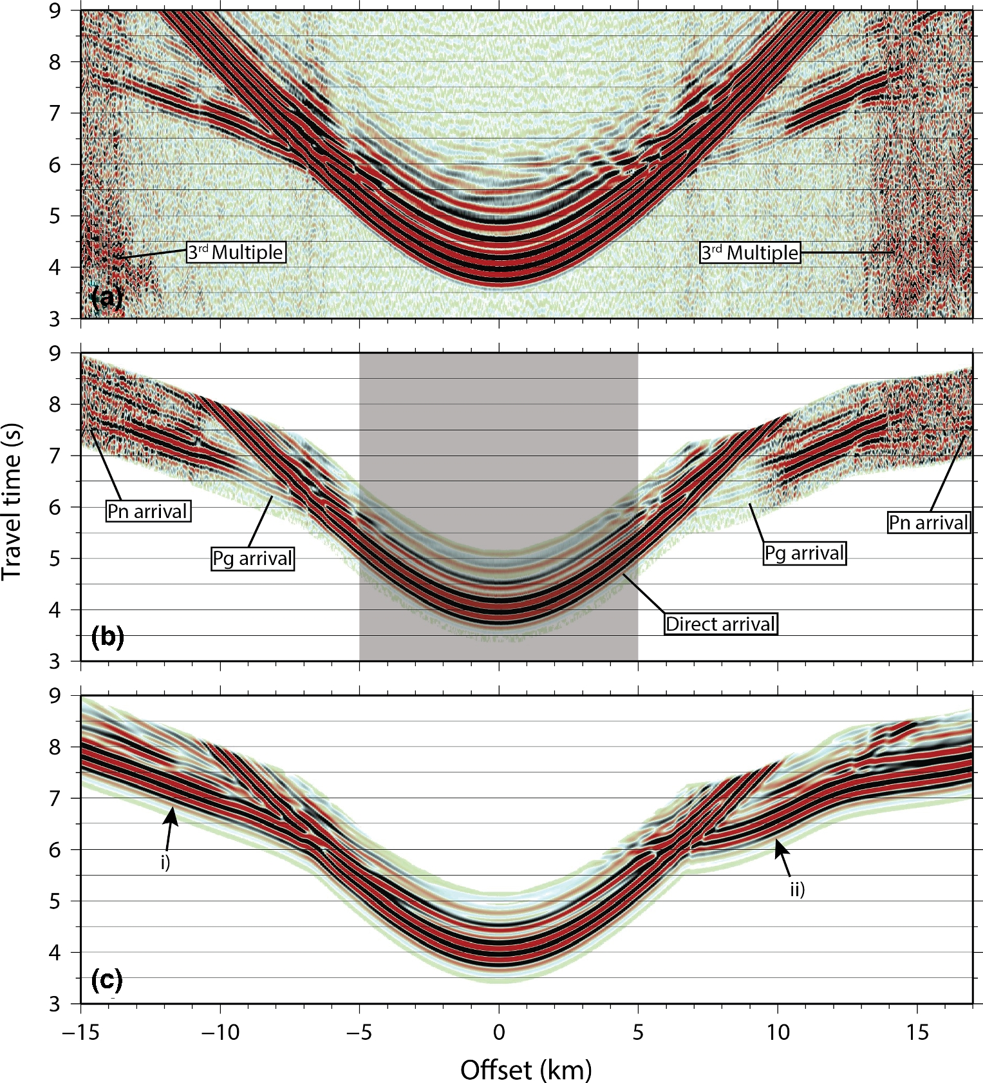
Figure 2. (a) Example receiver gather from OBS 46, filtered with an Ormsby bandpass comprised of corner frequencies 2–3 ...
Notes:
Figure 2. (a) Example receiver gather from OBS 46, filtered with an Ormsby bandpass comprised of corner frequencies 2–3 and 4.5–6.5 Hz. The third multiple from the previous seismic shot is indicated. (b) Same receiver gather as in (a), windowed 1.8 s after the first arrival for input into the inversion process. Grey area indicates data excluded from the inversion. Identified seismic phases are indicated. (c) Synthetic receiver gather for OBS46 generated using the starting velocity model in (a). Please note that receiver gathers, here and thereafter, are illustrated with a trace dependent gain for display purposes.
Unless provided in the caption above, the following copyright applies to the content of this slide: © The Authors 2017. Published by Oxford University Press on behalf of The Royal Astronomical Society.

Slide 3
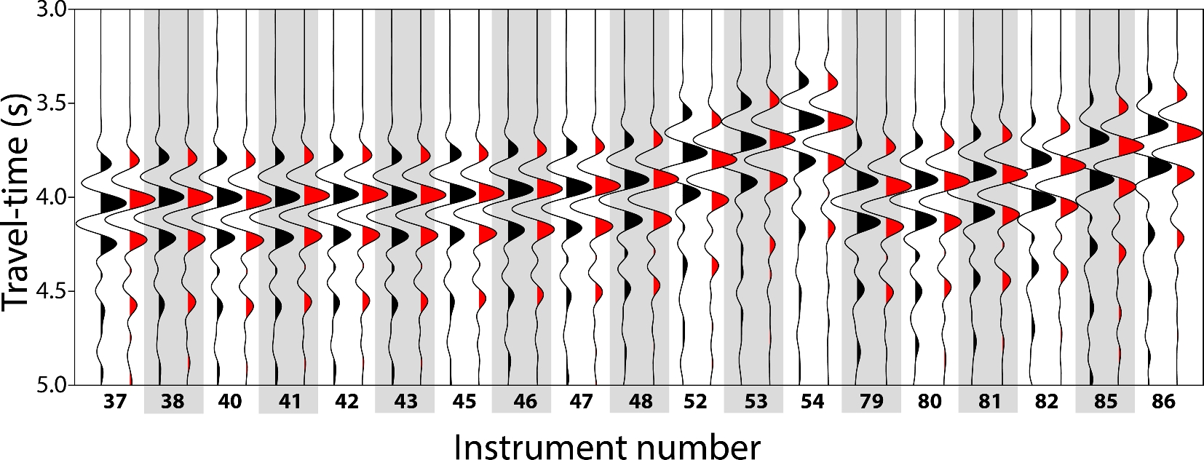
Figure 3. Fit between observed and synthetic direct water-wave arrivals. Observed near-offset traces (black) compared ...
Notes:
Figure 3. Fit between observed and synthetic direct water-wave arrivals. Observed near-offset traces (black) compared with the equivalent synthetic trace (red) through the starting velocity model, for all instruments used in this study. Observed data are bandpass filtered (Ormsby, corner frequencies 2–3 and 4.5–6.5 Hz).
Unless provided in the caption above, the following copyright applies to the content of this slide: © The Authors 2017. Published by Oxford University Press on behalf of The Royal Astronomical Society.

Slide 4
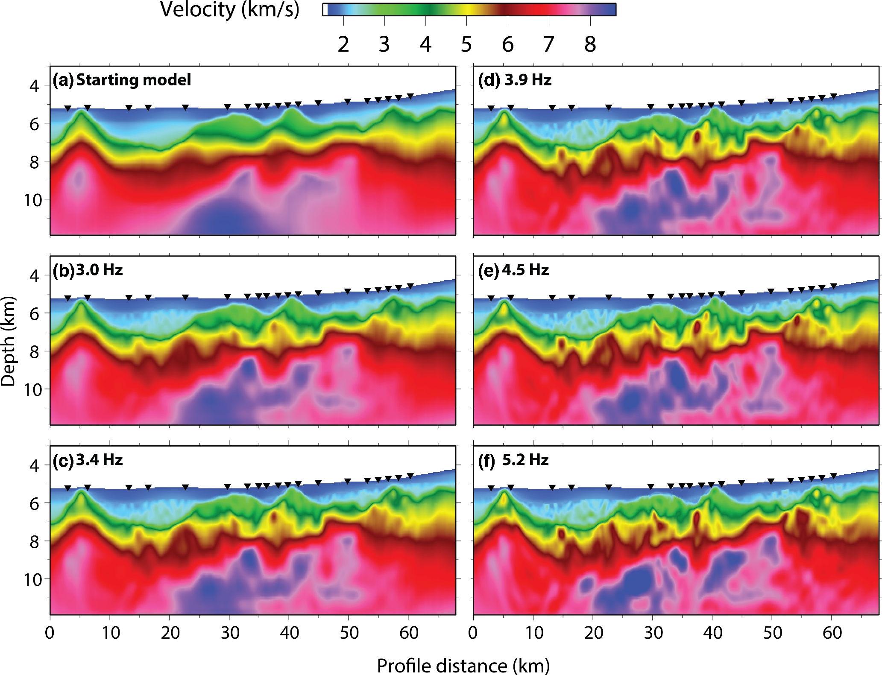
Figure 4. (a) Starting velocity model input to the FWI. Results of the iterative FWI process for low-pass filter ...
Notes:
Figure 4. (a) Starting velocity model input to the FWI. Results of the iterative FWI process for low-pass filter frequencies of: (b) 3.0 Hz; (c) 3.4 Hz; (d) 3.9 Hz; (e) 4.5 Hz and (f) 5.2 Hz. Black upturned triangles indicate the locations of utilized instruments. Vertical exaggeration is 3.2.
Unless provided in the caption above, the following copyright applies to the content of this slide: © The Authors 2017. Published by Oxford University Press on behalf of The Royal Astronomical Society.

Slide 5
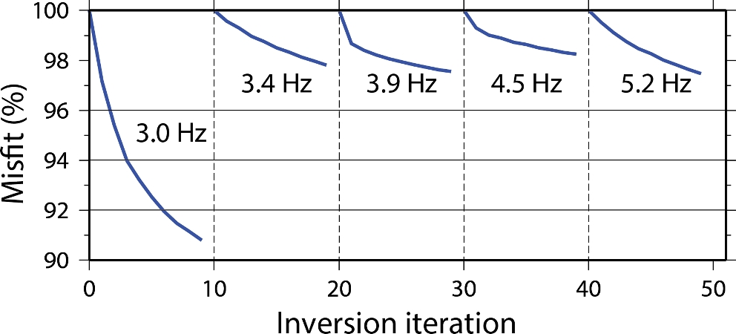
Figure 5. Misfit reduction versus inversion iterations for the five low-cut frequency bands, 3.0, 3.4, 3.9, 4.5 and ...
Notes:
Figure 5. Misfit reduction versus inversion iterations for the five low-cut frequency bands, 3.0, 3.4, 3.9, 4.5 and 5.2 Hz.
Unless provided in the caption above, the following copyright applies to the content of this slide: © The Authors 2017. Published by Oxford University Press on behalf of The Royal Astronomical Society.

Slide 6
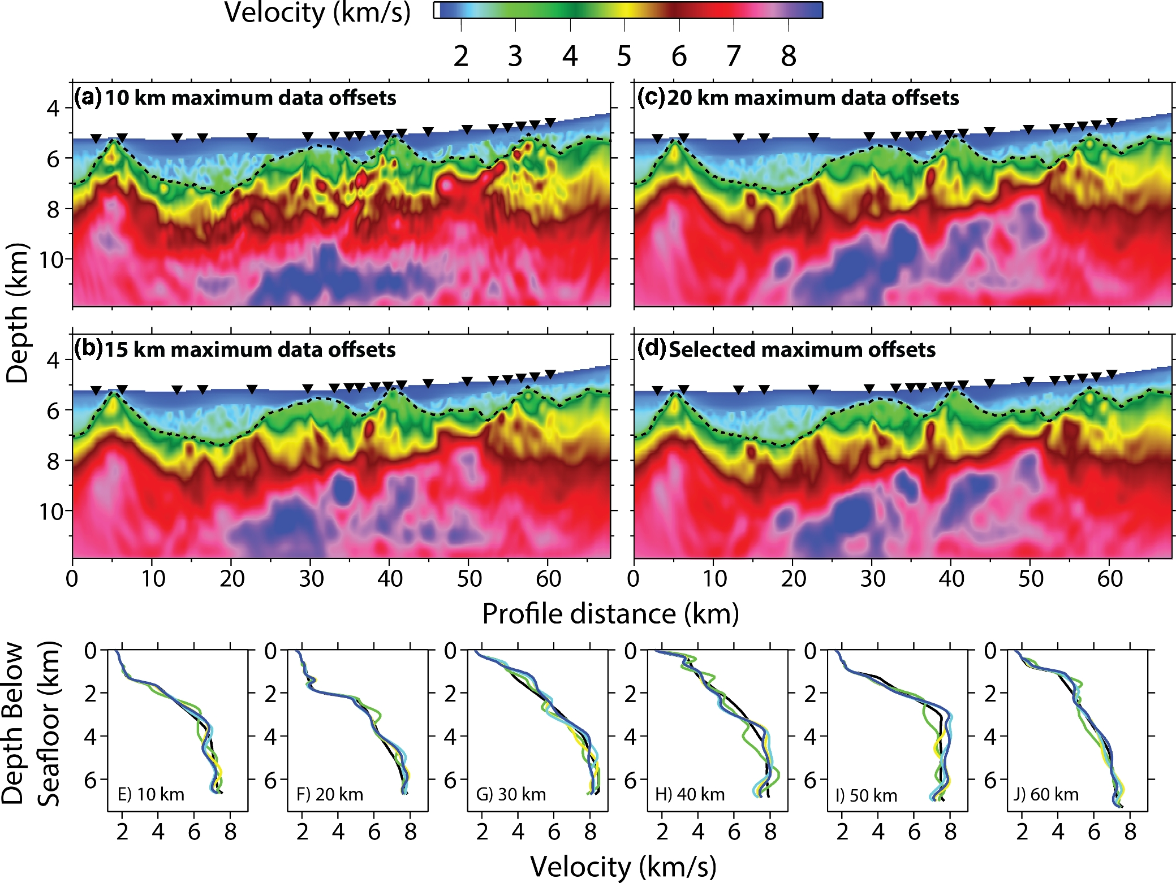
Figure 6. Inversion models for maximum data offsets of (a) 10 km, (b) 15 km, (c) 20 km and (d) instrument specific ...
Notes:
Figure 6. Inversion models for maximum data offsets of (a) 10 km, (b) 15 km, (c) 20 km and (d) instrument specific offsets. Black upturned triangles indicate the locations of utilized instruments and black dashed line indicates the base of post-rift sediments. Vertical exaggeration is 3.2. (e)–(j) 1-D velocity profiles through the resulting models, below the seafloor, at set profile distances (10, 20, 30, 40, 50 and 60 km, respectively). Line colours are black: starting model, green: 10 km data offsets, yellow: 15 km data offsets, light blue: 20 km data offsets and blue: instrument specific data offsets.
Unless provided in the caption above, the following copyright applies to the content of this slide: © The Authors 2017. Published by Oxford University Press on behalf of The Royal Astronomical Society.

Slide 7
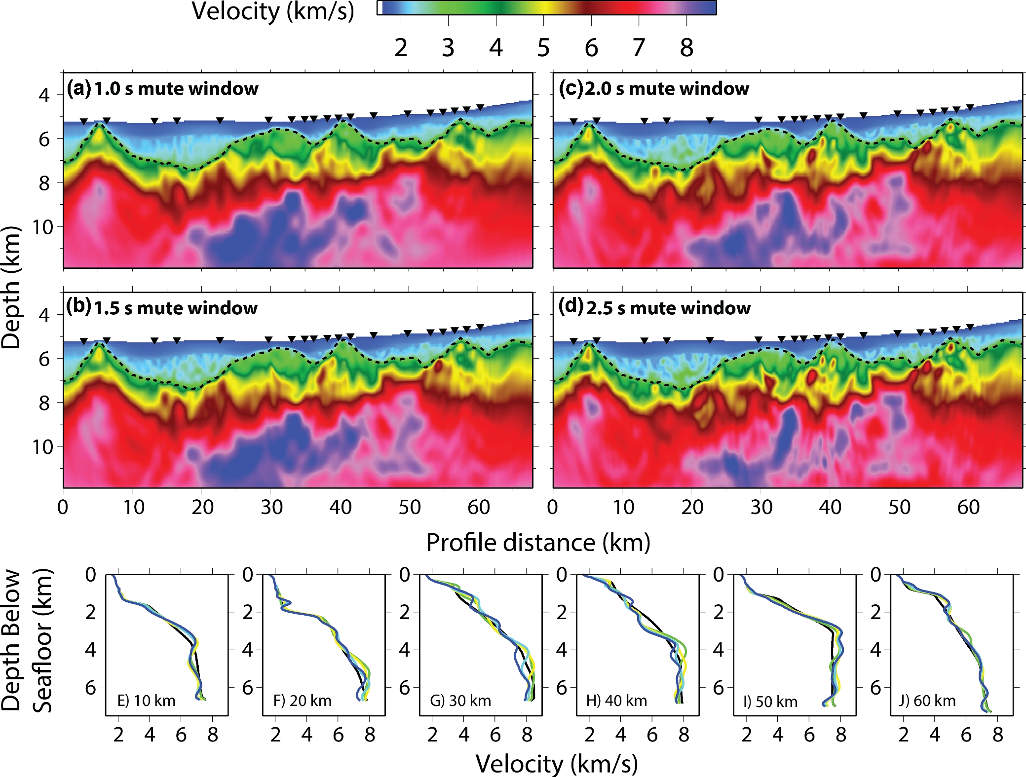
Figure 7. Inversion models for varying mute windows of (a) 1.0 s, (b) 1.5 s, (c) 2.0 s, (d) 2.5 s. Black upturned ...
Notes:
Figure 7. Inversion models for varying mute windows of (a) 1.0 s, (b) 1.5 s, (c) 2.0 s, (d) 2.5 s. Black upturned triangles indicate the locations of utilized instruments and black dashed line indicates the base of post-rift sediments. Vertical exaggeration is 3.2. (e)–(j) 1-D velocity profiles through the resulting models, below the seafloor, at set profile distances (10, 20, 30, 40, 50 and 60 km, respectively). Line colours are black: starting model, green: 1.0 s, yellow: 1.5 s, light blue: 2.0 s and blue: 2.5 s.
Unless provided in the caption above, the following copyright applies to the content of this slide: © The Authors 2017. Published by Oxford University Press on behalf of The Royal Astronomical Society.

Slide 8
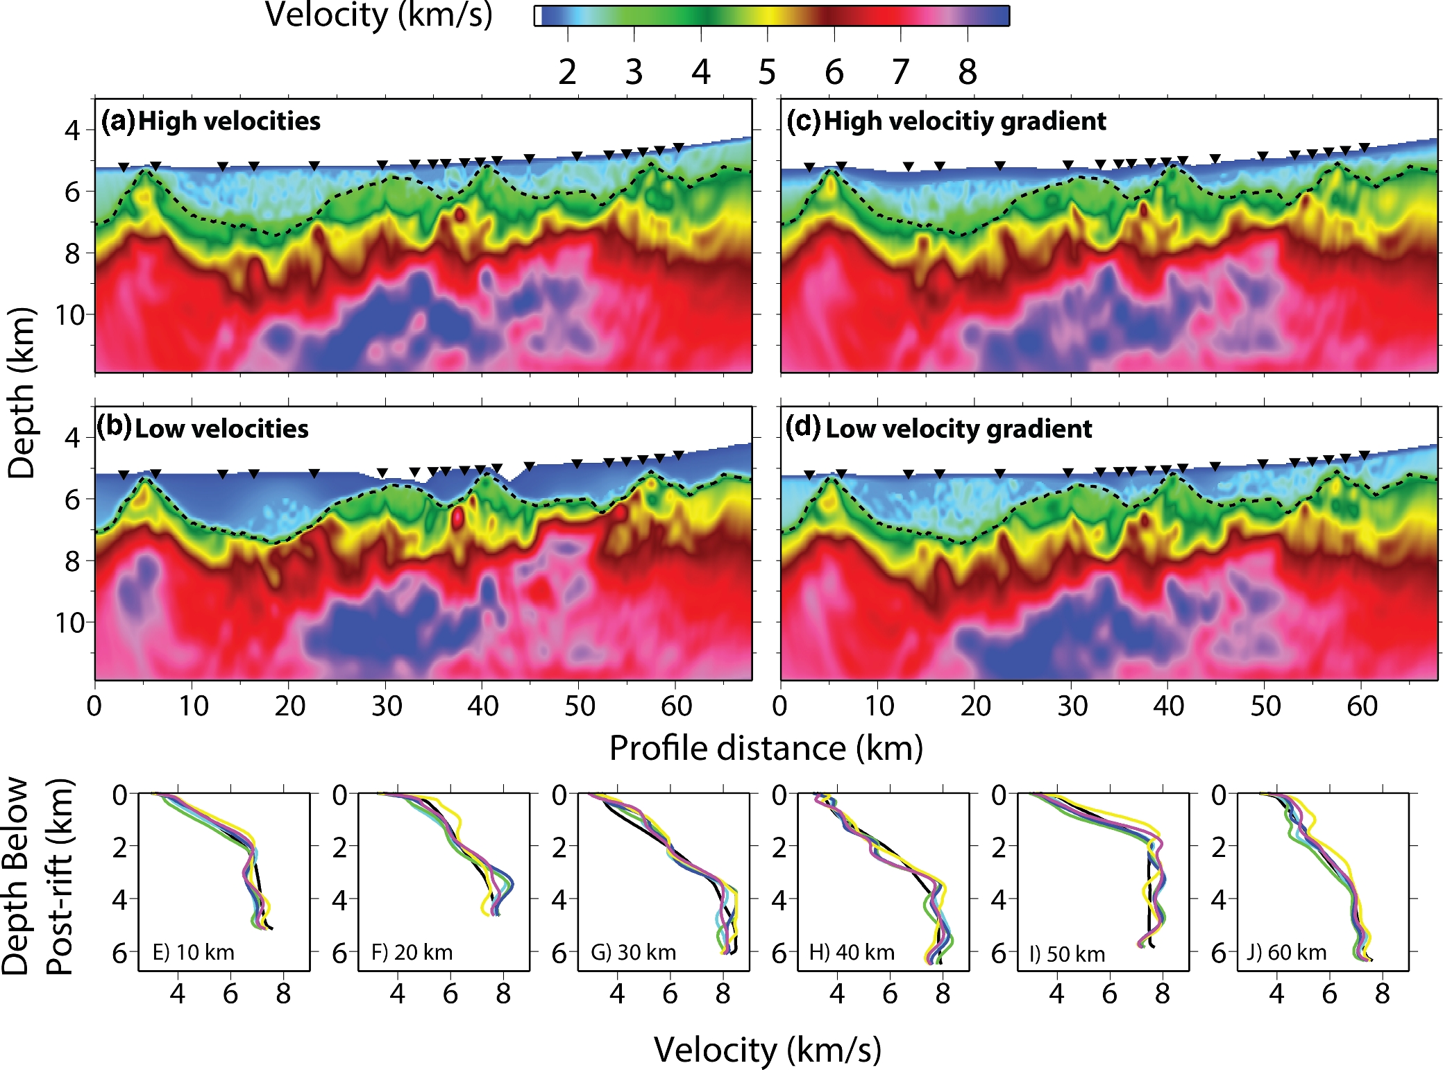
Figure 8. Inversion models for varying starting sediment velocity models, as described in Section 3.7: (a) high ...
Notes:
Figure 8. Inversion models for varying starting sediment velocity models, as described in Section 3.7: (a) high velocities, (b) low velocities, (c) high-velocity gradient and (d) Low-velocity gradient. Black upturned triangles indicate the locations of utilized instruments and black dashed line indicates the base of post-rift sediments. Vertical exaggeration is 3.2. (e)–(j) 1-D velocity profiles through the resulting models, below post-rift sediment, at set profile distances (10, 20, 30, 40, 50 and 60 km, respectively). Line colours are black: starting model, green: high velocities, yellow: low velocities, light blue: high-velocity gradient and blue: low-velocity gradient.
Unless provided in the caption above, the following copyright applies to the content of this slide: © The Authors 2017. Published by Oxford University Press on behalf of The Royal Astronomical Society.

Slide 9
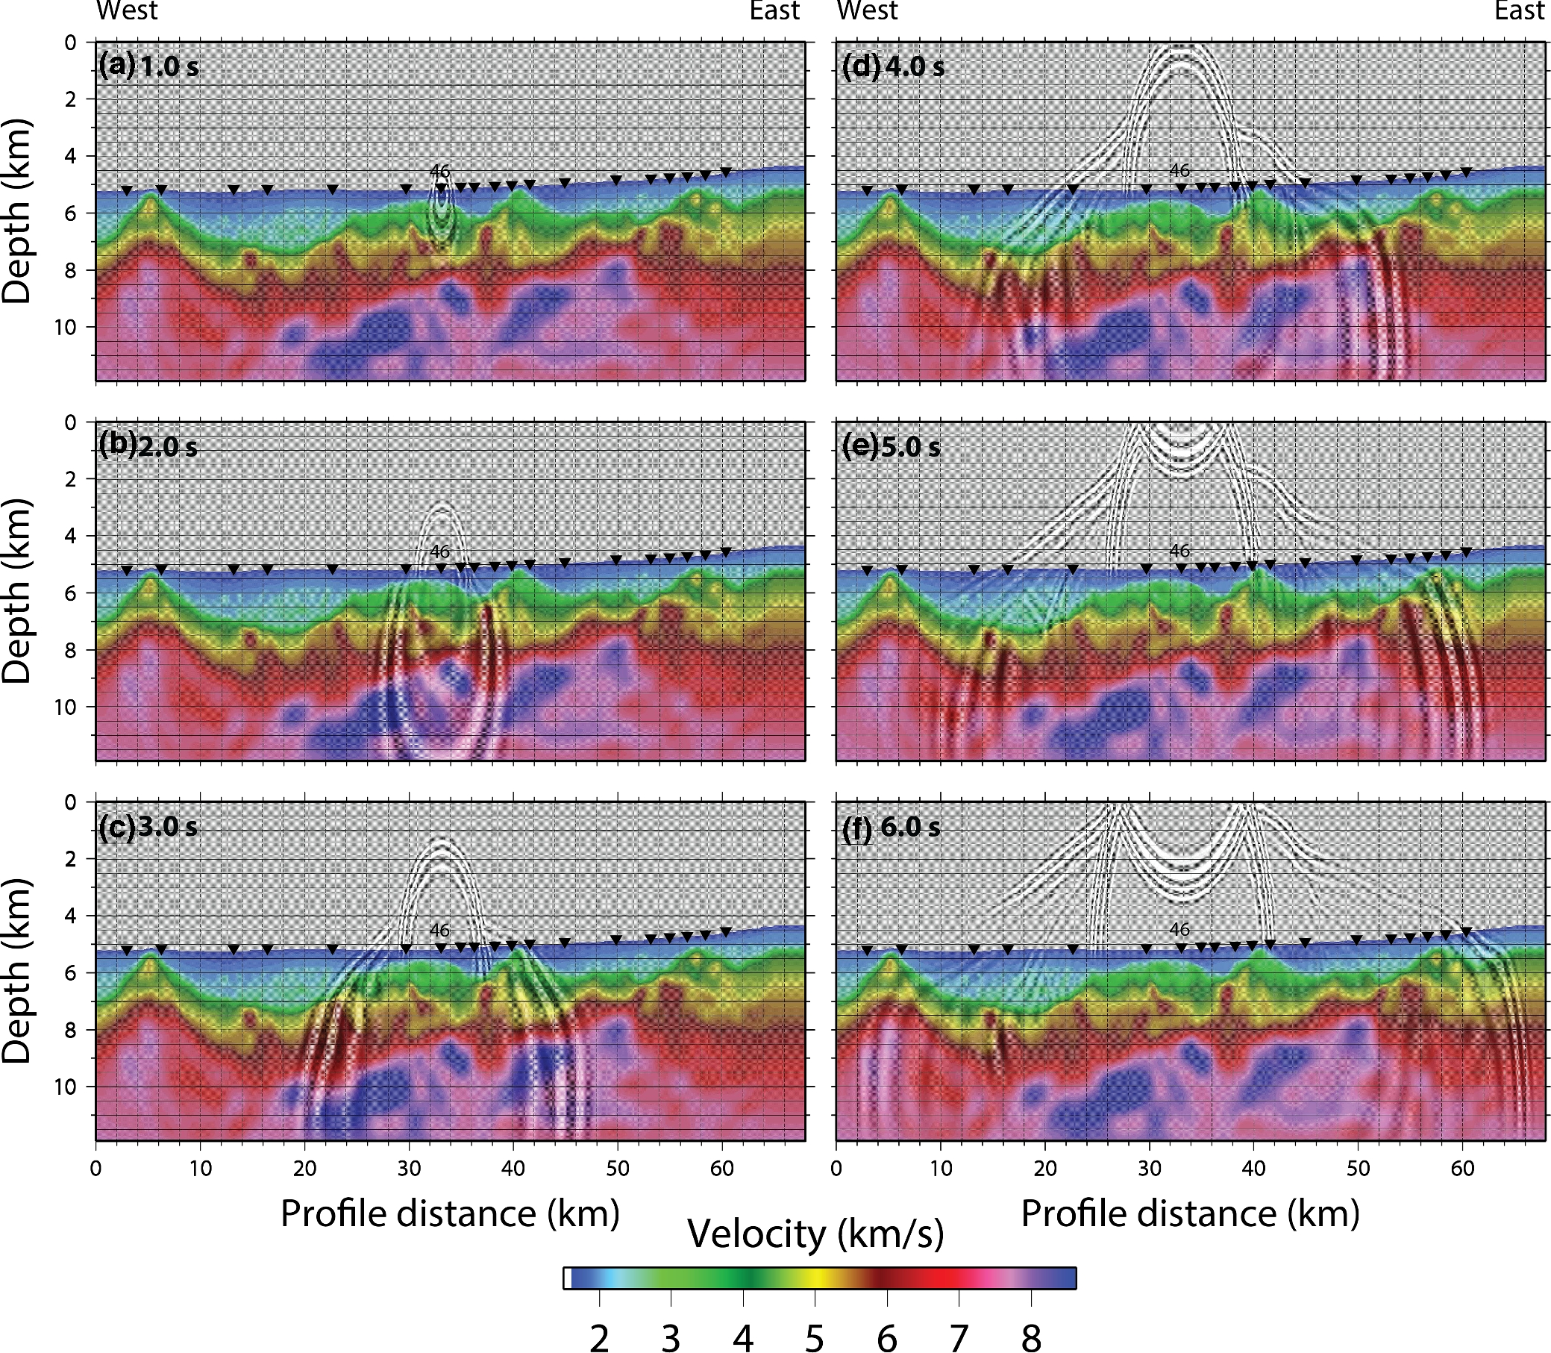
Figure 9. Propagation of the derived source wavelet through the final inversion model, originating at OBS46, at ...
Notes:
Figure 9. Propagation of the derived source wavelet through the final inversion model, originating at OBS46, at discrete times: (a) 1.0 s, (b) 2.0 s, (c) 3.0 s, (d) 4.0 s, (e) 5.0 s and (f) 6.0 s. Black upturned triangles indicate the locations of utilized instruments. Vertical exaggeration is 3.2.
Unless provided in the caption above, the following copyright applies to the content of this slide: © The Authors 2017. Published by Oxford University Press on behalf of The Royal Astronomical Society.

Slide 10
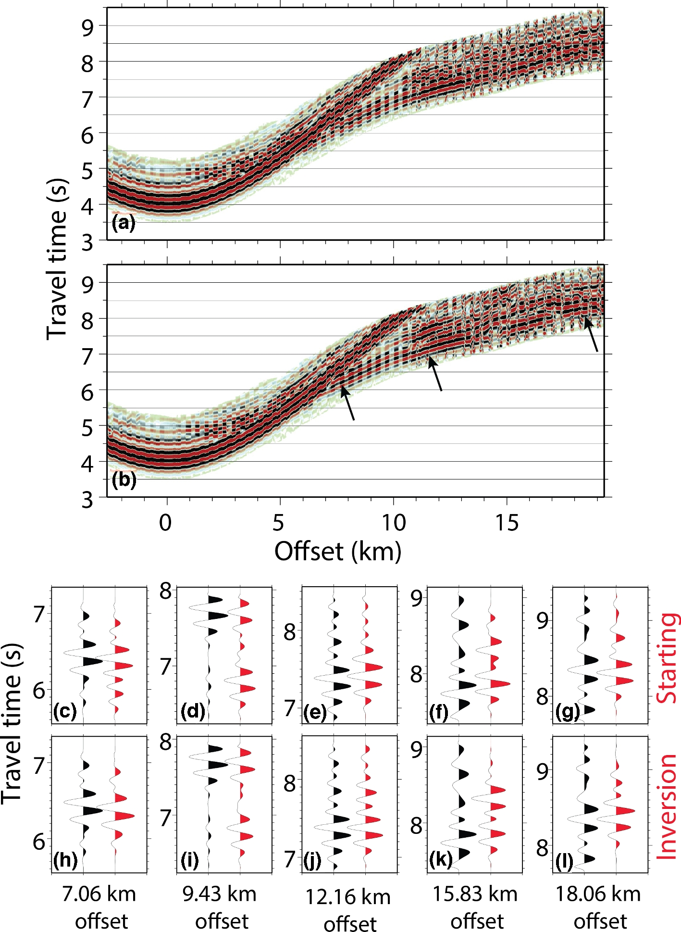
Figure 10. OBS 37. (a) Observed data interleaved with synthetic through the starting model in alternative offset bins of ...
Notes:
Figure 10. OBS 37. (a) Observed data interleaved with synthetic through the starting model in alternative offset bins of 200 m. (b) Observed data interleaved with synthetic through the inversion model in alternative offset bins of 200 m. (c)–(g) Black traces: observed data and red traces: synthetic data through the starting model. (h)–(l) Black traces: observed data and red traces: synthetic data through the FWI model.
Unless provided in the caption above, the following copyright applies to the content of this slide: © The Authors 2017. Published by Oxford University Press on behalf of The Royal Astronomical Society.

Slide 11
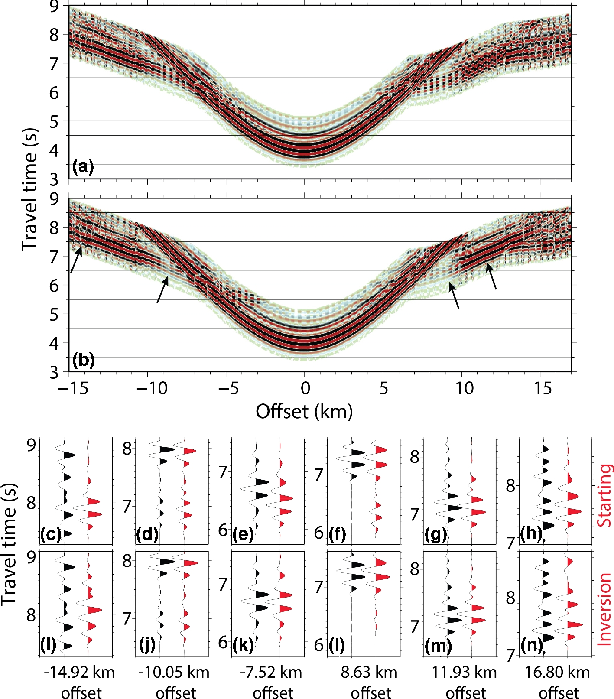
Figure 11. OBS 46. (a) Observed data interleaved with synthetic through the starting model in alternative offset bins of ...
Notes:
Figure 11. OBS 46. (a) Observed data interleaved with synthetic through the starting model in alternative offset bins of 200 m. (b) Observed data interleaved with synthetic through the inversion model in alternative offset bins of 200 m. (c)–(h) Black traces: observed data and red traces: synthetic data through the starting model. (i)–(n) Black traces: observed data and red traces: synthetic data through the FWI model.
Unless provided in the caption above, the following copyright applies to the content of this slide: © The Authors 2017. Published by Oxford University Press on behalf of The Royal Astronomical Society.

Slide 12
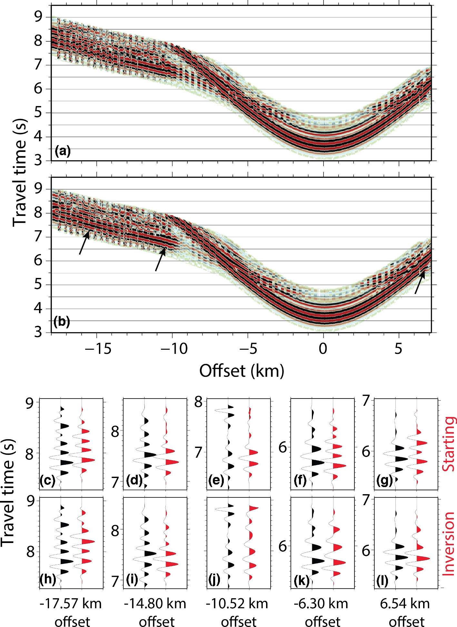
Figure 12. OBS 54. (a) Observed data interleaved with synthetic through the starting model in alternative offset bins of ...
Notes:
Figure 12. OBS 54. (a) Observed data interleaved with synthetic through the starting model in alternative offset bins of 200 m. (b) Observed data interleaved with synthetic through the inversion model in alternative offset bins of 200 m. (c)–(g) Black traces: observed data and red traces: synthetic data through the starting model. (h)–(l) Black traces: observed data and red traces: synthetic data through the FWI model.
Unless provided in the caption above, the following copyright applies to the content of this slide: © The Authors 2017. Published by Oxford University Press on behalf of The Royal Astronomical Society.

Slide 13
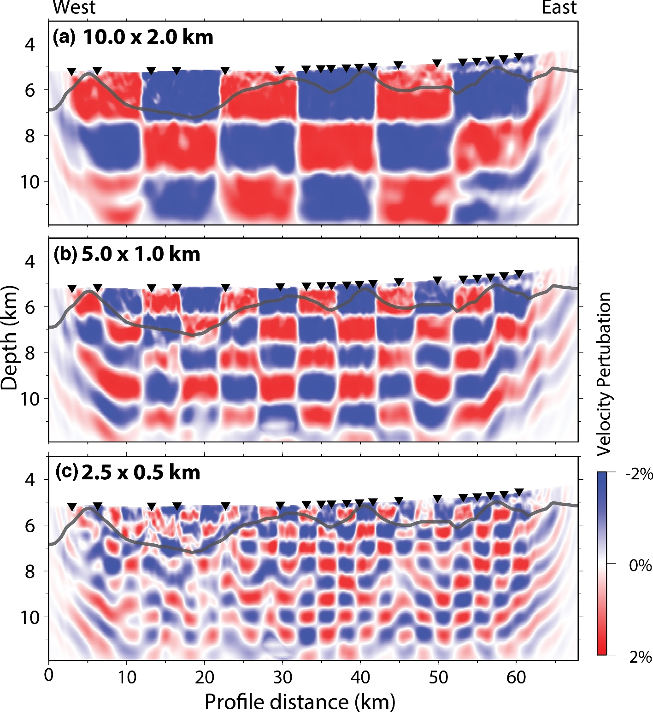
Figure 13. Checkerboard resolution test results. Anomaly check dimensions: (a) 10.0 × 2.0 km, (b) 5.0 × 1.0 km and (c) ...
Notes:
Figure 13. Checkerboard resolution test results. Anomaly check dimensions: (a) 10.0 × 2.0 km, (b) 5.0 × 1.0 km and (c) 2.0 × 0.5 km. Vertical exaggeration is 3.4. Grey line represents the top of the syn-rift sediments.
Unless provided in the caption above, the following copyright applies to the content of this slide: © The Authors 2017. Published by Oxford University Press on behalf of The Royal Astronomical Society.

Slide 14
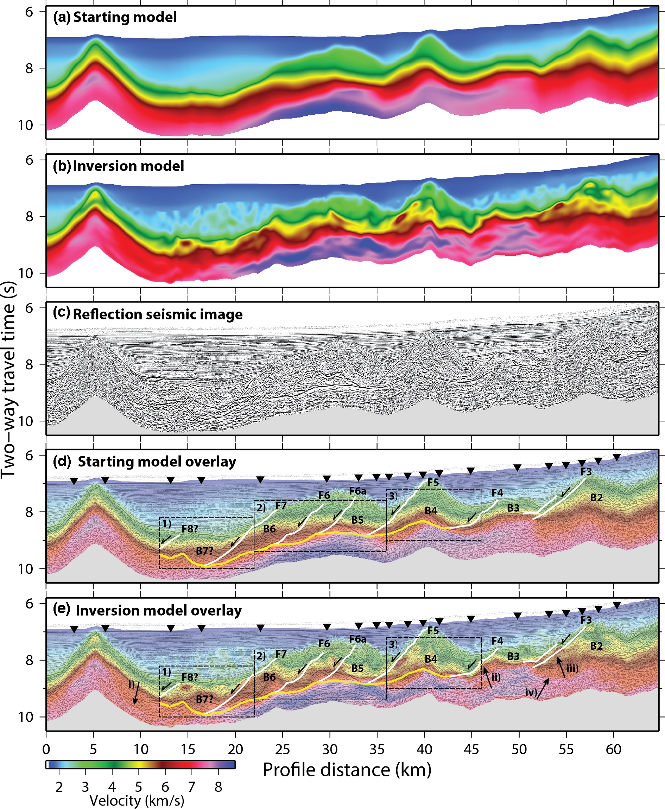
Figure 14. Comparison of large-scale features with seismic reflection imaging. (a) Starting velocity model. (b) Final ...
Notes:
Figure 14. Comparison of large-scale features with seismic reflection imaging. (a) Starting velocity model. (b) Final FWI velocity model. (c) Kirchhoff pre-stack time-migrated multichannel seismic image of inline 420. (d) Reflection image overlain with starting velocity model. (e) Reflection image overlain with FWI velocity model. White lines indicate the location of interpreted normal faulting and the yellow line is the interpreted S-reflector. Black upturned triangles indicate the locations of utilized instruments. Dashed black rectangles indicate the zoomed regions illustrated in Figs 4–15. Black arrows indicate regions discussed in the text.
Unless provided in the caption above, the following copyright applies to the content of this slide: © The Authors 2017. Published by Oxford University Press on behalf of The Royal Astronomical Society.

Slide 15
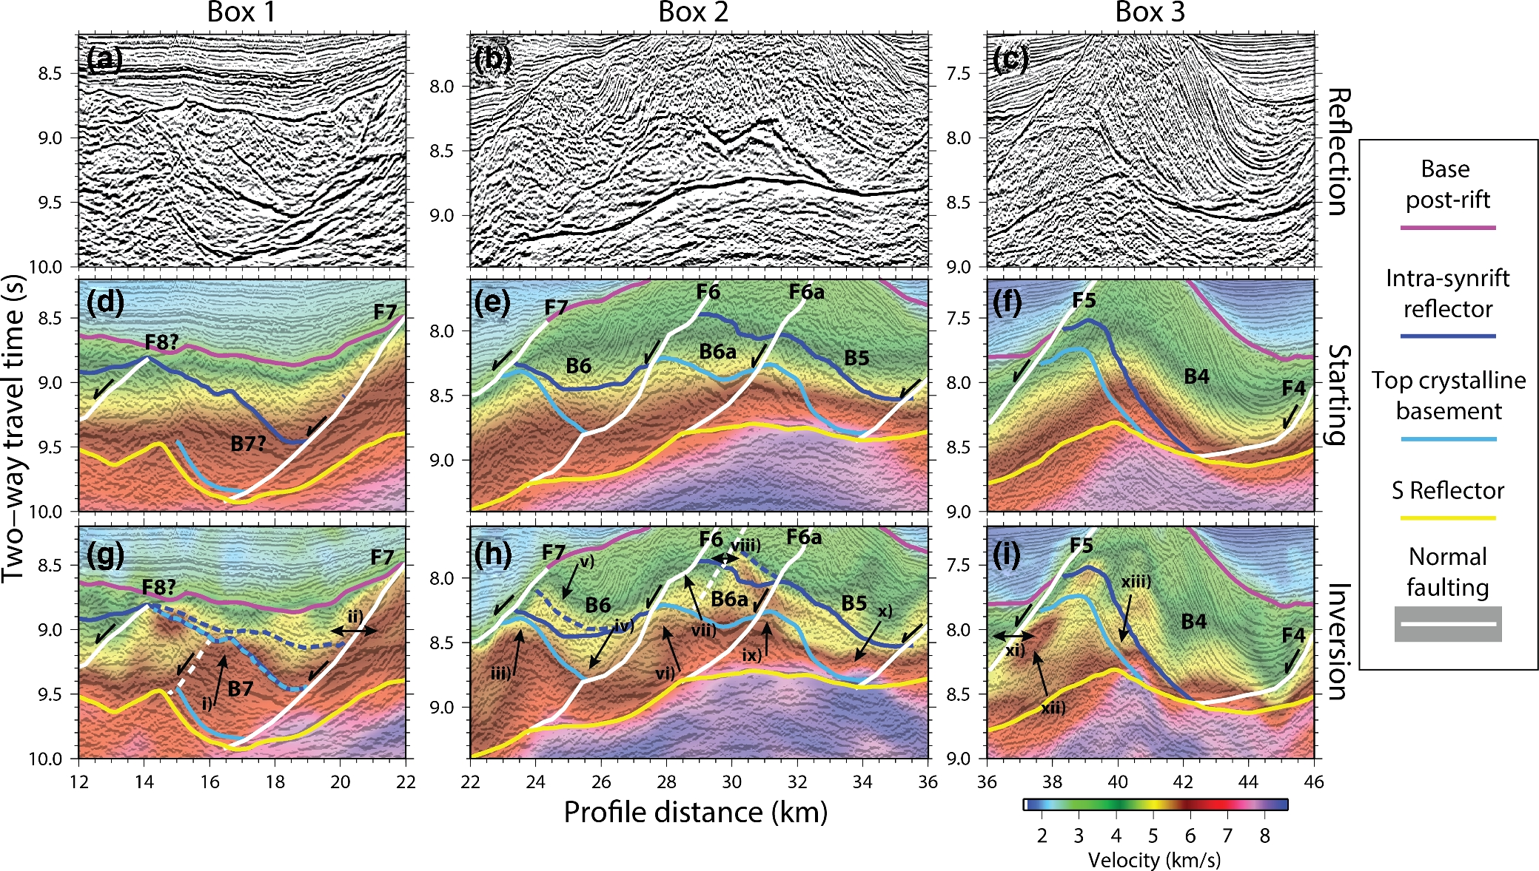
Figure 15. (a)–(c) Sections of interest of the Kirchhoff pre-stack time-migrated multichannel seismic image of inline ...
Notes:
Figure 15. (a)–(c) Sections of interest of the Kirchhoff pre-stack time-migrated multichannel seismic image of inline 420. (d)–(f) Same reflection images as (a)–(c), overlain by the time-converted starting velocity model. (g)–(i) Same reflection images as (a)–(c), overlain by the time-converted final FWI velocity model. Interpreted faults and horizons: white lines indicate normal faulting; yellow lines indicate the S-reflector; pink lines indicate the base of the post-rift sediments; dark blue indicate an intra syn-rift horizon and light blue indicates the top of crystalline basement. Black arrows indicate regions discussed in the text. Dashed lines indicate the reinterpretation of faults and horizons, based on the final FWI velocity model.
Unless provided in the caption above, the following copyright applies to the content of this slide: © The Authors 2017. Published by Oxford University Press on behalf of The Royal Astronomical Society.

Slide 16
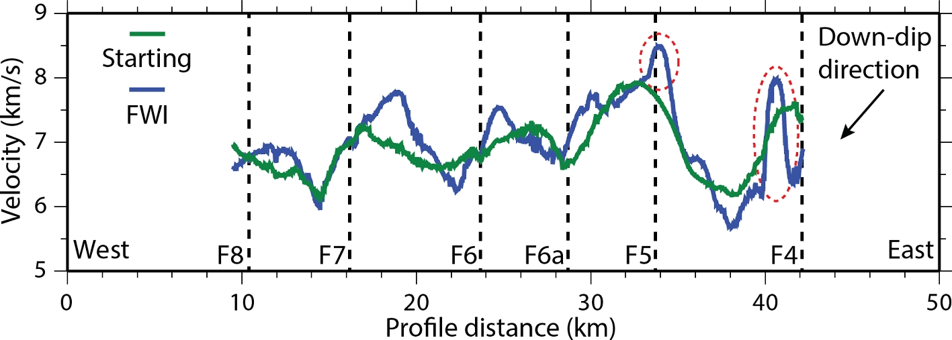
Figure 16. Velocities below the interpreted S-reflector (averaged over a 100 ms window). The green line indicates ...
Notes:
Figure 16. Velocities below the interpreted S-reflector (averaged over a 100 ms window). The green line indicates velocities from the starting velocity model and the blue line indicates velocities from the final FWI velocity model. Vertical dashed lines indicate the locations where interpreted normal faults sole onto the S-reflector. Red dashed ellipses indicate anomalous features of the inversion model.
Unless provided in the caption above, the following copyright applies to the content of this slide: © The Authors 2017. Published by Oxford University Press on behalf of The Royal Astronomical Society.

