Slide 1
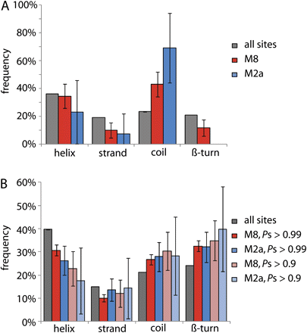
FIG. 1. Proportions of all sites (gray bars) and positively selected sites (colored bars) according to the M1a/M2a ...
Notes:
FIG. 1. Proportions of all sites (gray bars) and positively selected sites (colored bars) according to the M1a/M2a and M7/M8 LRT in different secondary structures determined experimentally (A) and predicted computationally (B). A threshold probability of Ps ≥ 0.5 was used in (A) and two thresholds (Ps ≥ 0.9 or ≥ 0.99) were used in (B).
Unless provided in the caption above, the following copyright applies to the content of this slide: © The Author(s) 2010. Published by Oxford University Press on behalf of the Society for Molecular Biology and Evolution.This is an Open Access article distributed under the terms of the Creative Commons Attribution Non-Commercial License (http://creativecommons.org/licenses/by-nc/2.5), which permits unrestricted non-commercial use, distribution, and reproduction in any medium, provided the original work is properly cited.

Slide 2
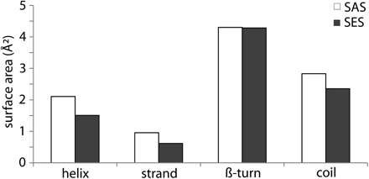
FIG. 2. Mean solvent exposed (SES, black bars) and solvent accessible (SAS, white bars) areas, expressed in square ...
Notes:
FIG. 2. Mean solvent exposed (SES, black bars) and solvent accessible (SAS, white bars) areas, expressed in square ångströms, in each of the four secondary structures.
Unless provided in the caption above, the following copyright applies to the content of this slide: © The Author(s) 2010. Published by Oxford University Press on behalf of the Society for Molecular Biology and Evolution.This is an Open Access article distributed under the terms of the Creative Commons Attribution Non-Commercial License (http://creativecommons.org/licenses/by-nc/2.5), which permits unrestricted non-commercial use, distribution, and reproduction in any medium, provided the original work is properly cited.

Slide 3
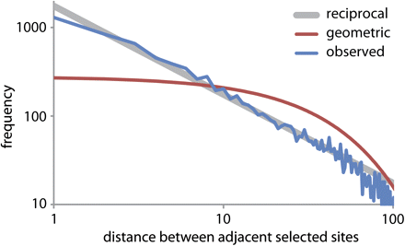
FIG. 3. The size distribution of intervals between adjacent selected sites on a log–log scale, with the geometric ...
Notes:
FIG. 3. The size distribution of intervals between adjacent selected sites on a log–log scale, with the geometric curve expected given no clustering of sites, and a power law fitted to the curve at lower gap sizes.
Unless provided in the caption above, the following copyright applies to the content of this slide: © The Author(s) 2010. Published by Oxford University Press on behalf of the Society for Molecular Biology and Evolution.This is an Open Access article distributed under the terms of the Creative Commons Attribution Non-Commercial License (http://creativecommons.org/licenses/by-nc/2.5), which permits unrestricted non-commercial use, distribution, and reproduction in any medium, provided the original work is properly cited.

Slide 4
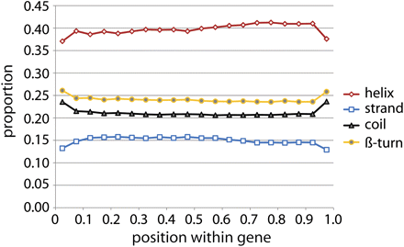
FIG. 4. Variation in the frequencies of different secondary structures along the length of genes when divided into 20 ...
Notes:
FIG. 4. Variation in the frequencies of different secondary structures along the length of genes when divided into 20 equal segments at all sites.
Unless provided in the caption above, the following copyright applies to the content of this slide: © The Author(s) 2010. Published by Oxford University Press on behalf of the Society for Molecular Biology and Evolution.This is an Open Access article distributed under the terms of the Creative Commons Attribution Non-Commercial License (http://creativecommons.org/licenses/by-nc/2.5), which permits unrestricted non-commercial use, distribution, and reproduction in any medium, provided the original work is properly cited.

Slide 5
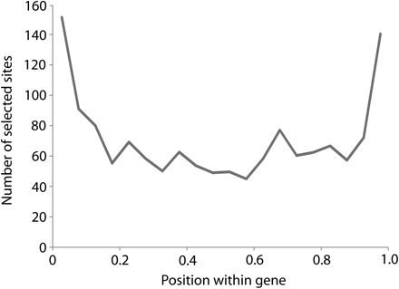
FIG. 5. Variation in the number of sites under selection along the length of a gene, when divided into 20 equal ...
Notes:
FIG. 5. Variation in the number of sites under selection along the length of a gene, when divided into 20 equal segments. Zero marks the start (N-terminus) and 1 the end (C-terminus).
Unless provided in the caption above, the following copyright applies to the content of this slide: © The Author(s) 2010. Published by Oxford University Press on behalf of the Society for Molecular Biology and Evolution.This is an Open Access article distributed under the terms of the Creative Commons Attribution Non-Commercial License (http://creativecommons.org/licenses/by-nc/2.5), which permits unrestricted non-commercial use, distribution, and reproduction in any medium, provided the original work is properly cited.

Slide 6
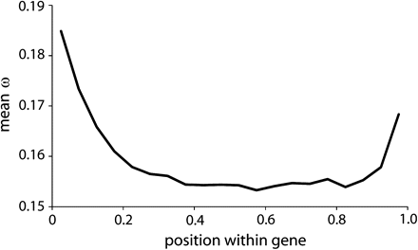
FIG. 6. Graph of mean ω against position in the gene. Data were binned into 20 equal segments along the gene.
Notes:
FIG. 6. Graph of mean ω against position in the gene. Data were binned into 20 equal segments along the gene.
Unless provided in the caption above, the following copyright applies to the content of this slide: © The Author(s) 2010. Published by Oxford University Press on behalf of the Society for Molecular Biology and Evolution.This is an Open Access article distributed under the terms of the Creative Commons Attribution Non-Commercial License (http://creativecommons.org/licenses/by-nc/2.5), which permits unrestricted non-commercial use, distribution, and reproduction in any medium, provided the original work is properly cited.

