Slide 1
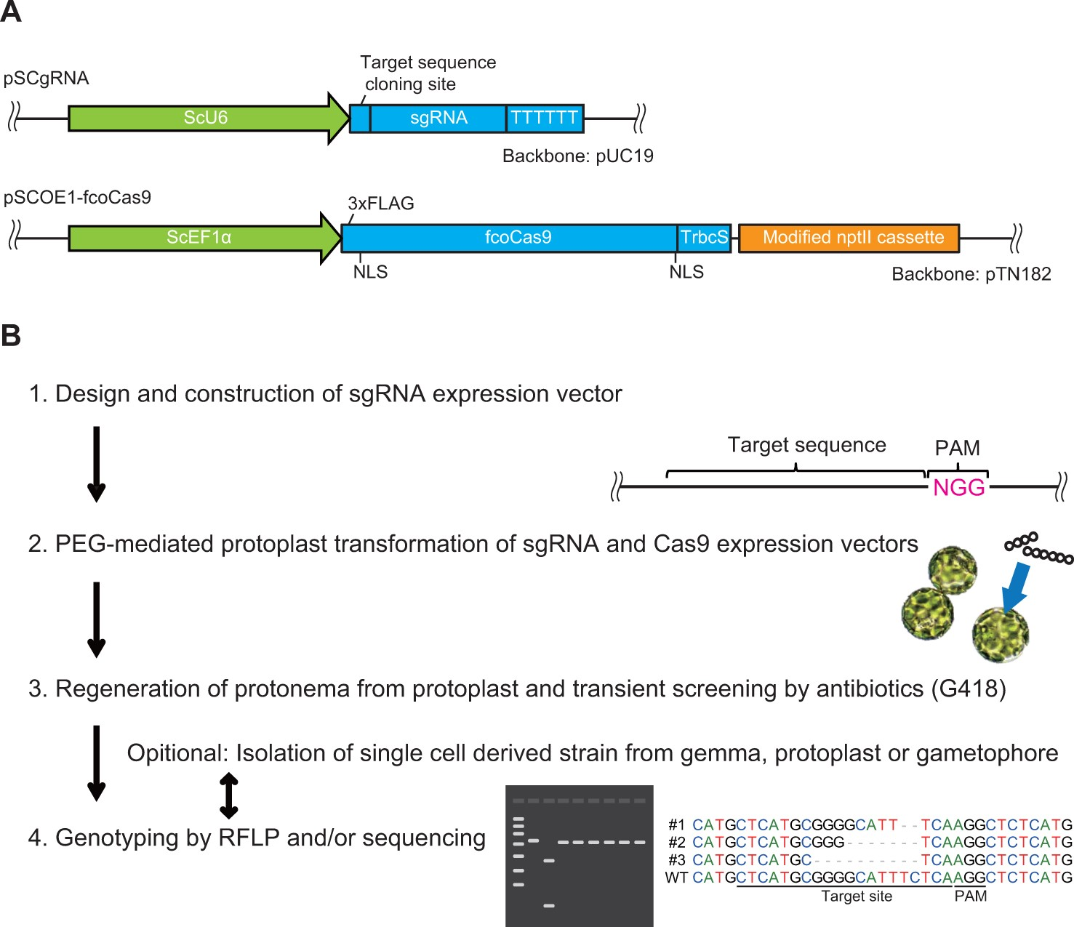
Fig. 1 CRISPR/Cas9 system in mosses. (A) Schematic representation of the single-chain guide RNA and Cas9 expression ...
Notes:
Fig. 1 CRISPR/Cas9 system in mosses. (A) Schematic representation of the single-chain guide RNA and Cas9 expression vectors. ScU6, U6 small nuclear RNA promoter from S. cataractae; ScEF1α, elongation factor 1α promoter from S. cataractae. (B) Acquisition method of strains with targeted mutations using the CRISPR/Cas9 system in mosses.
Unless provided in the caption above, the following copyright applies to the content of this slide: © The Authors 2016. Published by Oxford University Press on behalf of Japanese Society of Plant Physiologists. All rights reserved. For permissions, please email: journals.permissions@oup.com

Slide 2
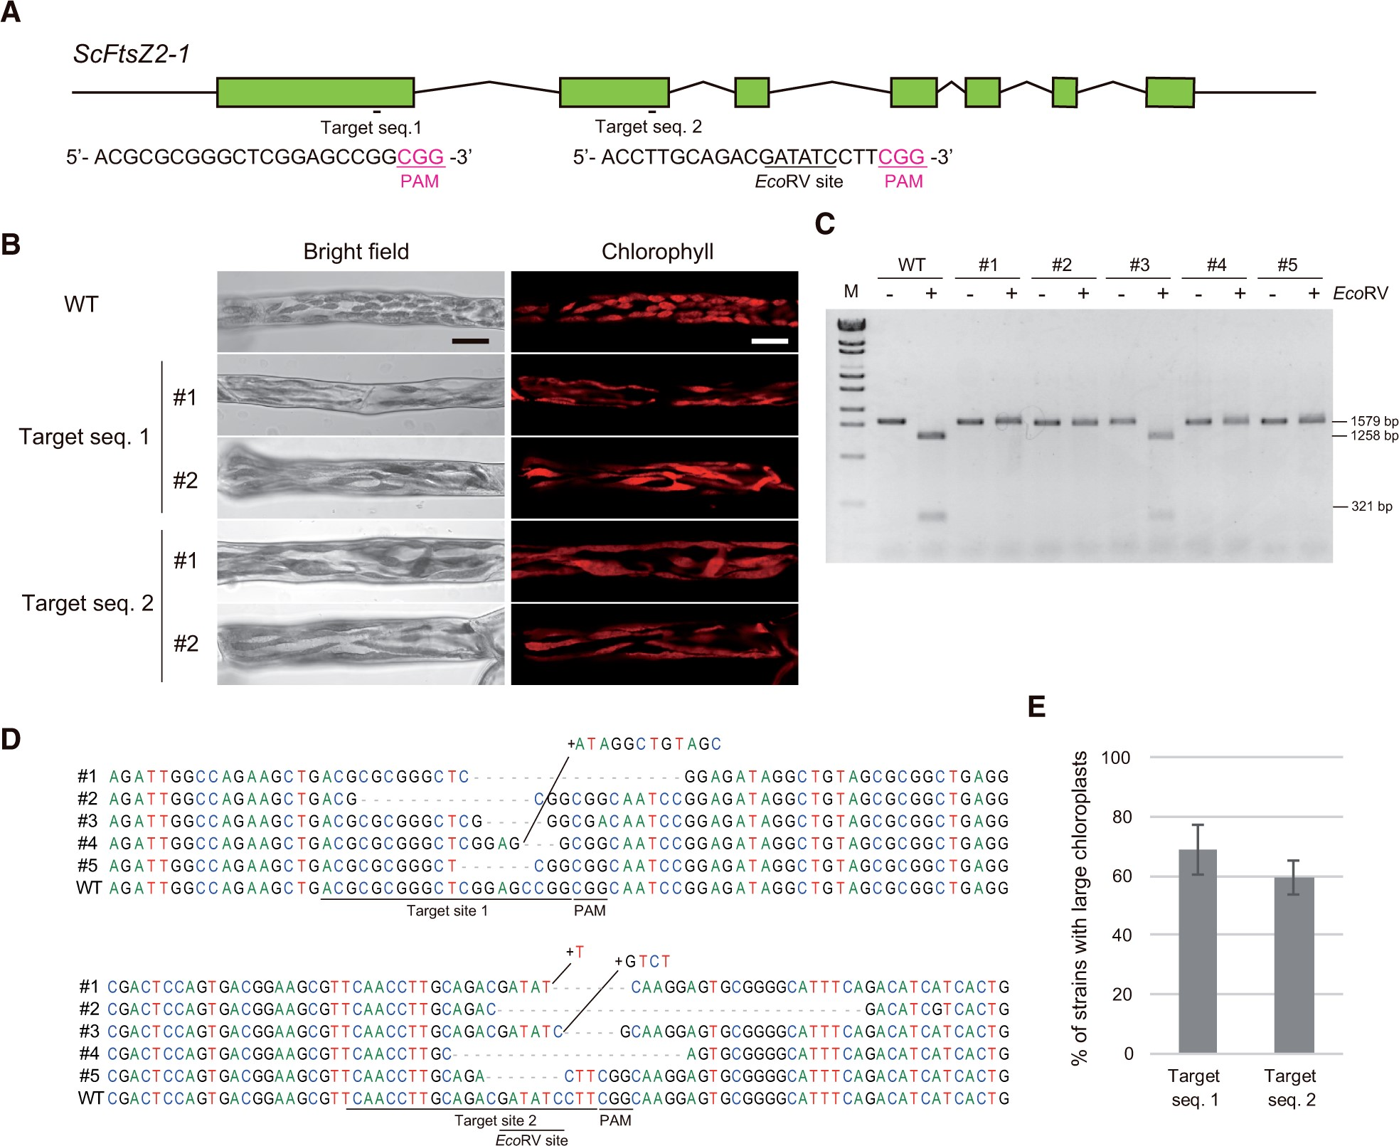
Fig. 2 CRISPR/Cas9-mediated mutagenesis of ScFtsz2-1 in Scopelophila cataractae. (A) Schematic illustration of the ...
Notes:
Fig. 2 CRISPR/Cas9-mediated mutagenesis of ScFtsz2-1 in Scopelophila cataractae. (A) Schematic illustration of the ScFtsZ2-1 gene and the two targeted exon sequences. Green boxes indicate exons. Red letters indicate protospacer-adjacent motif sequences. (B) Protonemata of representative strains with large chloroplasts, derived from the expression of ScFtsZ2-1 targeted single-chain guide RNA and Cas9. Scale bars = 20 μm. (C) Restriction fragment length polymorphism (RFLP)-based genotyping-targeted mutagenesis in ScFtsZ2-1. M, λ-EcoT14 I digest molecular marker; (–), non-enzyme treated; (+), EcoRV treated. (D) Sequencing-based genotyping of targeted mutagenesis in ScFtsZ2-1. Upper, target site 1; lower, target site 2. Dashes indicate deletions. (E) Percentages of first- and second-target strains with large chloroplasts. More than 600 colonies were assessed. Values represent the means ± SD of seven independent transformations.
Unless provided in the caption above, the following copyright applies to the content of this slide: © The Authors 2016. Published by Oxford University Press on behalf of Japanese Society of Plant Physiologists. All rights reserved. For permissions, please email: journals.permissions@oup.com

Slide 3
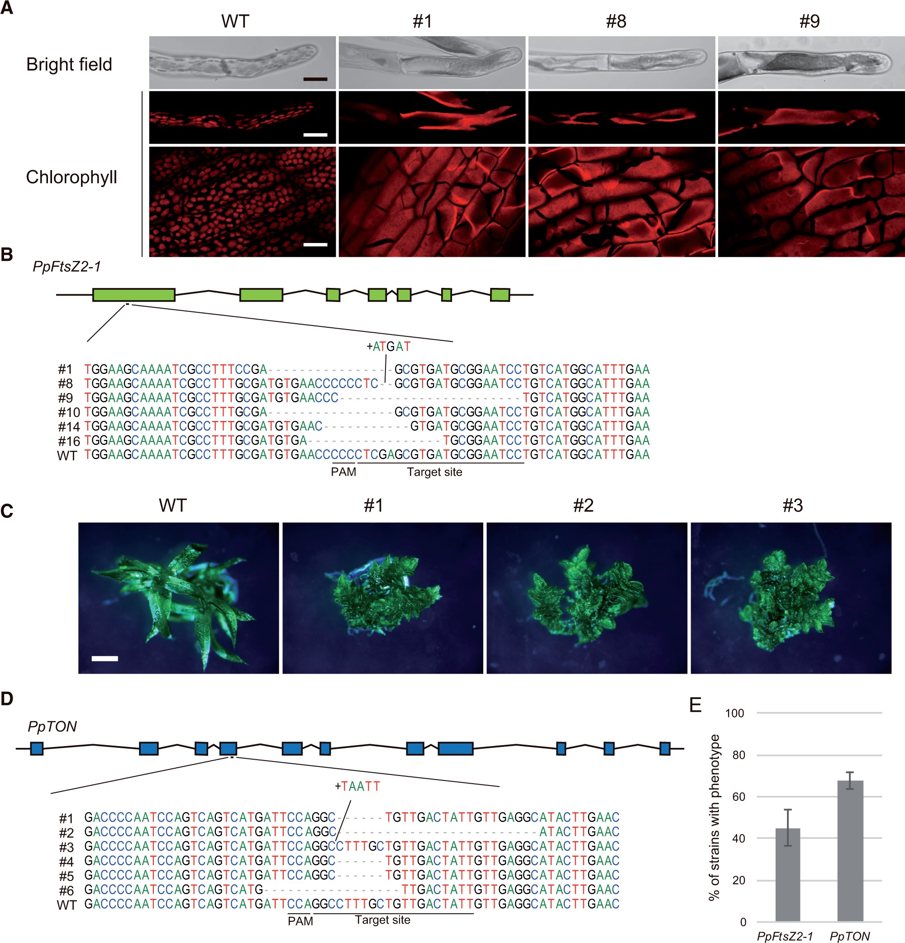
Fig. 3 CRISPR/Cas9-mediated targeted mutagenesis of PpFtsz2-1 and PpTON in Physcomitrella patens. (A) Protonemata ...
Notes:
Fig. 3 CRISPR/Cas9-mediated targeted mutagenesis of PpFtsz2-1 and PpTON in Physcomitrella patens. (A) Protonemata and leaves of representative strains with large chloroplasts, derived from the expression of PpFtsZ2-1 targeted single-chain guide RNA and Cas9. Scale bars = 20 μm. (B) Schematic illustration of the PpFtsZ2-1 gene and sequencing-based genotyping of targeted mutagenesis. Dashes indicate the deletions. (C) Representative strains with small gametophores, derived from the expression of PpTON targeted single-chain guide RNA and Cas9. Scale bars = 0.5 mm. (D) Schematic illustration of the PpTON gene and sequencing-based genotyping of targeted mutagenesis. Dashes indicate deletions. (E) Percentages of phenotypically changed strains obtained using the PpFtsz2-1 or PpTON target sequence. More than 1,700 colonies in PpFtsz2-1and 400 colonies in PpTON were assessed. Values represent the means ± SD of seven independent PpFtsz2-1 transformations and three independent PpTON transformations.
Unless provided in the caption above, the following copyright applies to the content of this slide: © The Authors 2016. Published by Oxford University Press on behalf of Japanese Society of Plant Physiologists. All rights reserved. For permissions, please email: journals.permissions@oup.com

Slide 4
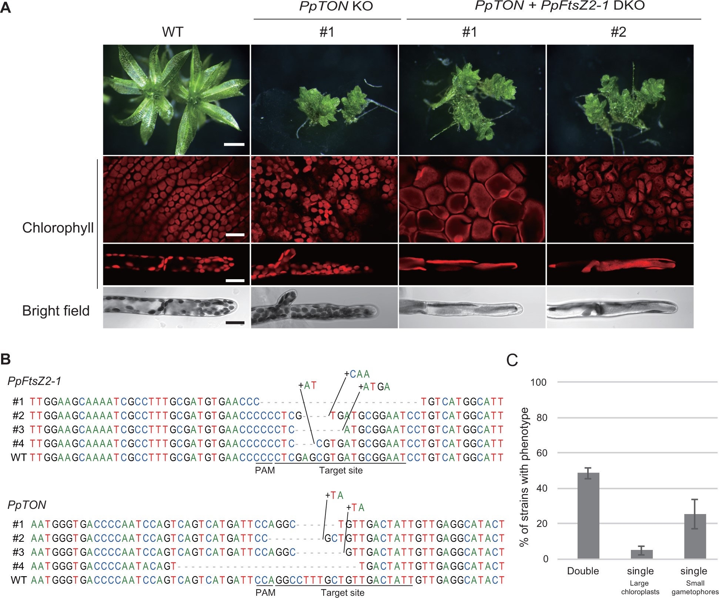
Fig. 4 CRISPR/Cas9-mediated double-targeted mutagenesis of two independent genes in Physcomitrella patens. (A) ...
Notes:
Fig. 4 CRISPR/Cas9-mediated double-targeted mutagenesis of two independent genes in Physcomitrella patens. (A) Protonemata and leaves of representative strains with small gametophores and large chloroplasts, respectively, derived from both PpFtsZ2-1- and PpTON-targeted single-chain guide RNAs and Cas9. Upper scale bar = 0.5 mm. Lower scale bar = 20 μm. (B) Sequencing-based genotyping of targeted mutagenesis of PpFtsZ2-1 and PpTON. Upper, target site of PpFtsz2-1; lower, target site of PpTON. Dashes indicate the deletions. (C) Percentages of double and single phenotypically changed strains obtained using the PpFtsz2-1 and PpTON target sequences. More than 1,000 colonies were assessed. Values represent means ± SD of six independent transformations.
Unless provided in the caption above, the following copyright applies to the content of this slide: © The Authors 2016. Published by Oxford University Press on behalf of Japanese Society of Plant Physiologists. All rights reserved. For permissions, please email: journals.permissions@oup.com

Slide 5
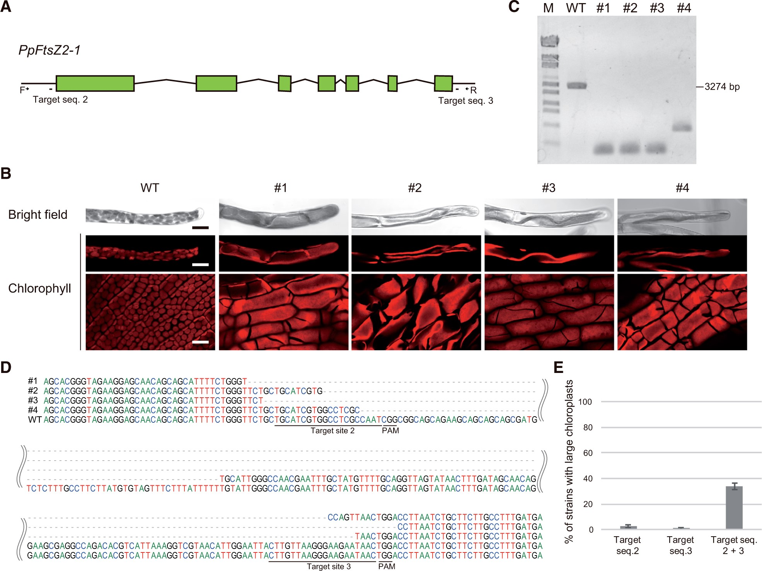
Fig. 5 CRISPR/Cas9-mediated introduction of large deletions, using two target sequences. (A) Schematic illustration ...
Notes:
Fig. 5 CRISPR/Cas9-mediated introduction of large deletions, using two target sequences. (A) Schematic illustration of the PpFtsZ2-1 gene and two target sequences outside of the 5’- and 3’-coding sequences of PpFtsZ2-1. F and R arrows indicate the primers used for genotyping. (B) Protonemata and leaves of representative strains with large chloroplasts, derived from the expression of two PpFtsZ2-1-targeted single-chain guide RNAs and Cas9. Scale bar = 20 μm. (C) PCR-based genotyping of large deletions in PpFtsZ2-1. M, λ-EcoT14 I digest molecular marker. (D) Sequencing-based genotyping of large deletions in PpFtsZ2-1. (E) Percentages of strains with large chloroplasts obtained using the second, third or both target sequences. More than 1,000 colonies were assessed. Values represent means ± SD of five independent transformations (Target Seq. 2 + 3) and four independent Target Seq. 2 or 3 transformations.
Unless provided in the caption above, the following copyright applies to the content of this slide: © The Authors 2016. Published by Oxford University Press on behalf of Japanese Society of Plant Physiologists. All rights reserved. For permissions, please email: journals.permissions@oup.com

