Slide 1
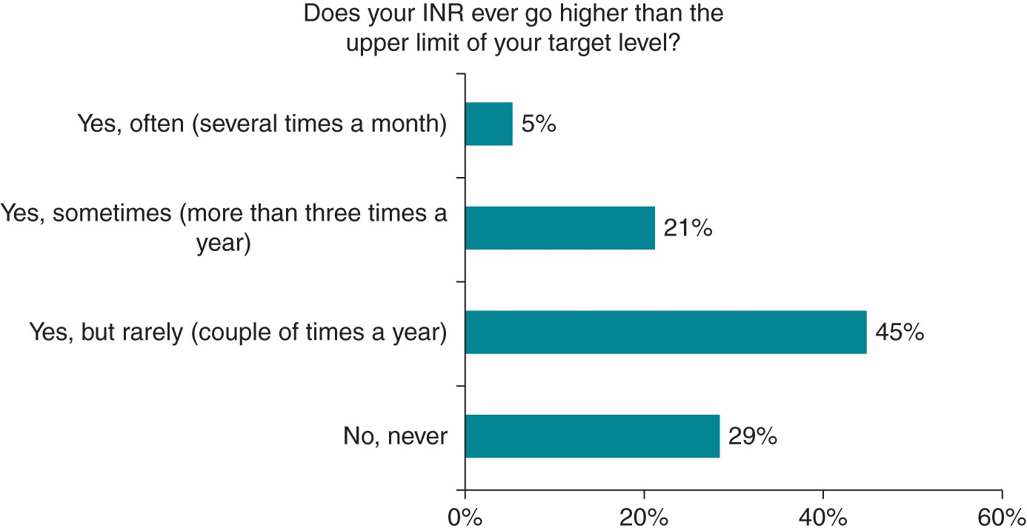
Figure 1 Frequency of INR higher than the upper limit of the target level. INR, international normalized ratio.
Notes:
Figure 1 Frequency of INR higher than the upper limit of the target level. INR, international normalized ratio.
Unless provided in the caption above, the following copyright applies to the content of this slide: Published on behalf of the European Society of Cardiology. All rights reserved. © The Author 2015. For permissions please email: journals.permissions@oup.com

Slide 2
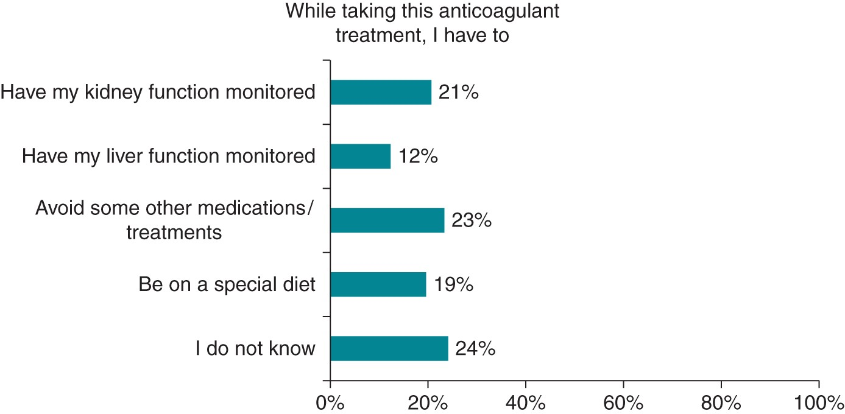
Figure 2 Monitoring on NOACs.
Notes:
Figure 2 Monitoring on NOACs.
Unless provided in the caption above, the following copyright applies to the content of this slide: Published on behalf of the European Society of Cardiology. All rights reserved. © The Author 2015. For permissions please email: journals.permissions@oup.com

Slide 3
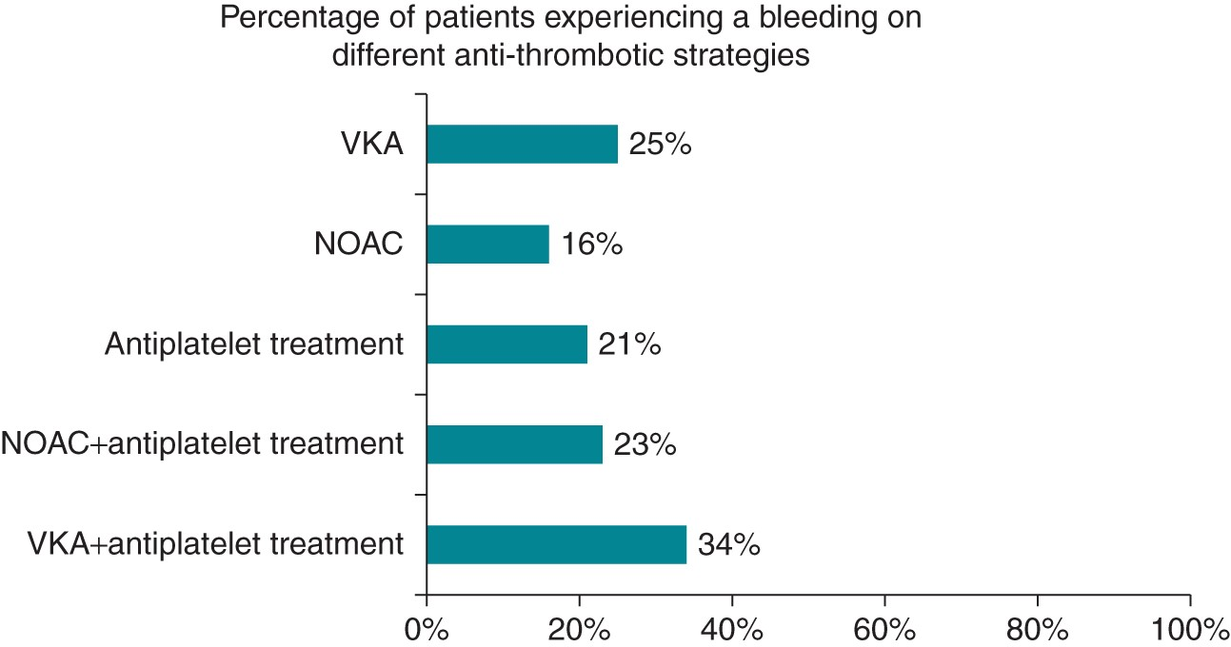
Figure 3 Patients with bleeding on different anti-thrombotic therapies.
Notes:
Figure 3 Patients with bleeding on different anti-thrombotic therapies.
Unless provided in the caption above, the following copyright applies to the content of this slide: Published on behalf of the European Society of Cardiology. All rights reserved. © The Author 2015. For permissions please email: journals.permissions@oup.com

Slide 4
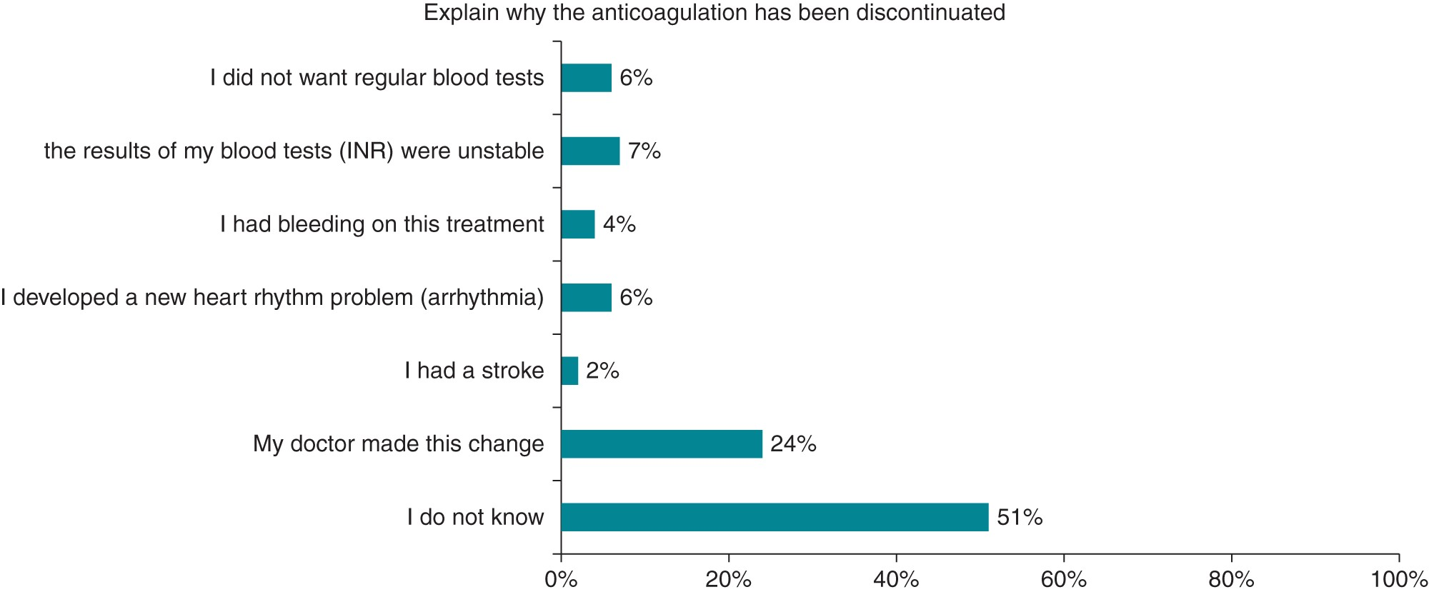
Figure 4 Reasons for anticoagulation discontinuation. INR, international normalized ratio.
Notes:
Figure 4 Reasons for anticoagulation discontinuation. INR, international normalized ratio.
Unless provided in the caption above, the following copyright applies to the content of this slide: Published on behalf of the European Society of Cardiology. All rights reserved. © The Author 2015. For permissions please email: journals.permissions@oup.com

