Slide 1
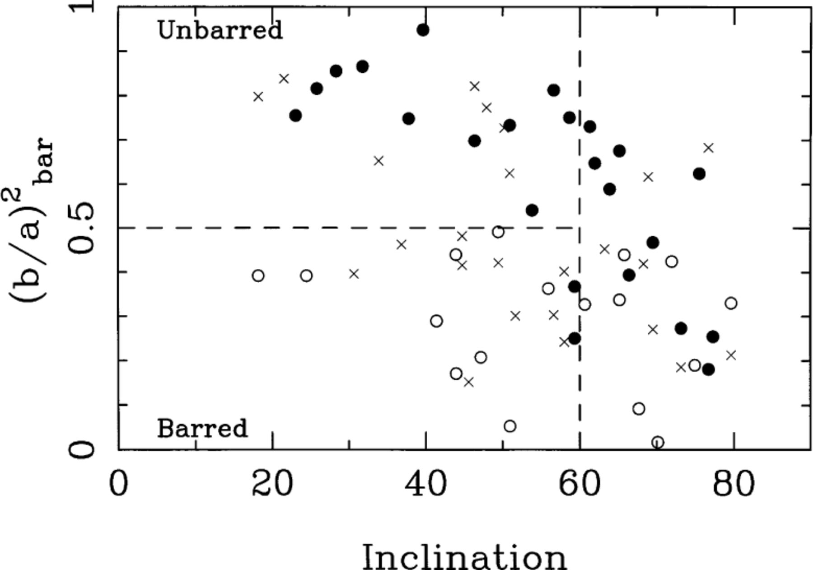
Figure 1. plotted as a function of galaxy inclination for the local spirals in the Frei et al. (1996)B-band CCD ...
Notes:
Figure 1. plotted as a function of galaxy inclination for the local spirals in the Frei et al. (1996)B-band CCD imaging sample. Note how this single parameter is remarkably effective at distinguishing between barred and unbarred spirals at inclinations below ∼60°. Both our representative cut at and the inclination cut at 60° are shown. Symbols are keyed to classifications in RC3. Strongly barred spirals (RC3 class SB) are shown as open circles, weakly barred spirals (RC3 class SAB) are shown as crosses, and unbarred spirals (RC3 class SA) are shown as filled circles.
Unless provided in the caption above, the following copyright applies to the content of this slide:

Slide 2
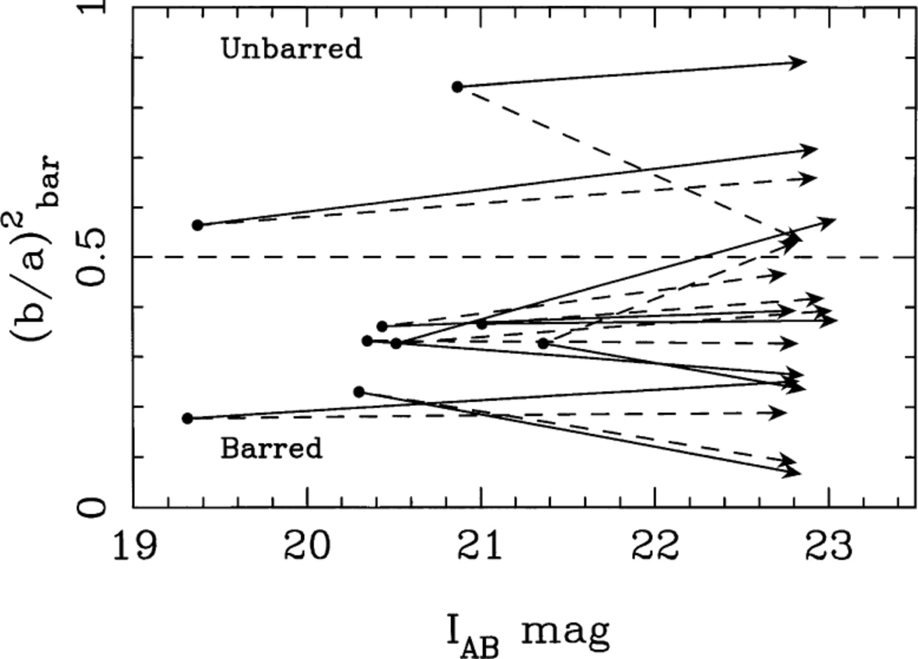
Figure 2. Tracks showing the recovery of measurements for bright HDF systems degraded to the magnitude limit of our ...
Notes:
Figure 2. Tracks showing the recovery of measurements for bright HDF systems degraded to the magnitude limit of our sample. The predominantly horizontal tracks indicate that, within the range explored in the present paper, measurements of are robust to signal-to-noise ratio and size degradation. Solid tracks correspond to galaxies reduced to 60 per cent of their original size, and dashed tracks to the galaxies in the extreme case where galaxies are reduced to 30 per cent of their original size. After size reduction and diminution of galactic light to our approximate flux limit, galaxies were convolved with the dithered HSTI814 W-band PSF before being digitally added to a blank portion of the HDF sky and re-analysed.
Unless provided in the caption above, the following copyright applies to the content of this slide:

Slide 3
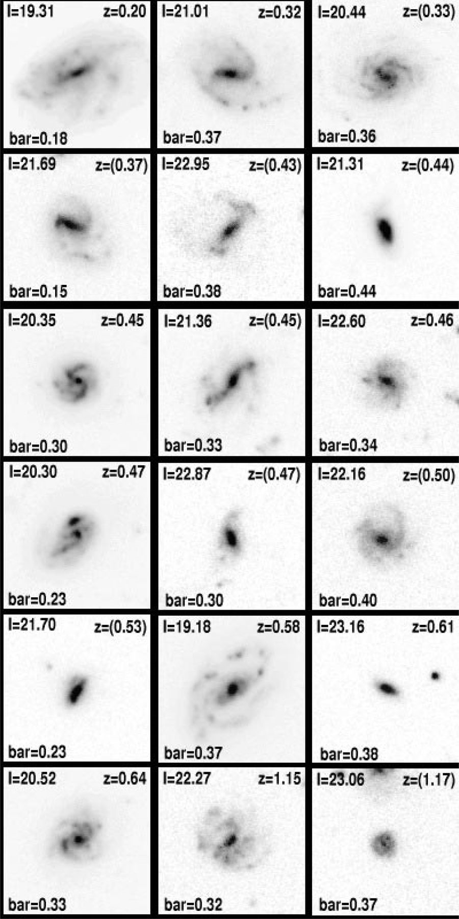
Figure 3. All spiral galaxies with I_{814 W}<23.2, inclination i<60° and in the northern and southern Hubble ...
Notes:
Figure 3. All spiral galaxies with I814 W<23.2, inclination i<60° and in the northern and southern Hubble Deep Fields ordered according to redshift. True colour images are shown, constructed from the B450 W-, V814 W- and I814 W-band data. Each panel represents a field of 5.1 arcsec on a side. The redshift and value of are indicated (photometric redshifts are in parentheses).
Unless provided in the caption above, the following copyright applies to the content of this slide:

Slide 4
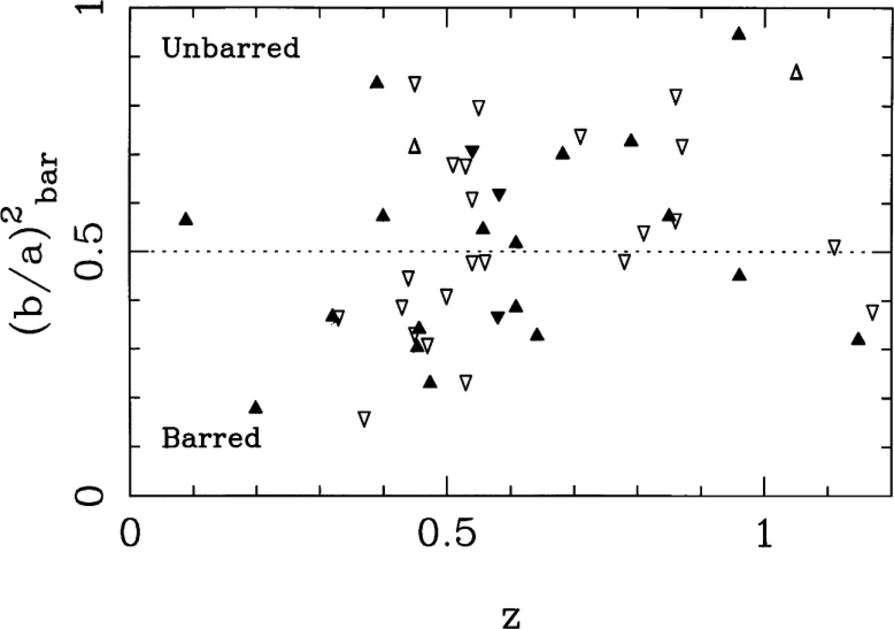
Figure 4. The bar strength estimator plotted as a function of spectroscopic redshift (filled symbols) or photometric ...
Notes:
Figure 4. The bar strength estimator plotted as a function of spectroscopic redshift (filled symbols) or photometric redshift (open symbols) in the northern (upward-pointing triangles) and southern (downward-pointing triangles) Hubble Deep Fields. Note the marked gradient in the proportion of barred systems with redshift, beginning at z∼0.5–0.6.
Unless provided in the caption above, the following copyright applies to the content of this slide:

