Slide 1
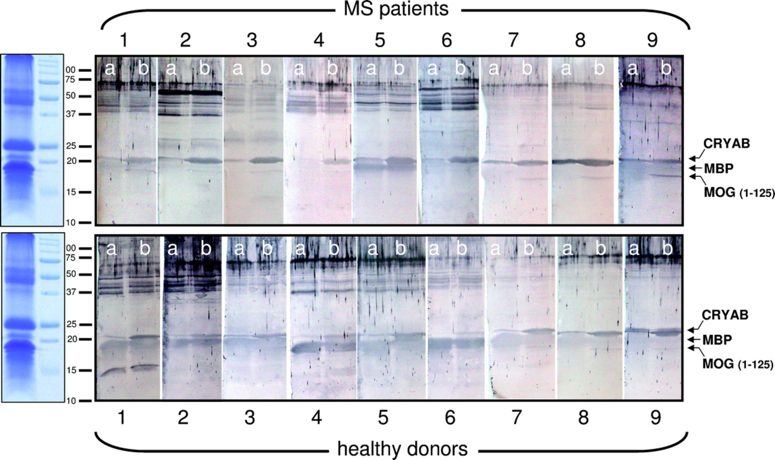
FIGURE 1. Serum immunoglobulin G (IgG) reactivity against total myelin protein extracts. Serum IgG reactivities against ...
Notes:
FIGURE 1. Serum immunoglobulin G (IgG) reactivity against total myelin protein extracts. Serum IgG reactivities against myelin proteins in 9 multiple sclerosis (MS) patients and 9 healthy controls were probed by Western blotting. In all cases, the a lanes contained 100-μg samples of total myelin proteins, as characterized by Coomassie staining on the left. The b lanes contained 100-μg samples that were supplemented with an extra 2 μg of both recombinant human αB-crystallin (CRYAB) and the recombinant extracellular domain 1-125 of human myelin-oligodendrocyte glycoprotein (MOG). The increased reactivities (denser bands) at the 22-kd position in the b lanes indicate that CRYAB is the target of the antibody responses seen in the a lanes. MBP, myelin basic protein.
Unless provided in the caption above, the following copyright applies to the content of this slide: Copyright © 2010 by the American Association of Neuropathologists, Inc.

Slide 2
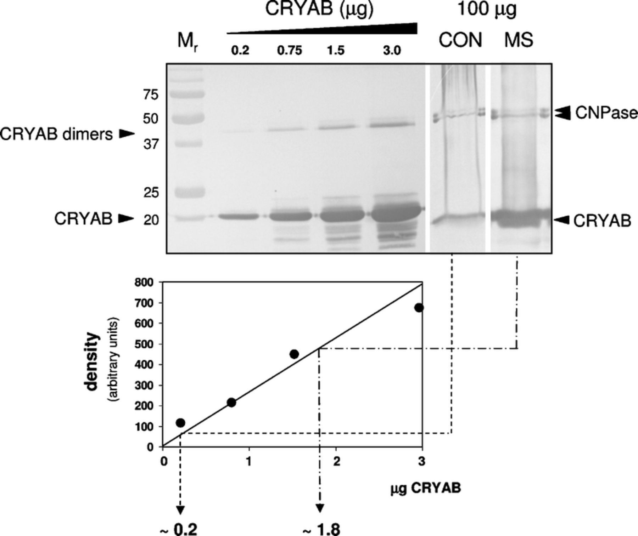
FIGURE 2. Multiple sclerosis (MS)-induced accumulation of αB-crystallin (CRYAB) in myelin preparations. Samples of 100 ...
Notes:
FIGURE 2. Multiple sclerosis (MS)-induced accumulation of αB-crystallin (CRYAB) in myelin preparations. Samples of 100 μg of proteins from control myelin (CON) or myelin purified from tissue samples containing active MS lesions (MS) were probed by Western blotting using a mixture of a CRYAB-specific and 2′,3′-cyclic nucleotide 3′-phosphodiesterase (CNPase)-specific monoclonal antibodies to verify equivalent loading of gels. Antibody-binding signals were compared with those generated against reference amounts of recombinant human CRYAB included on the same blot to permit absolute quantification (graph). CRYAB represents about 0.2% of all proteins in control myelin, but in MS-affected tissue samples, this level is approximately 10-fold higher. Figure 2 is representative of data obtained from 3 different MS samples.
Unless provided in the caption above, the following copyright applies to the content of this slide: Copyright © 2010 by the American Association of Neuropathologists, Inc.

Slide 3
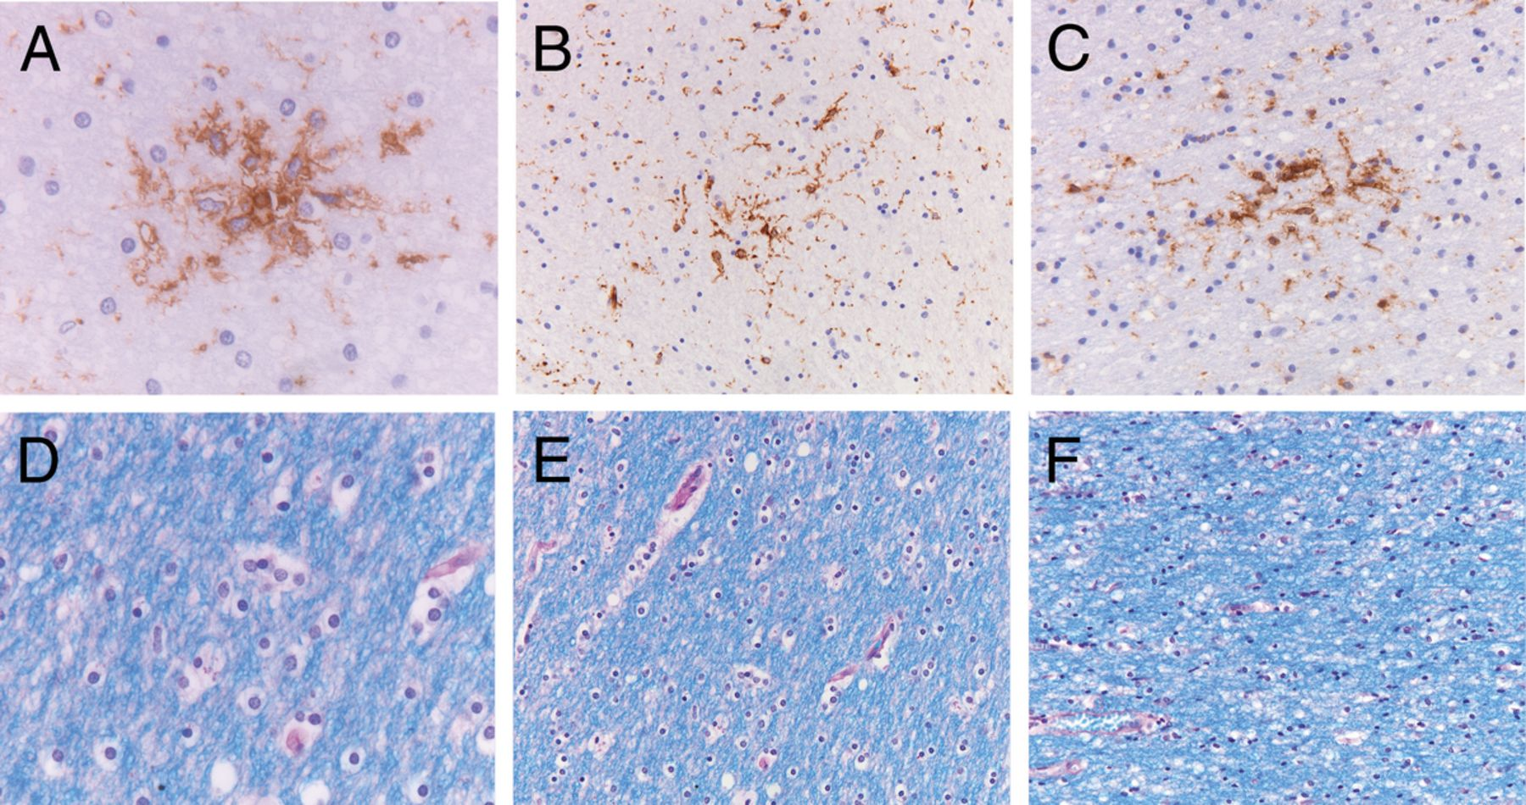
FIGURE 3. Pathological features of preactive lesions. Preactive lesions are defined as clusters of activated microglia ...
Notes:
FIGURE 3. Pathological features of preactive lesions. Preactive lesions are defined as clusters of activated microglia in areas of intact myelin in which there are no obvious blood-brain barrier abnormalities or leukocyte infiltration visible. (A-C) Clusters of microglia that express HLA-DR are shown in 3 examples. (D-F) Intact myelin by Luxol fast blue staining of the corresponding regions. Original magnification: (A, D) 100×; (B, F) 25×; (C, E) 40×.
Unless provided in the caption above, the following copyright applies to the content of this slide: Copyright © 2010 by the American Association of Neuropathologists, Inc.

Slide 4
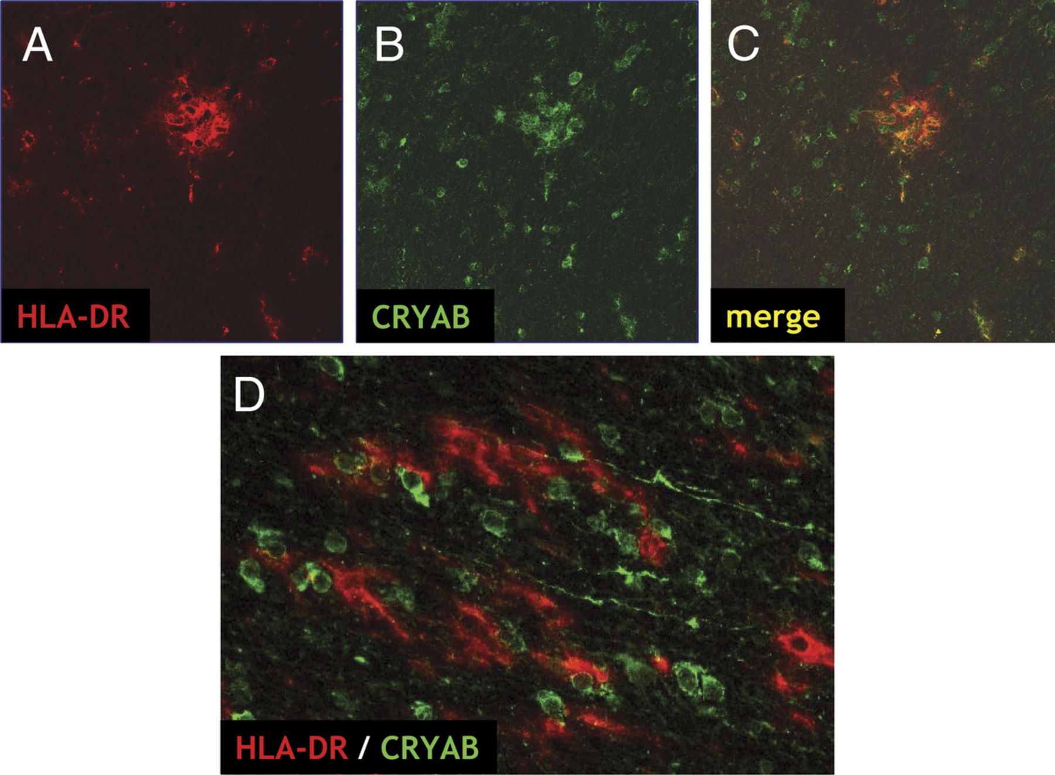
FIGURE 4. αB-crystallin (CRYAB) in preactive lesions. (A-D) Close association of CRYAB and HLA-DR immunoreactivity in 2 ...
Notes:
FIGURE 4. αB-crystallin (CRYAB) in preactive lesions. (A-D) Close association of CRYAB and HLA-DR immunoreactivity in 2 examples of preactive lesions (A-C and D). Original magnification: (A-D) 20×.
Unless provided in the caption above, the following copyright applies to the content of this slide: Copyright © 2010 by the American Association of Neuropathologists, Inc.

Slide 5
FIGURE 5. αB-crystallin (CRYAB) exclusively accumulates in oligodendrocytes in preactive multiple sclerosis (MS) ...
Notes:
FIGURE 5. αB-crystallin (CRYAB) exclusively accumulates in oligodendrocytes in preactive multiple sclerosis (MS) lesions. (A, B) CRYAB is expressed in olig2-positive oligodendrocytes (arrows [A]) surrounded by intact myelin indicated by staining for myelin proteolipid protein ([PLP] B). (C, D) There is no colocalization of CRYAB with the astrocyte marker glial fibrillary acidic protein ([GFAP] C) or with the axonal marker neurofilament light ([NF-L] D). Original magnification: (A-D) 20×.
Unless provided in the caption above, the following copyright applies to the content of this slide: Copyright © 2010 by the American Association of Neuropathologists, Inc.

Slide 6
FIGURE 6. αB-crystallin (CRYAB) is in contact with activated microglia in preactive lesions. (A, B) Colocalization of ...
Notes:
FIGURE 6. αB-crystallin (CRYAB) is in contact with activated microglia in preactive lesions. (A, B) Colocalization of accumulated CRYAB and HLA-DR on microglia in crescent-shaped areas, suggesting direct contact between microglia and intact oligodendrocytes. (C) On other occasions, there is colocalization in small intracellular vesicles, suggesting CRYAB uptake in the HLA-DR-containing endosomal compartment of microglia. Original magnification: (A-C) 20×.
Unless provided in the caption above, the following copyright applies to the content of this slide: Copyright © 2010 by the American Association of Neuropathologists, Inc.

Slide 7
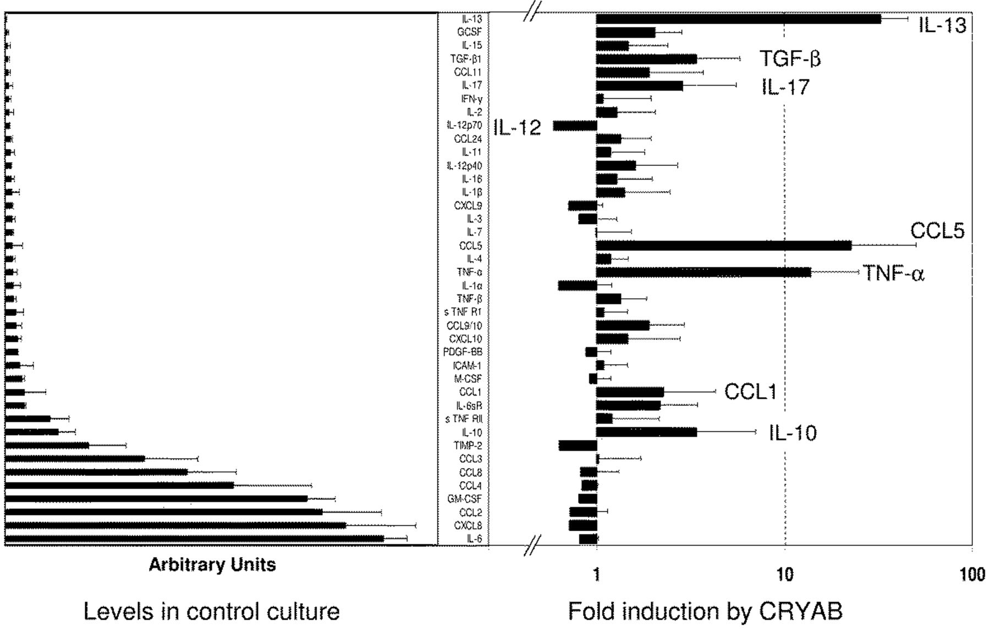
FIGURE 7. αB-crystallin (CRYAB)-induced cytokine and chemokine release by human microglia. Levels of 40 cytokines and ...
Notes:
FIGURE 7. αB-crystallin (CRYAB)-induced cytokine and chemokine release by human microglia. Levels of 40 cytokines and chemokines in microglial culture media were evaluated by antibody arrays. Left panel: results are shown for media collected after 24hours of culturing microglia without CRYAB, illustrating a relatively high basal secretion of interleukin 6 (IL-6), CCL2, CCL3, CCL4, and CCL8 under these conditions. Right panel: the relative change is illustrated for each mediator found after 24-hour incubation of microglia from the same isolate with 50 μg/mL CRYAB. Results are the mean ± SD of 4 independent experiments, each performed with microglia from a different donor. TGF-β, transforming growth factor-β; TNF-α, tumor necrosis factor-α.
Unless provided in the caption above, the following copyright applies to the content of this slide: Copyright © 2010 by the American Association of Neuropathologists, Inc.

Slide 8
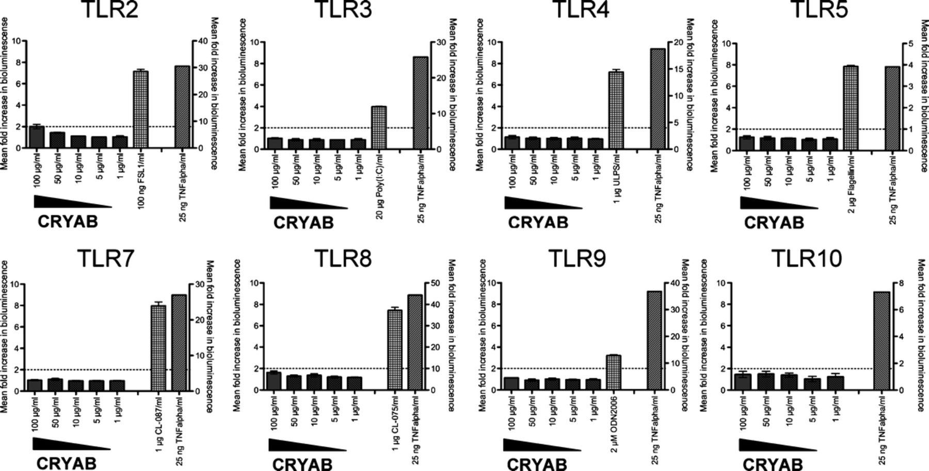
FIGURE 8. αB-crystallin (CRYAB) does not directly activate any toll-like receptor (TLR) known to be involved in ...
Notes:
FIGURE 8. αB-crystallin (CRYAB) does not directly activate any toll-like receptor (TLR) known to be involved in recognizing bacterial products. To verify that activation of microglia by recombinant human CRYAB was not caused by bacterial contaminants in the preparation, CRYAB was tested for its ability to activate a panel or HEK293 reporter cells, each expressing a different TLR family member. In all cases, CRYAB up to 100 μg/mL did not trigger any significant response. Results are the mean ± SD of 3 experiments.
Unless provided in the caption above, the following copyright applies to the content of this slide: Copyright © 2010 by the American Association of Neuropathologists, Inc.

