Slide 1
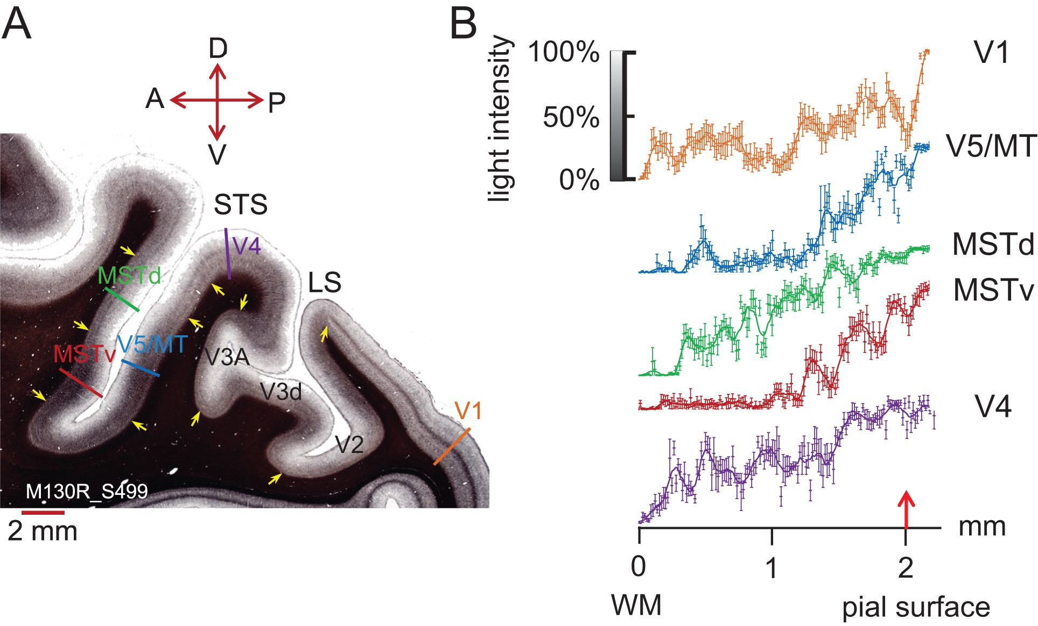
Figure 1. Myelin density across cortical layers. (A) A parasagittal section (thickness 30 μm) through occipital cortex ...
Notes:
Figure 1. Myelin density across cortical layers. (A) A parasagittal section (thickness 30 μm) through occipital cortex from the right hemisphere of a Rhesus macaque (M130R_S499) shows distinct patterns of myelination for visual areas V1, V4, V5/MT, MSTv (ventral MST in our sections), and MSTd (dorsal MST in our sections) after staining with Gallyas. In V1, a dark, dense band of myelin can be seen in layer 4. V4 shows 2 distinct myelin bands, MSTd 1 band. Both areas, V5/MT and parts of MST, show heavy myelination across the lower cortical layers. The colored bars indicate where intensity profiles were measured for panel (B). Yellow arrows give an indication of boundaries between cortical areas based on differences in the myelination pattern. LS, lateral sulcus. Slide orientation: P, posterior; A, anterior; D, dorsal; V - ventral. (B) Image intensity profiles of the myelin stain for different visual areas were measured with Neurolucida (Microbrightfield Ltd). Measurements orthogonal to the cortical layers were taken every 15 μm (n = 6 measurements per data point). Data points were fitted with a sliding average function (smooth rloess function uses weighted linear least squares regression and a second-degree polynomial model, Matlab). Some intensity profiles are distinct, for example, V5/MT and V1. Although at first glance, the image intensity profiles for V5/MT and ventral MST appear similar, they are significantly different from each other when compared quantitatively (2-sample Kolmogorov–Smirnov test, D = 0.1987, P = 0.0041). Red arrow denotes pial surface. Error bars are ±1 SD.
Unless provided in the caption above, the following copyright applies to the content of this slide: © The Author 2016. Published by Oxford University Press.This is an Open Access article distributed under the terms of the Creative Commons Attribution License (http://creativecommons.org/licenses/by/4.0/), which permits unrestricted reuse, distribution, and reproduction in any medium, provided the original work is properly cited.

Slide 2
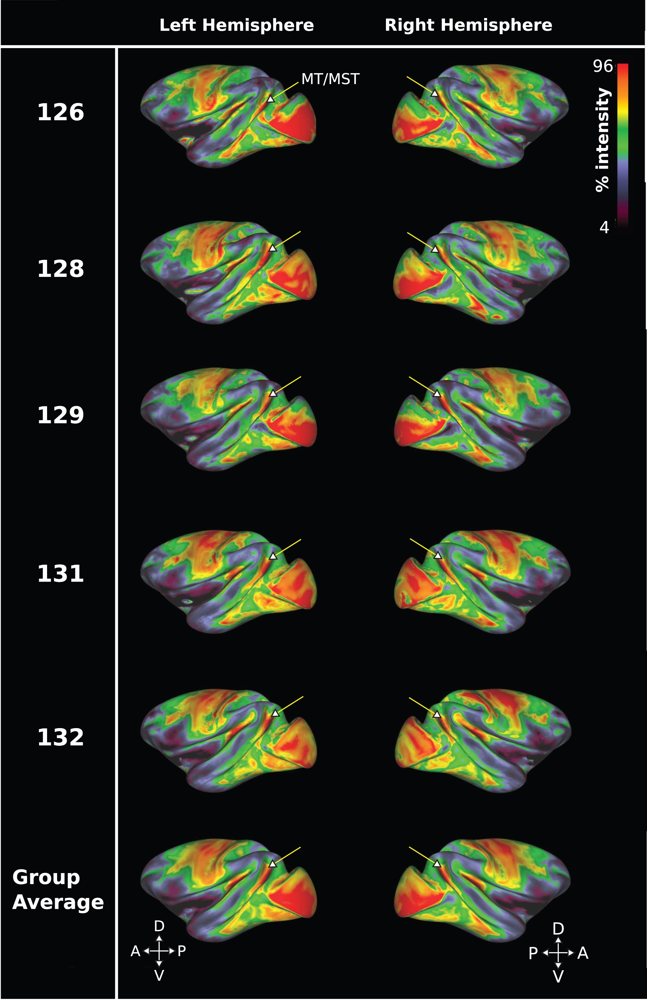
Figure 2. Cortical surface myelin maps from in vivo 3T T₁w/T₂w sMRI data for 5 Rhesus macaques. ...
Notes:
Figure 2. Cortical surface myelin maps from in vivo 3T T1w/T2w sMRI data for 5 Rhesus macaques. Data are presented on a color map scale, with red indicating high sMRI signal intensity and therefore regions of greater myelin density. An arrow indicates the approximate anatomical position of V5/MT and MST. Each row displays the left and right hemisphere from a different subject, with the bottom row showing average data. The data show that a high myelin signal delineates a distinct region coinciding with the anatomical location of area V5/MT and MST in the dorsal STS of the Rhesus macaque.
Unless provided in the caption above, the following copyright applies to the content of this slide: © The Author 2016. Published by Oxford University Press.This is an Open Access article distributed under the terms of the Creative Commons Attribution License (http://creativecommons.org/licenses/by/4.0/), which permits unrestricted reuse, distribution, and reproduction in any medium, provided the original work is properly cited.

Slide 3
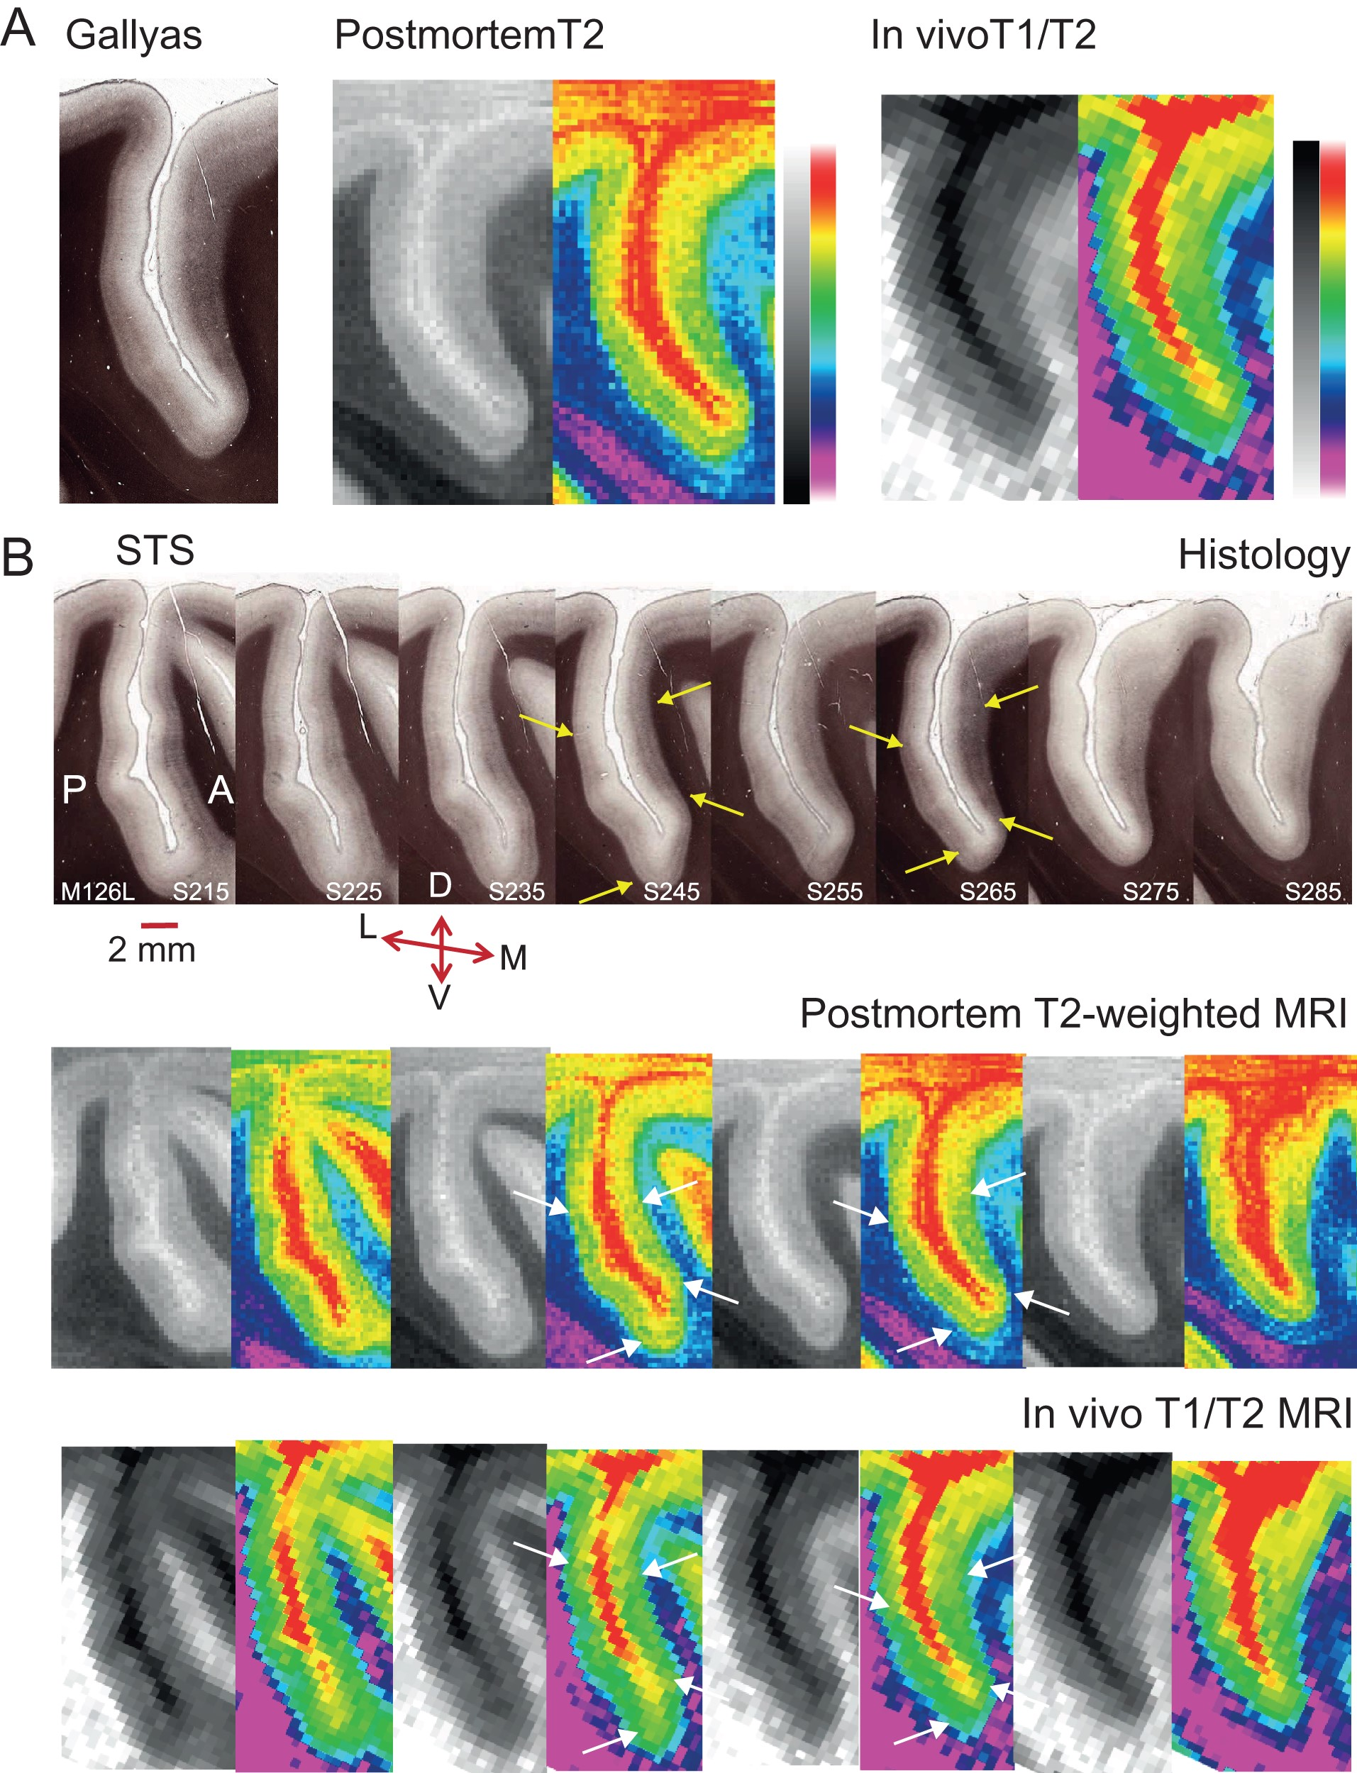
Figure 3. Slice-by-slice comparison of histological sections and matched sMRI for the Rhesus macaque. (A) A ...
Notes:
Figure 3. Slice-by-slice comparison of histological sections and matched sMRI for the Rhesus macaque. (A) A Gallyas-stained parasagittal section showing the dorsal part of the STS from the left hemisphere of 1 macaque (M126L, S265) was matched to the equivalent parasagittal sections obtained previously from a postmortem scan of the same intact, fixed brain and to MRI obtained from the same brain in vivo. The histological section is 50 μm thick: dense cortical myelin shows up as dark brown, particularly in the lower cortical layers in the histological sections. In the postmortem T2w MRI scans, this is evident in dark regions relative to surrounding cortical tissue, and as lighter voxels relative to surrounding cortical tissue for the in vivo T1w/T2w images. To enhance visibility, the same sMRI images were pseudo-colored by converting to a color gradient (Adobe Photoshop; gradient map “transparent rainbow”; postmortem images were contrast inverted to yield the same color scale). (B) Shown is a 1 in 10 series of 50 μm parasagittal sections with a separation of 500 μm between consecutive histological sections for the same hemisphere (M126L) as in (A). The series was matched to the equivalent sMRI slices obtained postmortem or in vivo from the same block of cortical tissue. Yellow/white arrows indicate borders of dense myelination for extrastriate visual area V5/MT on the posterior bank of the STS, and for parts of MST on the anterior bank across all 3 methods for 2 example sections. Every second MRI section was replaced with a pseudo-colored version (see A.). The original MRI sections from M126L and from a further example brain are available online as Supplementary Figure S1. Series orientation: lateral (L) to medial (M). Section orientation: D, dorsal; V, ventral; P, posterior; A, anterior.
Unless provided in the caption above, the following copyright applies to the content of this slide: © The Author 2016. Published by Oxford University Press.This is an Open Access article distributed under the terms of the Creative Commons Attribution License (http://creativecommons.org/licenses/by/4.0/), which permits unrestricted reuse, distribution, and reproduction in any medium, provided the original work is properly cited.

Slide 4
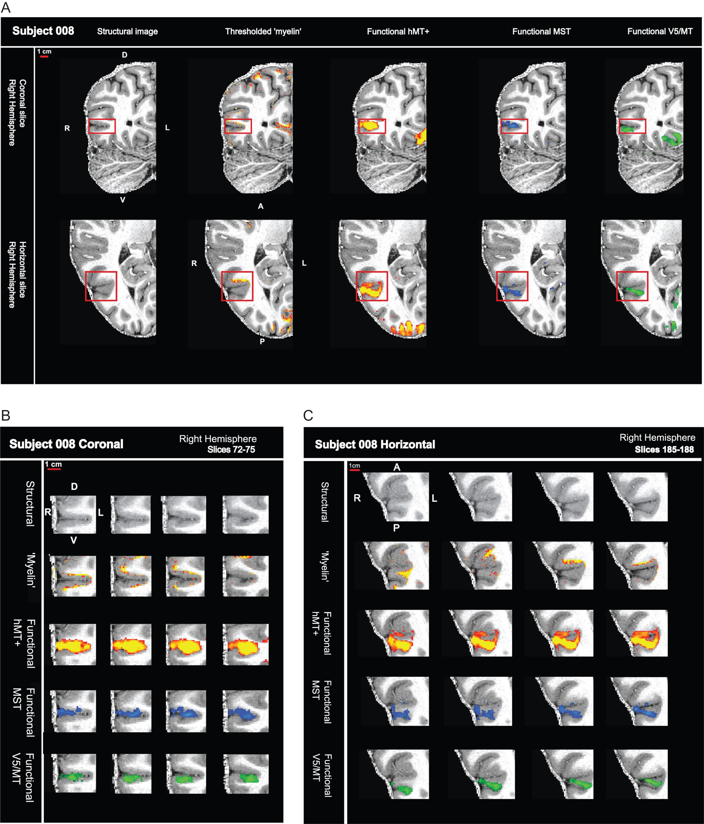
Figure 4. High field fMRI and sMRI in humans localizes signals to the cortical ribbon. (A) sMRI (7T MP2RAGE) and fMRI ...
Notes:
Figure 4. High field fMRI and sMRI in humans localizes signals to the cortical ribbon. (A) sMRI (7T MP2RAGE) and fMRI (7T) data are shown for one hemisphere—in a coronal and horizontal slice. The sequence of images show, from left to right, the structural scan first on its own, then either with the myelin-weighted map overlaid (red-yellow scale; threshold: mean intensity +1 SEM) or with functional activation for full field motion (red-yellow scale; threshold: z > 2.3; cluster threshold: p = 0.05), with functional activation for ipsilateral motion (blue; threshold: z > 2.3; cluster threshold: p = 0.05) and with the contralateral polar retinotopic activation (green). Red box contains the visual motion area hMT+. (B) Close-up view of sequential coronal slices for red box area in (A). (C) Close-up view of sequential horizontal slices for red box area in (A).
Unless provided in the caption above, the following copyright applies to the content of this slide: © The Author 2016. Published by Oxford University Press.This is an Open Access article distributed under the terms of the Creative Commons Attribution License (http://creativecommons.org/licenses/by/4.0/), which permits unrestricted reuse, distribution, and reproduction in any medium, provided the original work is properly cited.

Slide 5
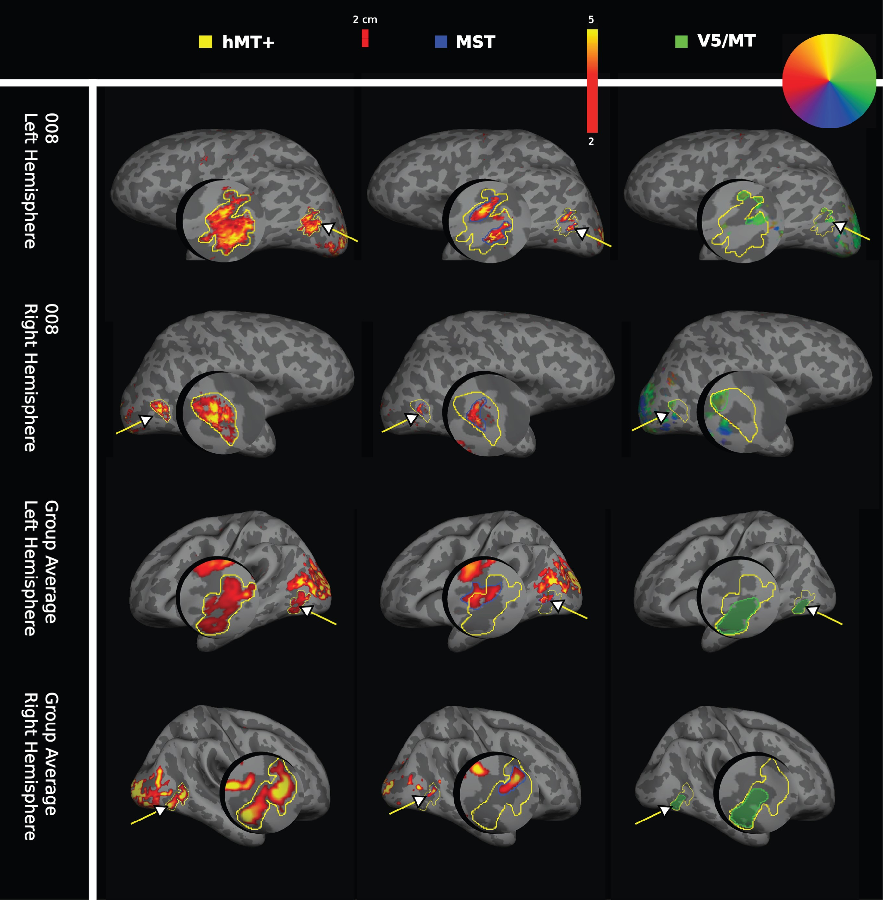
Figure 5. Individual and average functional activation for visual areas hMT+, MST, and V5/MT in humans. Functional ...
Notes:
Figure 5. Individual and average functional activation for visual areas hMT+, MST, and V5/MT in humans. Functional activation for visual areas hMT+, MST, and V5/MT (arrows) are shown on the inflated cortex including a magnified cutout of the area of interest. The first column shows the functional activations for area hMT+ to a full field moving dot stimulus (yellow outline), the second column the ipsilateral activation for area MST (blue outline), both shown on a red-yellow signal intensity scale. The third column shows contralateral polar retinotopic activation for area V5/MT (green outline), color-coded according to a retinotopic color wheel for the brain of participant 008. The group average masks for area V5/MT were colored green for consistency. Activation patterns are presented for the left and right hemispheres, for subject 008 (first and second row) and for the group average (n = 10 subjects for hMT+ and for MST; n = 8 subjects for V5/MT; third and fourth row). For the retinotopy used to localize V5/MT, the group average shows the average of the individual masks for V5/MT activation.
Unless provided in the caption above, the following copyright applies to the content of this slide: © The Author 2016. Published by Oxford University Press.This is an Open Access article distributed under the terms of the Creative Commons Attribution License (http://creativecommons.org/licenses/by/4.0/), which permits unrestricted reuse, distribution, and reproduction in any medium, provided the original work is properly cited.

Slide 6
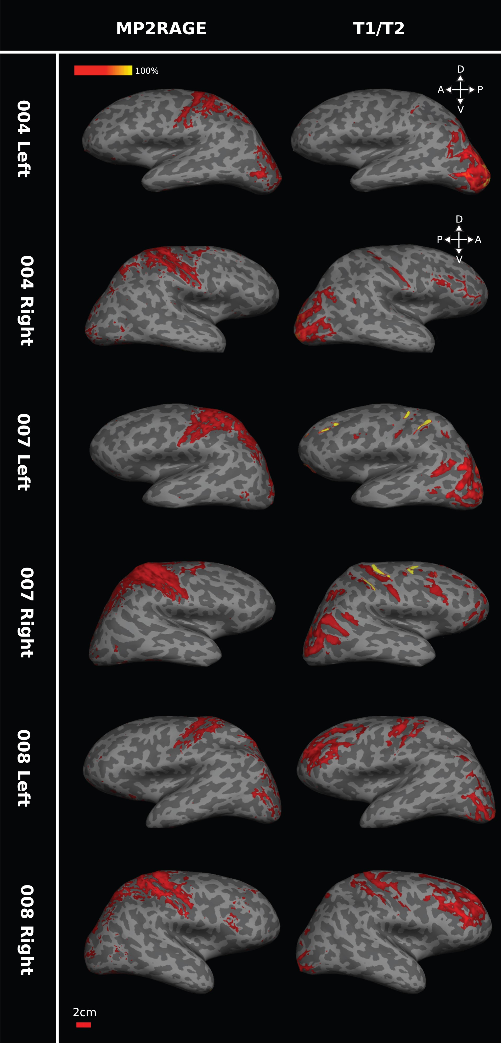
Figure 6. Comparing 7T MP2RAGE and 3T T₁w/T₂w scans for myelin in humans. The pair of images in ...
Notes:
Figure 6. Comparing 7T MP2RAGE and 3T T1w/T2w scans for myelin in humans. The pair of images in each row shows the myelin maps obtained for one hemisphere of the same individual participant based on the MP2RAGE images at 7T (left) or on T1w/T2w at 3T (right). While 7T MP2RAGE appears more sensitive to central sulcus myelin and 3T T1w/T2w images to occipital myelin and despite some individual variation, the general pattern in these images indicates consistency of high sMRI signal in regions associated with dense myelination (central sulcus, V1, hMT+). Data for each of the 3 participants (004, 007, and 008) are presented on each individual's inflated surface generated from 7T structural scans. Brain orientation: D, dorsal; V, ventral; A, anterior; P, posterior.
Unless provided in the caption above, the following copyright applies to the content of this slide: © The Author 2016. Published by Oxford University Press.This is an Open Access article distributed under the terms of the Creative Commons Attribution License (http://creativecommons.org/licenses/by/4.0/), which permits unrestricted reuse, distribution, and reproduction in any medium, provided the original work is properly cited.

Slide 7
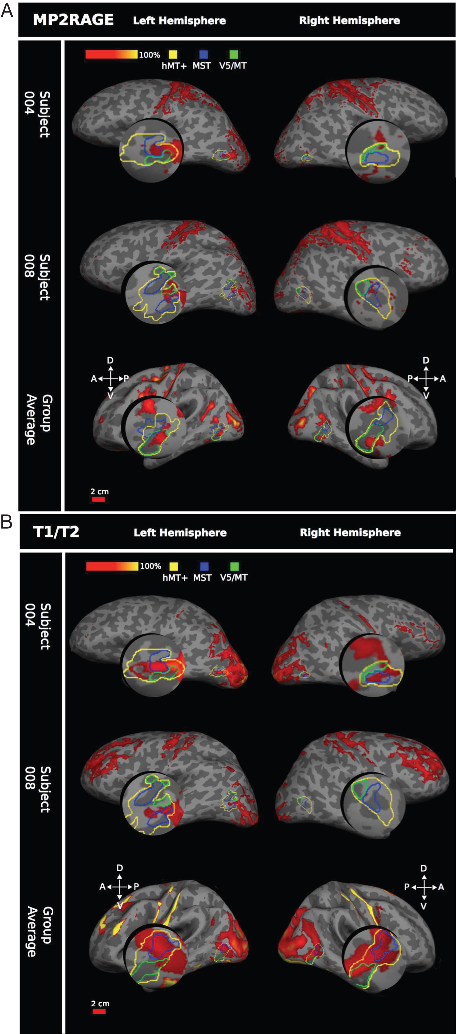
Figure 7. Comparing myelin intensity with functional hMT+ in humans. (A) 7T MP2RAGE myelin, 2 example participants and ...
Notes:
Figure 7. Comparing myelin intensity with functional hMT+ in humans. (A) 7T MP2RAGE myelin, 2 example participants and group average (n = 10 participants). Functional hMT+ is outlined in yellow, functional MST in blue, and retinotopically defined V5/MT in green. Myelin dense areas were calculated as +1 SEM above the mean intensity of the 7T MP2RAGE image, shown on a red-yellow scale of intensity values. In all hemispheres, a region of dense myelination is associated with area hMT+, MST, or V5/MT. However, there is no consistent association across individuals. All data are presented on the individual subject's inflated cortical surface generated from a 7T structural scan, or the average generated surface (for the average data). (B) Human 3T T1w/T2w myelin shows 2 example subjects plus group average (n = 3 participants). Similar measurements and same conventions as in (A), but here the myelin maps were generated from the 3T T1w/T2w scan.
Unless provided in the caption above, the following copyright applies to the content of this slide: © The Author 2016. Published by Oxford University Press.This is an Open Access article distributed under the terms of the Creative Commons Attribution License (http://creativecommons.org/licenses/by/4.0/), which permits unrestricted reuse, distribution, and reproduction in any medium, provided the original work is properly cited.

Slide 8
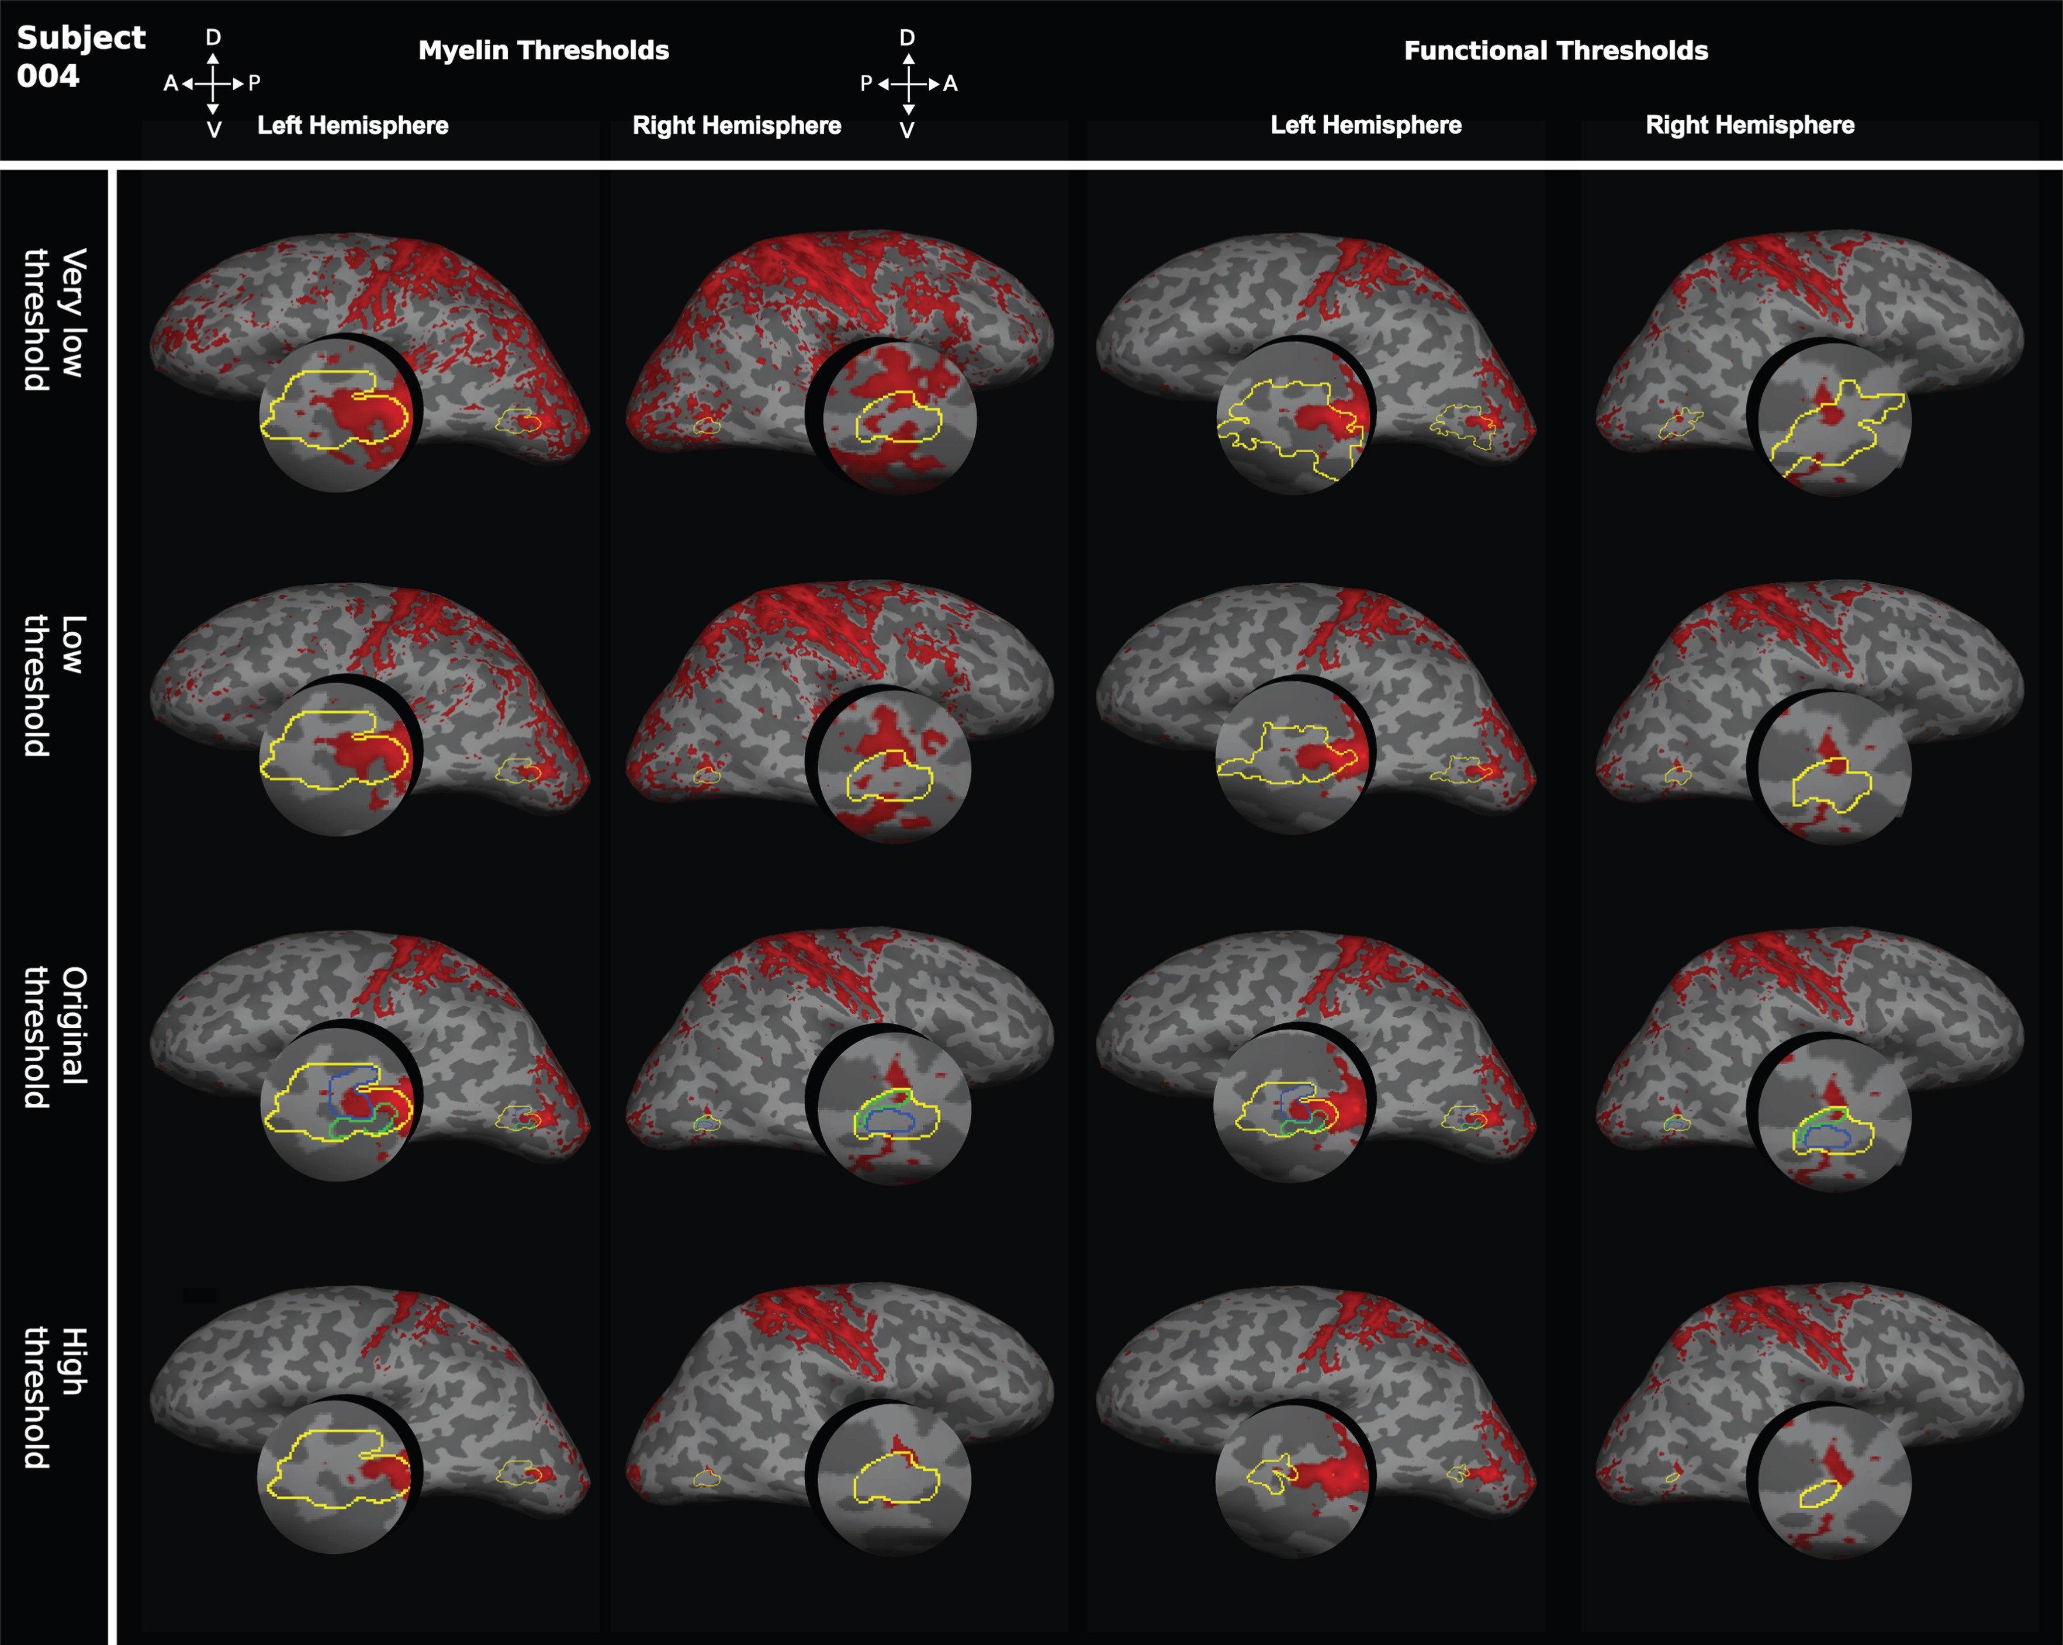
Figure 8. Effect of varying thresholds for myelin-weighted maps or functional delineations of hMT+. To test whether the ...
Notes:
Figure 8. Effect of varying thresholds for myelin-weighted maps or functional delineations of hMT+. To test whether the degree of overlap between structural and functional area definitions were influenced by threshold selection, the thresholds for myelin-weighted maps based on the 7T MP2RAGE image and functional definitions of hMT+ were systematically changed. On the left, we show for the 2 hemispheres of 1 participant the effect of changing the myelin-weighted maps to a “very low threshold” (mean intensity), to a “low threshold” (mean intensity +0.5 SEM), and to a “high threshold” (mean intensity +1.5 SEM). These myelin-weighted maps were compared with the original functional definitions of hMT+ at z > 2.3. Functional definitions were also varied systematically for the same brain (right). We examined a “very low threshold” (z > 1.3), a “low threshold” (z > 1.8), and a “high threshold” (z > 2.8). The different area definitions of hMT+ obtained were then compared with the original myelin-weighted map at a threshold of mean intensity +1 SEM.
Unless provided in the caption above, the following copyright applies to the content of this slide: © The Author 2016. Published by Oxford University Press.This is an Open Access article distributed under the terms of the Creative Commons Attribution License (http://creativecommons.org/licenses/by/4.0/), which permits unrestricted reuse, distribution, and reproduction in any medium, provided the original work is properly cited.

Slide 9
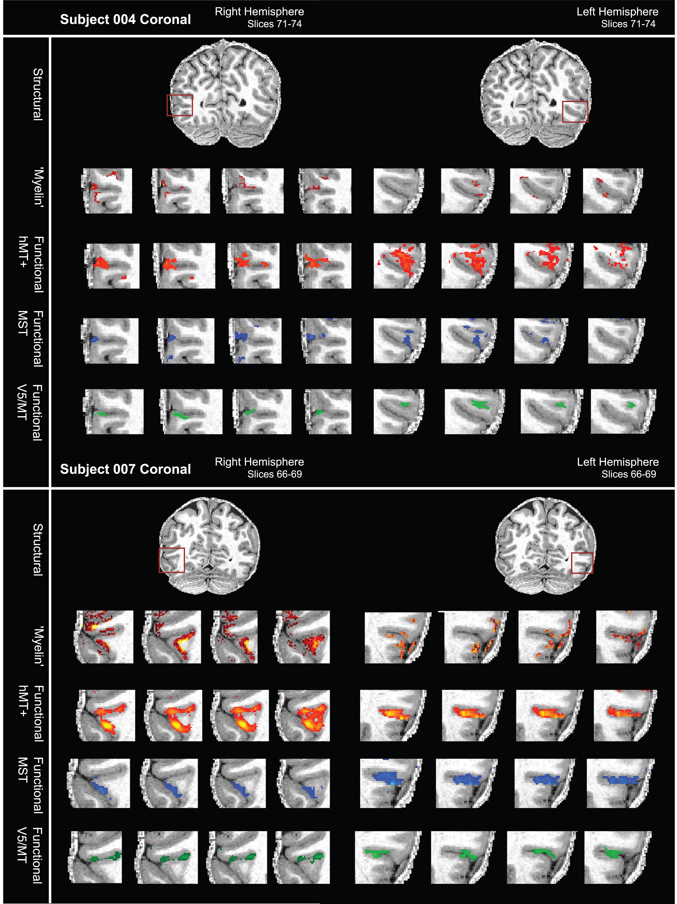
Figure 9. Variable overlap between myelin-weighted sMRI and functional localizers for hMT+, V5/MT, and MST in native ...
Notes:
Figure 9. Variable overlap between myelin-weighted sMRI and functional localizers for hMT+, V5/MT, and MST in native space. (A) sMRI (7T MP2RAGE) and fMRI (7T) data are shown in a series of coronal slices (1 mm separation; left to right) for both hemispheres of participant 004. From top to bottom, the sequence of slices shows first the structural scan with the myelin-weighted map overlaid (red-yellow scale; threshold at mean intensity +1 SEM), then with functional activation for full field motion (red-yellow scale; threshold: z > 2.3; cluster threshold: p = 0.05), with functional activation for ipsilateral motion (blue; threshold: z > 2.3; cluster threshold: p = 0.05) and finally with the contralateral polar retinotopic activation (green). The red box on the structural image at the top indicates location of the visual motion area hMT+. Broadly, the regions of dense myelination are next to, and to varying degrees overlapping with, the region of functional activation for hMT+. Data are generally restricted to the cortical ribbon. (B) sMRI and fMRI data for a second participant (007), conventions as in (A). Regions of dense myelination are next to, and partly overlapping with, the regions of functional activation. Data are well restricted to the gray matter. See also Supplementary Figure S2 for further examples.
Unless provided in the caption above, the following copyright applies to the content of this slide: © The Author 2016. Published by Oxford University Press.This is an Open Access article distributed under the terms of the Creative Commons Attribution License (http://creativecommons.org/licenses/by/4.0/), which permits unrestricted reuse, distribution, and reproduction in any medium, provided the original work is properly cited.

