Slide 1
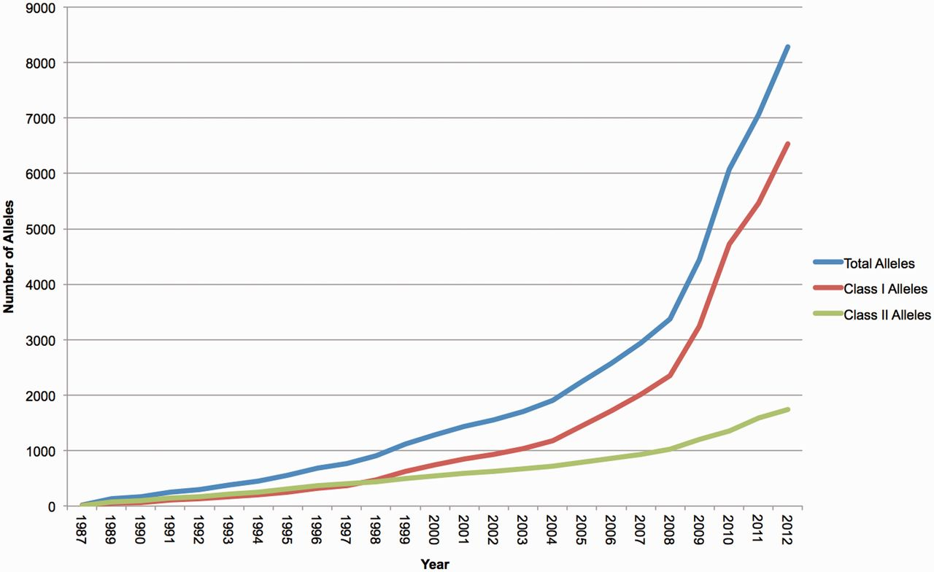
Figure 1. The number of HLA alleles named each year and included in the IMGT/HLA Database. The recent surge in the ...
Notes:
Figure 1. The number of HLA alleles named each year and included in the IMGT/HLA Database. The recent surge in the number of submissions received by the database is clearly shown.
Unless provided in the caption above, the following copyright applies to the content of this slide: © The Author(s) 2012. Published by Oxford University Press.This is an Open Access article distributed under the terms of the Creative Commons Attribution License (http://creativecommons.org/licenses/by-nc/3.0/), which permits non-commercial reuse, distribution, and reproduction in any medium, provided the original work is properly cited. For commercial re-use, please contact journals.permissions@oup.com.

Slide 2
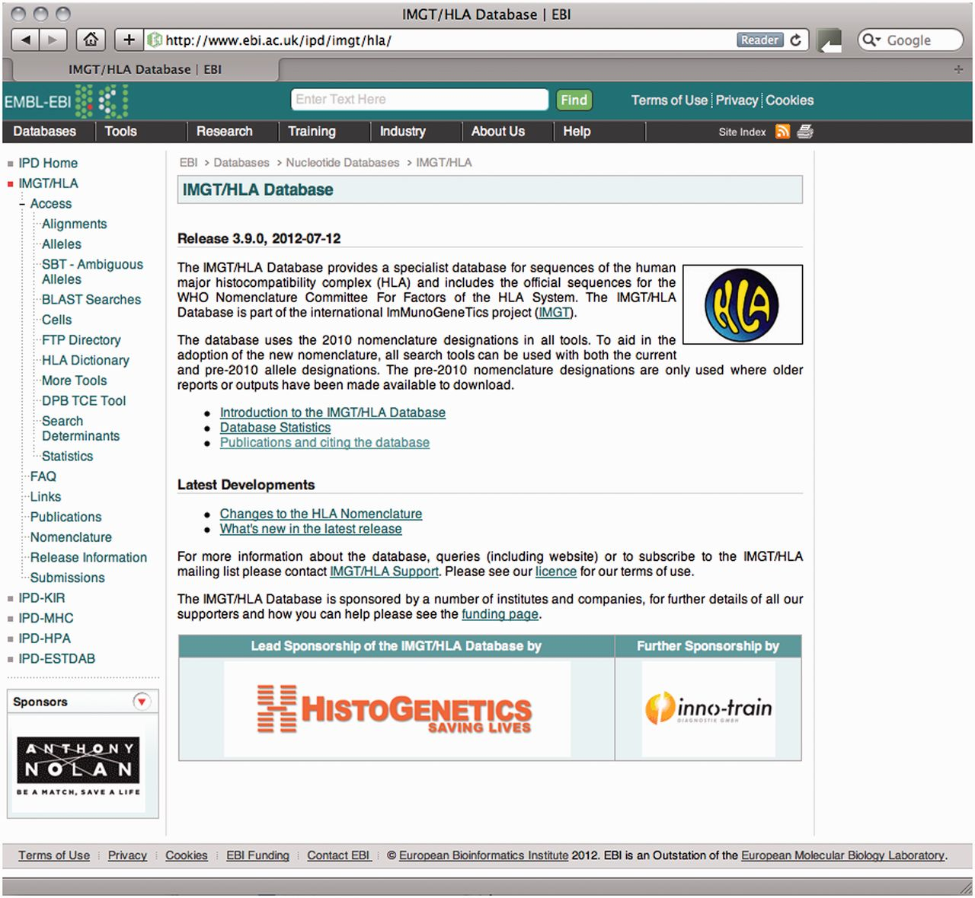
Figure 2. The IMGT/HLA homepage, which acts as a portal to the different tools provided on the website.
Notes:
Figure 2. The IMGT/HLA homepage, which acts as a portal to the different tools provided on the website.
Unless provided in the caption above, the following copyright applies to the content of this slide: © The Author(s) 2012. Published by Oxford University Press.This is an Open Access article distributed under the terms of the Creative Commons Attribution License (http://creativecommons.org/licenses/by-nc/3.0/), which permits non-commercial reuse, distribution, and reproduction in any medium, provided the original work is properly cited. For commercial re-use, please contact journals.permissions@oup.com.

Slide 3
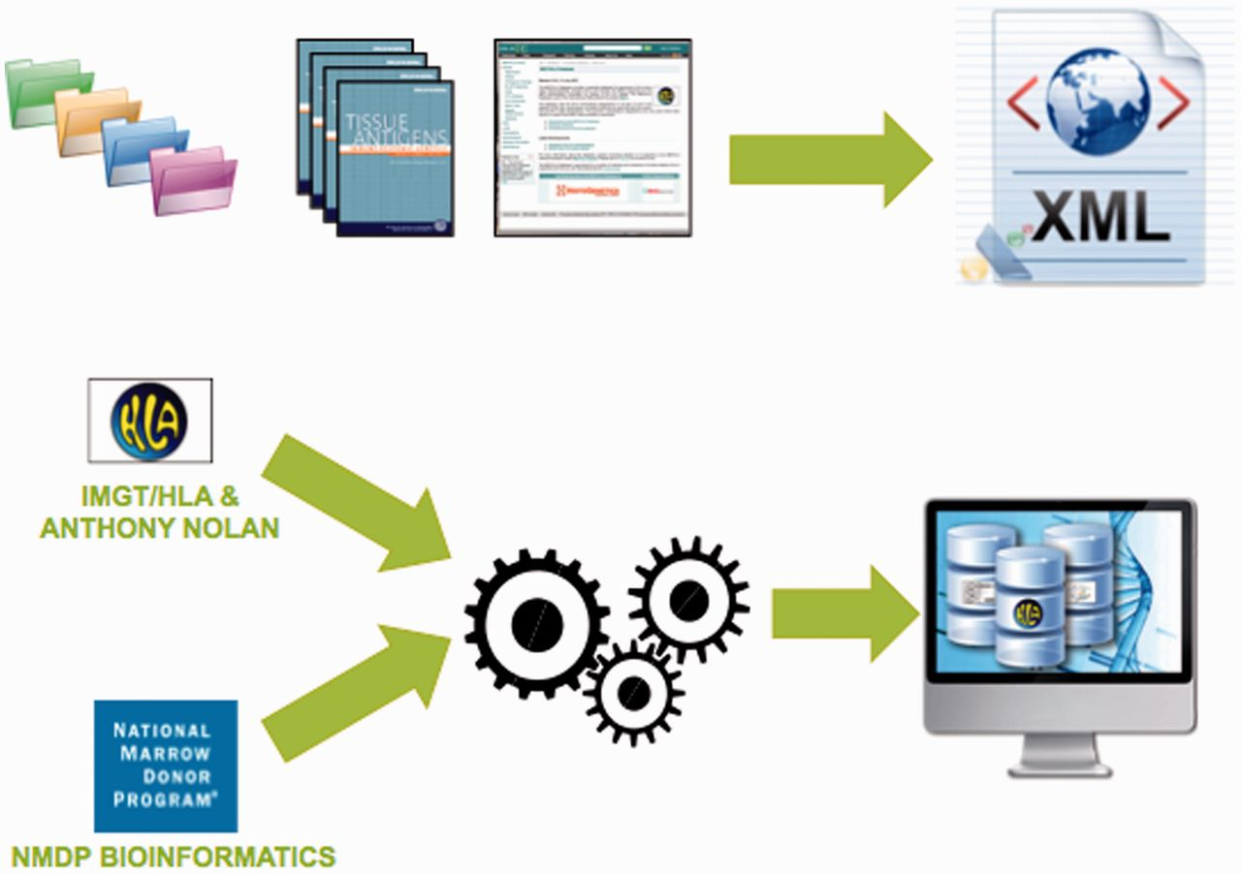
Figure 3. The IMGT/HLA export combines a number of existing file formats and data source into a single format. The data ...
Notes:
Figure 3. The IMGT/HLA export combines a number of existing file formats and data source into a single format. The data are available from the IMGT/HLA database. The tool set is available from the Bioinformatics Group, of the National Marrow Donor Program. Together these allow the user to import the HLA data directly into their local database structure.
Unless provided in the caption above, the following copyright applies to the content of this slide: © The Author(s) 2012. Published by Oxford University Press.This is an Open Access article distributed under the terms of the Creative Commons Attribution License (http://creativecommons.org/licenses/by-nc/3.0/), which permits non-commercial reuse, distribution, and reproduction in any medium, provided the original work is properly cited. For commercial re-use, please contact journals.permissions@oup.com.

