Slide 1
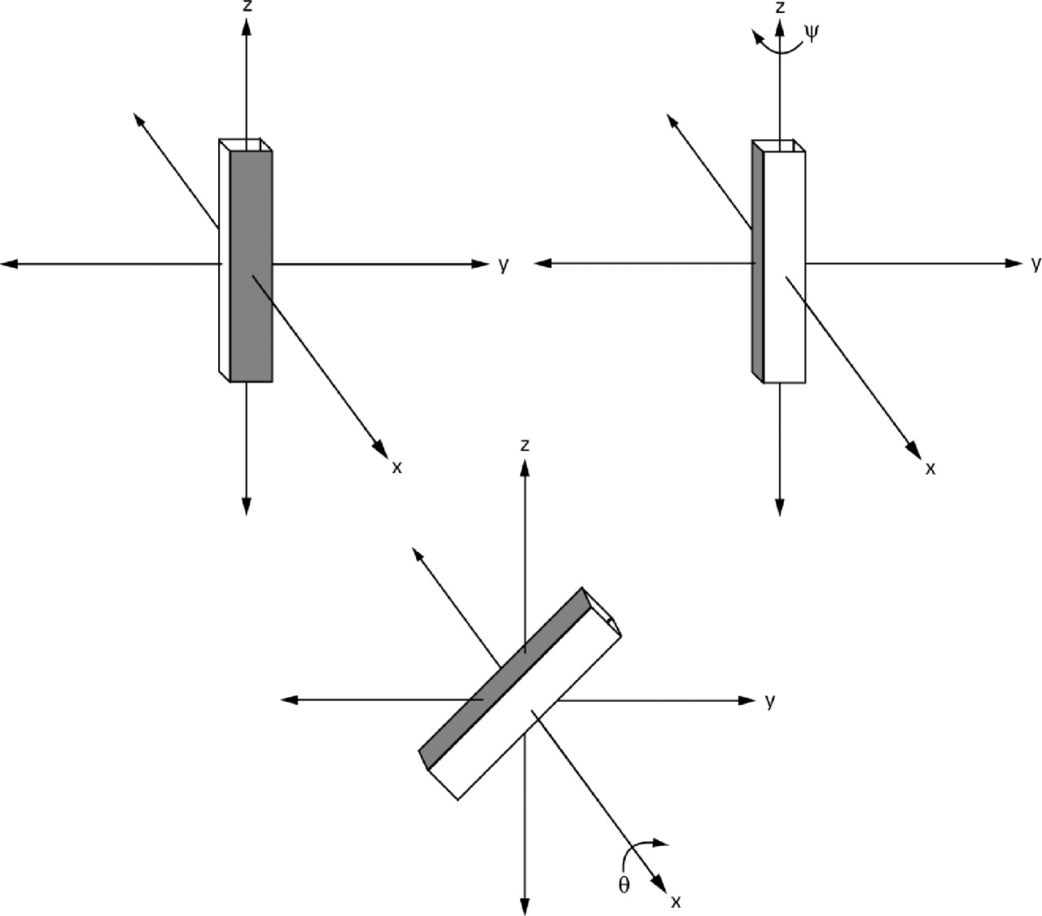
Fig. 1 Diagram of successive rotation through Euler angles ψ and θ the angles used to describe the rotational ...
Notes:
Fig. 1 Diagram of successive rotation through Euler angles ψ and θ the angles used to describe the rotational configuration of the ligand and receptor. In this case, ψ = 90° and θ = 45°.
Unless provided in the caption above, the following copyright applies to the content of this slide: © The Author 2004. Published by Oxford University Press. All rights reserved. For Permissions, please email: journals.permissions@oupjournals.org

Slide 2
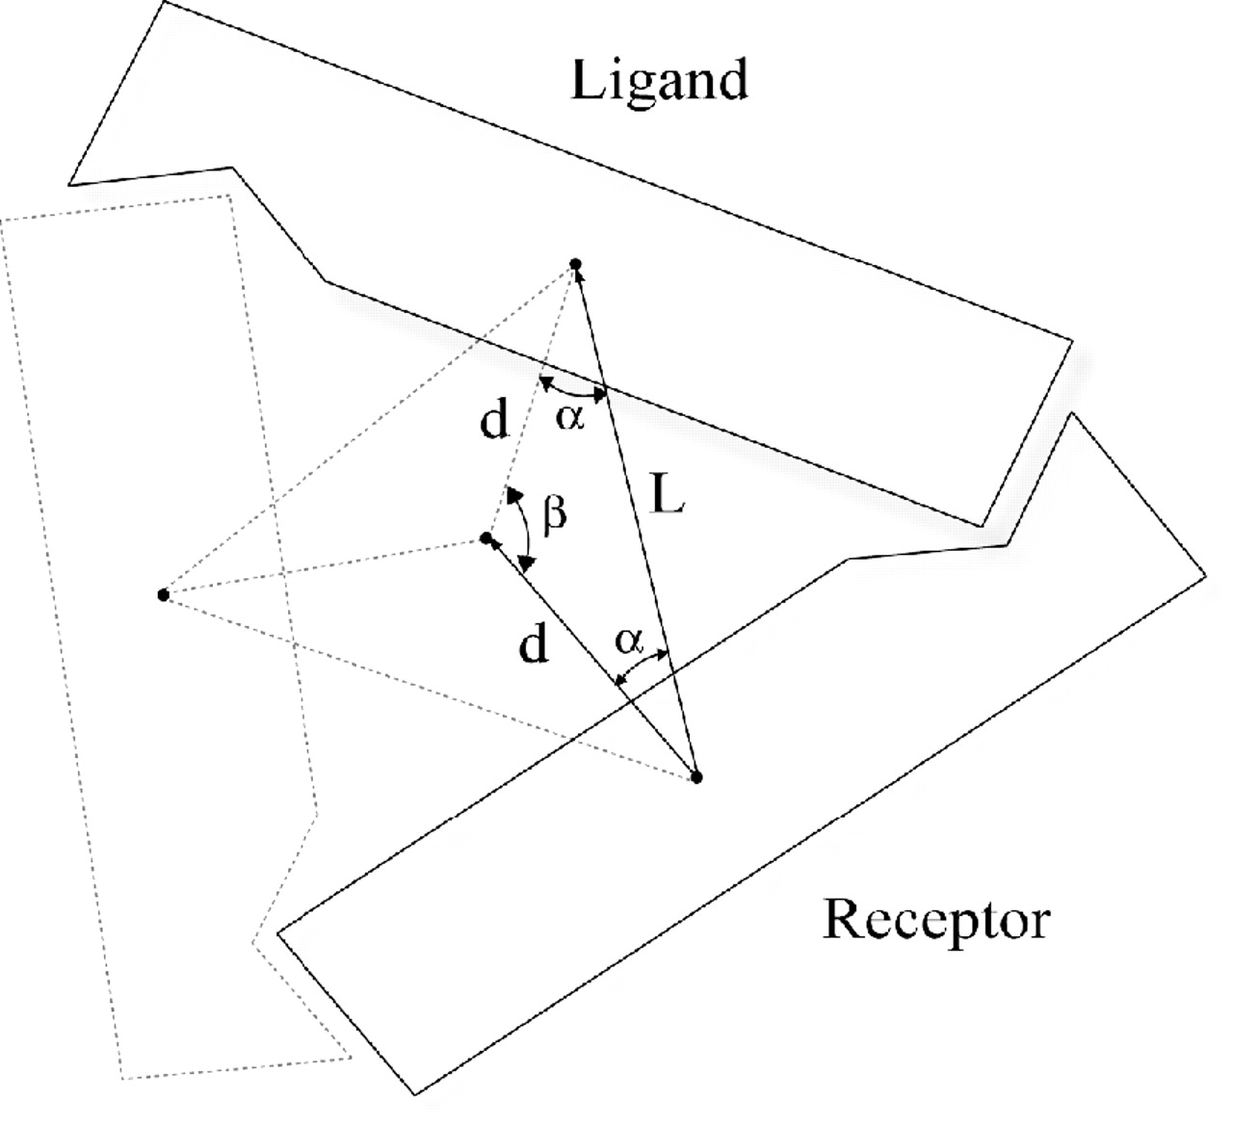
Fig. 2 The relative positions of the subunits of a C₃ multimer. The vector L is the relative position ...
Notes:
Fig. 2 The relative positions of the subunits of a C3 multimer. The vector L is the relative position between the receptor and the ligand (which is the receptor rotated by β degrees; in this case β = 120°). The magnitude of vector d to the axis of symmetry and the angle α between vectors L and d can be determined algebraically. Thus, once the interface between the ligand and receptor is evaluated by M-ZDOCK, the rest of the multimer (in this case the subunit represented by the dashed lines) can be generated automatically.
Unless provided in the caption above, the following copyright applies to the content of this slide: © The Author 2004. Published by Oxford University Press. All rights reserved. For Permissions, please email: journals.permissions@oupjournals.org

Slide 3
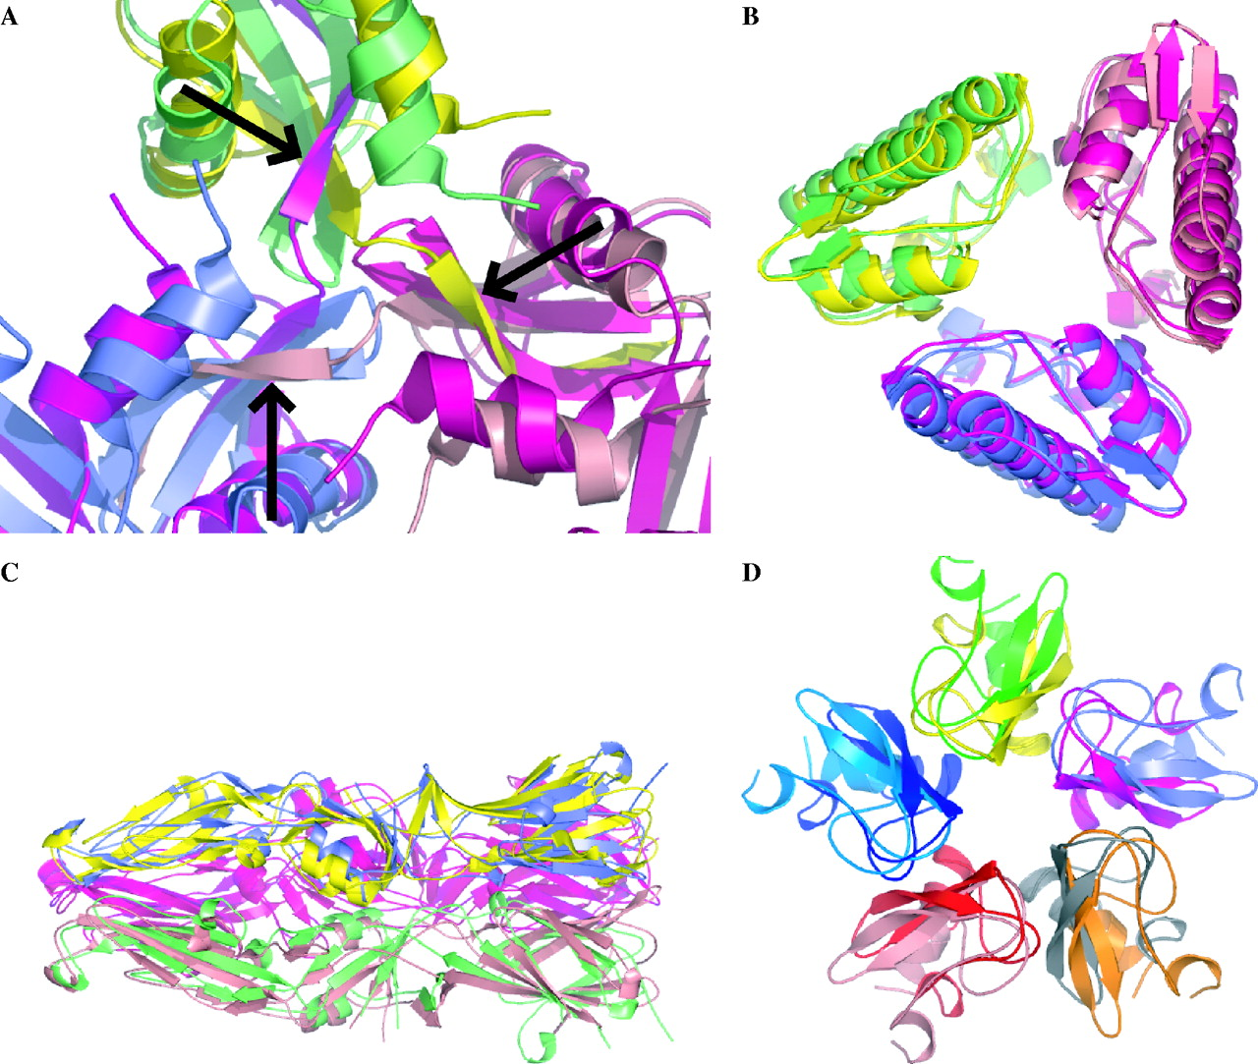
Fig. 3 The highest ranked hits of M-ZDOCK superposed onto the structures of the complexes, with each predicted and ...
Notes:
Fig. 3 The highest ranked hits of M-ZDOCK superposed onto the structures of the complexes, with each predicted and actual chain colored separately. Images generated with PyMOL (Delano, 2002). (a) The interface region of RNase A, with arrows indicating the β-strands that swap in the trimeric structure. Predicted: magenta, green, blue; Actual: purple, pink, yellow (b) Phospholipase A2. Predicted: purple, pink, yellow; Actual: magenta, green, blue (c) TBEV E Protein, truncated at the highly mobile C-terminal domain. Predicted: purple, pink, yellow; Actual: magenta, green, blue (d) Bovine pancreatic trypsin inhibitor. Predicted: magenta, yellow, blue, red, grey; Actual: slate, green, aqua, peach, orange.
Unless provided in the caption above, the following copyright applies to the content of this slide: © The Author 2004. Published by Oxford University Press. All rights reserved. For Permissions, please email: journals.permissions@oupjournals.org

