Slide 1
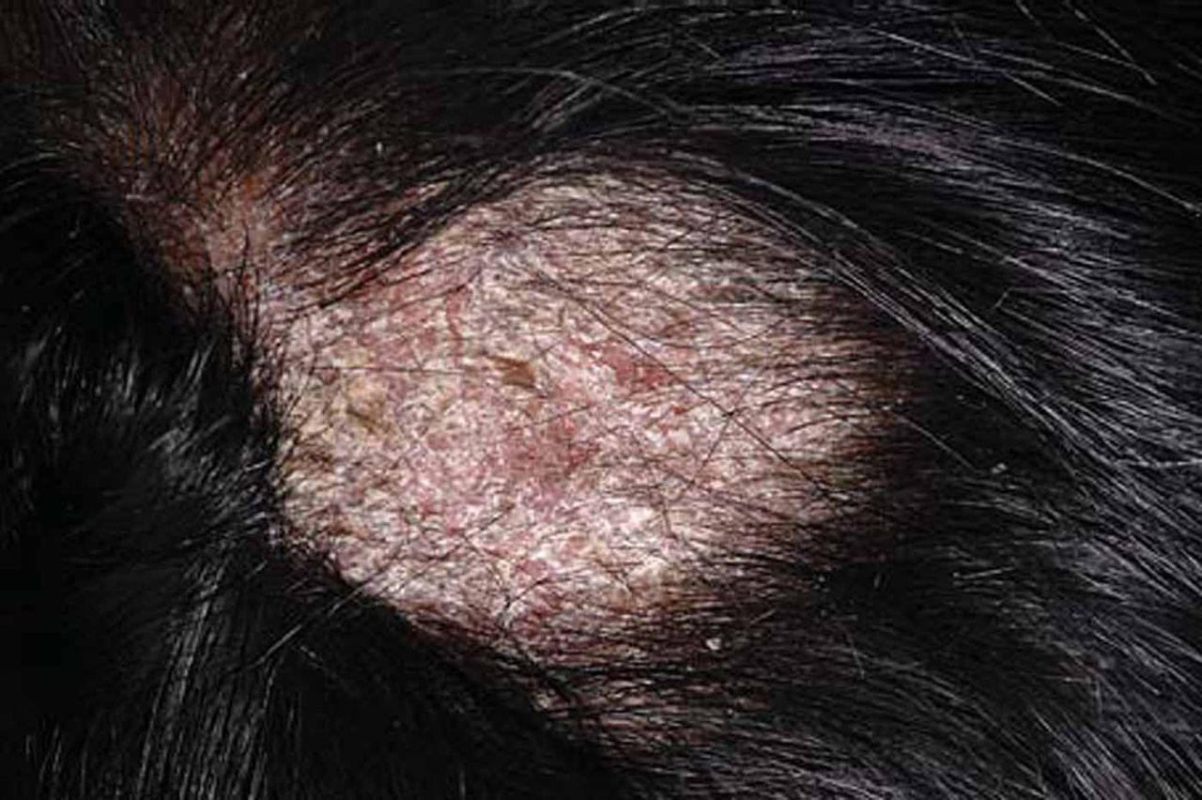
Fig. 1 Alopecic patch in the vertex area of the scalp with erythematous ground and pronounced scaling of an ...
Notes:
Fig. 1 Alopecic patch in the vertex area of the scalp with erythematous ground and pronounced scaling of an 8-year-old boy (patient 2).
Unless provided in the caption above, the following copyright applies to the content of this slide: © 2011 ISHAM

Slide 2
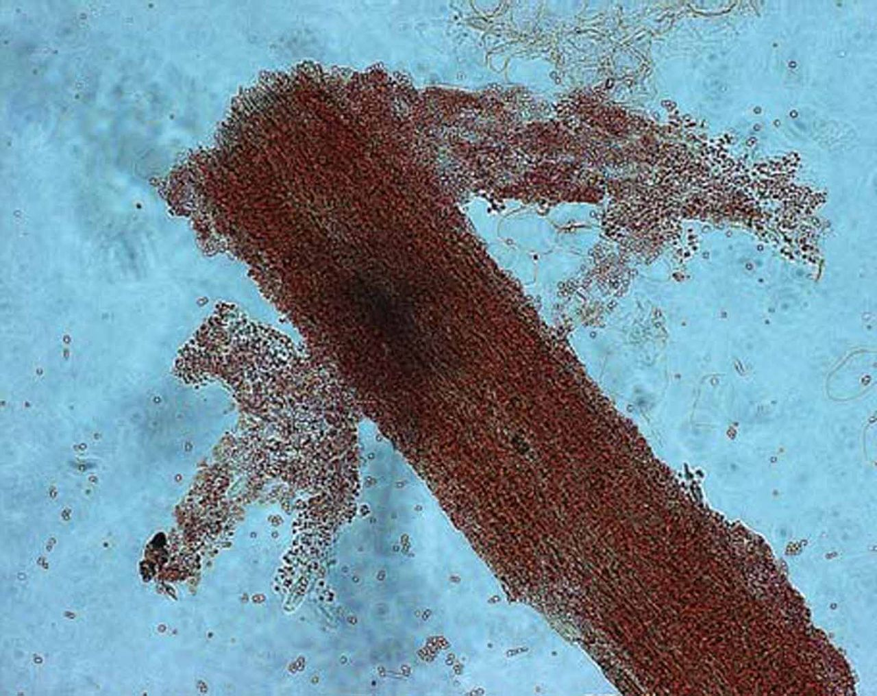
Fig. 2 Direct microscopic examination of hair from patient 1 in 5% SDS solution containing Congo red reveals masses ...
Notes:
Fig. 2 Direct microscopic examination of hair from patient 1 in 5% SDS solution containing Congo red reveals masses of small spores around the hair shaft (Ectothrix).
Unless provided in the caption above, the following copyright applies to the content of this slide: © 2011 ISHAM

Slide 3
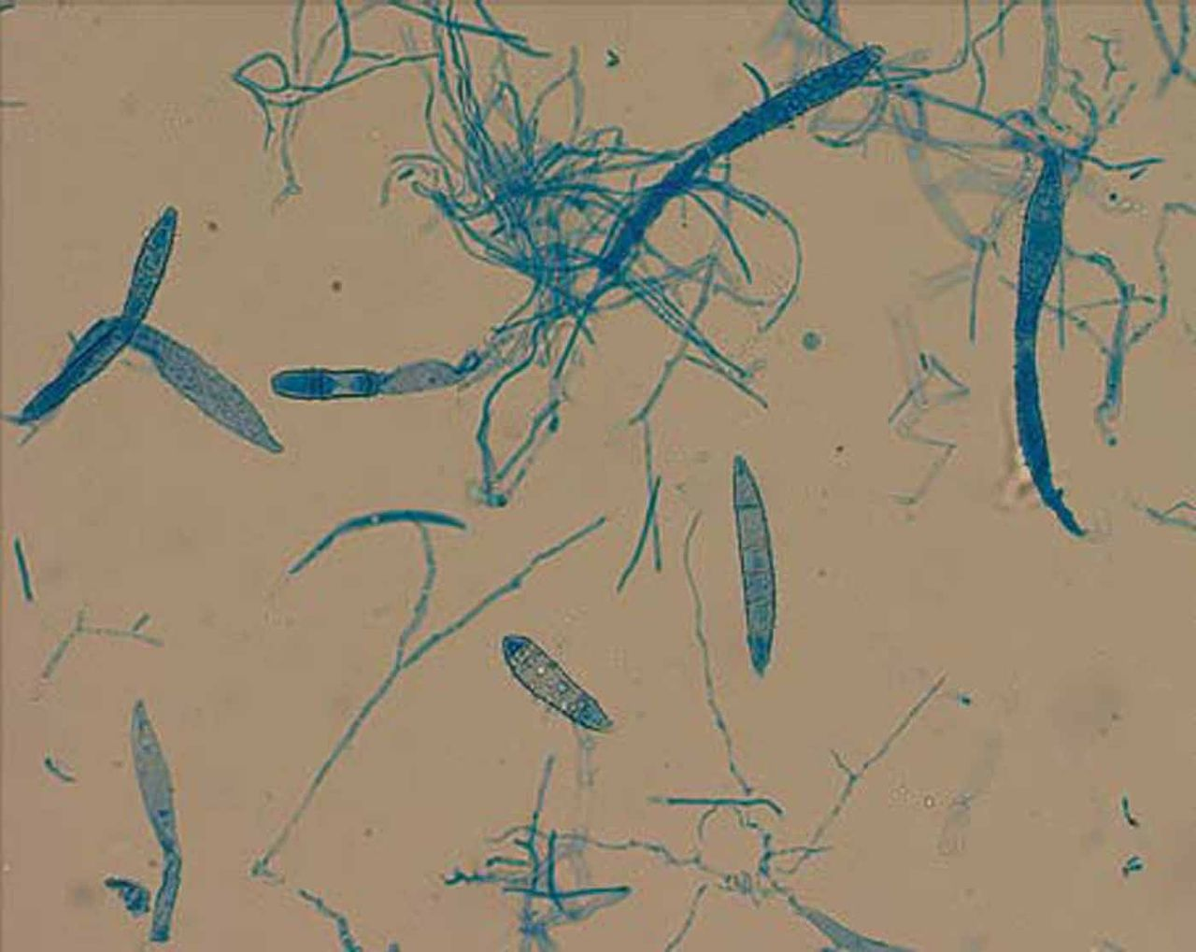
Fig. 3 Microscopic examination of a 14-day-old culture showing macroconidia which were long, slender and frequently ...
Notes:
Fig. 3 Microscopic examination of a 14-day-old culture showing macroconidia which were long, slender and frequently constricted near the middle.
Unless provided in the caption above, the following copyright applies to the content of this slide: © 2011 ISHAM

