Slide 1
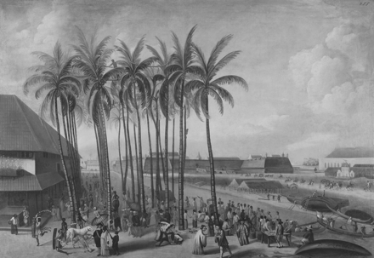
Fig. 1. The Castle of Batavia, seen from West Kali Besar (the Tjiliwung river). The Asian headquarters of the Dutch ...
Notes:
Fig. 1. The Castle of Batavia, seen from West Kali Besar (the Tjiliwung river). The Asian headquarters of the Dutch East Indies Company (VOC) were located in the castle. In the foreground is a fish market. This area of Batavia depicted in this painting was abandoned in the nineteenth century because of its unhealthy conditions. Painting by Andries Beeckman, ca. 1656–58. Source: Tropenmuseum, Amsterdam collection number 118-167.
Unless provided in the caption above, the following copyright applies to the content of this slide: © The Author 2011. Published by Oxford University Press. All rights reserved. For permissions, please e-mail: journals.permissions@oup.com

