Slide 1
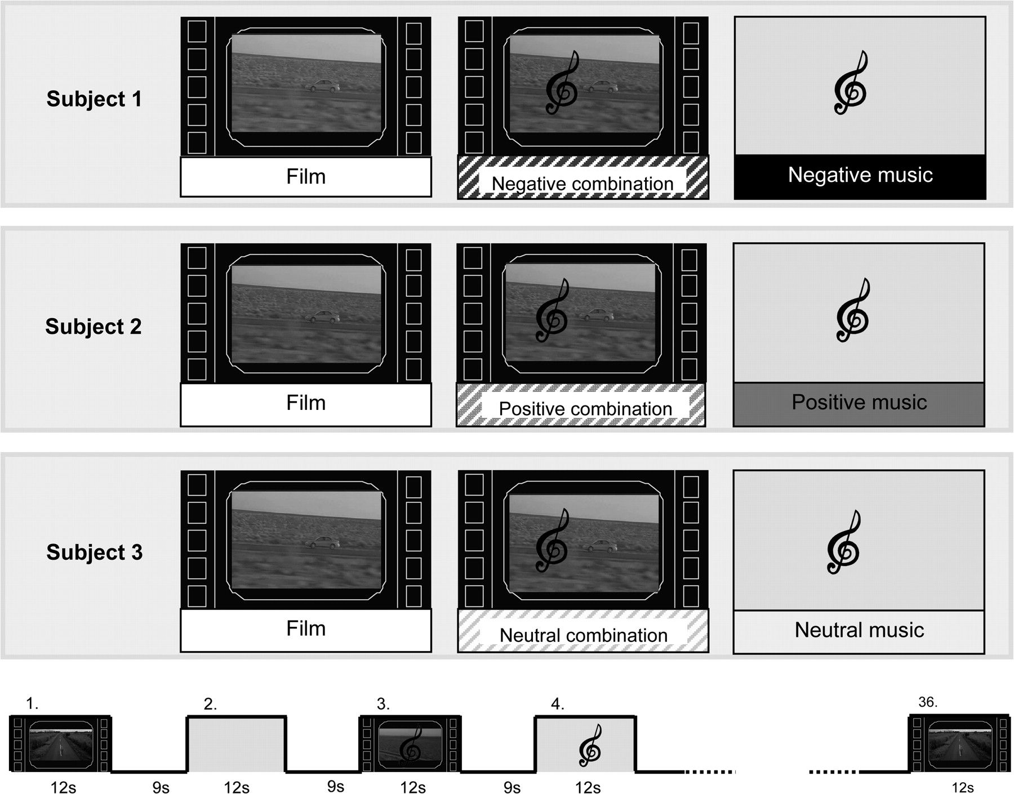
Figure 1. The experimental paradigm. All subjects were shown negative, positive, and neutral stimuli (shown here and ...
Notes:
Figure 1. The experimental paradigm. All subjects were shown negative, positive, and neutral stimuli (shown here and through the text as black, dark gray, and light gray, respectively). Each subject was presented with 12 neutral video clips and 12 emotional music clips (4 negative, 4 positive, 4 neutral) both separately and in combination. Specific films were not associated with a specific type of music: a film clip that was combined with positive music in one third of the subjects was combined with negative music in another third and with neutral music in the remaining third. All conditions were order-balanced and pseudorandomly distributed. The clips were 12 s long and separated by 9-s blank epochs. Readers are encouraged to view and listen to examples of the stimuli provided in the online supplementary material (Supplemental Video 1–8, Supplemental Audio 1–6).
Unless provided in the caption above, the following copyright applies to the content of this slide: © The Author 2007. Published by Oxford University Press. All rights reserved. For Permissions, please email: journals.permissions@oxfordjournals.org

Slide 2
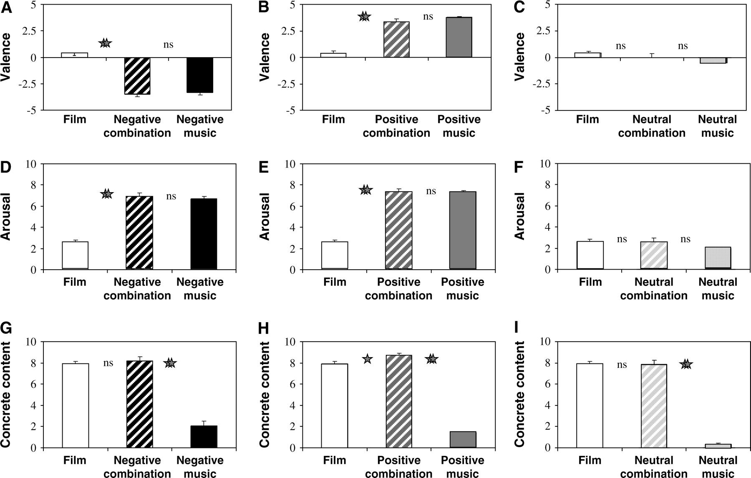
Figure 2. Behavioral study. The emotional properties of the various clips were rated in terms of valence (A–C) and ...
Notes:
Figure 2. Behavioral study. The emotional properties of the various clips were rated in terms of valence (A–C) and arousal (D–F), n = 15. Valence was rated on a scale of +5 (positive) to −5 (negative). Arousal was rated on a scale of 0 (nonarousing) to 10 (highly arousing). The clips were also rated in terms of their concrete content (E–G) on a scale of 0 (not concrete) to 10 (very concrete), n = 9. Note that the combinations and the music clips on their own were rated similarly in their emotional properties but differently in their concrete content. Error bars represent standard error of mean. *P < 0.05, **P < 0.00001, and ns, nonsignificant.
Unless provided in the caption above, the following copyright applies to the content of this slide: © The Author 2007. Published by Oxford University Press. All rights reserved. For Permissions, please email: journals.permissions@oxfordjournals.org

Slide 3
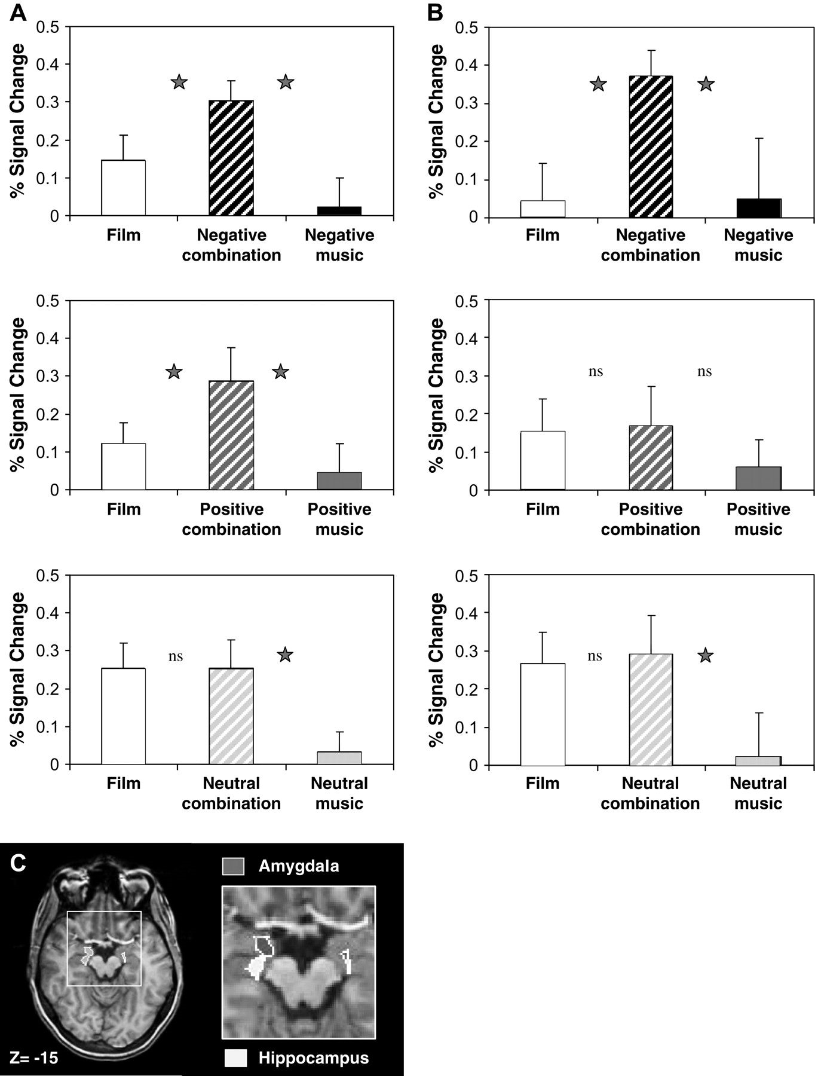
Figure 3. Limbic ROIs. Averaged activations during the combined and separate music and film in the amygdala (A) and ...
Notes:
Figure 3. Limbic ROIs. Averaged activations during the combined and separate music and film in the amygdala (A) and anterior hippocampus (B). The ROIs in the right and left hemispheres did not significantly differ in the contrast of interest and are presented together. Error bars represent standard error of mean. *P < 0.05 and ns, nonsignificant; n = 12. The amygdala and the anterior hippocampus ROIs are delineated on an axial section (C). The ROIs were anatomically marked out of a general functional cluster that was obtained by the contrast of all the combination conditions versus baseline (P < 0.005, uncorrected, fixed effect) (see Materials and Methods).
Unless provided in the caption above, the following copyright applies to the content of this slide: © The Author 2007. Published by Oxford University Press. All rights reserved. For Permissions, please email: journals.permissions@oxfordjournals.org

Slide 4
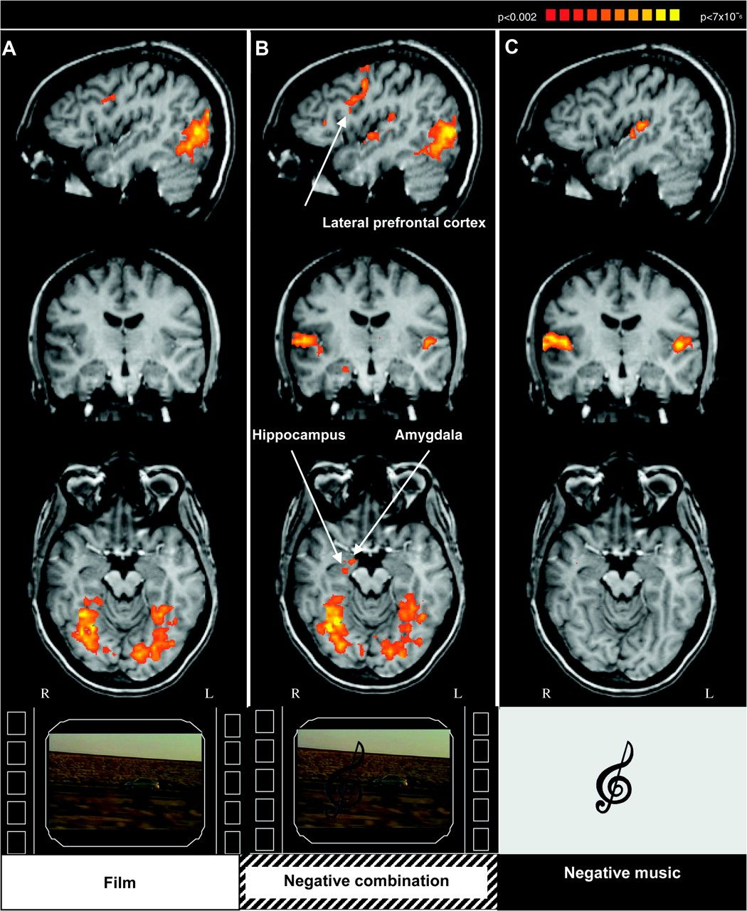
Figure 4. Activity in response to the combined and separate conditions. Activations obtained for the film condition ...
Notes:
Figure 4. Activity in response to the combined and separate conditions. Activations obtained for the film condition (A), negative combination condition (B), and negative music condition (C) compared with baseline (P < 0.002, uncorrected, random effects analysis, n = 12). Talairach coordinates x = 43, y = −13, z = −17.
Unless provided in the caption above, the following copyright applies to the content of this slide: © The Author 2007. Published by Oxford University Press. All rights reserved. For Permissions, please email: journals.permissions@oxfordjournals.org

Slide 5
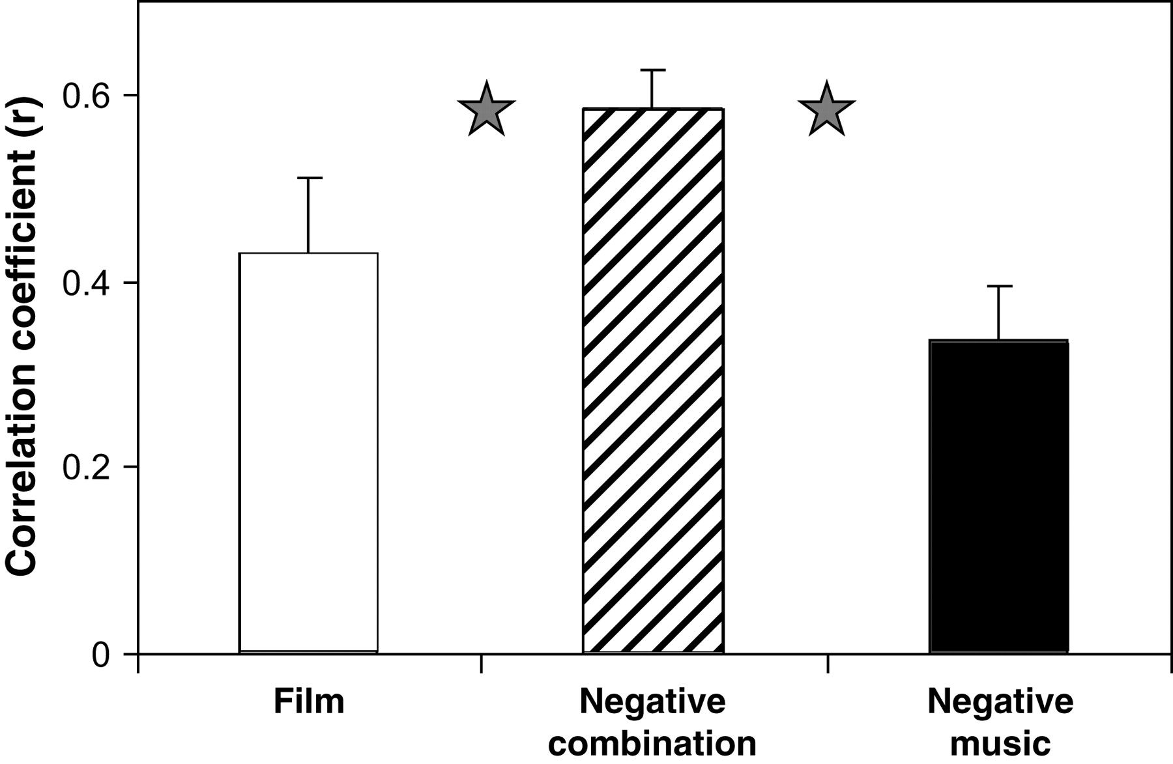
Figure 5. Time course correlation between the right amygdala and hippocampus ROIs. Linear correlation between the BOLD ...
Notes:
Figure 5. Time course correlation between the right amygdala and hippocampus ROIs. Linear correlation between the BOLD signal of the right amygdala and anterior hippocampus during the separate and combined conditions. Averaged correlation coefficients were compared between the separate and combined conditions, with a paired t-test. Resulting with a t value of 1.73 between film and combo coefficients and a t value of 2.0 between music and combo coefficients. Error bars represent standard error of mean. *P < 0.055, n = 12.
Unless provided in the caption above, the following copyright applies to the content of this slide: © The Author 2007. Published by Oxford University Press. All rights reserved. For Permissions, please email: journals.permissions@oxfordjournals.org

Slide 6
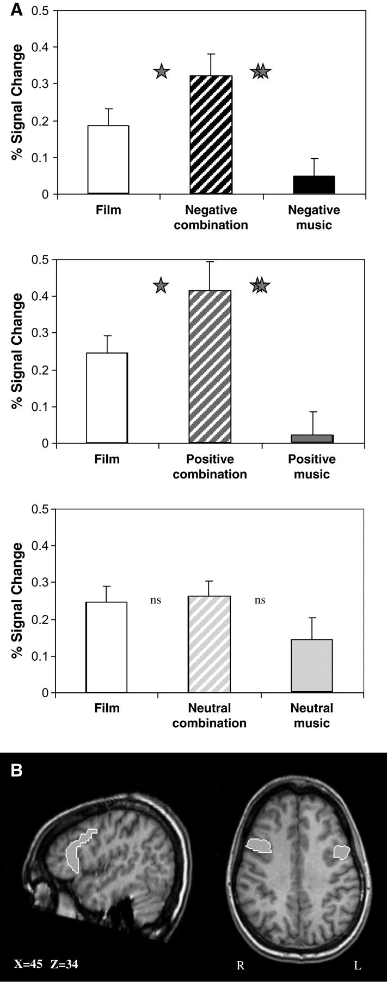
Figure 6. Prefrontal ROI. Averaged activations during the combined and separate music and films (A). The ROIs in the ...
Notes:
Figure 6. Prefrontal ROI. Averaged activations during the combined and separate music and films (A). The ROIs in the right and left hemispheres did not differ in the contrast of interest and are presented together. Error bars represent standard error of mean. *P < 0.05, **P < 0.001, ns, nonsignificant; n = 12. The prefrontal ROI is delineated on sagittal and axial sections. (B) The ROIs were anatomically marked out of a general functional cluster that was obtained by the contrast of all combination conditions versus baseline (P < 0.005, uncorrected, fixed effect).
Unless provided in the caption above, the following copyright applies to the content of this slide: © The Author 2007. Published by Oxford University Press. All rights reserved. For Permissions, please email: journals.permissions@oxfordjournals.org

Slide 7
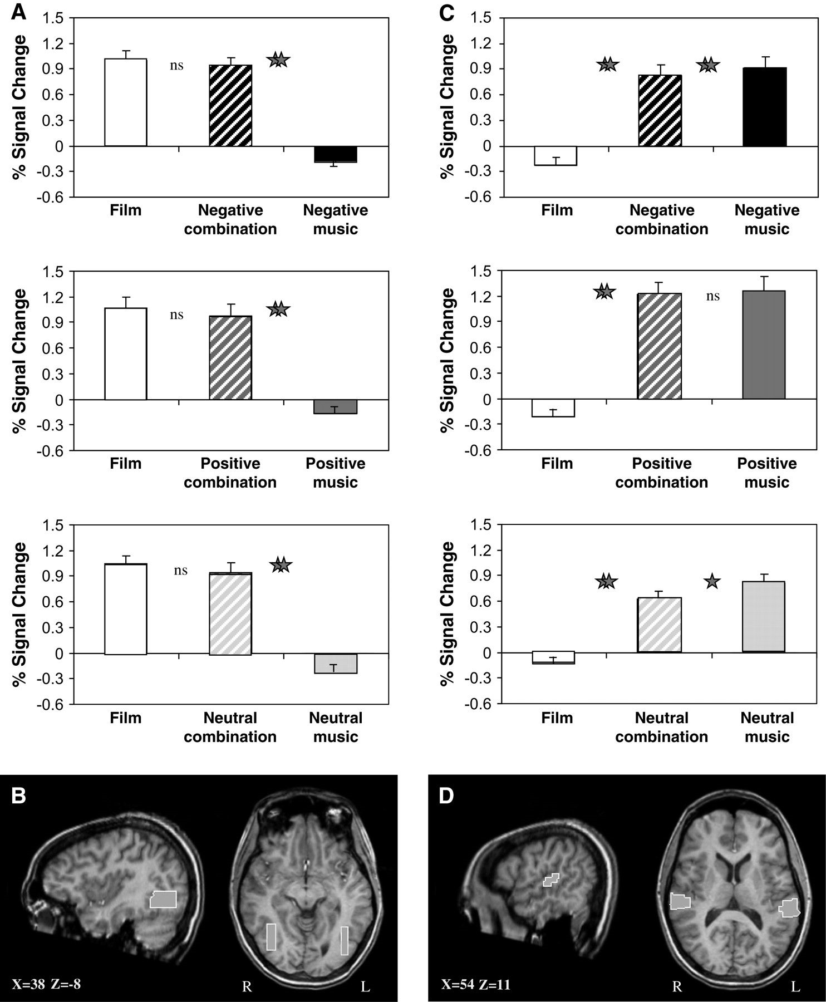
Figure 7. Sensory ROIs. Averaged activation during the combined and separate music and films in the LOC (A) and PT (C) ...
Notes:
Figure 7. Sensory ROIs. Averaged activation during the combined and separate music and films in the LOC (A) and PT (C) ROIs. The right and left ROIs did not significantly differ in the contrast of interest and are presented together. Error bars represent standard error of mean. *P < 0.05, **P < 0.001, ns, nonsignificant; n = 12. The LOC (B) and PT (D) ROIs are delineated on sagittal and axial sections (see Materials and Methods). The ROIs were all anatomically marked based on its own reported Talairach coordinates.
Unless provided in the caption above, the following copyright applies to the content of this slide: © The Author 2007. Published by Oxford University Press. All rights reserved. For Permissions, please email: journals.permissions@oxfordjournals.org

