Slide 1
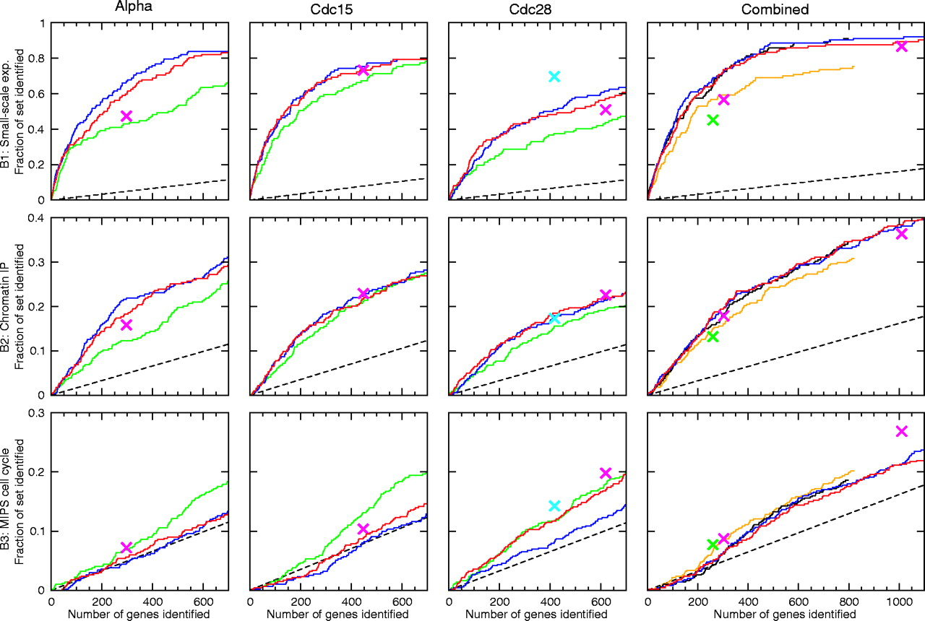
Fig. 1 Comparison of published methods. The fraction of the benchmark set that is identified is plottted as a ...
Notes:
Fig. 1 Comparison of published methods. The fraction of the benchmark set that is identified is plottted as a function of gene rank for each method, experiment and benchmark set. The different methods are coloured as follows: Cho et al. (1998) (M1, cyan), Spellman et al. (1998) (M2, black), Johansson et al. (2003) (M3, blue), Zhao et al. (2001) (M4, green), Luan and Li (2004) (M5, magenta), Lu et al. (2004) (M6, orange) and our permutation-based approach (M7, red). Random performance is shown as a black dotted line.
Unless provided in the caption above, the following copyright applies to the content of this slide: © The Author 2004. Published by Oxford University Press. All rights reserved. For Permissions, please email: journals.permissions@oupjournals.org

Slide 2
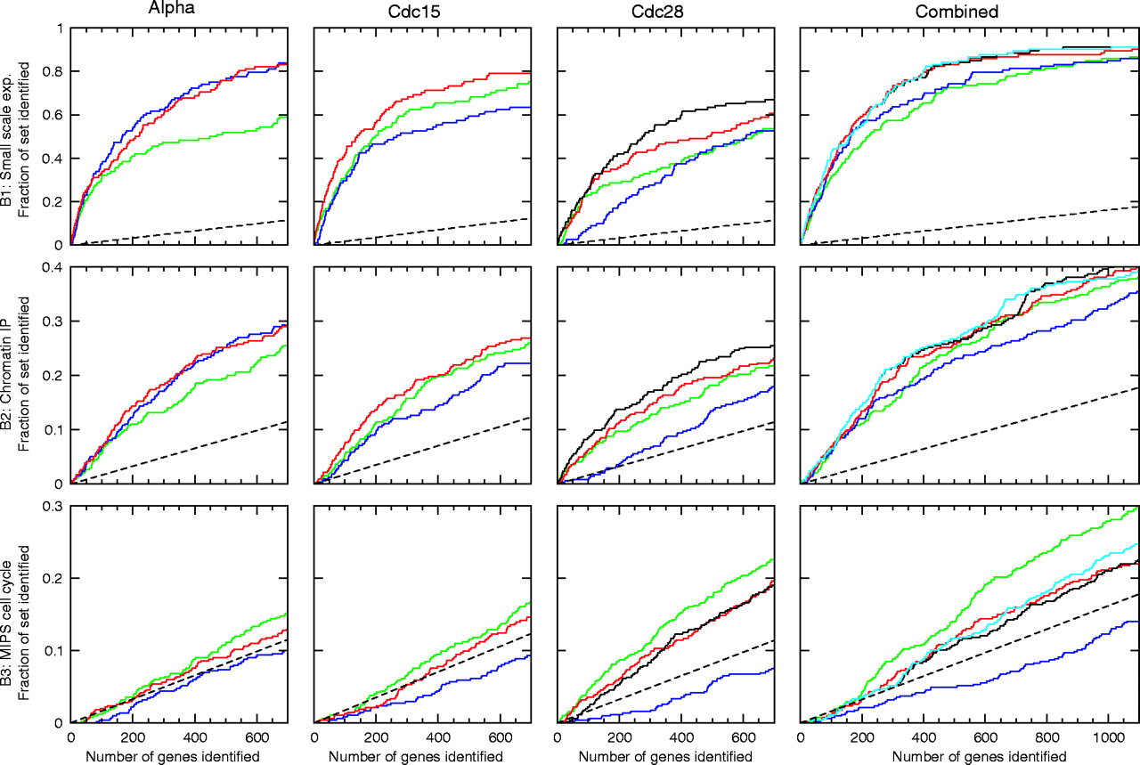
Fig. 2 Regulation versus periodicity. As in Figure 1 the fraction of the benchmark set that is identified is plotted ...
Notes:
Fig. 2 Regulation versus periodicity. As in Figure 1 the fraction of the benchmark set that is identified is plotted as a function of gene rank for each method, experiment and benchmark set. For the original data sets, the regulation score alone (blue), periodicity score alone (green) and combined score (red, also shown in Fig. 1) are shown. Results using the renormalized Cdc28 data are shown in black. Also shown is the combined score with peak time consistency filter (cyan). Random performance is shown as a black dotted line.
Unless provided in the caption above, the following copyright applies to the content of this slide: © The Author 2004. Published by Oxford University Press. All rights reserved. For Permissions, please email: journals.permissions@oupjournals.org

Slide 3
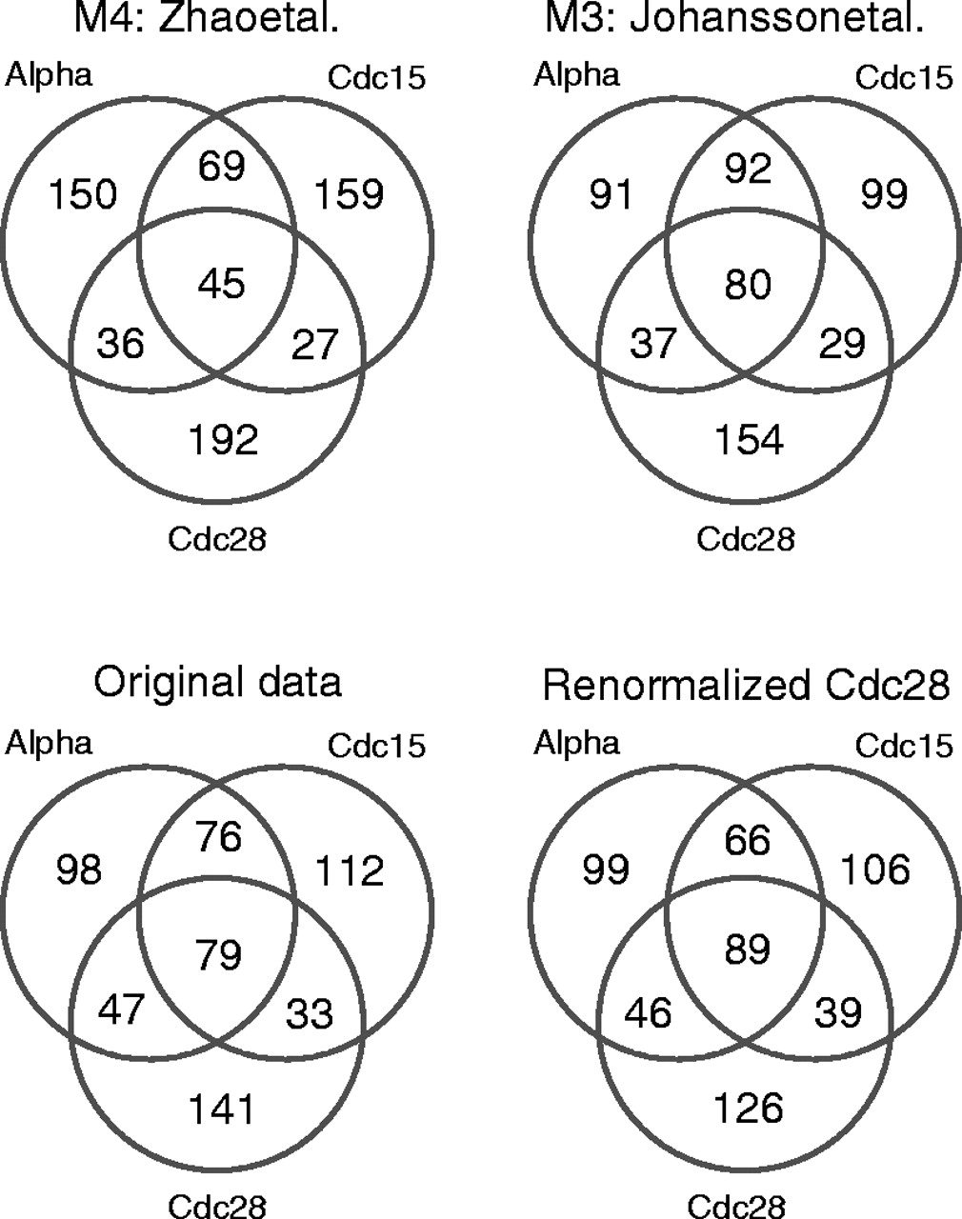
Fig. 3 Agreement across experiments. Venn diagrams based on the top 300 genes from each experiment are shown for the ...
Notes:
Fig. 3 Agreement across experiments. Venn diagrams based on the top 300 genes from each experiment are shown for the methods that provide ranked lists for the individual experiments. The lower two diagrams show the results of our analysis using the original and renormalized Cdc28 data respectively.
Unless provided in the caption above, the following copyright applies to the content of this slide: © The Author 2004. Published by Oxford University Press. All rights reserved. For Permissions, please email: journals.permissions@oupjournals.org

Slide 4
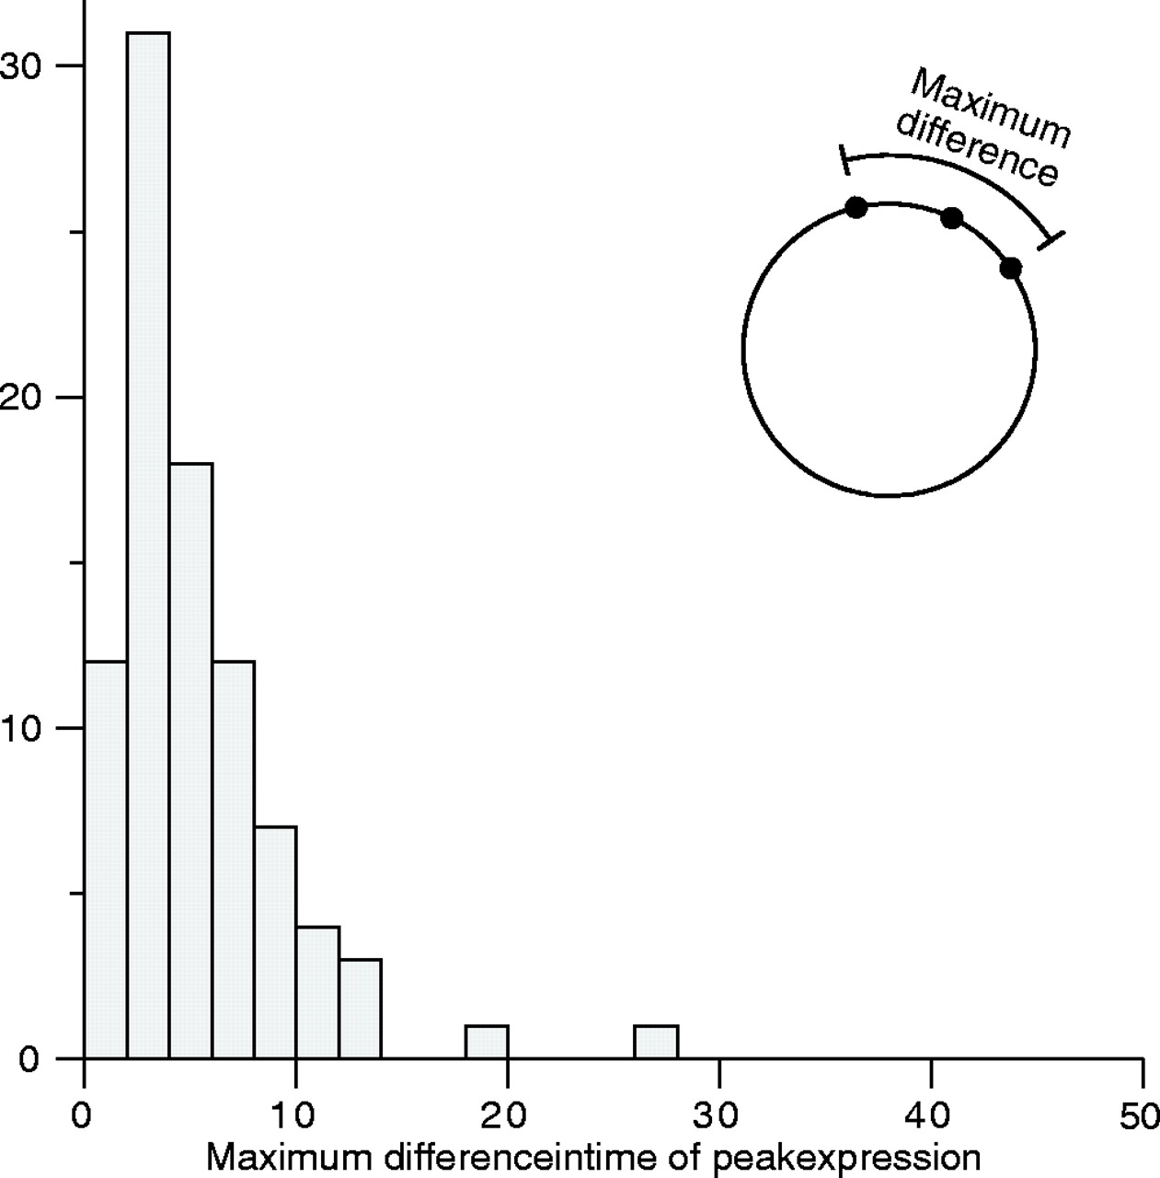
Fig. 4 Consistency of peak expression. For the 89 genes identified in all three experiments (see bottom right ...
Notes:
Fig. 4 Consistency of peak expression. For the 89 genes identified in all three experiments (see bottom right diagram in Fig. 3) the largest difference in peak time was computed and summarized as a histogram.
Unless provided in the caption above, the following copyright applies to the content of this slide: © The Author 2004. Published by Oxford University Press. All rights reserved. For Permissions, please email: journals.permissions@oupjournals.org

Slide 5
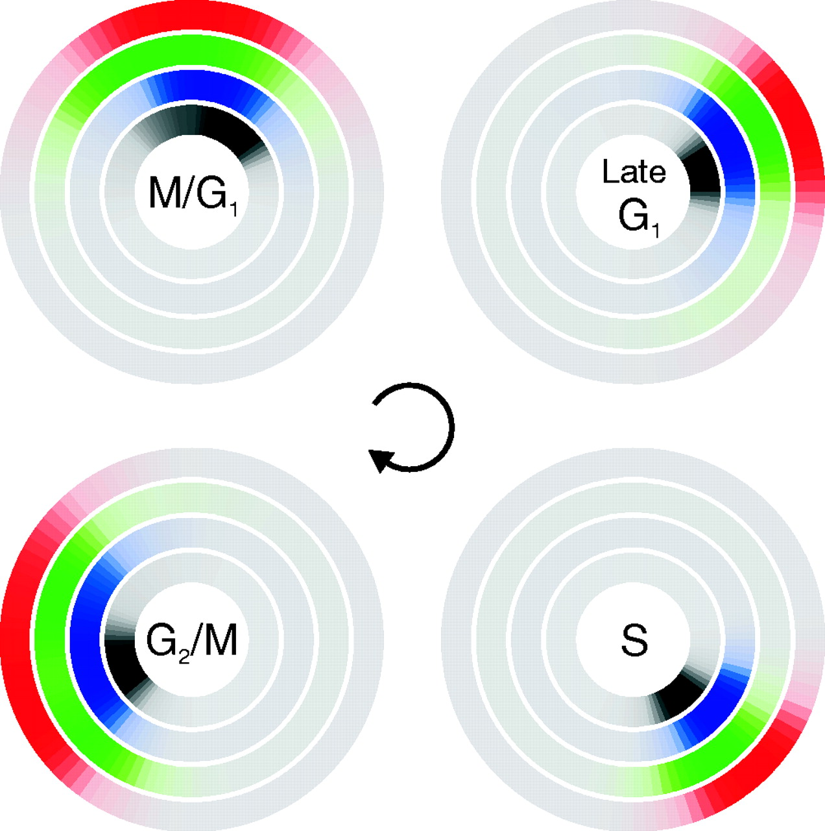
Fig. 5 Expression of phase-specific genes. For the phase-specific gene sets identified in small-scale experiments, ...
Notes:
Fig. 5 Expression of phase-specific genes. For the phase-specific gene sets identified in small-scale experiments, the distribution of peak times is shown for each experiment: cdc28 (black), cdc15 (blue), alpha (green) and the three experiments in combination (red). The mode of the peak time distribution for the M/G1 group was chosen to define the zero time point. Within each experiment, only genes in the top 500 of our periodicity analysis were included.
Unless provided in the caption above, the following copyright applies to the content of this slide: © The Author 2004. Published by Oxford University Press. All rights reserved. For Permissions, please email: journals.permissions@oupjournals.org

