Slide 1
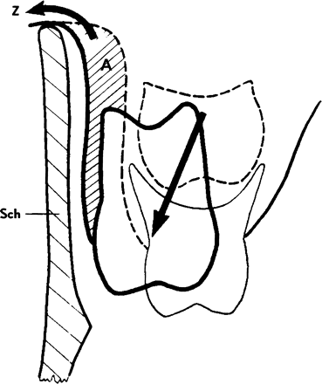
Figure 1 Schematic representation of the influence of vestibular screens upon the eruptive path and dentoalveolar ...
Notes:
Figure 1 Schematic representation of the influence of vestibular screens upon the eruptive path and dentoalveolar development. The traction on the apical base (see arrow) facilitates the drift of erupting teeth in an outward direction and induces remodelling in the outer alveolar process, A.
Unless provided in the caption above, the following copyright applies to the content of this slide: © European Orthodontic Society. Published by Oxford University Press on behalf of the European Orthodontic Society.

Slide 2
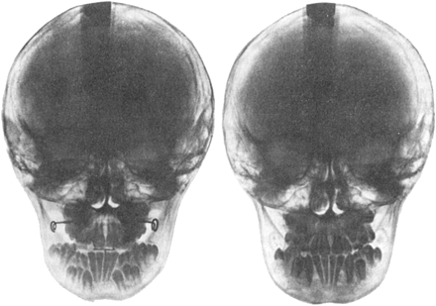
Figure 2 The first radiograph (left) of a case with severe crowding shows an accentuated lingual inclination of the ...
Notes:
Figure 2 The first radiograph (left) of a case with severe crowding shows an accentuated lingual inclination of the mandibular canines and premolars. The fourth radiograph (right), taken two years after the start of treatment exhibits the guiding effect of function correctors.
Unless provided in the caption above, the following copyright applies to the content of this slide: © European Orthodontic Society. Published by Oxford University Press on behalf of the European Orthodontic Society.

Slide 3
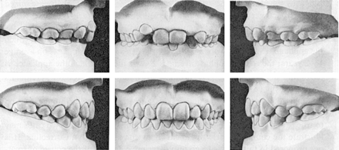
Figure 3 Case 1, Models of a girl aged 7 years 11 months at the beginning (top row) and after treatment with function ...
Notes:
Figure 3 Case 1, Models of a girl aged 7 years 11 months at the beginning (top row) and after treatment with function correctors for 2 years 5 months (bottom row).
Unless provided in the caption above, the following copyright applies to the content of this slide: © European Orthodontic Society. Published by Oxford University Press on behalf of the European Orthodontic Society.

Slide 4
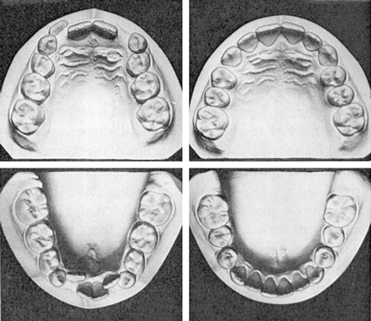
Figure 4 Case 1. Models, occlusal view, of Figure 3.
Notes:
Figure 4 Case 1. Models, occlusal view, of Figure 3.
Unless provided in the caption above, the following copyright applies to the content of this slide: © European Orthodontic Society. Published by Oxford University Press on behalf of the European Orthodontic Society.

Slide 5
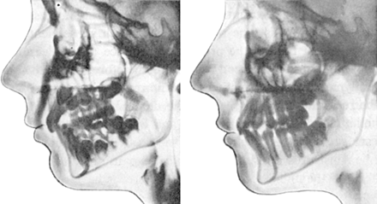
Figure 5 The radiographs, corresponding to the Figures 3 and 4. The apices of the erupting teeth change their ...
Notes:
Figure 5 The radiographs, corresponding to the Figures 3 and 4. The apices of the erupting teeth change their positions in an occlusal direction, particularly the canines and mandibular premolars.
Unless provided in the caption above, the following copyright applies to the content of this slide: © European Orthodontic Society. Published by Oxford University Press on behalf of the European Orthodontic Society.

Slide 6
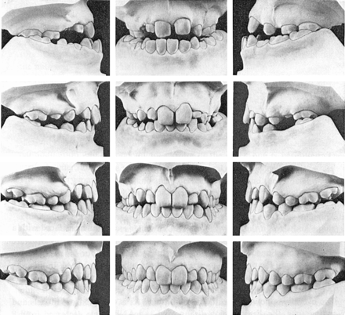
Figure 6 Case 2. First row: at the beginning of treatment; Second row: after 2 years treatment with the function ...
Notes:
Figure 6 Case 2. First row: at the beginning of treatment; Second row: after 2 years treatment with the function corrector; Third row: after 2 years 5 months retention; Fourth row: 1 year 6 months after the retaining appliance was removed.
Unless provided in the caption above, the following copyright applies to the content of this slide: © European Orthodontic Society. Published by Oxford University Press on behalf of the European Orthodontic Society.

Slide 7
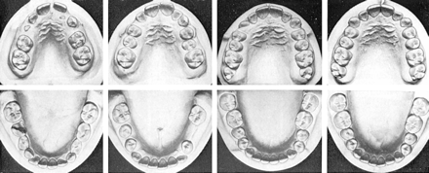
Figure 7 Models, occlusal view, corresponding to Figure 6.
Notes:
Figure 7 Models, occlusal view, corresponding to Figure 6.
Unless provided in the caption above, the following copyright applies to the content of this slide: © European Orthodontic Society. Published by Oxford University Press on behalf of the European Orthodontic Society.

